Slide 1


OTA Service
Alexander Link / SAP AG
July 19, 2013

Slide 2
Over-The-Air Deployment (OTA) Service Basics & Reason
Alexander Link / SAP AG
July 19, 2013

Slide 3
Agenda
Overview
Scenario
Benefits of using OTA Service
Ways to get an App on a device
How Apple Over-The-Air deployment works
How to achieve Over-The-Air Deployment
Features of OTA Service
How the OTA Service works

Slide 4

Scenario

Slide 5
Scenario
Company building Apps using Apple Enterprise Account … or a development team having a continuous integration build server
Apps need to be distributed to developers, testers and users
Once built Apps can be provided from different locations, e.g.:
Continuous Integration Build Server, Release/Milestone Build Server
Central Repository
Internal App Store
Apps shall be installable with low effort

Slide 6
Benefits of OTA Service

Slide 7

(Apple) Ways To Get An App On A Device
iTunes + USB
Download IPA file
Import IPA file to iTunes on Mac/PC
Connect device via USB cable
Synchronize iTunes with device
5-10 minutes
Mac/PC needed
Over-The-Air Deployment
Open install page in browser on device
Click install button / link (App will directly be installed)
0-1 minute
No additional hardware needed

Slide 8
How Apple Over-The-Air Deployment Works
HTML
PLIST
IPA
Install Link
URL to IPA
</>
</>
01000101011
Absolute URLs !
Absolute URL!
Notes:
In general to enable Over-The-Air Deployment the following files need to be exposed via HTTP/HTTPS:
The IPA file (the App binary)
A PLIST file (XML) with deployment metadata
A HTML page with an (itms-service://) install link
A user opens the URL to the HTML page on his iPhone/iPad. After clicking the install link a dialog needs to be confirmed and afterwards the App is directly installed on the device.
The „install link“ on the HTML page has to contain an absolute URL to the PLIST file.
The PLIST file has to contain an absolute URL to the IPA file.
Therefore the generated files and OTA deployment only work on the server location the URLs were generated for.
The HTML and PLIST file would have to be generated again for other environments (e.g. Nexus, internal AppStore,…).

Slide 9

How To Achieve Over-The-Air Deployment
Without OTA Service
Provide IPA file via HTTP
Create PLIST file with absolute URL to IPA + provide via HTTP
Create install HTML page with absolute URL to PLIST file + provide via HTTP
Works only for this specific location
PLIST and HTML page have to be created again for new location
With OTA Service +
Provide IPA file via HTTP
Generate* install HTML page once with OTA Service iFrame + provide via HTTP
Works for every location Simply copy IPA and HTML page
*) Xcode-Maven-Plugin supports OTA Service

Slide 10
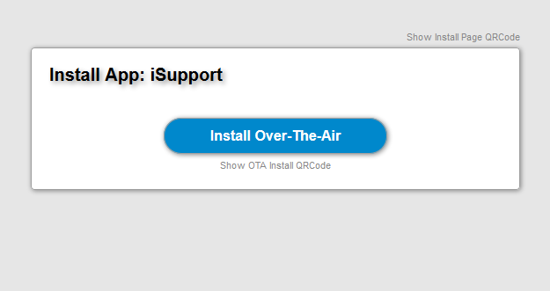
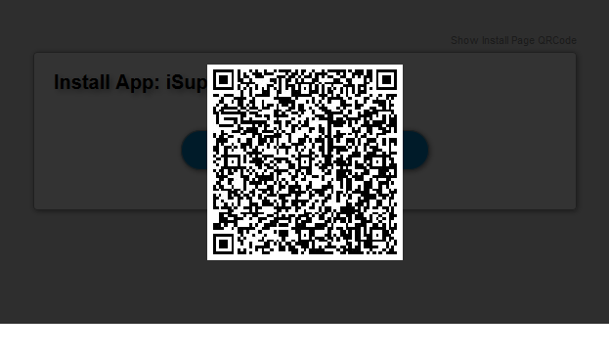
Features of the OTA Service
OTA Service also generates QRCodes to scan from device. Enables: direct installation + direct access to install page
OTA Install QR Code
OTA Install Page (iPhone/iPad)
This is an example of the default install HTML page generated by the OTA Service.

Slide 11
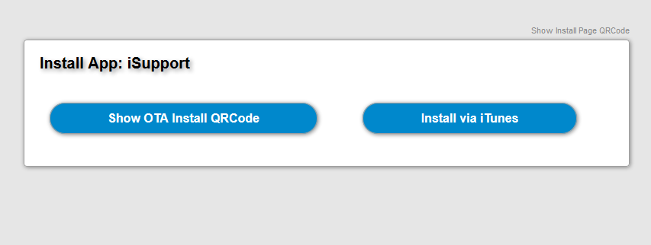
Features of the OTA Service
OTA Install Page (desktop version)
UI adapted to desktop. E.g. install like would be useless here.

Slide 12
How OTA Service Works

Slide 13
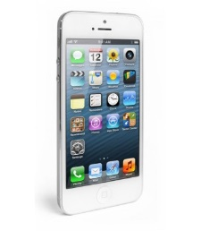
OTA Service
Web Server
OTA Web Server
HTML
URL: App Parameters + Referer
HTML
<iframe/>
HTML
generate
Install Link
</>
</>
1
2
OTA Service
URL: App Parameters + Referer
IPA
4
3
PLIST
generate
010001
PLIST
IPA URL
URL: Original IPA Location
</>
Notes:
To enable location independent OTA deployment we provide the OTA Service.
The only two files generated during the build are the orange ones:
The IPA file (the App binary)
A HTML file only containing an iframe pointing the the OTA (HTML) Service (+ App parameters required for the following steps)
The iframe is populated by the OTA service on the fly. The HTML code will contain an „install link“ (itms-service://) containing an URL to the OTA (PLIST) service.
Once the install link is clicked the OTA (PLIST) service generates the PLIST file on the fly. The PLIST file contains a link to the IPA file on the server next to the original iframe HTML page.
This way the (iframe) HTML file and IPA file can be simply copied(deployed) to any other web server (e.g. Nexus, internal AppStore,…) to enable OTA deployment from there.
The OTA Service itself does not get in contact with the IPA file to be installed. It only generates the URLs.
This also works for iframe HTML and IPA files hosted inside the firewall while using an (public) OTA Service outside the firewall. The OTA Service simply generates the internal URLs only working from inside the firewall.

Slide 14

OTA Service
Web Server
OTA Web Server
HTML
URL: App Parameters + Referer
HTML
<iframe/>
HTML
generate
Install Link
</>
</>
1
2
OTA Service
URL: App Parameters + Referer
IPA
4
3
PLIST
generate
010001
PLIST
IPA URL
URL: Original IPA Location
</>
Notes:
To enable location independent OTA deployment we provide the OTA Service.
The only two files generated during the build are the orange ones:
The IPA file (the App binary)
A HTML file only containing an iframe pointing the the OTA (HTML) Service (+ App parameters required for the following steps)
The iframe is populated by the OTA service on the fly. The HTML code will contain an „install link“ (itms-service://) containing an URL to the OTA (PLIST) service.
Once the install link is clicked the OTA (PLIST) service generates the PLIST file on the fly. The PLIST file contains a link to the IPA file on the server next to the original iframe HTML page.
This way the (iframe) HTML file and IPA file can be simply copied(deployed) to any other web server (e.g. Nexus, internal AppStore,…) to enable OTA deployment from there.
The OTA Service itself does not get in contact with the IPA file to be installed. It only generates the URLs.
This also works for iframe HTML and IPA files hosted inside the firewall while using an (public) OTA Service outside the firewall. The OTA Service simply generates the internal URLs only working from inside the firewall.

Slide 15
OTA Service
Web Server
OTA Web Server
HTML
URL: App Parameters + Referer
HTML
<iframe/>
HTML
generate
Install Link
</>
V
P
N
</>
1
2
OTA Service
URL: App Parameters + Referer
IPA
4
3
PLIST
generate
010001
PLIST
IPA URL
URL: Original IPA Location
</>

Slide 16
Thank you
More information:
https://github.com/sap-production/OTAService
https://github.com/sap-production/xcode-maven-plugin
maven4ios@freelists.org

Slide 17
HTML
PLIST
IPA
</>
</>
011010011011001100110

