Slide 1
Educational Program Advisor

Slide 2



Slide 3
Problem statement
Problem: Every year school graduates faced with the problem of choosing a higher educational institution.
What specialty to choose?
What university to enter?
Users: School graduates and there parents, that prepares to enter to university.
Solution: Web application that contains list of all universities with details, prof orientation tests, algorithms of specialties selection.

Slide 4

User roles
Admin
Registered User
Visitor

Slide 5
Visitor functionality
View list of universities, specialties with detail information (data should be structured)
View TOP universities
Registration (SSO)
Research

Slide 6
Registered user functionality
Create account where displays his personal data
Add to wish list interested his specialties
Pass prof orientation tests
Auto generation of specialty list where to apply documents
Choose favorite subjects to generate specialty list

Slide 7
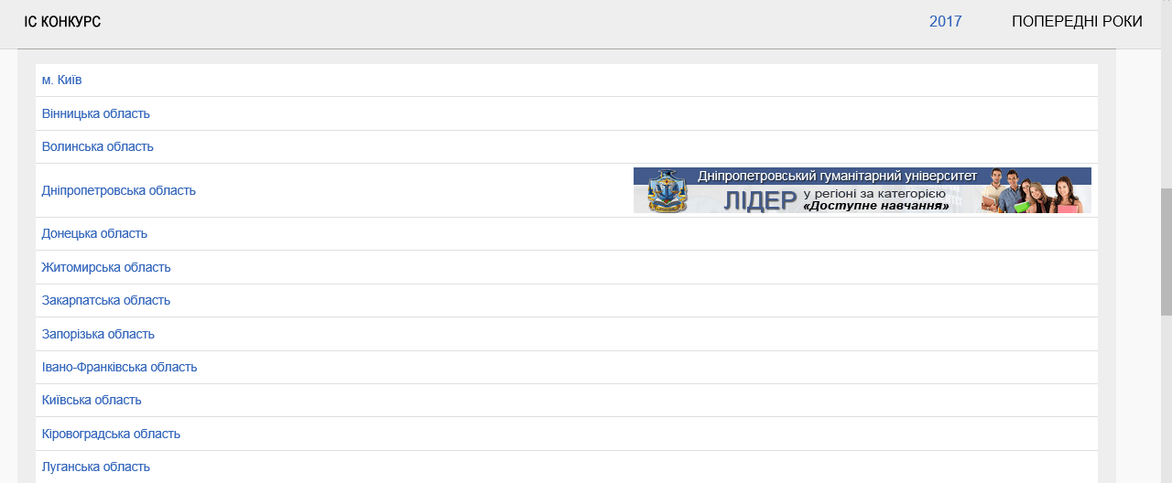
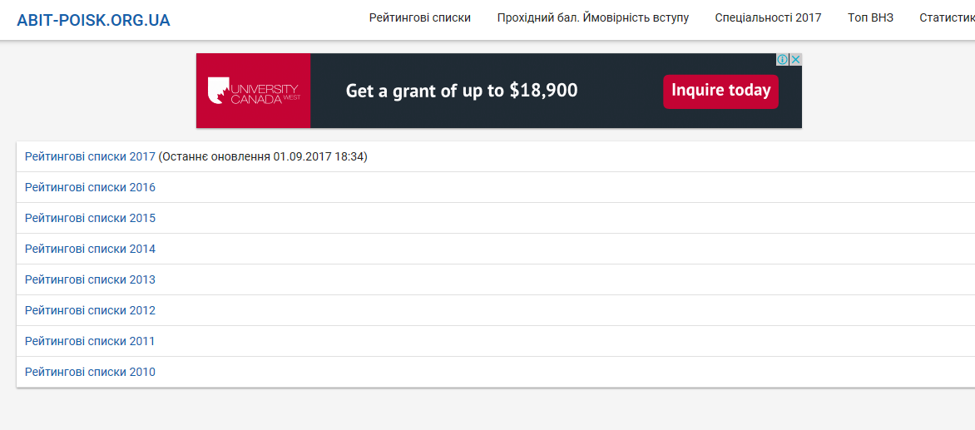
Analogues
http://www.vstup.info/
https://abit-poisk.org.ua/rate-review/

Slide 8

















Technologies we use
SCRUM

Slide 9
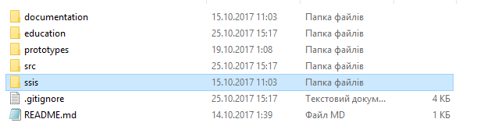
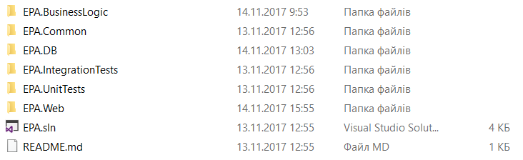
Solution architecture

Slide 10
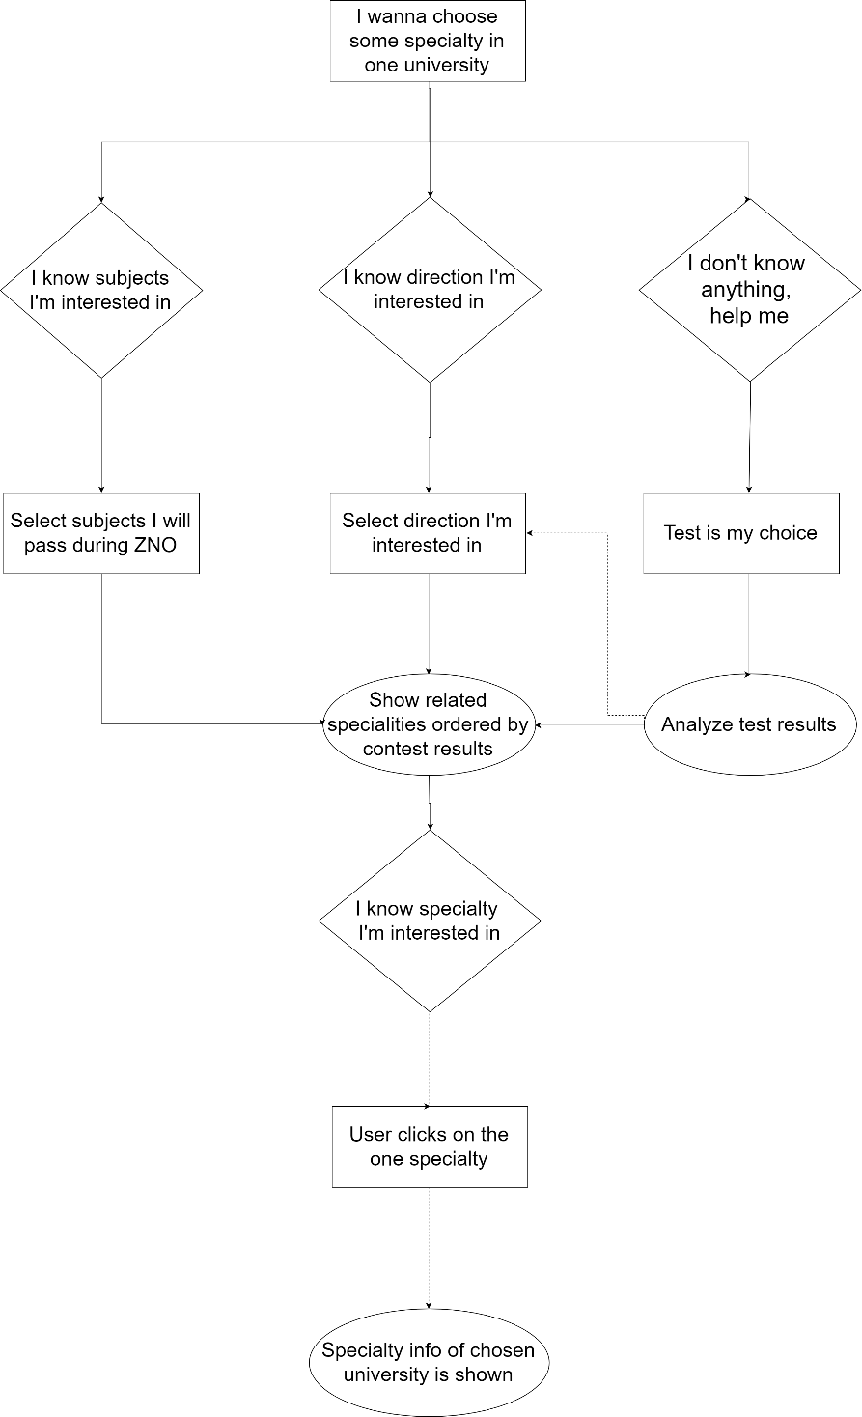
User flow

Slide 11
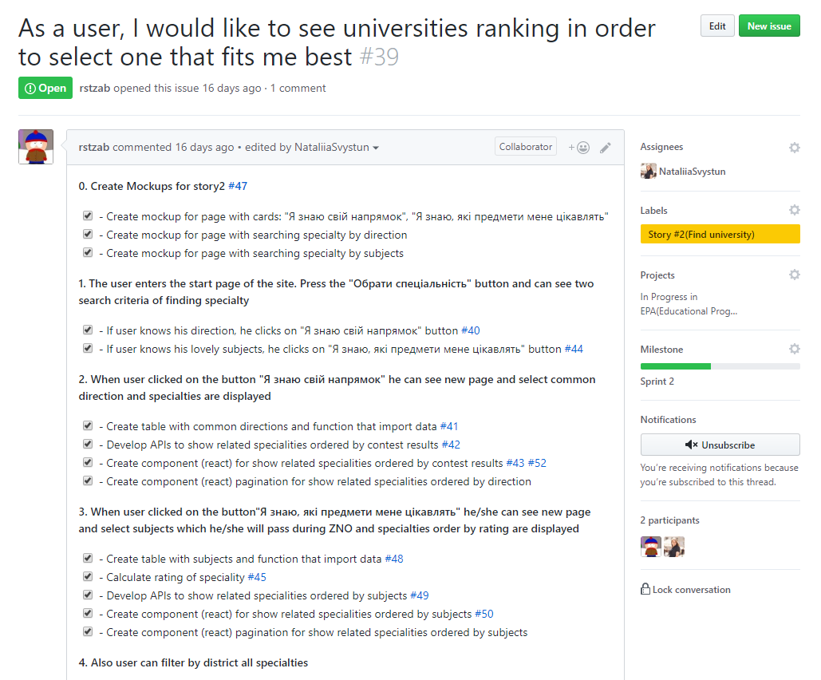
User story

Slide 12
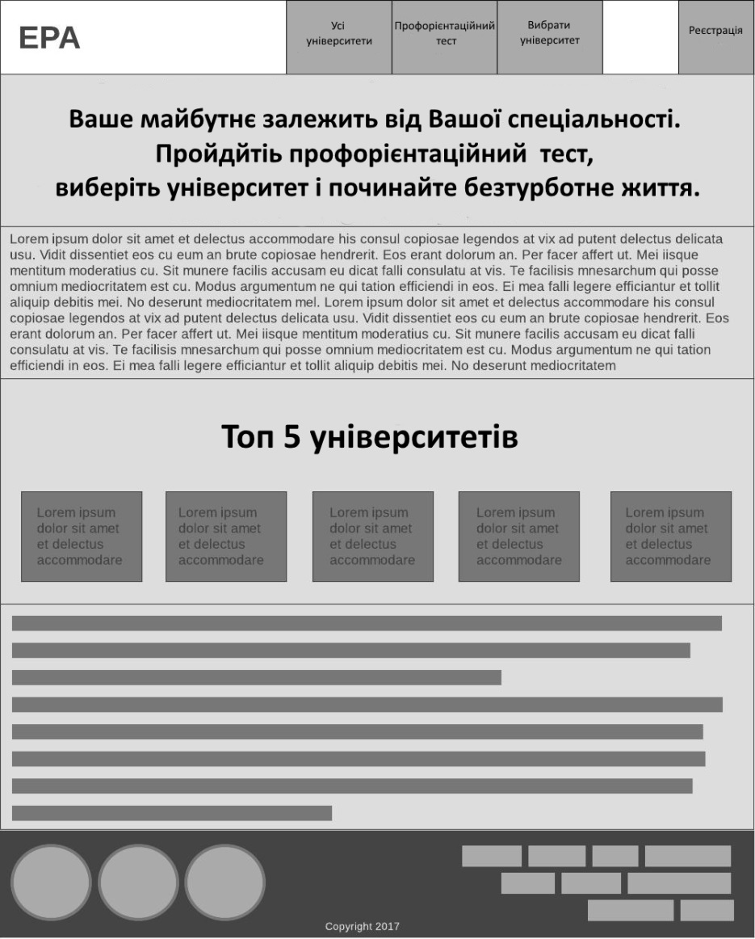
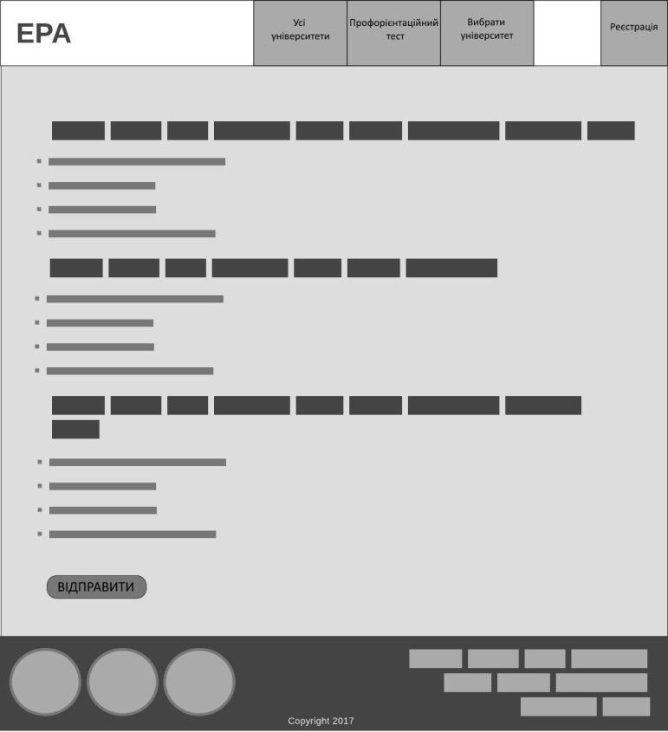
Mockup

Slide 13
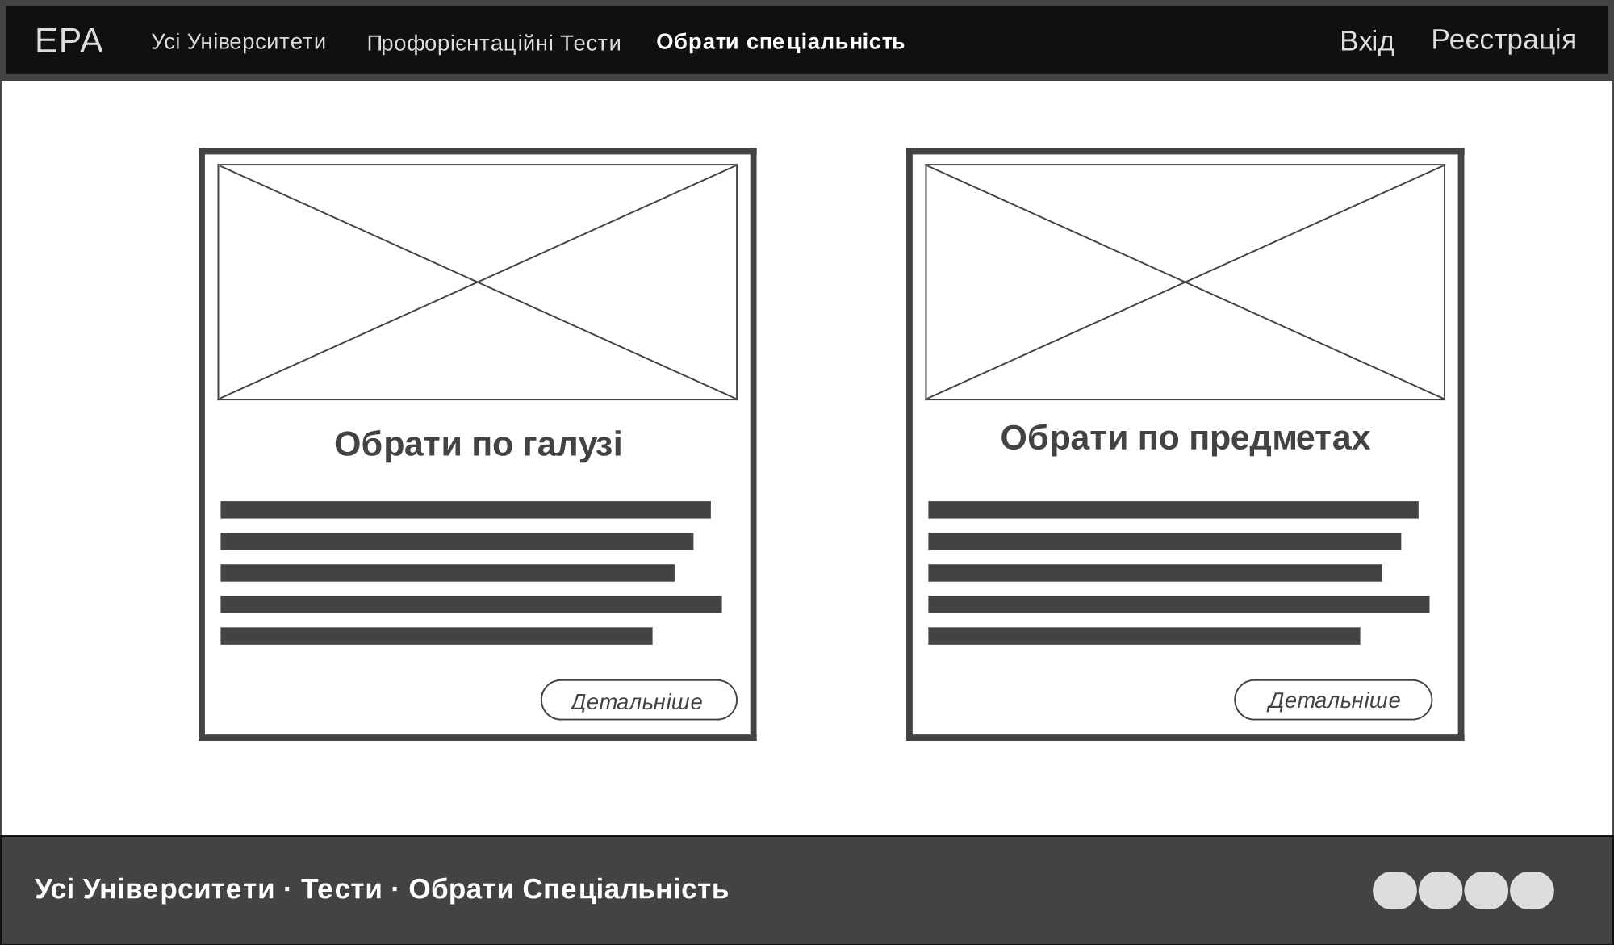
Mockup

Slide 14
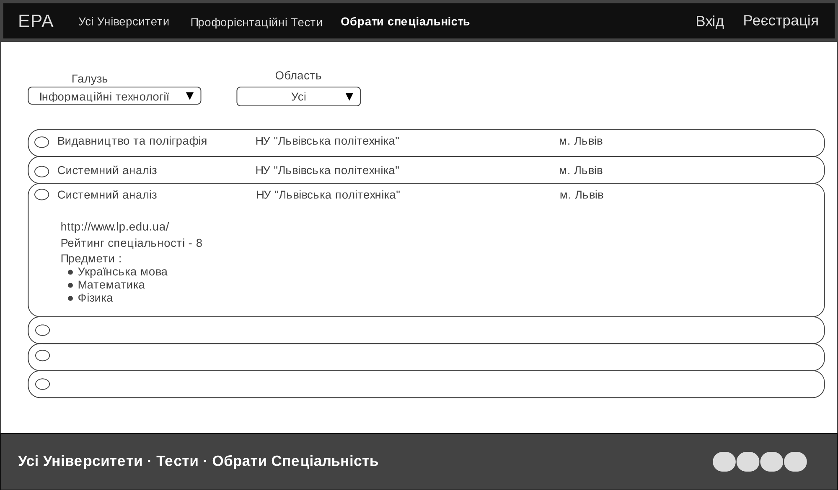
Mockup

Slide 15
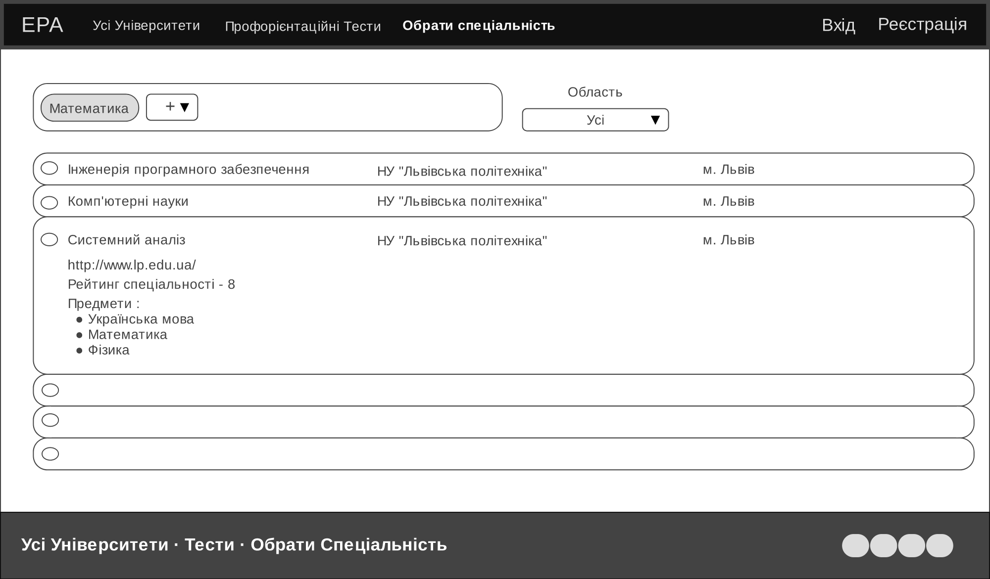
Mockup

Slide 16
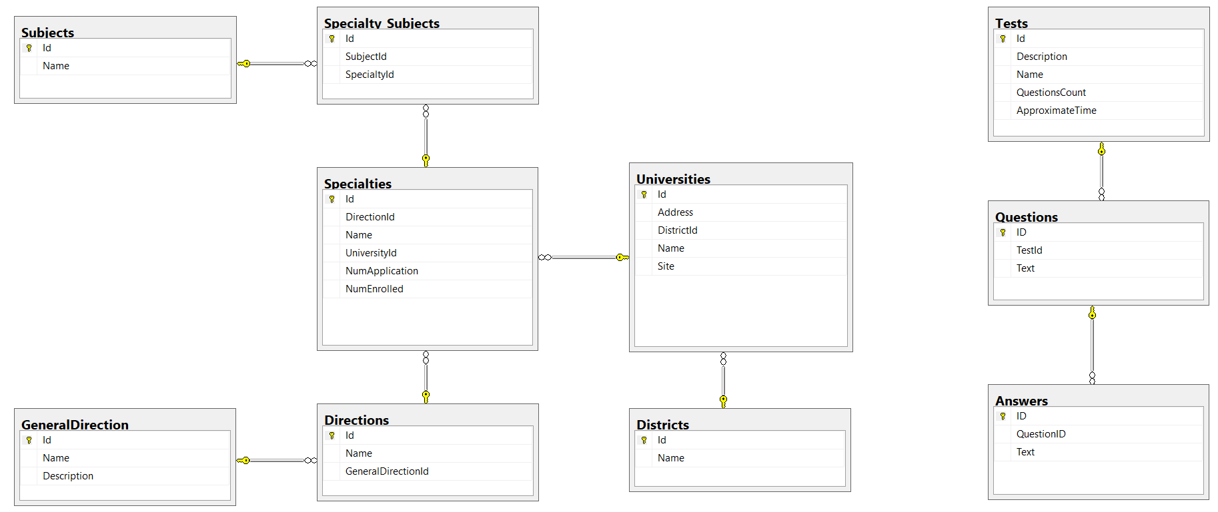
Data Base

Slide 17


Data integration
To fill data base tables that contain information about universities and their specialties, we create additional desktop application that parse information from site “vstup.info”.
This application will be completed once per year, when there can be added new universities or new specialties.
MSSQL

Slide 18









TEAM TEAM TEAM

