Slide 1
Educational Program Advisor

Slide 2
EPA
Problem statement
Problem: Every year school graduates faced with the problem of choosing a higher educational institution.
What specialty to choose?
What university to enter?
Users: School graduates and there parents, that prepares to enter to university.
Solution: Web application that contains list of all universities with details, prof orientation tests, algorithms of specialties selection, and full tracking of requests.

Slide 3
User roles
Visitor
Registered user
Administrator
??? Auto update

Slide 4
EPA
Visitor functionality
View list of universities, specialties with detail information (data should be structured)
View TOP universities
Registration (SSO)
Research

Slide 5
Registered user functionality
Create account where displays his personal data
Add to wish list interested his specialties
Pass proforientation tests
Auto generation of specialty list where to apply documents
Add favorite subjects to generate specialty list

Slide 6
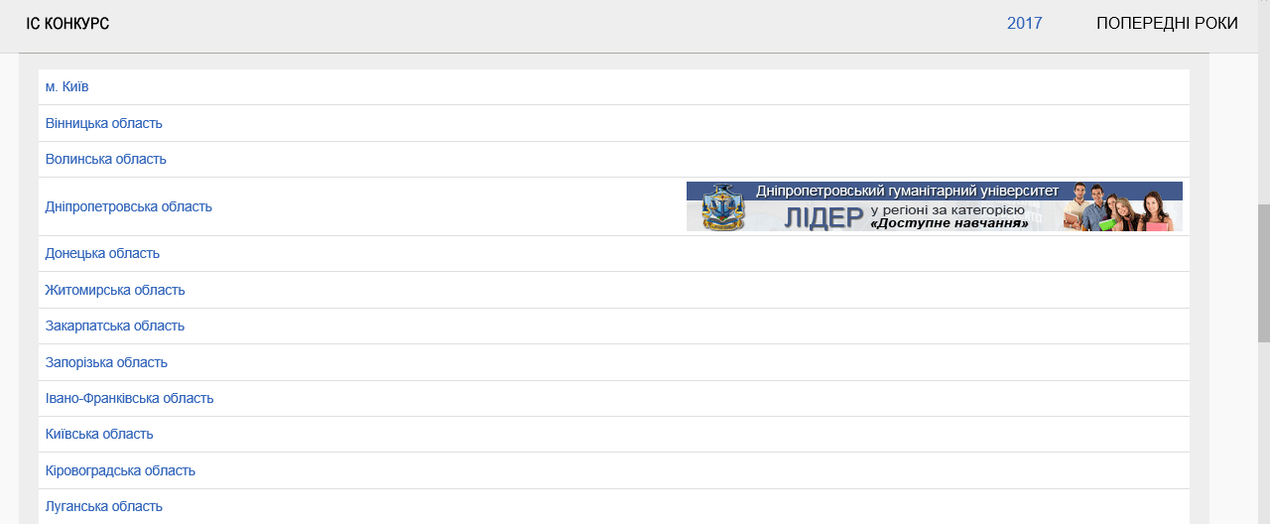
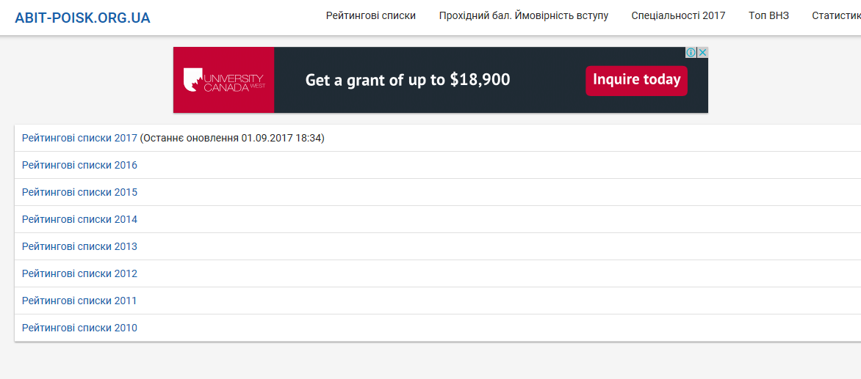
Analogues
http://www.vstup.info/
https://abit-poisk.org.ua/rate-review/

Slide 7
Data base

Slide 8
DB
What’s that?
A database is an organized collection of data. A relational database, on the other hand, is a collection of schemas, tables, queries, reports, views, and other elements.
Microsoft SQL Server is a relational database management system developed by Microsoft. As a database server, it is a software product with the primary function of storing and retrieving data as requested by other software applications - which may run either on the same computer or on another computer across a network (including the Internet).

Slide 9
How is it accepted to use?
The communication between databases and computer programs working with them is executed through a database management system (DBMS).
The latter represents a set of software programs that accept data requests from the application program and instruct the operating system how to handle the requested information.
This is done through a variety of control operations that a DBMS supports, such as organizing, storing, deleting or retrieving the data in a database. All these actions are executed through specific SQL commands.

Slide 10
DB
How is it used in similar systems?
Of course such a big amount of information have to store on data base. There are many filters, statistics that work up data from db and displays it to user.
For example https://abit-poisk.org.ua/rate-review/
There is information about universities, so there should be table in db that will contain details about each of them. The same is about list of abits, there exam result, there position in rating table.
To update the data they use api from http://www.vstup.info/

Slide 11
How will we use it?
We will use data base to store information about users
To store information from public api and results of parsing other sites
To connect to db and work with data from program we will use Microsoft Entity Framework
To fill data with need information we will use Integration service (SSIS)

Slide 12
Integration services

Slide 13
IS
What’s that?
Integration Services (IS) is a component of the database software that can be used to perform a broad range of data migration tasks.
IS is a platform for data integration and workflow applications. It features a data warehousing tool used for data extraction, transformation, and loading (ETL). The tool may also be used to automate maintenance of SQL Server databases and updates to multidimensional cube data.
AWS Database Migration Service
SAP BO Data Services
iPaaS

Slide 14
How is it accepted to use?
The IS lets the user create packages that move data from a single data source to a destination with no transformations. It can quickly move data from a variety of source types to a variety of destination types, including text files.
Developers tasked with creating IS packages use some additional tools and packages. A scripting environment in which to write programming code is also available in the tool.

Slide 15
IS
How is it used in similar systems?
There is no way to get information about abits – to control where abits applied there documents, whether abits get respond from university, only monitoring lists and parsing data from web sites of all those universities.
So they have to use some integration services, to control streams of information from many web sites.

Slide 16
How will we use it?
SSIS
A lot of documentation
Allows migration from different data bases – MS SQL, Postgres SQL, MySQL, Azure

