Slide 1
Git

Slide 2
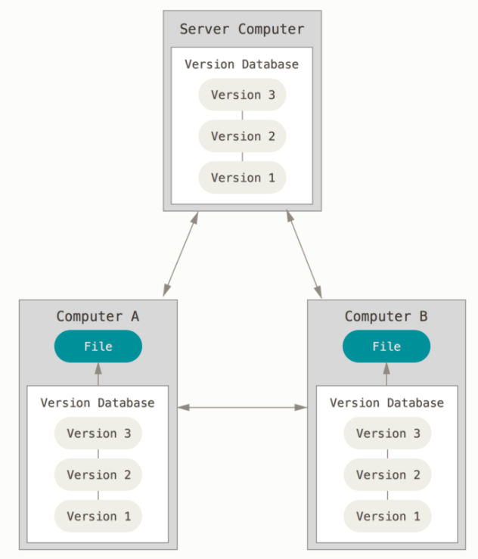
Version control
Version control system (VCS) is a system that records changes to a file or set of files over time so that you can recall specific versions later.
VCS Types:
Local Version Control Systems
Centralized Version Control Systems
Distributed Version Control Systems
GIT is Distributed Version Control Systems

Slide 3
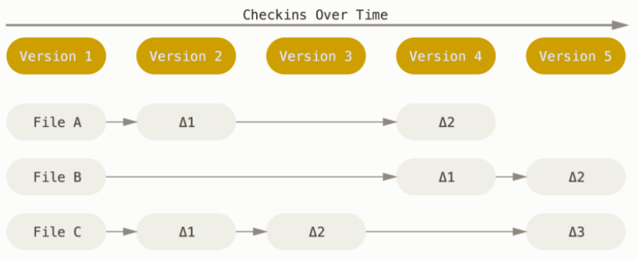
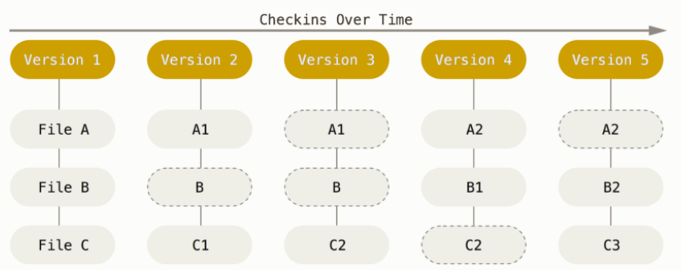
The major difference between Git and any other VCS (Subversion and friends included) is the way Git thinks about its data. Conceptually, most other systems store information as a list of file-based changes. These systems (CVS, Subversion, Perforce, Bazaar, and so on) think of the information they keep as a set of files and the changes made to each file over time.
other
git

Slide 4
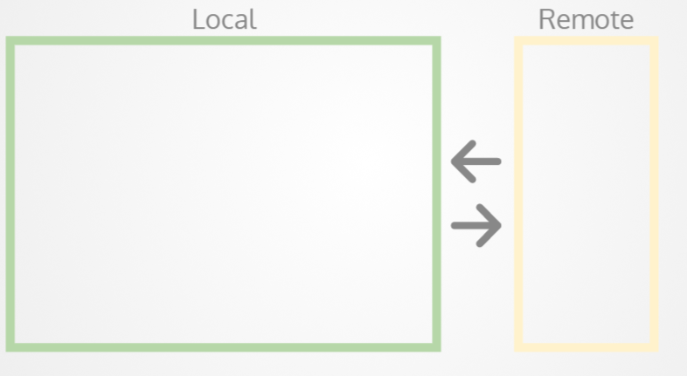
Spaces

Slide 5
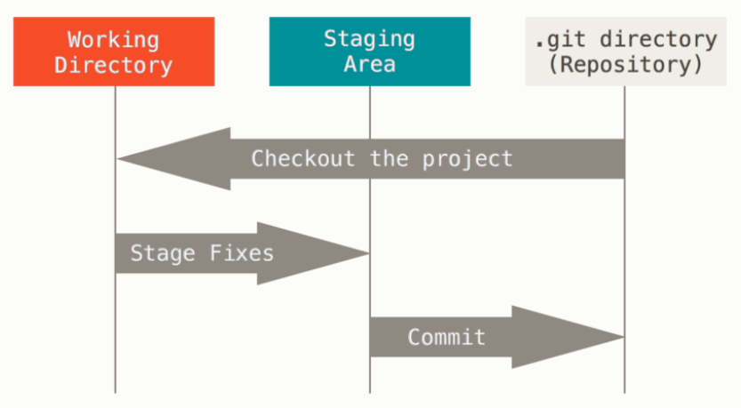
Git has three main states that your files can reside in: committed, modified, and staged. Committed means that the data is safely stored in your local database. Modified means that you have changed the file but have not committed it to your database yet. Staged means that you have marked a modified file in its current version to go into your next commit snapshot.
This leads us to the three main sections of a Git project: the Git directory, the working tree, and the staging area.

Slide 6
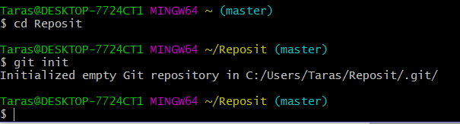
Initializing a Repository in an Existing Directory
1) Change Path
$ cd /...path.../my_project
2) Initialize repository
$ git init

Slide 7
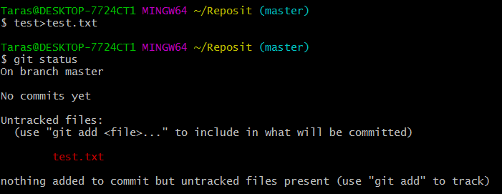
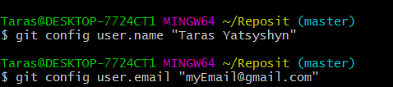
Creating text file and configuration
git status - Current state of the repository
This information is used to know which user has done which commits.

Slide 8
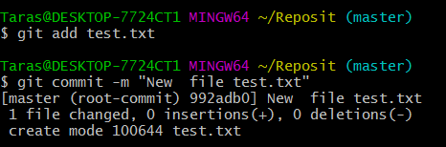
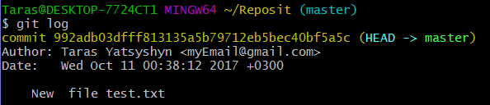
First commit
git add - Add one or more files to staging
git commit - Commit changes to head (but not yet to the remote repository):
git log - Shows the commit logs

Slide 9
status vs log
git status - show the working tree status
git log - show the history of changes through the commit logs

Slide 10
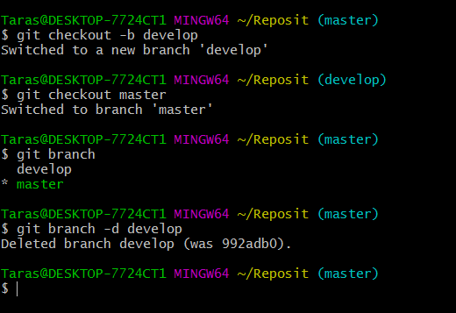
Branches
git checkout -b <branchname> - Create a new branch and switch to it
git checkout <branchname> - Switch from one branch to another
git branch - List all the branches in your repo, and also tell you what branch you're currently in
git branch -d <branchname> - Delete the feature branch

Slide 11
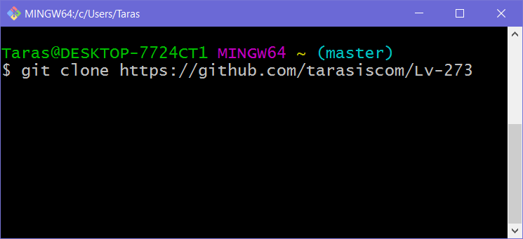
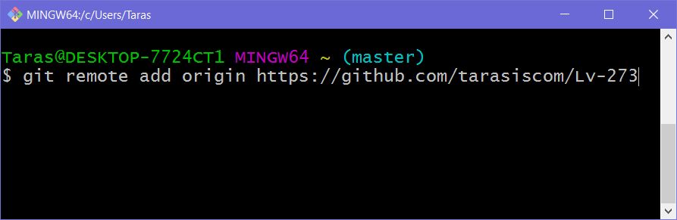
connecting to github(remote repo)
git clone git://github.com/tarasiscom/Lv-273 - clone remote repo to local repo
git remote add origin https://github.com/tarasiscom/Lv-273 - connecting to remote repo to be able to push to it
git remote -v - List all currently configured remote repositories

Slide 12
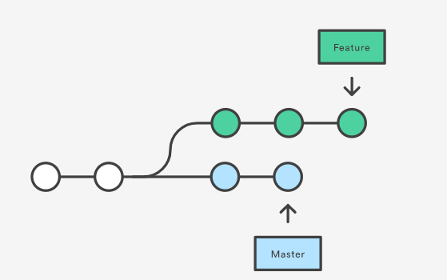
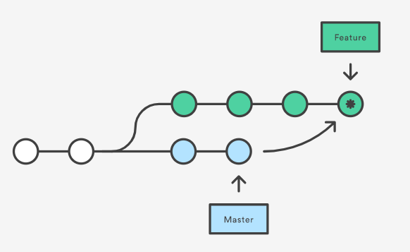
Marge
git merge <branchname>
git checkout feature
git merge master

Slide 13
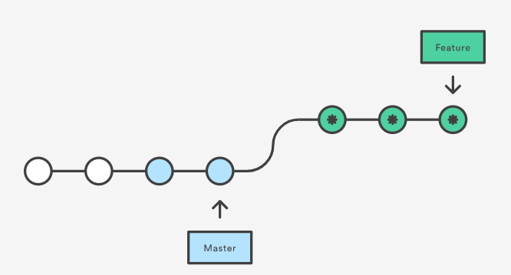
Rebase
git rebase <branchname>
git checkout feature
git rebase master

Slide 14
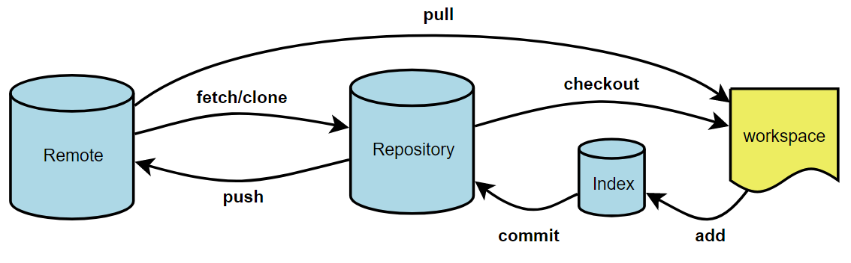
Push & Pull
Push | Pull
Send changes to the master branch of your remote repository | Fetch and merge changes on the remote server to your working directory

Slide 15

merge conflicts
View all the merge conflicts - git diff
View the conflicts against the base file - git diff --base <filename>
Preview changes, before merging - git diff <sourcebranch> <targetbranch>

Slide 16

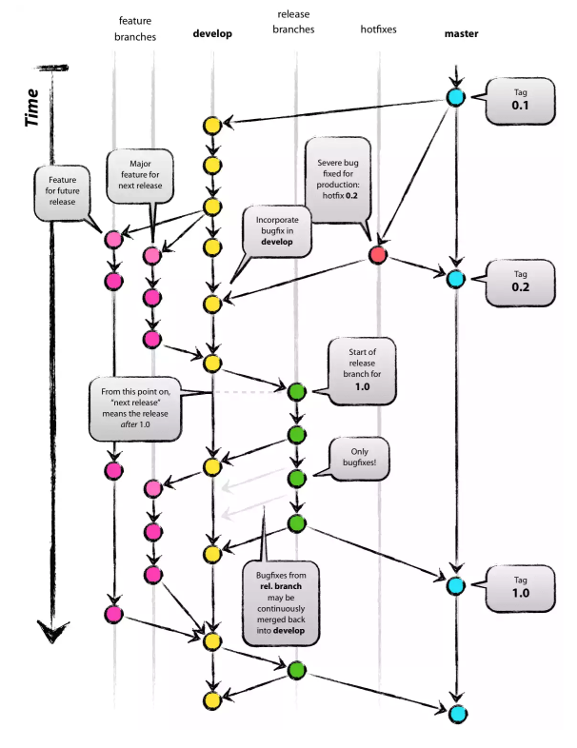
Git branching model
The main branches:
master
develop
Supporting branches:
Feature
Release
Hotfix

Slide 17
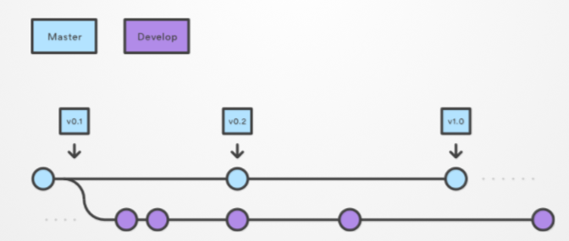
Main Branches
Master - Stores the official release history, so we must tag all commits in the master branch with a version number.
Develop - Acts as integration branch for feature branches.

Slide 18
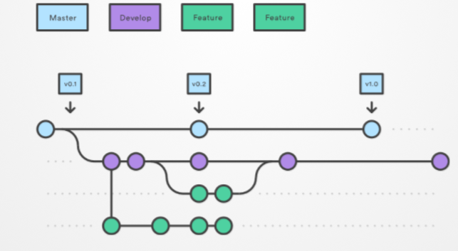
Feature
Each new feature should reside in its own branch.
Use develop branch as their parent branch.
When a feature is complete, it gets merged back into develop.
Features should never interact directly with master.

Slide 19
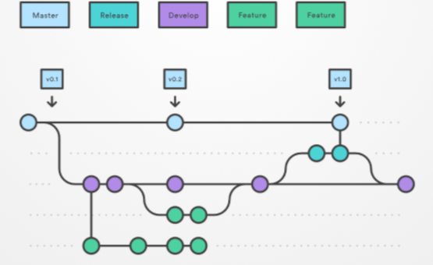
Release
Once develop has acquired enough features for a release:
Create a release branch using develop as their parent branch.
No new features can be added after this point (only release related tasks: bugs, documentation, etc).
​Once it's ready:
the release gets merged into master and tagged with a version number.
the release is merged back into develop (which may have progressed since the release was initiated).

Slide 20
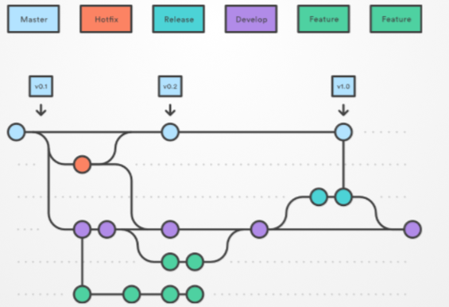
hotfix
Maintenance or “hotfix” branches are used to quickly patch production releases.
Should fork directly off of master.
Once fix is complete, it should be merged into both master and develop (or the current release branch)
master should be tagged with an updated version number.

Slide 21
MERGE vs REBASE
The major benefit of rebasing is that you get a much cleaner project history. First, it eliminates the unnecessary merge commits required by git merge. Second, as you can see in the above diagram, rebasing also results in a perfectly linear project history—you can follow the tip of feature all the way to the beginning of the project without any forks. This makes it easier to navigate your project with commands like git log, git bisect, and gitk.
Merge
Merge takes all the changes in one branch and merges them into another branch in one commit.
Rebase
Rebase says I want the point at which I branched to move to a new starting point

Slide 22
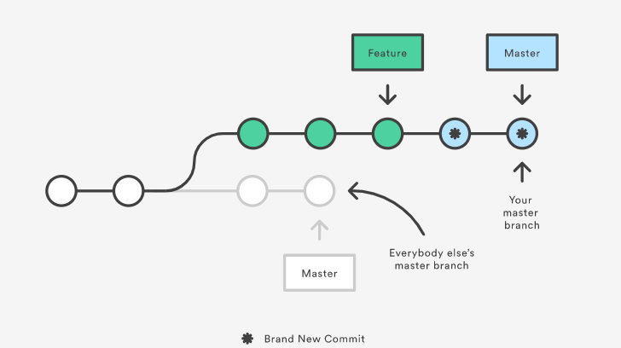
Golden rule of Rebase
“The golden rule of git rebase is to never use it on public branches”

Slide 23
Merge
Merge takes all the changes in one branch and merges them into another branch in one commit.
Rebase
Rebase says I want the point at which I branched to move to a new starting point

Slide 24
Merge
Let's say you have created a branch for the purpose of developing a single feature. When you want to bring those changes back to master, you probably want merge (you don't care about maintaining all of the interim commits).
Rebase
A second scenario would be if you started doing some development and then another developer made an unrelated change. You probably want to pull and then rebase to base your changes from the current version from the repo.

Slide 25
Reference:
https://www.atlassian.com/git/tutorials/merging-vs-rebasing
https://habrahabr.ru/post/106912/
http://product.hubspot.com/blog/git-and-github-tutorial-for-beginners
https://confluence.atlassian.com/bitbucketserver/basic-git-commands-776639767.html
http://eax.me/git-commands/
http://slides.com/acanimal/git#/

