Slide 1
Pattern Repository

Slide 2
Mediates between the domain and data mapping layers, acting like an in-memory collection of domain objects.
Repository
PoEAA by Martin Fowler

Slide 3
Why we need the Repository Pattern?
If an application does not follow the Repository Pattern, it may have the following problems:
Duplicate database operations codes
Need of UI to unit test database operations and business logic
Need of External dependencies to unit test business logic
A higher potential for programming errors

Slide 4
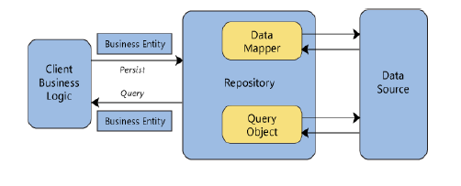

Slide 5
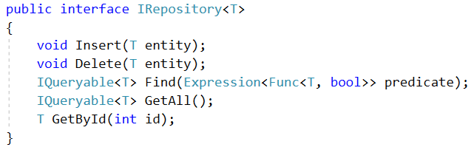
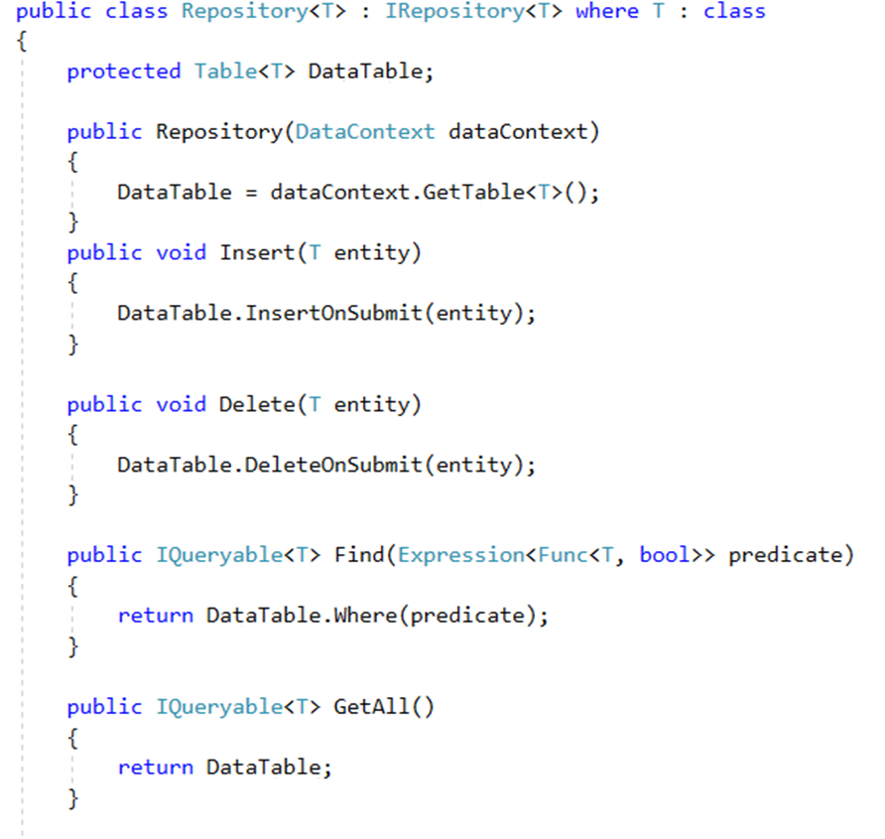
Example

Slide 6
Benefits
Minimizes duplicate query logic
Data Source can be changed without any changes in Business Logic Layer and minimum changes in Repository.
Facilitates automated Unit Testing, Test Driven Development.

Slide 7
Implementing Repository Pattern With Entity Framework
We can use any Entity Framework to perform database operations.
DbContext class is simply the way to incorporate EF-based data access into your application. The class that derives from DbContext is, in essence, the data access layer of your application.
DBSet class represents an entity set that is used for create, read, update, and delete operations.

Slide 8
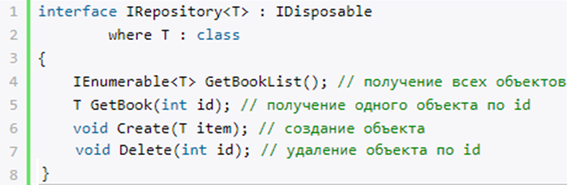
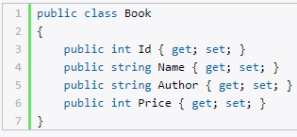
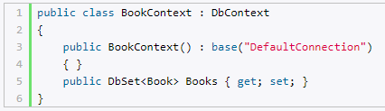
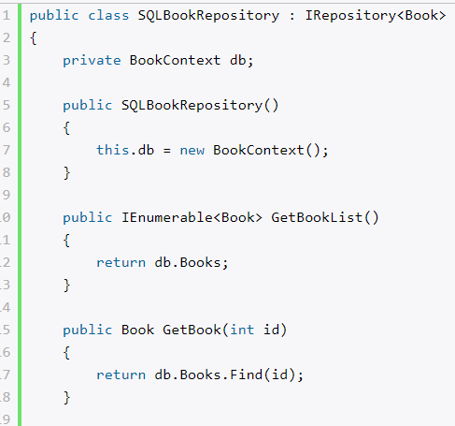
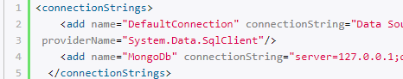
Example
4. Repository interface
1. Assume that we have class “Book”
2. Then we define data context class
5. Realization of interface IRepository
3. Edit connection string in file web.config

Slide 9
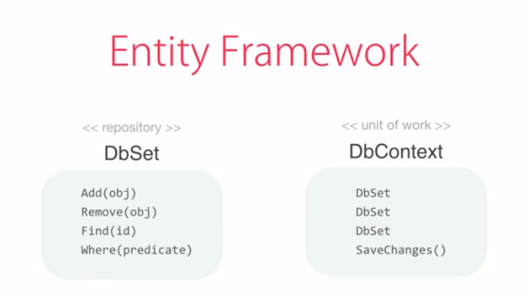

Slide 10
Unit of Work
This pattern keeps track of everything that happens during a business transaction that affects the database. At the conclusion of the transaction, it determines how to update the database to conform to the changes.

Slide 11
Thank you for attention☺

