Slide 1
ASP.Net Core
Exception handling in

Slide 2
What’s the difference
At first glance you might think that there is no difference, in the end it’s all written in C#, right? Well yeah, but not quite.
There are couple of differences:
- Web application;
- Errors may occur not in your code;
- Third-party modules
Notes:
First of all, these are sites that we’re making, not console applications. Web has a lot of dependencies, and correlation between different languages as well(e.g. react on javascript).
Second of all you never gonna be fully safe with all of your error handlers, cause there are a lot of unmanaged exceptions waiting for you around the corners
ASP.Net Core is fully modular system it has it’s advantages, so you can install a lot of error handling modules which we will discuss later on.

Slide 3
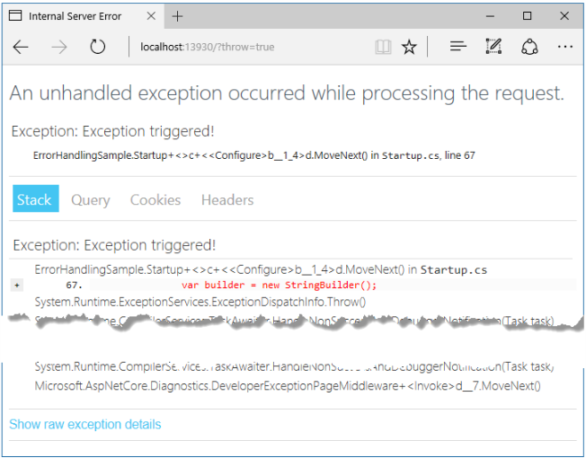
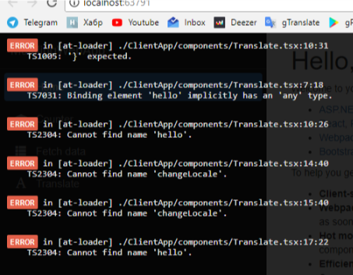
There are some built in handlers
Standard and The one we got

Slide 4
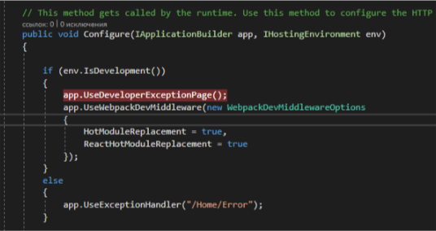
Code part
Where they are announced
Notes:
Are you surprised that you already got a error handler running? Don’t be so happy about it, it’s not all that kneet’n’shiny. Where were we, right, that’s where they are announced.

Slide 5
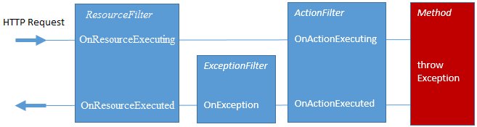
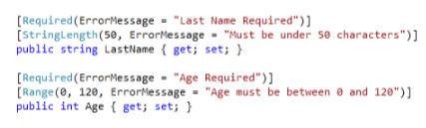
Some features
ASP.Net MVC apps have some additional options for handling errors:
Exception filters;
- Model validation;
Notes:
Exception filters you might use in some specific situations when you have different scenarios for different incoming data, it should occur mostly within MVC actions, because it has less flexibility rather than error handling middleware.
Model validation occurs prior to each controller action being invoked, and it is the action method’s responsibility to inspect ModelState.IsValid and react appropriately. In many cases, the appropriate reaction is to return some kind of error response, ideally detailing the reason why model validation failed.

Slide 6



Third-party modules
These are two most common logging modules on the market:
- ELMAH
- Log4net
- NLog
- Serilog

Slide 7
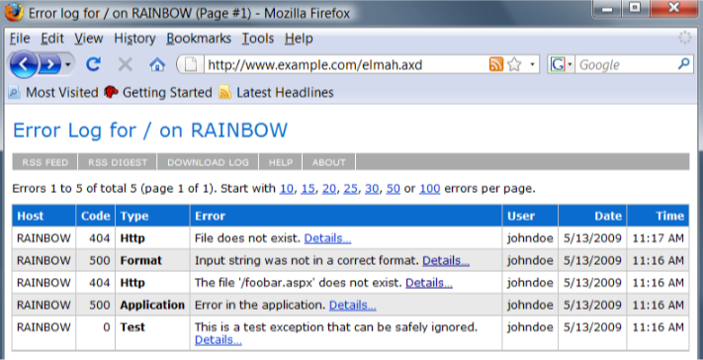
ELMAH
First on the market easy-to use web logging tool, fully pluggable, no extra code required
Notes:
ELMAH (Error Logging Modules and Handlers) is an application-wide error logging facility that is completely pluggable. It can be dynamically added to a running ASP.NET web application, or even all ASP.NET web applications on a machine, without any need for re-compilation or re-deployment.
Tell about no use for asp.net core, cuz it doesn’t support it

Slide 8
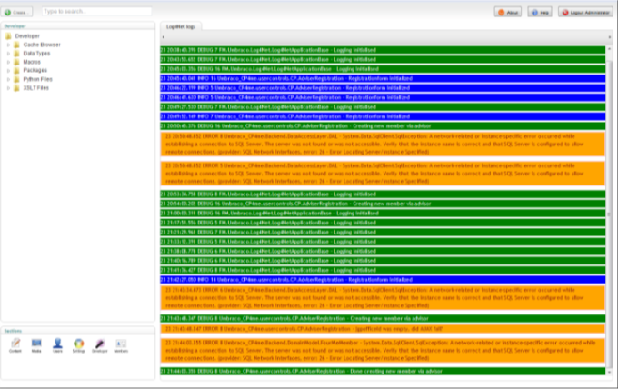
log4net
More general logging app, commonly used for logging desktop applications.
Notes:
Tell about slow log4net asp.ne core updates

Slide 9
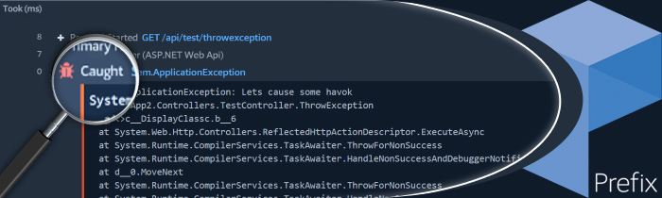
NLog
.Net Error logging library with various features
Notes:
Tell about the point where there is no much difference in libraries, the “prefix” error logging viewer, which supports log4ne, nlog, and serilog, and on that point move to serilog

Slide 10
Serilog
Yet another .Net error logging library
Notes:
Serilog, tell bout my personal favor of this one, mention structured logging method that occurs in this lib, tell bout most simple implementation and switch to showing that fast implementation

Slide 11
How to setup:
Step №1: Install it;
Step №2: Initialize it in Program.cs; *be careful with Program.cs
Step №3: Enjoy;

Slide 12
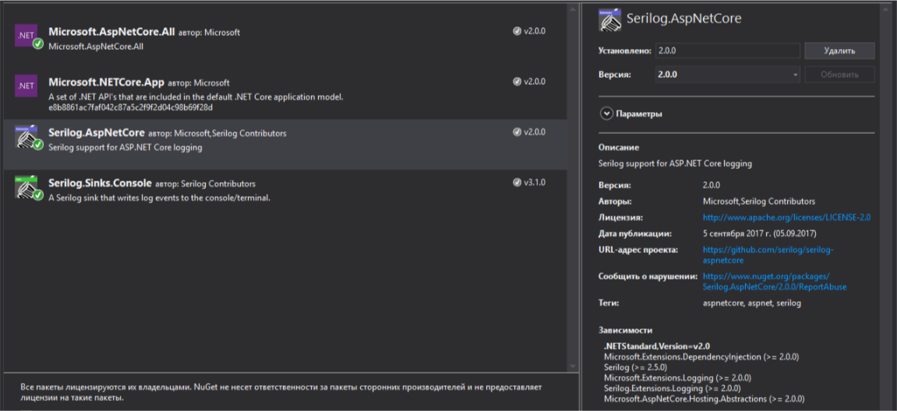
Step №1: Install it
Using NuGet

Slide 13
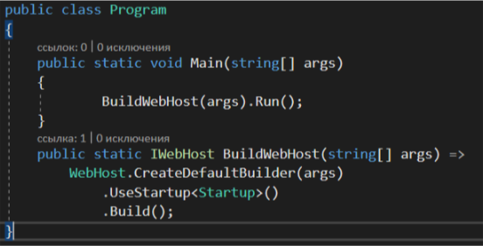
Step №2: Initialize it in Program.cs
Before:

Slide 14
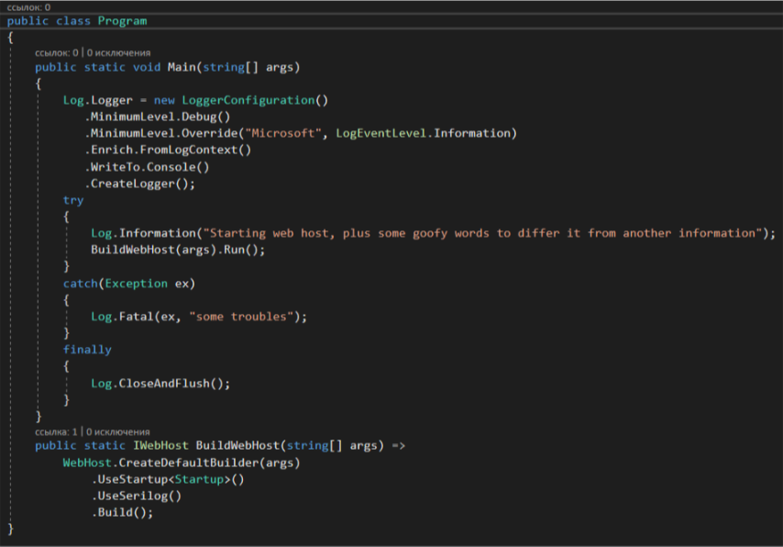
Step №2: Initialize it in Program.cs
After:

Slide 15
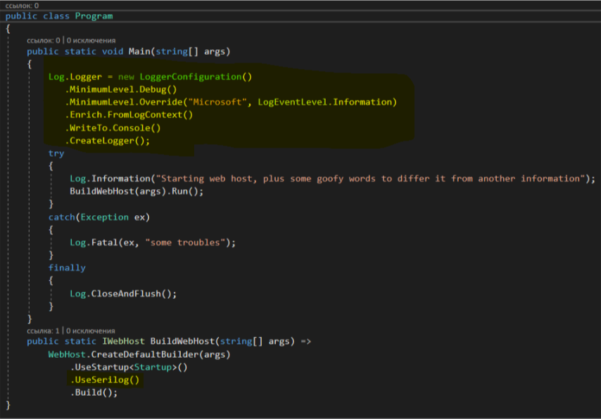
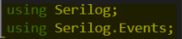
Step №2: Initialize it in Program.cs
What you have to add for it to work:

Slide 16
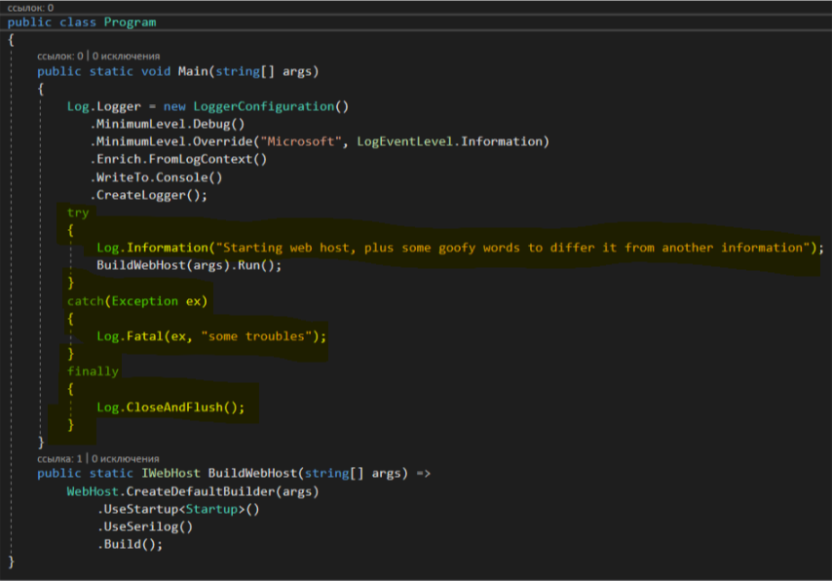
Step №2: Initialize it in Program.cs
This is to check if it works:

Slide 17
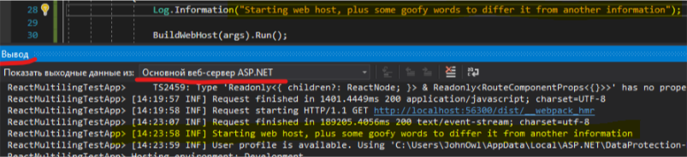
Step №3: Enjoy
…And it does
Though, this is not the only way you can store your logs…

Slide 18
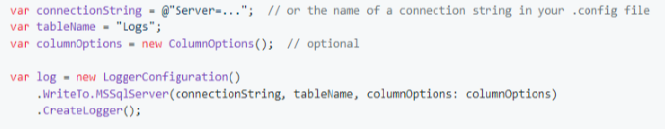
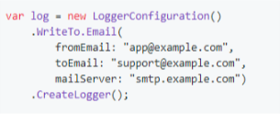
There are more
MSSQL:
Download Serilog.Sinks.MSSqlServer NuGet package
Email:
Download Serilog.Sinks.Email NuGet package
And far more, just open your NuGet manager, and type Serilog.Sinks to find option you need.

Slide 19
That’s about it for now! Refferences: https://nblumhardt.com/2017/08/use-serilog/ https://www.darylcumbo.net/serilog-vs-nlog-benchmarks/ https://www.darylcumbo.net/structured-logging/ https://stackify.com/asp-net-core-logging-what-changed/

