Slide 1
I18n
Internationalization Implementation

Slide 2
What is internationalization
First we need to distinguish couple of terms: localization and globalization. Because term internationalization combines both of mentioned above terms in itself.
Globalization
Localization
Internationalization
Notes:
Глобализация это процесс поддержки разных языковых культур. Локализация вбирает в себя перевод/описание интерфейса на определенный язык

Slide 3


Ways to implement internationalization
There are couple of ways for us to make our site multilingual:
Standard and Node Package Manager
*To be fair there is only one

Slide 4
Standard way
The wrong way as you also may call it.
The problem is that this way is not
applicable for single-page-applications.
Though it seems logical to use asp.net core utilities to solve our multilingual problem, it won’t work cause of our react part of application, you know the one which responsible for SPA’ness. And there is not only that..

Slide 5
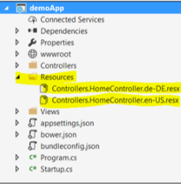
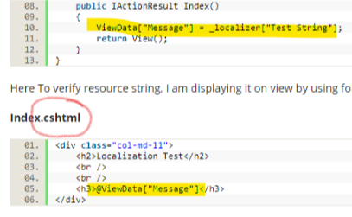
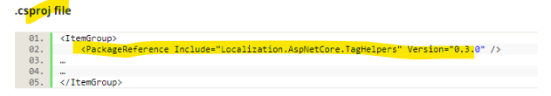
Some genius techniques to achieve i18n via ASP.NET Core MVC
Resources naming
Our little SPA problem
Some minor complaints

Slide 6
Node Package Manager way
Or as some would call the right one.
Unlike Standard way, this one does not have one distinct realization. NPM is not even a technique, it’s a javascript code-sharing platform for developers. The idea is that you can download code package(library if you insist) written by somebody else and start doing some serious business instead of reinventing the wheel.

Slide 7
Some techniques to achieve i18n via NPM
Well, first of all you need to install a node package manager on your computer, good thing that you already did it cause it comes with node.js which you installed for making our site work on your computer.
Second of all you need to find some sweet npm’s for internationalization on react, again, good thing that there is whole lot of npm’s to choose from.
Third of all you need to add that npm to your VS Solution. And here we got some problems… but we’ll talk about it later.

Slide 8
The second bit
As I said earlier there is a lot of npm’s to choose from. And even more discussions on which is the best.
Like a lot: react-multilingual, react-redux-multilingual, react-intl, Airbnb.polyglot, i18n-react, react-intl-redux, react-react-i18n, redux-pagan etc.
I guess that for our purposes we can choose any, some of them have some extra features, some don’t.

Slide 9
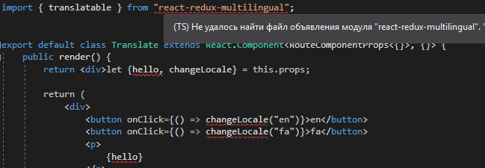
The last bit
Uhm.. yeah, there is one problem..

Slide 10
That’s all folks!

