Slide 1
Educational Program Advisor

Slide 2



Slide 3
Problem statement
Problem: Every year school graduates face the problem of choosing a higher educational institution.
What specialty to choose?
What university to enter?
Users: School graduates and their parents, who are deciding which university to choose.
Solution: Web application that contains list of all universities with details, prof orientational tests, specialties selection algorithms.

Slide 4

User roles
Admin
Registered User
Visitor

Slide 5
Visitor functionality
View list of universities, specialties with detailed information
View TOP universities
Registration (SSO)
Research

Slide 6
Registered user functionality
Create an account where personal data can be showed
Add to wish list interested specialties
Pass prof orientational tests
Auto generation of specialty list where he can apply documents
Specialty list can be generated based on ZNO subjects, Directions, and by Districts

Slide 7
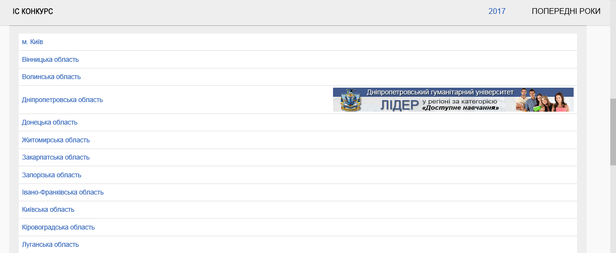
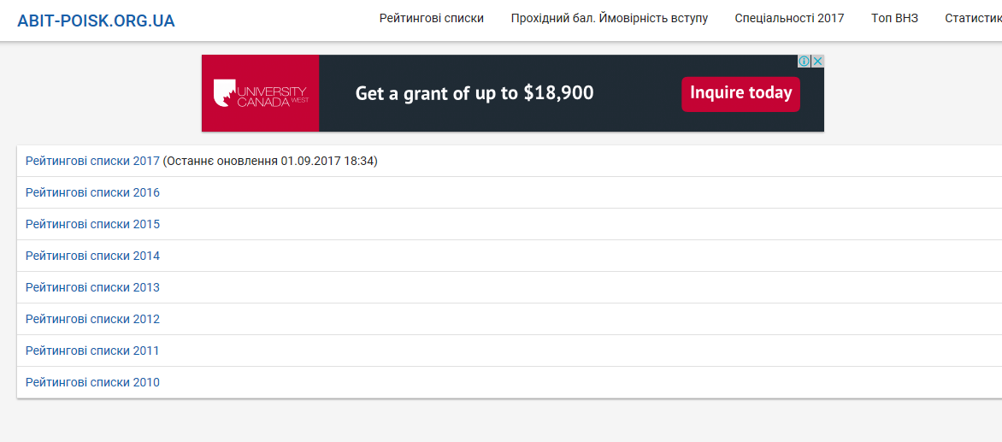
Analogues
http://www.vstup.info/
https://abit-poisk.org.ua/rate-review/

Slide 8

















Technologies we use
SCRUM

Slide 9
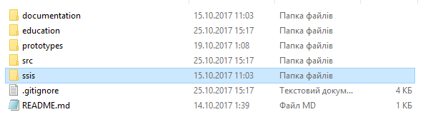
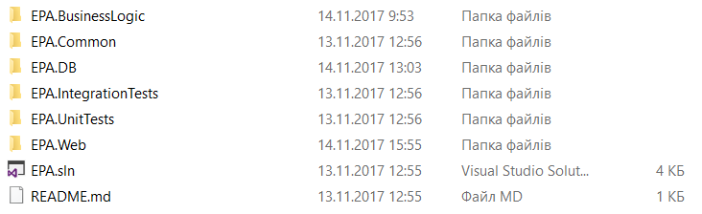
Solution architecture

Slide 10
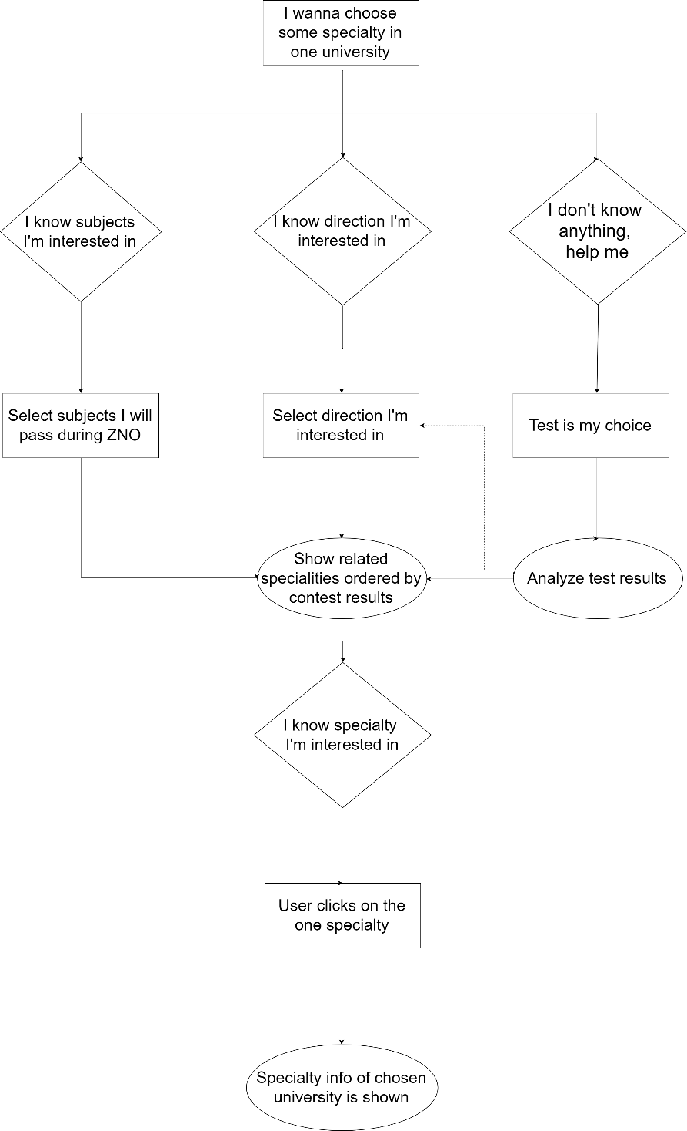
User flow

Slide 11
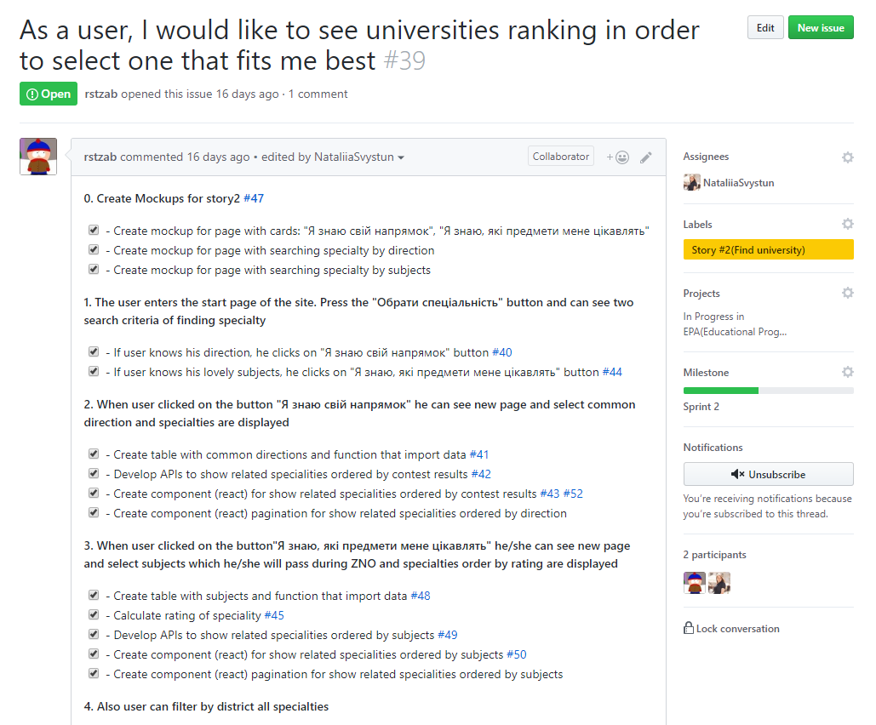
User story

Slide 12
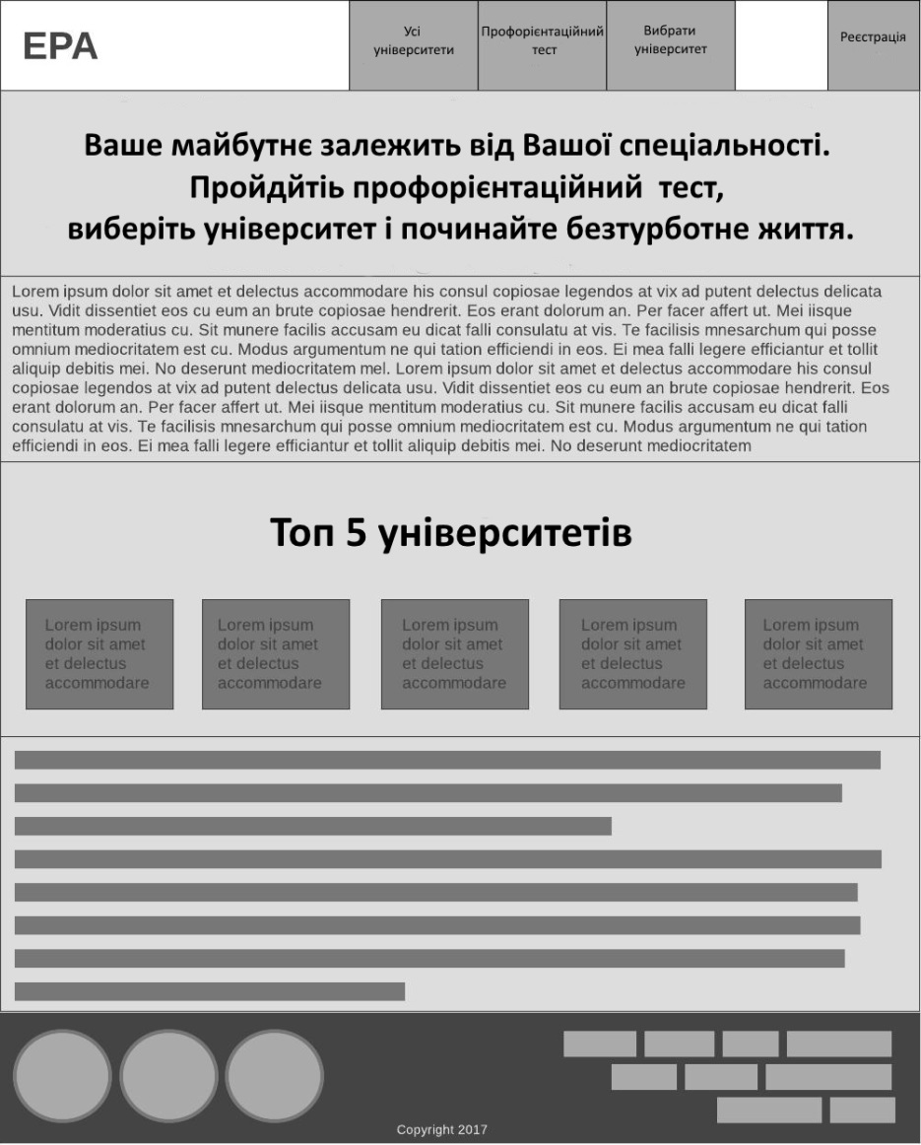
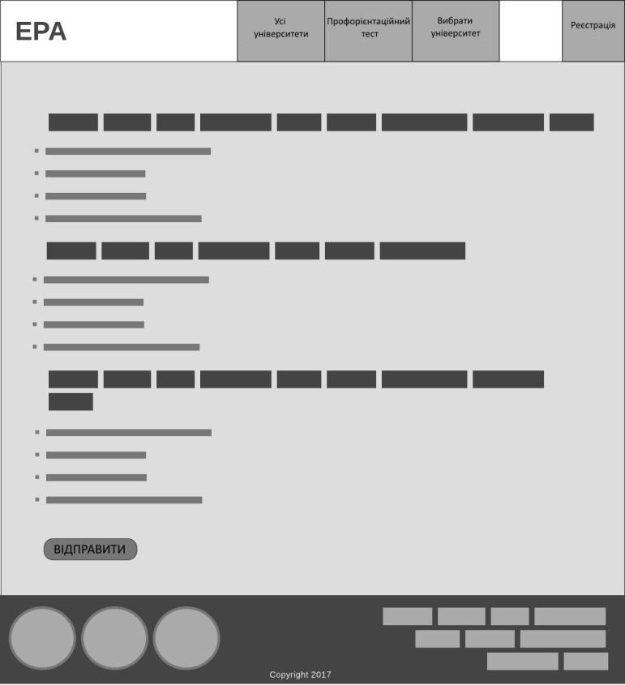
Mockup

Slide 13
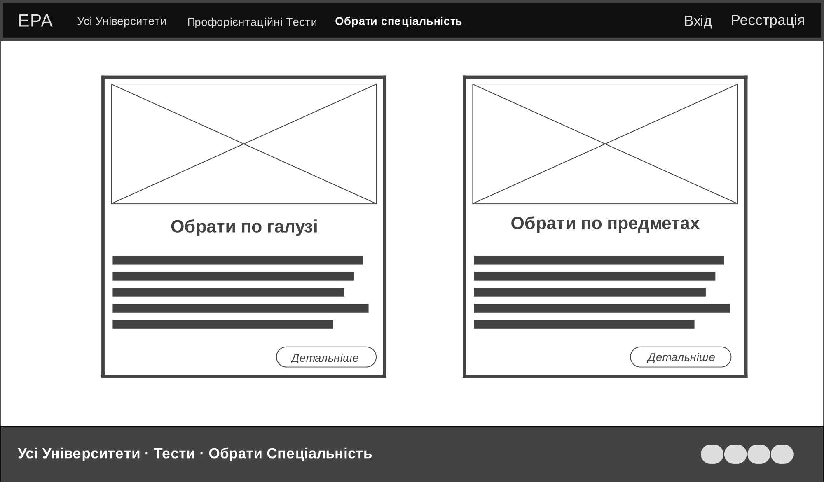
Mockup

Slide 14
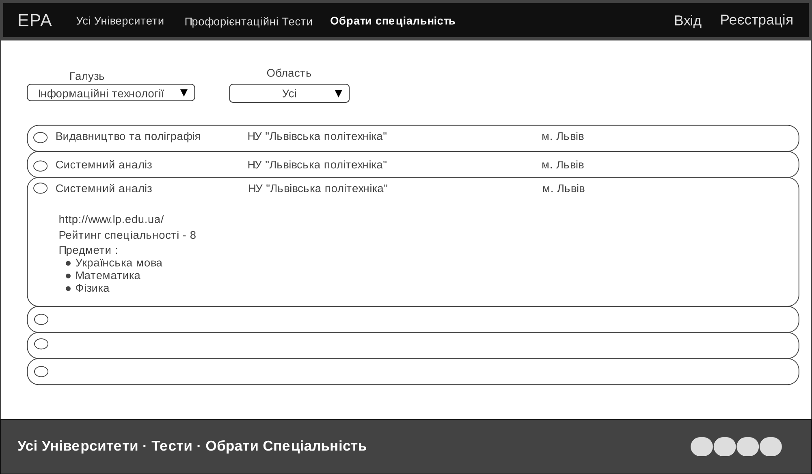
Mockup

Slide 15
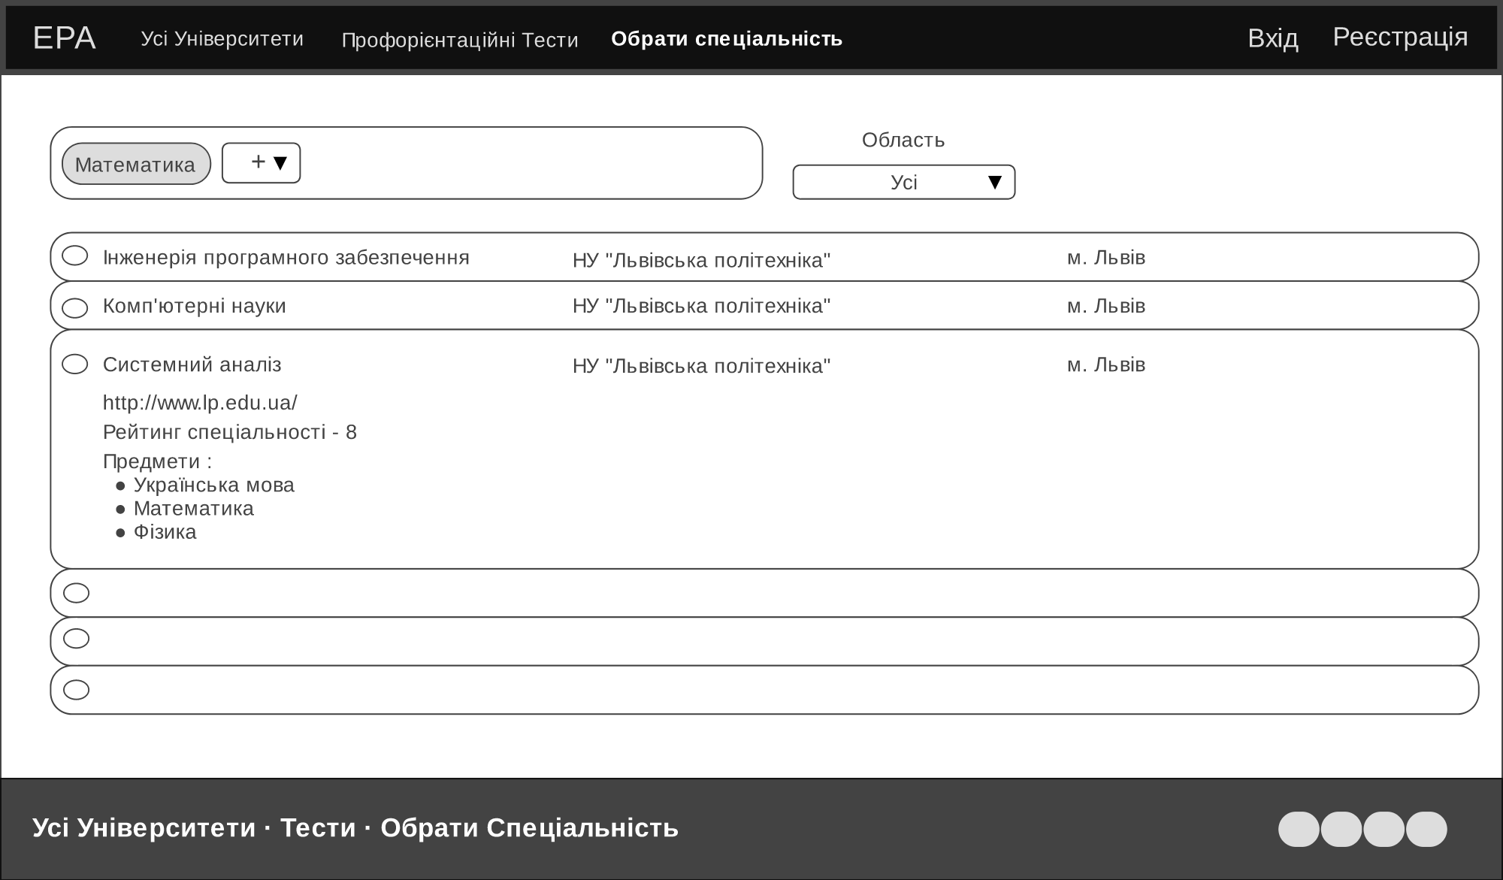
Mockup

Slide 16
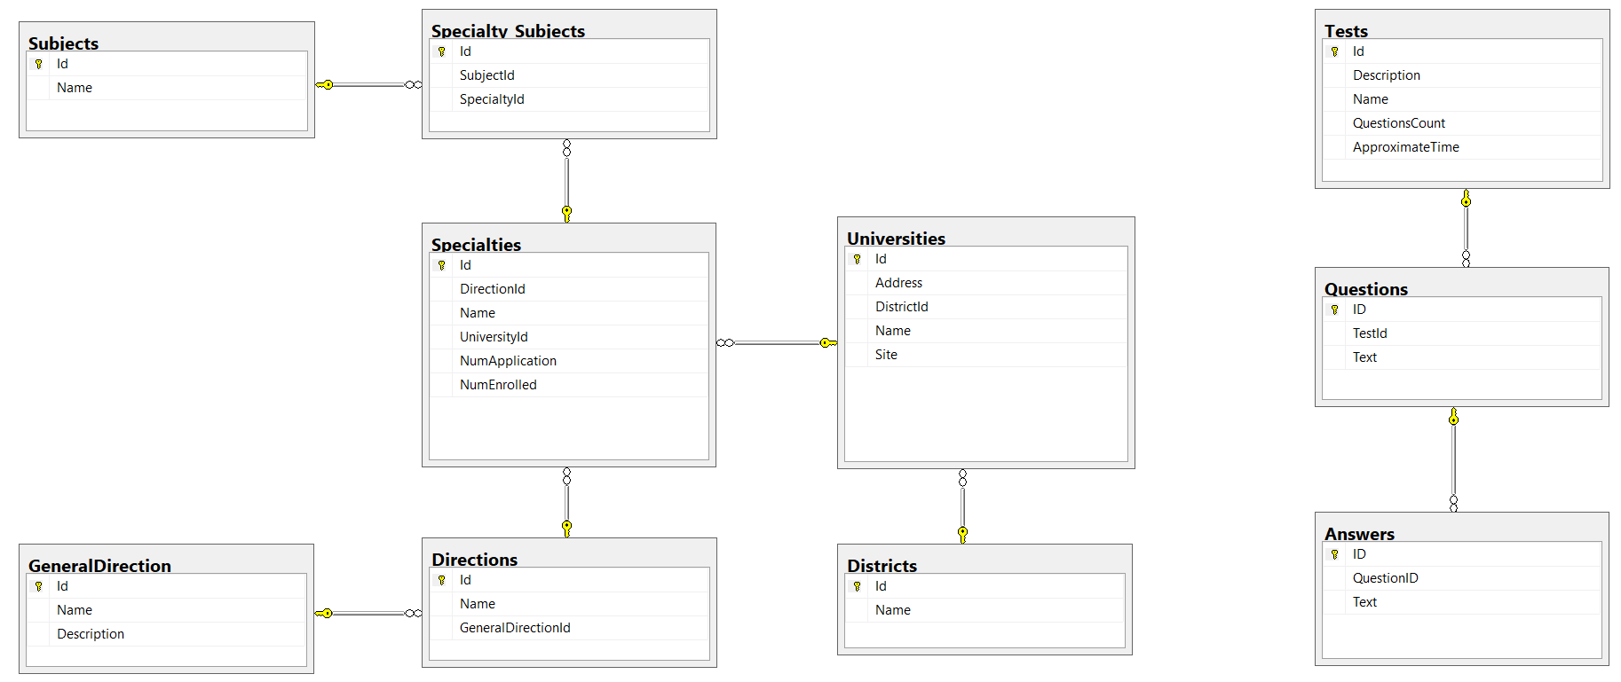
Data Base

Slide 17
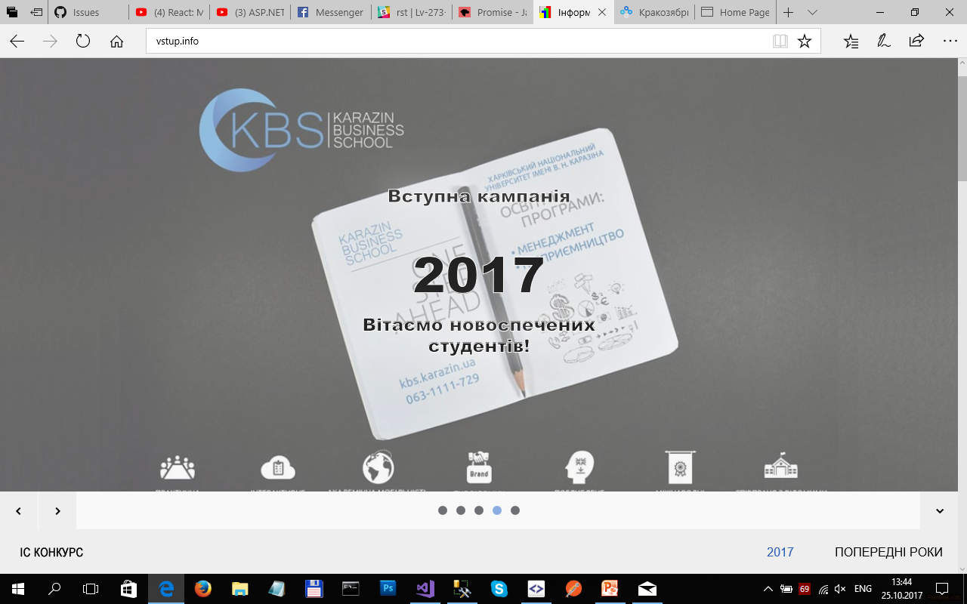

Data integration
To fill data base tables that contain information about universities and their specialties, we created additional desktop application that parses information from site “vstup.info”.
This application will be runned once per year, if there has been added new universities or new specialties.
MSSQL

Slide 18









TEAM TEAM TEAM

