Slide 1
ASP.Net Core
Exception handling in

Slide 2
What’s the difference
At first glance you might think that there is no difference, in the end it’s all written in C#, right? Well yeah, but not quiet.
First of all, these are sites that we’re making, not console applications. Web has a lot of dependencies, and correlation between different languages as well(e.g. react on javascript).
Second of all you never gonna be fully safe with all of your error handlers, cause there are a lot of unmanaged exceptions waiting for you around the corners
ASP.Net Core is fully modular system it has it’s advantages, so you can install a lot of error handling modules which we will discuss later on.

Slide 3
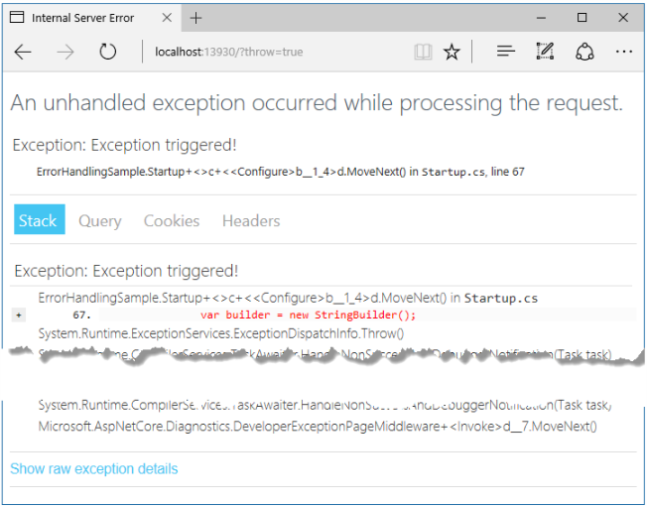
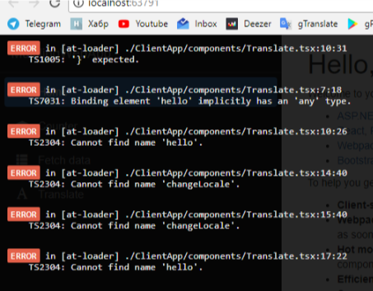
There are some built in handlers
Standard and The one we got

Slide 4
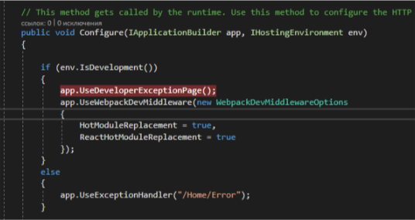
Code part
Are you surprised that you already got a error handler running? Don’t be so happy about it, it’s not all that kneet’n’shiny. Where were we, right, that’s where they are announced.

Slide 5
Some features
ASP.Net MVC apps have some additional options for handling errors, such as configuring exception filters and performing model validation.
Exception filters you might use in some specific situations when you have different scenarios for different incoming data, it should occur mostly within MVC actions, because it has less flexibility rather than error handling middleware.
Model validation occurs prior to each controller action being invoked, and it is the action method’s responsibility to inspect ModelState.IsValid and react appropriately. In many cases, the appropriate reaction is to return some kind of error response, ideally detailing the reason why model validation failed.

Slide 6
What about some third-party modules
Like ELMAH(H is silent) – heard of this one before? Bet you did, but what exactly does it do.
ELMAH stands for Error Logging Modules and Handlers, what does it mean.
It means that this module collect all of error logs data, and shows it to you in organized structure so you will understand where error leaks are happening, and where you should add some error handlers

Slide 7
That’s all folks!

