Slide 1
Analyzing the IT market in Tunisia
Kahouli Wajd
MR. Firas Hamila
Notes:
Hello,
Ladies and gentlemen welcome. Mr Sami. Mme Nahla Thank you for being here today
i m kahouli wajd, I m a 4th year software engineer and I work as a freelance unity developer for the mena region.
Now the main motivation for this project, I felt this is something that I personally needed and hopefully its going to be helpful for a lot of people.

Slide 2
Plan
01
02
03
04
Problematic
Solution and Methodology
Defining the issue and its current situation
Process and steps to achieve this project
Data Analysis
Realization
Visualization and interpretation of the Data
Interactive dashboard to display the results

Slide 3
Introduction
In today's dynamic work market, IT jobs represent around 37.31% of total jobs in Tunisia.
And the number of people interested in this sector is ever growing just like the number of new technologies and frameworks. Also digital platforms have revolutionized the way job offers are posted, searched, and analyzed.

Slide 4
01
Problematic
Defining the issue and its current situation

Slide 5

The unclear state and blurry future of the IT market
Determining the most in demand technologies or the future proof careers in Tunisia is a very complex task. It is difficult to answer these question :
Which IT domain is the most in demand ?
What are the trending technologies ?
Where are most IT jobs located ?
What are the IT jobs salaries expectations ?
Although there have been some attempts to solve this problem, they appear to miss the mark significantly

Slide 6
Current existing options
Period limited reports on the IT market
IT jobs posting platforms
Reports were made to visualize the shape of the IT market. However they are always limited to a certain period of time.
IT jobs in different domains are being posted all the time. With no tracking or whatsoever.

Slide 7
Solution and methodology
02
Process and steps to achieve this project

Slide 8
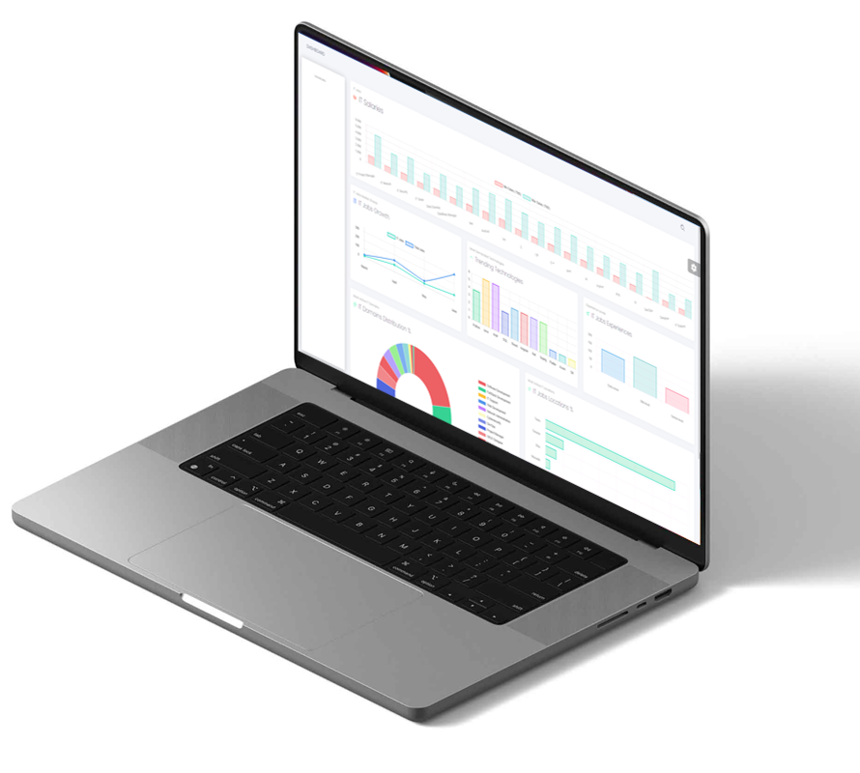
Solution : Analytical Dashboard
Modern
Up-to-date
Built with the latest technologies
Keeps track of the every day state of the IT market
Interactive
Insightful
Charts that are interactable for a better exploration
Based on multiple data sources and various chart types

Slide 9
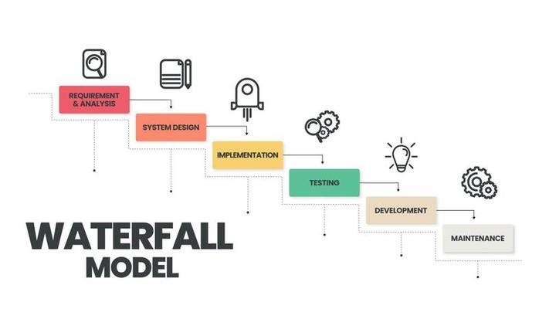
Methodology
Notes:
The waterfall model seems to be a perfect fit for this project since every process depends on the previous one

Slide 10
Project Process
Selecting Resources
Analyzing Data
Reliable, trusted and up-to-date
Reaching meaningful insights
Visualizing Data
Collecting and Cleaning Data
Presenting the data in various charts
Fetching and filtering the data

Slide 11




Technologies
Python
React JS
GitHub
VS Code
Notes:
Python for web scraping and fetching filtering data
React for the dashboard and charts implementation
Github for version control
Visual code as the coding environment

Slide 12



Data resources

Slide 13
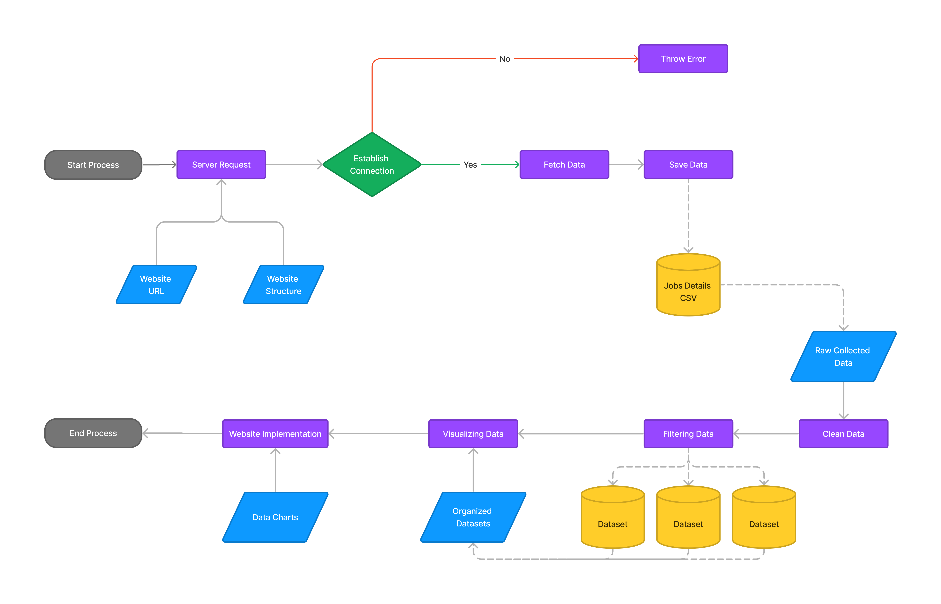
System flowchart

Slide 14
Data Analysis
03
Visualization and interpretation of the Data

Slide 15
Distribution of IT jobs in Tunisia
77%
11%
Tunis
6%
The capital seems to be a huge hub for IT companies
Sousse
The city is setting up a lot of investments in IT for the future
Sfax
Although being the second economical capital

Slide 16
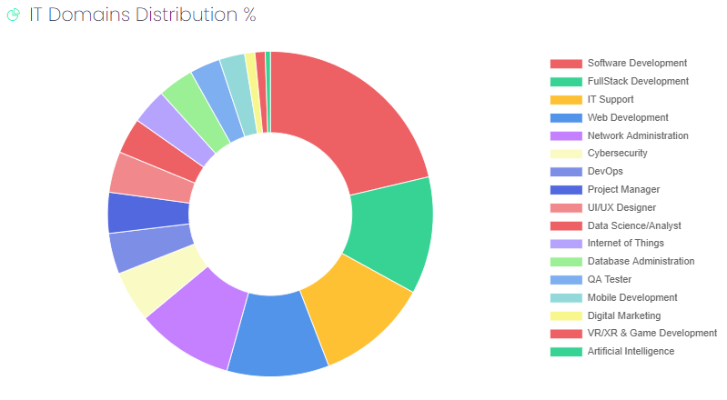
IT domains distribution

Slide 17
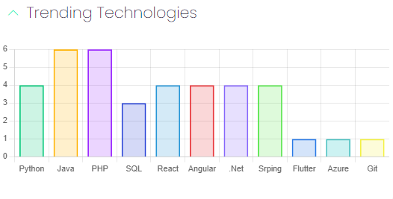
IT trending technologies

Slide 18
Realization
04
Interactive dashboard to display the results

Slide 19
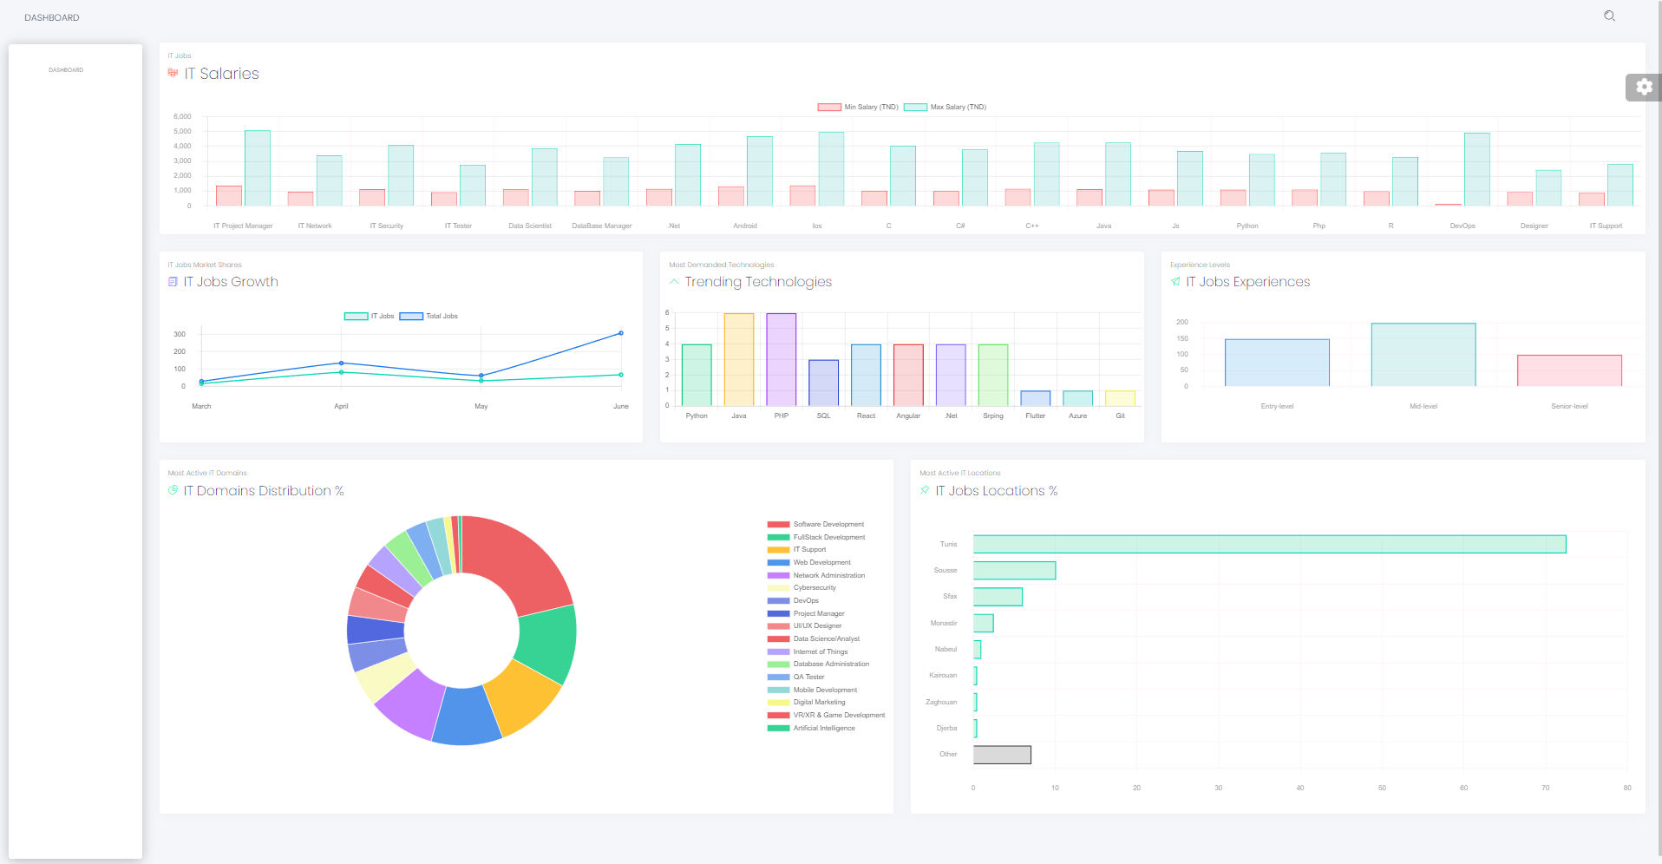

Slide 20
Conclusion
This project proves the potential of data analysis to better understand and predict the future of the IT market in Tunisia. Our platform's adaptability and scalability allow for continuous discovery and insight. We aim for it to become a key resource for IT professionals and students, guiding career decision.
- Future steps include collaborating with job sites for a larger database and adding custom analysis features.

Slide 21
Thank you.

