Slide 1
Windows Azure Storage
A Highly available cloud storage service with strong consistency
Calder, et al.
Presenters: Pankaja A. and Howie Benefiel

Slide 2
Topics
Introduction
Design features
WAS architecture
Stream layer
Partition layer
Application throughput
Workload Profiles
Design choices
Demo

Slide 3
Introduction
•WAS - Windows Azure Storage
•Scalable Cloud storage system, since 2008
•Store limitless amount of data
•Data accessible at all times
•Blobs, Tables and Queues
•Usage: social networking search, managing medical records
http://docs.nvidia.com/cuda/cuda-c-best-practices-guide/index.html
Notes:
WAS is a scalable cloud storage system that has been in prod since 2008.
It provides the customers the ability to store limitless amount of data for any duration of time.
WAS customers have access to their data from anywhere, at any time, and they only pay for what they use and store.
WAS provides cloud storage in the of Blobs(user files),Tables(structured storage) and Queues(message delivery).
Inside microsoft, this is used for applications such as social networking search, serving video, music and game content, managing medical records. In addition, there are thousands of customers outside MS using WAS and anyone can sign up over the internet to use WAS.

Slide 4
WAS design features
•Strong consistency, high availability,partition tolerance
•Global and scalable namespace/storage
•Disaster recovery
•Multi-tenancy and cost of storage.
http://docs.nvidia.com/cuda/cuda-c-best-practices-guide/index.html
Notes:
In the process of building WAS, feedback was taken from the external and internal customers and this influenced the design decisions.
-Especially enterprise customers moving their LOB to cloud. (CAP Theorem- A DS cannot have availability, consistency and partition tolerance at the same time.) WAS provides all at the same time.
-
-WAS implements a GNS that allows data to be stored and accessed in a consistent manner from any part of the world( more on the next slide).
-
-WAS stores customer data across multiple data centres – so this redundancy helps to recover the data in-case of disasters like earthquake
-To reduce/optimize the storage cost, many customers are served from the same shared storage infrastructure.

Slide 5
Global Partitioned Namespace
•Single global namespace
•Breaks the storage space into 3 parts -an account name, a partition name, and an object name
•http(s)://AccountName.1 .core.windows.net/PartitionName/ObjectName
Notes:
WAS provides a single global namespace that is scalable.
The storage space is broken down into 3 parts - an account name, a partition name, and an object name.
AccountName - customer selected account name for accessing storage and is part of the DNS host name. used to locate the primary storage cluster and data center where
the data is stored. This is the location where all requests for this account will goto.
PartitionName locates the data once a request reaches the storage cluster
When a PartitionName holds many objects, the ObjectName identifies individual objects within that partition.

Slide 6
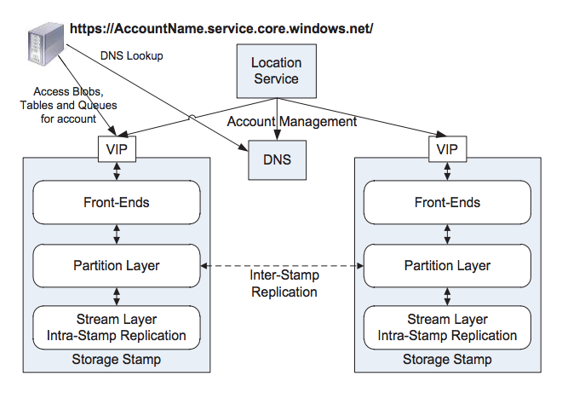
High-level Architecture
http://docs.nvidia.com/cuda/cuda-c-best-practices-guide/index.html
Notes:
When an application requests a new account for storing data, it specifies the location affinity for that storage(eg US north). The location service then chooses a storage stamp within the location as primary storage stamp for that account. The LS stores all the metadata for the account in that storage stamp so that the stamp can start accepting requests from the assigned account. The LS also updates the DNS so that any requests from this account will be routed to the VIP(virtual IP) is the resp storage stamp.

Slide 7
WAS Architecture
Storage stamps – is a cluster of N racks of storage nodes, holding upto 30PBs of data.
Location services – manages all the storage stamps and account namespaces across all stamps.
http://docs.nvidia.com/cuda/cuda-c-best-practices-guide/index.html
Notes:
Each cluster is typically 10-20 storage nodes.
Inorder to provide low cost cloud storage, the storage( in production) should be highly utilized as possible. The goal is to keep SS utilized upto 70% - avoid going above 80%- since 20% is kept reserve incase of rack failures.
Thus when the storage stamps reaches 70% utilization, the location services migrates account to a different stamps using inter stamp replication.
LS allocates accounts to storage stamps and manages them across storage stamps for disaster recovery and load balancing.
The LS has ability to add new regions, new locations to a region, new stamps to a location.

Slide 8
WAS Architecture
Three layers within a storage stamps:
Stream layer – Stores data, keeps the data durable within the stamp.
Partition layer - achieves scalability by partitioning all of the data objects within a stamp
Front-end layer - consists of a set of stateless servers that take incoming requests
http://docs.nvidia.com/cuda/cuda-c-best-practices-guide/index.html
Notes:
Stream layer stores the bits on disk and is in charge of distributing and replicating the data across many servers to keep data durable within a storage stamp. It understands files( which are streams ), how to store them, how to replicate them ect, but it does not understand the semantics. Data is stored in the stream layer and accessed from the partition layer.
Partition layer – understanding higher level abstractions, providing transaction ordering and strong consistency for objects, caching object data to reduce disk i/os.
responsibility of this layer is to achieve scalability by partitioning all of the data objects within a stamp. All objects have a partition name, and are served by different partition servers.
It is also responsible for automatic load balancing
The (FE) layer consists of a set of stateless servers that take incoming requests. Upon receiving a request, an FE looks up the AccountName, authenticates and authorizes the request, then routes the request to a partition server in the partition layer.

Slide 9
WAS Architecture
•Two replication engines:
•Intra stamp replication – provides synchronous replication. Performed by the stream layer.
•Inter stamp replication - provides asynchronous replication. Performed by the partition layer.
Notes:
Intra stamp replication - is focused on making sure all the data written into a stamp is kept durable within that stamp.
Intra-stamp replication is done completely by the stream layer and is on the critical path of the customer’s requests.
Inter stamp replication is focused on replicating data across stamps. This is done in the background and is NOT on the critical path of the customer’s requests.
Inter-stamp replication is focused on replicating objects and the transactions applied to those objects, whereas intra-stamp replication is focused on replicating blocks of disk storage that are used to make up the objects.

Slide 10
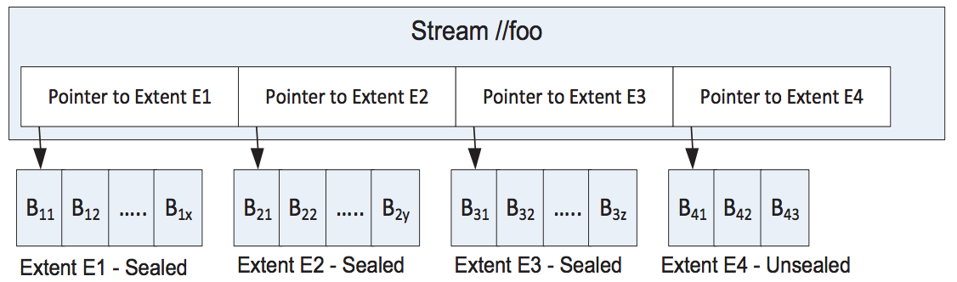
Stream Overview
A stream is an immutable ordered list of pointers which point to “extents”.
Looks like file to partition layer
An extent is an ordered list of blocks which are the fundamental unit of replication.
Blocks are the fundamental unit of data.
N bytes, e.g., 4 MB
http://docs.nvidia.com/cuda/cuda-c-best-practices-guide/index.html
Notes:
Talk about the structure of the stream and when an extent gets sealed

Slide 11
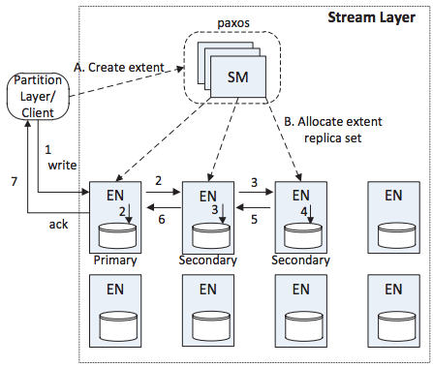
Stream Layer Architecture
Contract to client (partition layer) says:
if client gets ack on write request, all reads of that data will see same data
Once an entity is sealed, all subsequent reads of that entity will see same contents
Stream manager (SM) sends three replicas of entity to Entity Nodes (ENs)
http://docs.nvidia.com/cuda/cuda-c-best-practices-guide/index.html
Notes:
A. in diagram is when stream is first created
B. is SM choosing primary and secondary ENs
ENs for stream are cached with client, so writes and reads can go directly to ENs
ENs for stream are stored in the SM
SM - if the SM had to track blocks, it would be the bottleneck. This way it’s off the critical path.
uses erasure coding on sealed extents to avoid full replicas
Only tracks entities, not blocks
Responsible for intra-stamp replication
Reads from ANY REPLICA will see same data - strong consistency
SM handles sealing of extent.
the algorithm for sealing ensures that even if one EN has more data written than another, the client will only know that data was written to the sealed portion

Slide 12
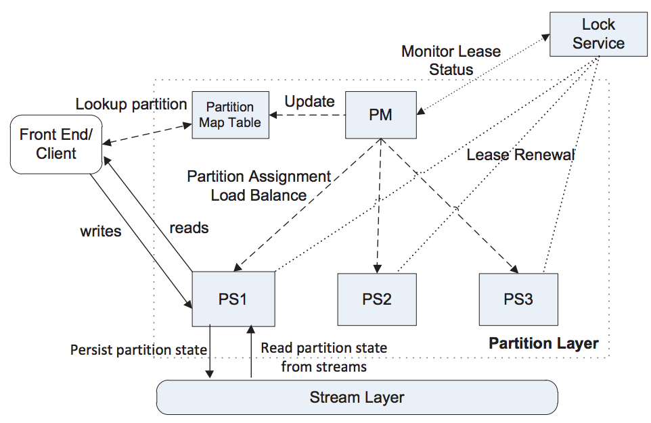
Partition Layer Components
Object Table (OT) - Contains data about objects
RangePartition (RP) - Non-overlapping partition of OT
Partition Manager (PM) - delegate RPs to Partition Servers
Partition Server (PS) - Serves requests for assigned RPs
Lock Service - Used to elect leader and ensure one PS per RP
http://docs.nvidia.com/cuda/cuda-c-best-practices-guide/index.html
Notes:
OT - Petabyte scale tables. One type of table for each type of object (blob, entity [table], and message table) plus operational tables (Partition Map Table is most important). Contains data for each object and in the case of the blob table, contains pointers to the data (entity + offset, length)
Partition Map Table contains which PS each RP is on
RP - non-overlapping segment of object table. Every row in OT is represented by at least one row in the RP.
PM - responsible for splitting OTs into RPs and load balancing RPs among PS. Each stamp has multiple PMs running, so one acquires lock to be leader.
PS - serves requests for objects in its RPs. Acquires lock on RP using LS to ensure strong consistency
LS - Paxos Lock Service which guarantees one leader and one PS per RP

Slide 13
Partition Layer Operation
RP composed of in-memory and persistent (stream layer) data structures
Data Flow
FE makes write request -> PL writes to commit log & stores write in cache -> return 200
If a RP becomes too large or too small, the RP is split or merged by the PM.
Partition layer handles asynchronous inter-stamp replication
http://docs.nvidia.com/cuda/cuda-c-best-practices-guide/index.html
Notes:
In-memory: bloom filter (to deny existence of object), cache of writes to stream layer
Persistent = writes to stream layer (commit log stream, blob stream, row stream)
Data Flow: Point out that once the in-memory cache gets to certain size, PL writes to checkpoint and flushes cache
After commit log and in-memory cache, you have persistent storage of the object, so client gets success then
When an account is created, a primary stamp is chosen in the desired region
One or more secondary stamps are chosen in a different region
Primary stamp will take live traffic and secondary stamp will take replication
Asynchronous so data loss is possible
30 seconds between replication polls

Slide 14
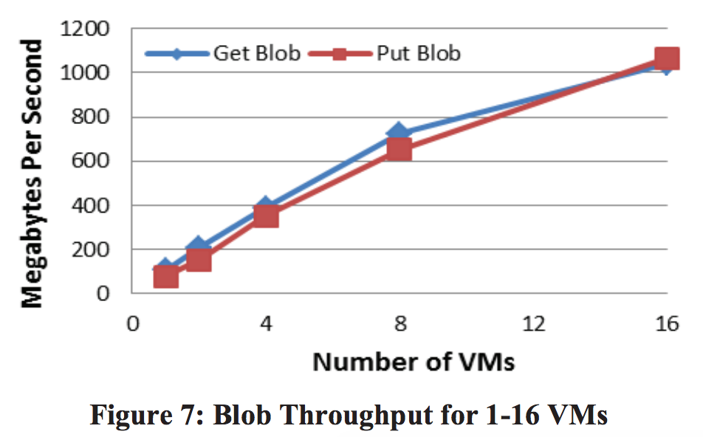
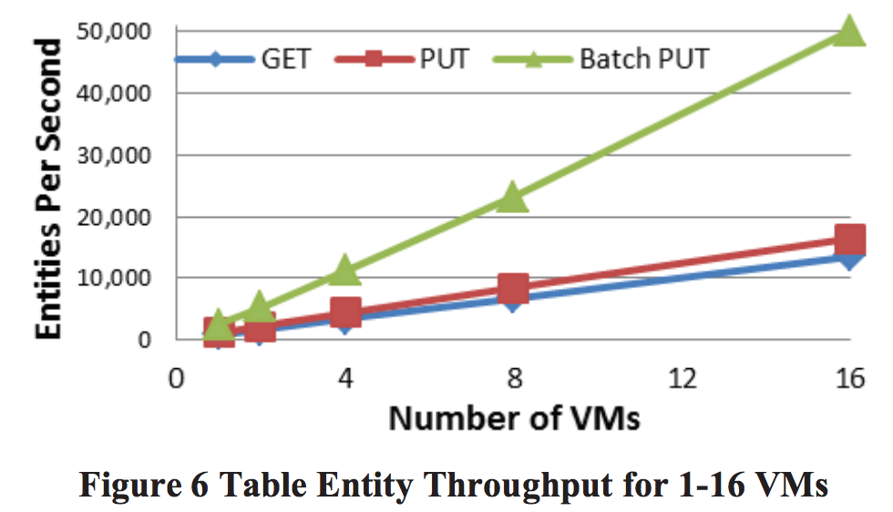
Application Throughput
http://docs.nvidia.com/cuda/cuda-c-best-practices-guide/index.html
Notes:
Overall explanation: Performance as number of clients makes random GET and PUT requests
Tested on production stamps and with customer clients
Left - Table throughput:
Batch PUT is 3x as fast because it minimizes number of network roundtrips
Scales linearly which is great
Right - Blob throughput:
Scales linearly up to 8 VMs. After 8 VMs, network is saturated client-side

Slide 15
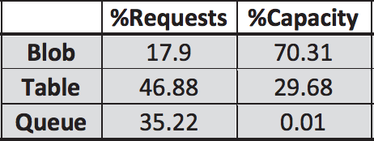
Workload Profiles
Powers the Zune music storage service!
Across four workload profiles:
http://docs.nvidia.com/cuda/cuda-c-best-practices-guide/index.html
Notes:
Blobs account for a minority of requests but a majority of capacity
Queues account for very little capacity because things are typically taken off a queue

Slide 16
Design choices
Scaling compute separately from storage
Range vs. Hash-based partitioning
Throttling
Automatic Load Balancing
Append-only stream layer is extremely important
Violates CAP theorem?
http://docs.nvidia.com/cuda/cuda-c-best-practices-guide/index.html
Notes:
Computer vs. Storage important because Redshift
Decided on range based partitioning because it allows them to co-locate one customer’s data in one partition (good sequentia reads)
Hash would’ve been good because you get load balancing for free
They had to build their own load balancing system
Too many accounts and partitions to keep track of which accounts are behaving badly, so they use a sample-and-hold algorithm to keep track of the top N accounts behaving the worst
Handled at the partition layer
Microsoft developed a bespoke algorithm to load balance RangePartitons based on load, capacity, CPU, network
They go to great lengths to emphasize how the append-only stream layer simplified the semantics of storage and recovery
They claim WAS provides strong consistency and high availability. This is in opposition to the CAP theorem.
Published before Cloud Spanner :P
Achieved through designing their failure modes to isolate network partition issues.
For instance, if a router fails (messages drop), that rack is immediately removed from the system which protects consistency and availability of the rest of the system

Slide 17
Demo
http://docs.nvidia.com/cuda/cuda-c-best-practices-guide/index.html
Notes:
export AZURE_STORAGE_ACCOUNT='howiedistributedpaper' AZURE_STORAGE_KEY='+XlsrP4pGyZBjA4KKmoCt4jHw1amwJTU0+0w2BP8WdDCATe1xbQrrXrqU2fQ5PiM8YhyQQyhrIs6hvCBVDEgcQ=='
az storage blob upload -f /root/.bash_profile -c whatever -n my_bash_profile
az storage table create -n papertable
az storage entity insert -t papertable -e PartitionKey=example-creation-creativities RowKey=howie Content=very_low
az storage entity show -t papertable --partition-key example-creation-creativities --row-key howie

Slide 18
Questions?
http://docs.nvidia.com/cuda/cuda-c-best-practices-guide/index.html

