Slide 1
A Distributed Algorithm for Spanning Trees
R. G. GALLAGER, P. A. HUMBLET, and P. M. SPIRA
present by Robert Pate and My Luc

Slide 2
Overview
Introduction
Spanning trees and the high level of MST algorithm
Description of MST distributed algorithm
Communication cost analysis
Time analysis
Notes:
Overview of the presentation.
Talk about spanning tree and the high level of the algorithm
Talk about the algorithm in detail
Then cost analysis and time analysis

Slide 3
Introduction
Connected undirected graph with N nodes and E edges (distinct weights)
Each node knows the weight its edges
Cost of sending message in both directions is the same
-> asynchronous distributed algorithm to determine the minimum-weight spanning tree (MST)
Notes:
Initially, we have a connected undirected graph with N nodes and E edges. Each edge has a distinct weight.
Each node knows the weight of each edge adjacent to that node.
The cost of transmitting message in both directions on the edge is the same
-> the paper describes an asynchronous distributed algorithm to determine the minimum-weight spanning tree (MST) of the graph.

Slide 4
Applications
Broadcast information in communication networks
Generate spanning tree from any node when network failure
Find highest number node in network
Notes:
Some applications mentioned in the paper:
-Distributed MST algorithms are useful in communication networks when we want to broadcast information from one node to all other nodes and there is a cost associated with each channel of the network
-With the change of topology that caused by failures in the network, it is desirable to generate a spanning tree starting from any node or subset of nodes.
-MST algorithm can be used to select the node in the network with the highest identity number.

Slide 5
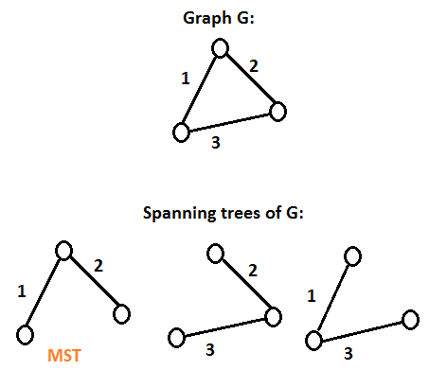
What is minimum spanning tree?
An undirected graph G = (V, E)
Spanning tree of G: a subset of the edges of G that connect all vertices without any cycle
Minimum spanning tree: a spanning tree with the minimum total edge weight
Notes:
A little review of a minimum spanning tree.
Initially we have a graph with nodes and edges
Spanning tree is a subset of edge that connect all the nodes without an cycle
Minimum spanning tree is a spanning tree with the minimum total edge weight (basically it is the cheapest way to visit all nodes)

Slide 6
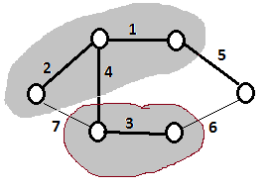
MST fragment
A fragment of MST: a subtree of the MST
Outgoing edge of a fragment if one adjacent node is in the fragment and the other is not.
Notes:
A fragment of an MST is defined as a subtree of the MST, that is, a connected set of nodes and edges of the MST
Outgoing edge is the edge that connects 2 nodes, 1 inside the fragment, 1 outside of the same fragment. In this case, edges with weight 4, 5,6,7 are outgoing edges.

Slide 7
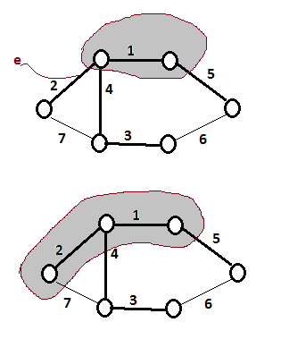
MST Property 1
Given a fragment of an MST, let e be a minimum-weight outgoing edge of the fragment. Then joining e and its adjacent nonfragment node to the fragment yields another fragment of an MST
Notes:
Property1 is saying: given a fragment, pick a smallest outgoing edge of the fragment, then combining that edge and the node that it is connecting to to form a another fragment

Slide 8
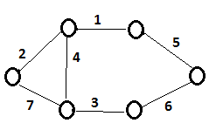
MST property 2
If all the edges of a connected graph have different weights, then the MST is unique.
Notes:
Property 2 is saying if all the edges have different weights, then the MST is unique.
Property 1 and 2 allow fragments to enlarge and combine.
There are different ways to create MST depending on the orders in which the fragments are enlarged and combined

Slide 9
Distributed MST
Each fragment finds its minimum-weight outgoing edge
Then it tries to combine the fragment at the other edge
How and when to combine depending on the levels of the two fragments
Notes:
In the algorithm,
each fragment finds its minimum-weight outgoing edge, then the fragment tries to combine with the fragment at the other end of the edge.
How and when this combination takes place depends on the levels of the two fragments, which depends on the previous fragment combinations.

Slide 10
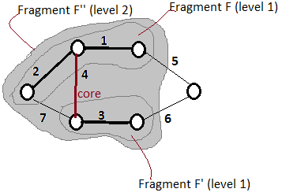
Distributed MST - Level
Fragment with single node has level 0
Fragment F (level L) wants to connect to fragment F’ (level L’):
If L < L’, F is absorbed as part of F’ becoming new fragment at level L’
If L = L’, F and F’ combine into new fragment at level L +1. Combining edge is called core of the new fragment.
Identity of fragment is the weight of its core
Notes:
Initially, fragment with single node is level 0
Basically, the rule is:
- If 2 fragments have the same level, after they combine, the level of the new combined fragment is the current level +1
- if 2 fragments have different levels, after they combine, the level the new combined fragment is the higher level between the 2.
The edge that combining 2 fragments is called core.
And the weight of the core edge is used as the identity of the fragment.

Slide 11
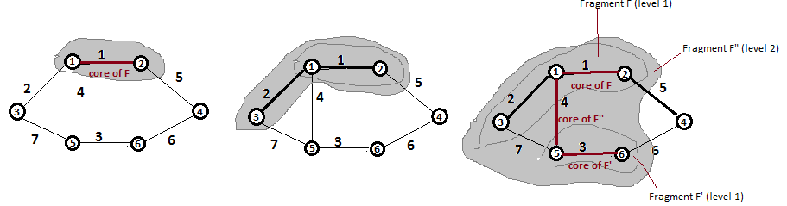
Distributed MST
Node 1 and node 2 combine on their common minimum weight edge
Node 3 and its minimum weight edge are then absorbed -> fragment F
Node 5 and node 6 combine on their common minimum weight edge -> fragment F’
F and F’ combine on their minimum weight edge to form level 2 fragment F’’
Node 4 can be absorbed to F or F’’ depending on the timing
Notes:
Here is an example of the algorithm in high level. Detail later.
- Initially, node 1 and node 2 are 2 fragments at level 0, they combine on their common minimum weight edge (which is the edge with weight 1 here) -> the new combined fragment now has level 1 (again the level increases by 1 when combining 2 fragments with the same level)
-Node 3 and its minimum weight edge then get absorbed -> the new combined fragment still has level 1
-Meanwhile, node 5 and 6 are also formed a new fragment with level 1.
-Then it will combine with the fragment that has node 1,2,and 3 to form a new fragment with level 2.
-Node 4 can be absorbed now to this big fragment or it could be absorbed earlier with the fragment of node 1,2,3 depending on the timing.

Slide 12
Part 3: Description - Wake a Single Node
4
Level 0
Awaken
Mark the shortest edge as a Branch
Send Connect (LN) to the node on it
LN is the node level, starts at 0
Change state to Found
1
Connect (0)
A
Branch
5

Slide 13
Part 3: Description - Two Nodes
4
Level 0
Level 0
Connect(0) wakes Node B
Repeat the previous wakeup process
Run the “On Receive Connect” Process:
Test if the sent level is less than current
Test if the edge is marked as basic
Else send Init(Level 1, Weight 1, Find)
1
Connect (0)
A
B
Init (1, 1, Find)
5
3

Slide 14
Part 3: Description - Two Nodes
4
Level 1
Level 1
Node A receives the Init() from B
Accepts Branch 1 as its fragment identity
Proceeds to Init() and Test() other edges
More on Test() in a minute!
1
A
B
Init (1, 1, Find)
5
3

Slide 15
Part 3: Description - Two Fragments and Initiate
Init(Level 1, Core ID 3, Find) sent across all branches of new core.
9
4
E
1 (core of A,B)
Level 0
8
6
A
B
5
2 (core of C,D)
Level 0
3 (new core)
Level 2
C
D
7

Slide 16
Part 3: Description - Find Min-Outgoing Edges
G
9
4
Basic
E
8
6
A
1
B
Basic
Find!
Branch
5
2
3 (core)
Level 2
C
D
Basic
Find!
Branch
F

Slide 17
Part 3: Description - Test Basic Branches
G
Test (Level 1, Core ID 3)
9
4
Basic
E
8
6
A
1
B
Basic
Find!
Branch
5
2
3 (core)
Level 2
C
D
Basic
Find!
Branch
F
(If the node is already part of the same fragment, the edge gets rejected)

Slide 18
Part 3: Description - Wake and Connect
Wake!
Connect (Level 0)
G
9
4
Wake!
Basic
E
8
6
A
1
B
Basic
Branch
5
2
3 (core)
Level 2
C
D
Basic
Branch
F

Slide 19
Part 3: Description - Init and Test
L1 !> LN0 so queue Test();
Receive Init(1, 3, Find)
Edge turns to Branch
G
9
4
Branch
E
8
6
A
1
B
Branch
Branch
5
2
3 (core)
Level 2
C
D
Basic
Branch
F

Slide 20
Part 3: Description - Test and Accept
The Init() causes more tests
The previous test gets an Accept()
Accept increments the level
G
9
4
Branch
E
8
6
A
1
B
Branch
Branch
5
2
3 (core)
Level 3
C
D
Basic
Branch
F

Slide 21
Part 3: Description - Test and Reject
The tests get a Reject reply
(Node is part of same fragment)
G
9
4
Branch
E
8
6
A
1
B
Branch
Branch
5
2
3 (core)
Level 4
C
D
Basic
Branch
F

Slide 22
Part 3: Description - Finding Outgoing Edge
G
Rejected
9
4
Branch
E
8
6
A
1
B
Rejected
Branch
Branch
5
2
3 (core)
Level 4
C
D
Best outgoing Edge
So Change Core
Branch
7 (core) Level 1
F
G

Slide 23
Part 3: Description - Finding Outgoing Edge
G
Rejected
9
4
Branch
E
8
6
A
1
B
Rejected
Branch
Branch
5
Branch
2
3
C
D
New Core
Branch
7
F
G
Branch

Slide 24
Part 4: Communication Cost - Weight
Components of most complex message:
One edge weight
A level between zero and log N
A bit representing message type

Slide 25
Part 4: Communication Cost - Count
Message Count
One rejection per edge and two messages per rejection
2E
Five Messages for levels besides first (zero) and last (log₂N)
Init, accept, successful-test, report, change-root/connect
5N(-1 + log N)
First and Last
First: Init, Connect
Last: Report
Both less than 5, so call it 5 for simplicity
Maximum:
5N log N + 2E

Slide 26
Part 5: Timing Analysis
Waking one at a time could lead to at worst N(N - 1) sequential messages
Waking all is better, N-1 time to wake all and 5N Log₂N to complete.
Worst case is a graph split equally into a handle and head: O (N log N)
N/2

Slide 27
Sampling of Related Papers 1
"O jistém problému minimálním" Jarník, V. (1930)
"Shortest connection networks And some generalizations" Prim, R. C. (1957)
"A note on two problems in connexion with graphs" Dijkstra, E. W. (1959)

Slide 28
Sampling of Related Papers 2
“Optimal Distributed Algorithms for Minimum Weight Spanning Tree, Counting, Leader Election and related problems” Awerbuch, Baruch (1987)
“A Highly Asynchronous Minimum Spanning Tree Protocol” Singh, Gurdip and Bernstein, Arthur J. (1995)
“Distributed Maintenance of a Spanning Tree using Labeled Tree Encoding” Garg, Vijay K. and Agarwal, Anurag (2005)

