Slide 1



Advanced Applications of Systems Modeling &Simulation
IE526
UTK/ISE
Dr. Xueping Li
University of Tennessee

Slide 2

What is Simulation?

Slide 3
Simulation Is …
Simulation – very broad term – methods and applications to imitate or mimic real systems, usually via computer
Applies in many fields, industries
Very popular, powerful
Book covers simulation in general, AnyLogic simulation software in particular
This chapter – general ideas, terminology, examples of applications, good/bad things, kinds of simulation, software options, how/when simulation is used

Slide 4
Systems
System – facility or process, actual or planned
Examples abound …
Manufacturing facility
Bank operation
Airport operations (passengers, security, planes, crews, baggage)
Transportation/logistics/distribution operation
Hospital facilities (emergency room, operating room, admissions)
Computer network
Freeway system
Business process (insurance office)
Criminal justice system
Chemical plant
Fast-food restaurant
Supermarket
Theme park
Emergency-response system
Shipping ports, berths
Military combat, logistics

Slide 5
See some examples?

Slide 6
Work With the System?
Study system – measure, improve, design, control
Maybe just play with actual system
Advantage — unquestionably looking at the right thing
But often impossible in reality with actual system
System doesn’t exist
Would be disruptive, expensive, dangerous

Slide 7
Models
Model – set of assumptions/approximations about how system works
Study model instead of real system … usually much easier, faster, cheaper, safer
Can try wide-ranging ideas with model
Make your mistakes on the computer where they don’t count, rather than for real where they do count
Often, just building model is instructive – regardless of results
Model validity (any kind of model … not just simulation)
Care in building to mimic reality faithfully
Level of detail
Get same conclusions from model as you would from system
More in Chapter 13

Slide 8
Types of Models
Physical (iconic) models
Tabletop material-handling models
Mock-ups of fast-food restaurants
Flight simulators
Logical (mathematical) models
Approximations, assumptions about system’s operation
Often represented via computer program in appropriate software
Exercise program to try things, get results, learn about model behavior

Slide 9
Studying Logical Models
If model is simple enough, use traditional mathematical analysis … get exact results, lots of insight into model
Queueing theory
Differential equations
Linear programming
But complex systems can seldom be validly represented by simple analytic model
Danger of over-simplifying assumptions … model validity?
Type III error – working on the wrong problem
Often, complex system requires complex model, analytical methods don’t apply … what to do?

Slide 10
Computer Simulation
Methods for studying wide variety of models of systems
Numerically evaluate on computer
Use software to imitate system’s operations, characteristics, often over time
Can use to study simple models, but should not use if an analytical solution is available
Real power of simulation – studying complex models
Simulation can tolerate complex models since we don’t even aspire to an analytical solution

Slide 11
Popularity of Simulation
Has been consistently ranked as the most useful, popular tool in broader area of operations research / management science
1978: M.S. graduates of CWRU O.R. Department … after graduation
1. Statistical analysis
2. Forecasting
3. Systems Analysis
4. Information systems
5. Simulation
1979: Survey 137 large firms, which methods used?
1. Statistical analysis (93% used it)
2. Simulation (84%)
3. Followed by LP, PERT/CPM, inventory theory, NLP, …

Slide 12
Popularity of Simulation (cont’d.)
1980: (A)IIE O.R. division members
First in utility and interest — simulation
First in familiarity — LP (simulation was second)
1983, 1989, 1993: Longitudinal study of corporate practice
1. Statistical analysis
2. Simulation
1989: Survey of surveys
Heavy use of simulation consistently reported
Since these surveys, hardware/software have improved, making simulation even more attractive
Historical impediment to simulation – computer speed

Slide 13
Advantages of Simulation
Flexibility to model things as they are (even if messy and complicated)
Avoid looking where the light is (a morality play):
Allows uncertainty, nonstationarity in modeling
The only thing that’s for sure: nothing is for sure
Danger of ignoring system variability
Model validity
You’re walking along in the dark and see someone on hands and knees searching the ground under a street light.
You: “What’s wrong? Can I help you?”
Other person: “I dropped my car keys and can’t find them.”
You: “Oh, so you dropped them around here, huh?”
Other person: “No, I dropped them over there.” (Points into the darkness.)
You: “Then why are you looking here?”
Other person: “Because this is where the light is.”

Slide 14
Advantages of Simulation (cont’d.)
Advances in computing/cost ratios
Estimated that 75% of computing power is used for various kinds of simulations
Dedicated machines (e.g., real-time shop-floor control)
Advances in simulation software
Far easier to use (GUIs)
No longer as restrictive in modeling constructs (hierarchical, down to C)
Statistical design & analysis capabilities

Slide 15
The Bad News
Don’t get exact answers, only approximations, estimates
Also true of many other modern methods
Can bound errors by machine roundoff
Get random output (RIRO) from stochastic simulations
Statistical design, analysis of simulation experiments
Exploit: noise control, replicability, sequential sampling, variance-reduction techniques
Catch: “standard” statistical methods seldom work

Slide 16
Different Kinds of Simulation
Static vs. Dynamic
Does time have a role in model?
Continuous-change vs. Discrete-change
Can “state” change continuously, or only at discrete points in time?
Deterministic vs. Stochastic
Is everything for sure or is there uncertainty?
Most operational models:
Dynamic, Discrete-change, Stochastic
But Chapter 2 discusses one static model
And Chapter 11 discusses continuous and combined discrete-continuous models

Slide 17


Simulation by Hand: The Buffon Needle Problem
Estimate π (George Louis Leclerc, c. 1733)
Toss needle of length l onto table with stripes d (>l) apart
P (needle crosses a line) =
Repeat; tally = proportion of times a line is crossed
Estimate π by
Just for fun:
http://www.mste.uiuc.edu/reese/buffon/bufjava.html
http://www.angelfire.com/wa/hurben/buff.html

Slide 18
Why Toss Needles?
Buffon needle problem seems silly now, but has important simulation features:
Experiment to estimate something hard to compute exactly (in 1733)
Randomness, so estimate will not be exact; estimate the error in the estimate
Replication (the more the better) to reduce error
Sequential sampling to control error — keep tossing until probable error in estimate is “small enough”
Variance reduction (Buffon Cross)

Slide 19
Using Computers to Simulate
General-purpose languages (C, C++, C#, Java, Matlab, FORTRAN, others)
Tedious, low-level, error-prone
But, almost complete flexibility
Support packages for general-purpose languages
Subroutines for list processing, bookkeeping, time advance
Widely distributed, widely modified
Spreadsheets
Usually static models (only very simple dynamic models)
Financial scenarios, distribution sampling, SQC
Examples in Chapter 2 (one static, one dynamic)
Add-ins are available (@RISK, Crystal Ball)

Slide 20
Using Computers to Simulate (cont’d.)
Simulation languages
GPSS, SLX, SIMAN (on which Arena is based, included in Arena)
Popular, some still in use
Learning curve for features, effective use, syntax
High-level simulators
Very easy, graphical interface
Domain-restricted (manufacturing, communications)
Limited flexibility — model validity?

Slide 21
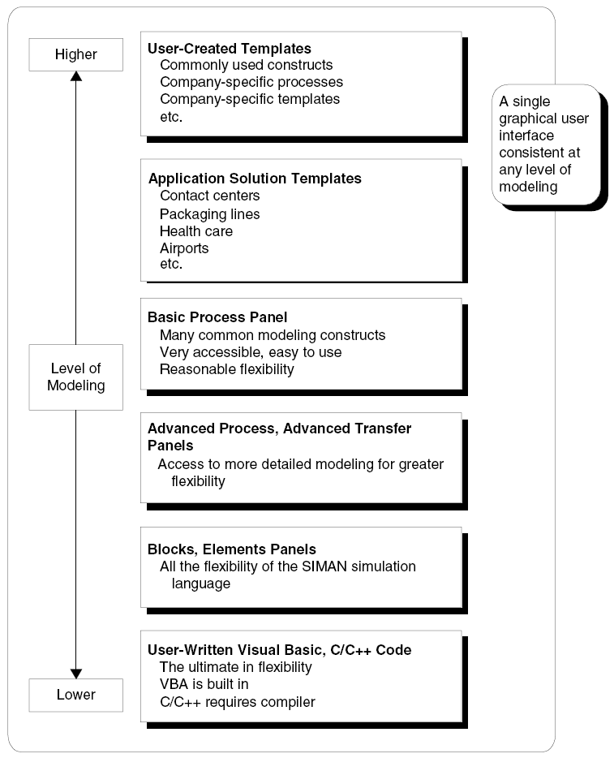
Where Arena/AnyLogic Fits In
Hierarchical structure
Multiple levels of modeling
Mix different modeling levels together in same model
Often, start high then go lower as needed
Get ease-of-use advantage of simulators without sacrificing modeling flexibility

Slide 22
How about AnyLogic?
Java based

Slide 23
When Simulations are Used
Use of simulation has evolved with hardware, software
Early years (1950s – 1960s)
Very expensive, specialized tool
Required big computers, special training
Mostly in FORTRAN (or even Assembler)
Processing cost as high as $1000/hour for a sub-PC level machine

Slide 24
When Simulations are Used (cont’d.)
Formative years (1970s – early 1980s)
Computers got faster, cheaper
Value of simulation more widely recognized
Simulation software improved, but still languages to be learned, typed, batch processed
Often used to clean up “disasters” in auto, aerospace industries
Car plant; heavy demand for certain model
Line underperforming
Simulated, problem identified
But demand had dried up — simulation was too late

Slide 25
When Simulations are Used (cont’d.)
Recent past (late 1980s – mid 2000s)
Microcomputer power
Software expanded into GUIs, animation
Wider acceptance across more areas
Traditional manufacturing applications
Services
Health care
“Business processes”
Still mostly in large firms
Simulation is often part of “specs”

Slide 26
When Simulations are Used (cont’d.)
Present
Proliferating into smaller firms
Becoming a standard tool
Being used earlier in design phase
Real-time control
Simulation & Big Data & AI
Future
Integration with other applications for visualization, analysis
Networked sharing of data in real time
Internet-enabled distributed model building, execution
Specialized vertical “templates” for specific industries, firms
Better model re-usability, operational decision making
Automated statistical design, analysis

Slide 27
Demo
Supply Chain, Transportation & Logistics
Healthcare
Marketplace & competition
Manufacturing & Business Processes
Social Dynamics
Military & Defense
Games & Fun
…

