Slide 1


Fundamental Simulation Concepts
Dr. Xueping Li
University of Tennessee

Slide 2
What We’ll Do ...
Underlying ideas, methods, and issues in simulation
Software-independent (setting up for AnyLogic)
Example of a simple processing system
Decompose problem
Terminology
Simulation by hand
Some basic statistical issues
Spreadsheet simulation
Simple static, dynamic models
Overview of a simulation study

Slide 3
The System: A Simple Processing System
Machine
(Server)
Arriving
Blank Parts
Departing
Finished Parts
7
6
5
4
Queue (FIFO)
Part in Service
General intent:
Estimate expected production
Waiting time in queue, queue length, proportion of time machine is busy
Time units
Can use different units in different places … must declare
Be careful to check units when specifying inputs
Declare base time units for internal calculations, outputs
Be reasonable (interpretation, roundoff error)

Slide 4
Model Specifics
Initially (time 0) empty and idle
Base time units: minutes
Input data (assume given for now …), in minutes:
Part Number Arrival Time Interarrival Time Service Time
1 0.00 1.73 2.90
2 1.73 1.35 1.76
3 3.08 0.71 3.39
4 3.79 0.62 4.52
5 4.41 14.28 4.46
6 18.69 0.70 4.36
7 19.39 15.52 2.07
8 34.91 3.15 3.36
9 38.06 1.76 2.37
10 39.82 1.00 5.38
11 40.82 . .
. . . .
. . . .
Stop when 20 minutes of (simulated) time have passed
Notes:
Production within 20 minutes = 5 parts; / 5
Average Waiting Time in Queue = 2.49 mins /

Slide 5
Goals of Study: Output Performance Measures
Total production of parts over run (P)
Average waiting time of parts in queue:
Maximum waiting time of parts in queue:
N = no. of parts completing queue wait
WQ_{i} = waiting time in queue of ith part
Know: WQ₁ = 0 (why?)
N > 1 (why?)

Slide 6
Goals of Study: Output Performance Measures (cont’d.)
Time-average number of parts in queue:
Maximum number of parts in queue:
Average and maximum total time in system of parts (a.k.a. cycle time):
Q(t) = number of parts in queue
at time t
TS_{i} = time in system of part i

Slide 7
Goals of Study: Output Performance Measures (cont’d.)
Utilization of machine (proportion of time busy)
Many others possible (information overload?)

Slide 8
Analysis Options
Educated guessing
Average interarrival time = 4.08 minutes
Average service time = 3.46 minutes
So (on average) parts are being processed faster than they arrive
System has a chance of operating in a stable way in long run, i.e., might not “explode”
If all interarrivals and service times were exactly at their mean, there would never be a queue
But data clearly exhibit variability, so a queue could form
If we’d had average interarrival < average service time, and this persisted, then queue would explode
Truth — between these extremes
Guessing has its limits …

Slide 9
Analysis Options (cont’d.)
Queueing theory
Requires additional assumptions about model
Popular, simple model: M/M/1 queue
Interarrival times ~ exponential
Service times ~ exponential, indep. of interarrivals
Must have E(service) < E(interarrival)
Steady-state (long-run, forever)
Exact analytic results; e.g., average waiting time in queue is
Problems: validity, estimating means, time frame
Often useful as first-cut approximation

Slide 10
Mechanistic Simulation
Individual operations (arrivals, service times) will occur exactly as in reality
Movements, changes occur at right “times,” in right order
Different pieces interact
Install “observers” to get output performance measures
Concrete, “brute-force” analysis approach
Nothing mysterious or subtle
But a lot of details, bookkeeping
Simulation software keeps track of things for you

Slide 11
Pieces of a Simulation Model
Entities
“Players” that move around, change status, affect and are affected by other entities
Dynamic objects — get created, move around, leave (maybe)
Usually represent “real” things
Our model: entities are parts
Can have “fake” entities for modeling “tricks”
Breakdown demon, break angel
Though Arena has built-in ways to model these examples directly
Usually have multiple realizations floating around
Can have different types of entities concurrently
Usually, identifying types of entities is first thing to do in building model

Slide 12
Pieces of a Simulation Model (cont’d.)
Attributes
Characteristic of all entities: describe, differentiate
All entities have same attribute “slots” but different values for different entities, for example:
Time of arrival
Due date
Priority
Color
Attribute value tied to a specific entity
Like “local” (to entities) variables
Some automatic in Arena, some you define

Slide 13
Pieces of a Simulation Model (cont’d.)
(Global) Variables
Reflects a characteristic of whole model, not of specific entities
Used for many different kinds of things
Travel time between all station pairs
Number of parts in system
Simulation clock (built-in Arena variable)
Name, value of which there’s only one copy for whole model
Not tied to entities
Entities can access, change variables
Writing on wall (rewriteable)
Some built-in by Arena, you can define others. (You always define your own in AnyLogic)

Slide 14
Pieces of a Simulation Model (cont’d.)
Resources
What entities compete for
People
Equipment
Space
Entity seizes a resource, uses it, releases it
Think of a resource being assigned to an entity, rather than an entity “belonging to” a resource
“A” resource can have several units of capacity
Seats at a table in a restaurant
Identical ticketing agents at an airline counter
Number of units of resource can be changed during simulation

Slide 15
Pieces of a Simulation Model (cont’d.)
Queues
Place for entities to wait when they can’t move on (maybe since resource they want to seize is not available)
Have names, often tied to a corresponding resource
Can have a finite capacity to model limited space — have to model what to do if an entity shows up to a queue that’s already full
Usually watch length of a queue, waiting time in it

Slide 16
Pieces of a Simulation Model (cont’d.)
Statistical accumulators
Variables that “watch” what’s happening
Depend on output performance measures desired
“Passive” in model — don’t participate, just watch
Many are automatic in Arena, but some you may have to set up and maintain during simulation
At end of simulation, used to compute final output performance measures

Slide 17
Pieces of a Simulation Model (cont’d.)
Statistical accumulators for simple processing system
Number of parts produced so far
Total of waiting times spent in queue so far
No. of parts that have gone through queue
Max time in queue we’ve seen so far
Total of times spent in system
Max time in system we’ve seen so far
Area so far under queue-length curve Q(t)
Max of Q(t) so far
Area so far under server-busy curve B(t)

Slide 18
Simulation Dynamics: Event-Scheduling “World View”
Identify characteristic events
Decide on logic for each type of event to:
Effect state changes for each event type
Observe statistics
Update times of future events (maybe of this type, other types)
Keep a simulation clock, future event calendar
Jump from one event to the next, process, observe statistics, update event calendar
Must specify an appropriate stopping rule
Usually done with general-purpose programming language (C++, Java, Matlab, FORTRAN, etc.)

Slide 19
Events for the Simple Processing System
Arrival of a new part to system
Update time-persistent statistical accumulators (from last event to now)
Area under Q(t)
Max of Q(t)
Area under B(t)
“Mark” arriving part with current time (use later)
If machine is idle:
Start processing (schedule departure), Make machine busy, Tally waiting time in queue (0)
Else (machine is busy):
Put part at end of queue, increase queue-length variable
Schedule next arrival event

Slide 20
Events for the Simple Processing System (cont’d.)
Departure (when a service is completed)
Increment number-produced stat accumulator
Compute & tally time in system (now – time of arrival)
Update time-persistent statistics (as in arrival event)
If queue is non-empty:
Take first part out of queue, compute & tally its waiting time in queue, begin service (schedule departure event)
Else (queue is empty):
Make machine idle (Note: there will be no departure event scheduled on future events calendar, which is as desired)

Slide 21
Events for the Simple Processing System (cont’d.)
The End
Update time-persistent statistics (to end of simulation)
Compute final output performance measures using current (= final) values of statistical accumulators
After each event, event calendar’s top record is removed to see what time it is, what to do
Also must initialize everything

Slide 22
Some Additional Specifics for the Simple Processing System
Simulation clock variable (internal in Arena)
Event calendar: list of event records:
[Entity No., Event Time, Event Type]
Keep ranked in increasing order on Event Time
Next event always in top record
Initially, schedule first Arrival, The End (Dep.?)
State variables: describe current status
Server status B(t) = 1 for busy, 0 for idle
Number of customers in queue Q(t)
Times of arrival of each customer now in queue (a list of random length)

Slide 23
Simulation by Hand
Manually track state variables, statistical accumulators
Use “given” interarrival, service times
Keep track of event calendar
“Lurch” clock from one event to next
Will omit times in system, “max” computations here (see text for complete details)

Slide 24
Simulation by Hand: Setup

Slide 25
Simulation by Hand: t = 0.00, Initialize

Slide 26
Simulation by Hand: t = 0.00, Arrival of Part 1
1

Slide 27
Simulation by Hand: t = 1.73, Arrival of Part 2
2
1

Slide 28
Simulation by Hand: t = 2.90, Departure of Part 1
2

Slide 29
Simulation by Hand: t = 3.08, Arrival of Part 3
3
2

Slide 30
Simulation by Hand: t = 3.79, Arrival of Part 4
4
3
2

Slide 31
Simulation by Hand: t = 4.41, Arrival of Part 5
5
4
3
2

Slide 32
Simulation by Hand: t = 4.66, Departure of Part 2
5
4
3

Slide 33
Simulation by Hand: t = 8.05, Departure of Part 3
5
4

Slide 34
Simulation by Hand: t = 12.57, Departure of Part 4
5

Slide 35
Simulation by Hand: t = 17.03, Departure of Part 5

Slide 36
Simulation by Hand: t = 18.69, Arrival of Part 6
6

Slide 37
Simulation by Hand: t = 19.39, Arrival of Part 7
7
6

Slide 38
Simulation by Hand: t = 20.00, The End
7
6

Slide 39
Simulation by Hand: Finishing Up
Average waiting time in queue:
Time-average number in queue:
Utilization of drill press:

Slide 40
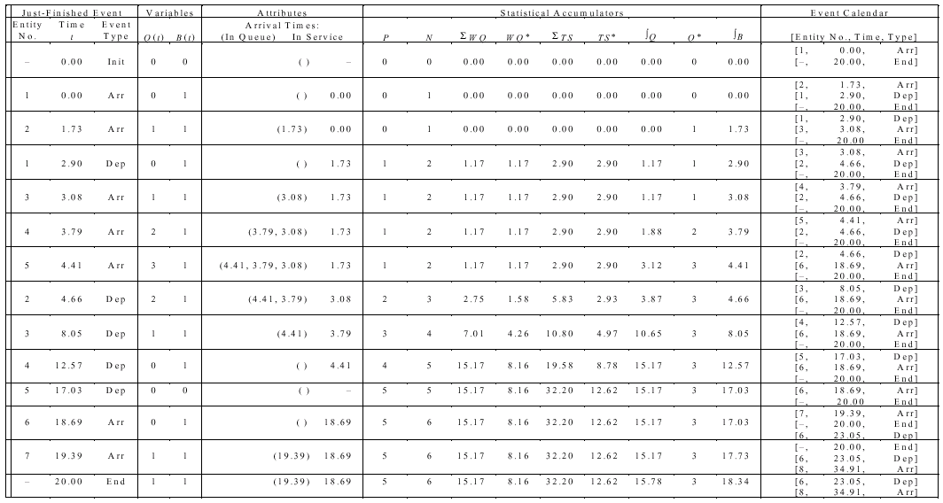
Complete Record of the Hand Simulation

Slide 41
Event-Scheduling Logic via Programming
Clearly well suited to standard programming language (C, C++, Java, etc.)
Often use “utility” libraries for:
List processing
Random-number generation
Random-variate generation
Statistics collection
Event-list and clock management
Summary and output
Main program ties it together, executes events in order

Slide 42
Simulation Dynamics: Process-Interaction World View
Identify characteristic entities in system
Multiple copies of entities co-exist, interact, compete
“Code” is non-procedural
Tell a “story” about what happens to a “typical” entity
May have many types of entities, “fake” entities for things like machine breakdowns
Usually requires special simulation software
Underneath, still executed as event-scheduling
View normally taken by Arena
Arena translates your model description into a program in SIMAN simulation language for execution

Slide 43
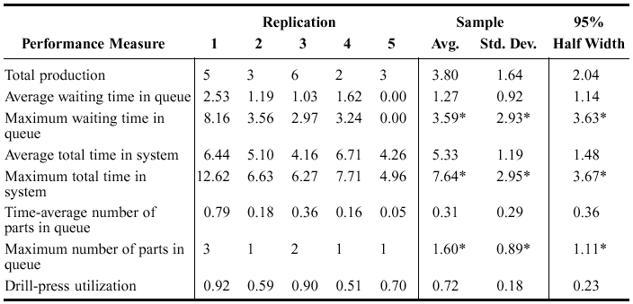
Randomness in Simulation
Above was just one “replication” — a sample of size one (not worth much)
Made a total of five replications (IID):
Confidence intervals for expected values:
In general, (normality assumption?)
For expected total production,
Substantial variability across replications
Precision?

Slide 44
Comparing Alternatives
Usually, simulation is used for more than just a single model “configuration”
Often want to compare alternatives, select or search for best (via some criterion)
Simple processing system: What would happen if arrival rate doubled?
Cut interarrival times in half
Rerun model for double-time arrivals
Make five replications

Slide 45
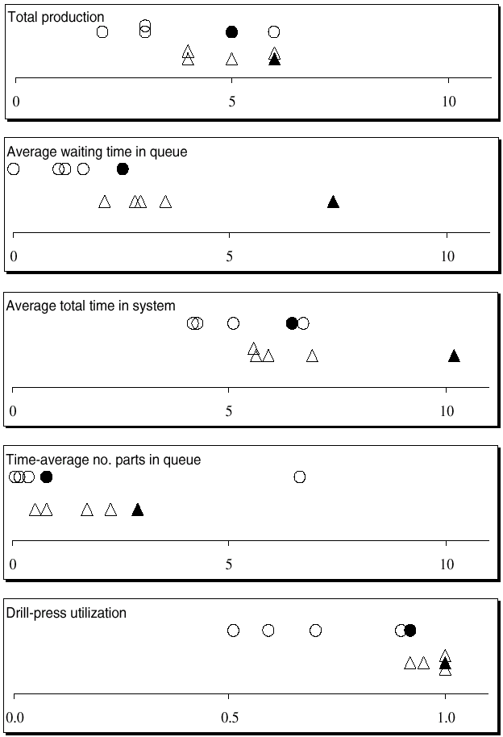
Results: Original vs. Double-Time Arrivals
Original – circles
Double-time – triangles
Replication 1 – filled in
Replications 2-5 – hollow
Note variability
Danger of making decisions based on one (first) replication
Hard to see if there are really differences
Need: Statistical analysis of simulation output data

Slide 46
Simulating with Spreadsheets: Introduction
Popular, ubiquitous tool
Can use for simple simulation models
Typically, only static models
Risk analysis, financial/investment scenarios
Only (very) simplest of dynamic models
Two examples
Newsvendor problem (static)
Waiting times in single-server queue (dynamic)
Special recursion valid only in this case

Slide 47
Simulating with Spreadsheets: Newsvendor Problem – Setup
Rupert sells daily newspapers on street
Rupert buys for c = $0.55 each, sells for r = $1.00 each
Each morning, Rupert buys q copies
q is a fixed number, same every day
Demand during a day: D = max (⎣X⎤, 0)
X ~ normal (μ = 135.7, σ = 27.1), from historical data
⎣X⎤ rounds X to nearest integer
If D ≤ q, satisfy all demand, and q – D ≥ 0 left over, sell for scrap at s = $0.03 each
If D > q, sells out (sells all q copies), no scrap
But missed out on D – q > 0 sales
What should q be?

Slide 48
Simulating with Spreadsheets: Newsvendor Problem – Formulation
Choose q to maximize expected profit per day
q too small – sell out, miss $0.45 profit per paper
q too big – have left over, scrap at a loss of $0.52 per paper
Classic operations-research problem
Many versions, variants, extensions, applications
Much research on exact solution in certain cases
But easy to simulate, even in a spreadsheet
Profit in a day, as a function of q:
W(q) = r min (D, q) + s max (q – D, 0) – cq
W(q) is a random variable – profit varies from day to day
Maximize E(W(q)) over nonnegative integers q
Sales revenue
Scrap revenue
Cost

Slide 49
Simulating with Spreadsheets: Newsvendor Problem – Simulation
Set trial value of q, generate demand D, compute profit for that day
Then repeat this for many days independently, average to estimate E(W(q))
Also get confidence interval, estimate of P(loss), histogram of W(q)
Try for a range of values of q
Need to generate demand D = max (⎣X⎤, 0)
So need to generate X ~ normal (μ = 135.7, σ = 27.1)
(Much) ahead – Sec. 12.2, generating random variates
In this case, generate X = Φ_{μ,σ}(U)
U is a random number distributed uniformly on [0, 1] (Sec. 12.1)
Φ_{μ,σ} is cumulative distribution function of normal (μ, σ) distribution
1

Slide 50
Simulating with Spreadsheets: Newsvendor Problem – Excel
File Newsvendor.xls
Input parameters in cells B4 – B8 (blue)
Trial values for q in row 2 (pink)
Day number (1, 2, ..., 30) in column D
Demands in column E for each day:
= MAX(ROUND(NORMINV(RAND(), $B$7, $B$8), 0), 0)
Rounding
function
Φ ^{1}
U(0, 1)
random number
μ
σ
RAND() is “volatile” so regenerates on any edit, or F9 key
X ~ normal (μ, σ)
Round to nearest
integer
$ pins down following column or row when copying formula
MAX 2nd
argument

Slide 51
Simulating with Spreadsheets: Newsvendor Problem – Excel (cont’d.)
For each q:
“Sold” column: number of papers sold that day
“Scrap” column: number of papers scrapped that day
“Profit” column: profit (+, –, 0) that day
Placement of “$” in formulas to facilitate copying
At bottom of “Profit” columns (green):
Average profit over 30 days
Half-width of 95% confidence interval on E(W(q))
Value 2.045 is upper 0.975 critical point of t distribution with 29 d.f.
Plot confidence intervals as “I-beams” on left edge
Estimate of P(W(q) < 0)
Uses COUNTIF function
Histograms of W(q) at bottom
Vertical red line at 0, separates profits, losses

Slide 52
Simulating with Spreadsheets: Newsvendor Problem – Results
Fine point – used same daily demands (column E) for each day, across all trial values of q
Would have been valid to generate them independently
Why is it better to use same demands for all q?
Results
Best q is about 140, maybe a little less
Randomness in all results (tap F9 key)
All demands, profits, graphics change
Confidence-interval, histogram plots change
Reminder that these are random outputs, random plots
Higher q ⇒ more variability in profit
Histograms at bottom are wider for larger q
Higher chance of both large profits, but higher chance of loss, too
Risk/return tradeoff can be quantified – risk taker vs. risk-averse

Slide 53
Simulating with Spreadsheets: Single-Server Queue – Setup
Like hand simulation, but:
Interarrival times ~ exponential with mean 1/λ = 1.6 min.
Service times ~ uniform on [a, b] = [0.27, 2.29] min.
Stop when 50th waiting time in queue is observed
i.e., when 50th customer begins service, not exits system
Watch waiting times in queue WQ₁, WQ₂, ..., WQ₅₀
Important – not watching anything else, unlike before
S_{i} = service time of customer i, A_{i} = interarrival time between custs. i – 1 and i
Lindley’s recursion (1952): Initialize WQ₁ = 0,
WQ_{i} = max (WQ_{i – 1} + S_{i – 1} – A_{i}, 0), i = 2, 3, ...

Slide 54
Simulating with Spreadsheets: Single-Server Queue – Simulation
Need to generate random variates: let U ~ U[0, 1]
Exponential (mean 1/λ): A_{i} = –(1/λ) ln(1 – U)
Uniform on [a, b]: S_{i} = a + (b – a) U
File MU1.xls
Input parameters in cells B4 – B6 (blue)
Some theoretical outputs in cells B8 – B10
Customer number (i = 1, 2, ..., 50) in column D
Five IID replications (three columns for each)
IA = interarrival times, S = service times
WQ = waiting times in queue (plot, thin curves)
First one initialized to 0, remainder use Lindley’s recursion
Curves rise from 0, variation increases toward right
Creates positive autocorrelation down WQ columns
Curves have less abrupt jumps than if WQ_{i}’s were independent

Slide 55
Simulating with Spreadsheets: Single-Server Queue – Results
Column averages (green)
Average interarrival, service times close to expectations
Average WQ_{i} within each replication
Not too far from steady-state expectation
Considerable variation
Many are below it (why?)
Cross-replication (by customer) averages (green)
Column T, thick line in plot to dampen noise
Why no sample variance, histograms of WQ_{i}’s?
Could have computed both, as in newsvendor; two issues:
Nonstationarity – what is a “typical” WQ_{i} here?
Autocorrelation – biases variance estimate, may bias histogram if run is not “long enough”

Slide 56
Simulating with Spreadsheets: Recap
Popular for static models
Add-ins – @RISK, Crystal Ball
Inadequate tool for dynamic simulations if there’s any complexity
Extremely easy to simulate single-server queue in Arena – Chapter 3 main example
Can build very complex dynamic models with Arena – most of rest of book

Slide 57
Overview of a Simulation Study
Understand system
Be clear about goals
Formulate model representation
Translate into modeling software
Verify “program”
Validate model
Design experiments
Make runs
Analyze, get insight, document results

