Slide 1
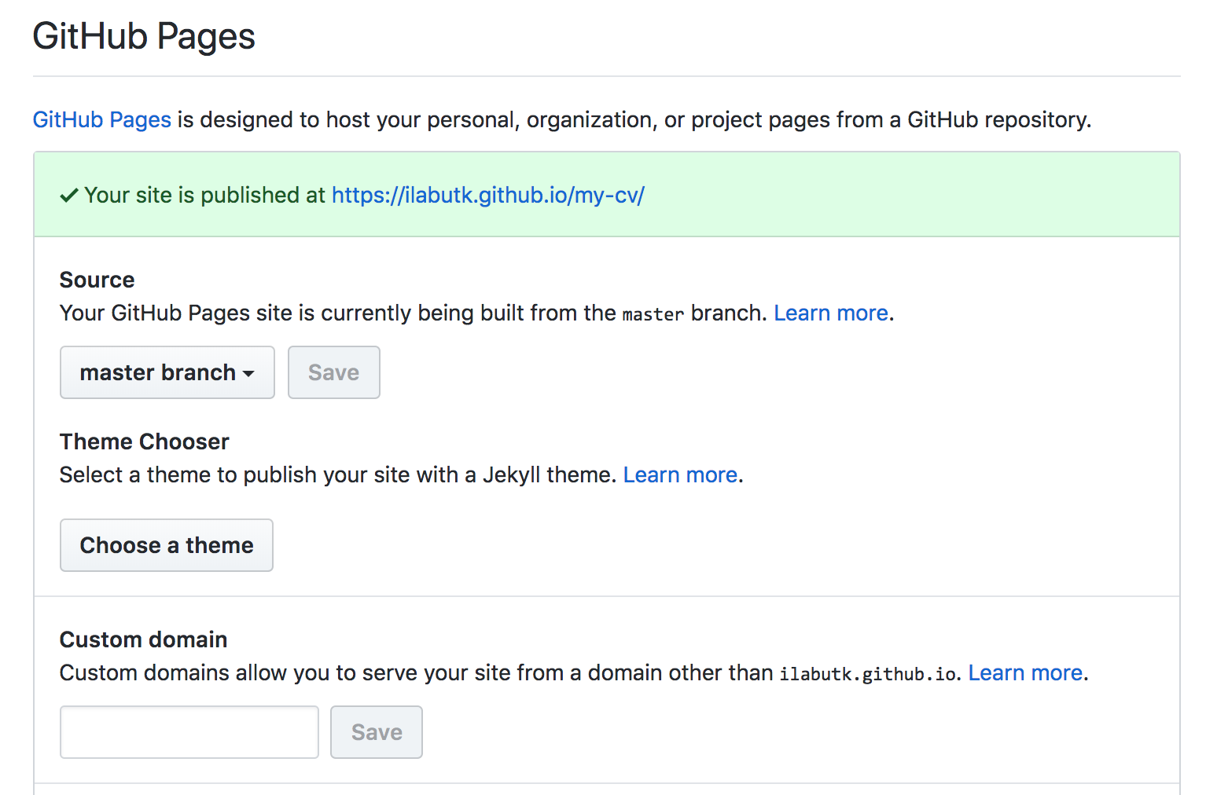
Free Web Hosting on Github
HOWTO
Why index.html?
SPA & links

Slide 2
https://www.w3schools.com/angular/default.asp
https://www.w3schools.com/angular/angular_application.asp

Slide 3
A Learning Guide to HTML/CSS/JavaScript AnGULARJS/CRUD Web Services/…
Dr. Xueping Li, University of Tennessee, Knoxville

Slide 4
FTP Site
Host: linuxise.engr.utk.edu
User: ie421
Password: 421@www
Test WWW:
https://linuxise.engr.utk.edu/ie421/

Slide 5
Setup a NodeJS Server
$ sudo npm install express –save
$ sudo npm install express-generator -g
$ cd (For Mac users, "cd" goes to your home folder; For PC type "cd c:\yourfolder".)
$ express --view=pug myapp
$ cd myapp
$ npm install
$ npm start
(If this works, open a browser and type http://localhost:3000.)

Slide 6
HOWTO:: use an existing project
Download the project (e.g. from FTP) to your folder, e.g. c:\code
“$ cd myapp”
$ npm install
$ npm run

Slide 7
My OWN server!
Make a basic index.html in the /public folder
Or copy your existing project there.
E.g. how about copying your CV project here?

Slide 8
Database Integration
How to display data from MySQL?
How to insert data?
How to update data?
How to delete data?

Slide 9
CRUD
GET
POST
PUT
DELETE

Slide 10
RESTful Web Services
What
http://www.drdobbs.com/web-development/restful-web-services-a-tutorial/240169069
https://www.ibm.com/developerworks/library/ws-restful/index.html
Used by Amazon, Google, LinkedIn, etc.

Slide 11
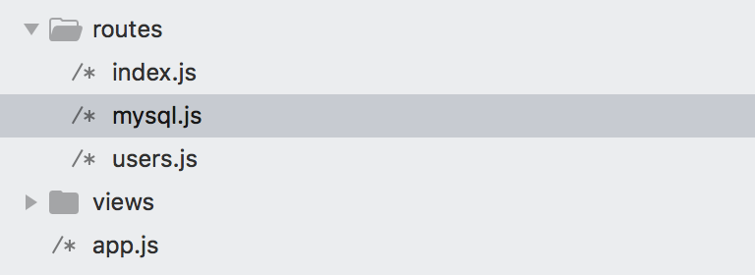
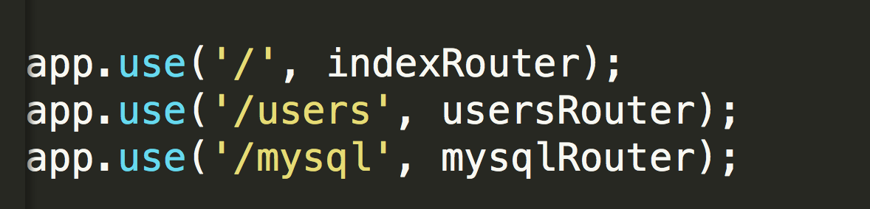
Routes

Slide 12
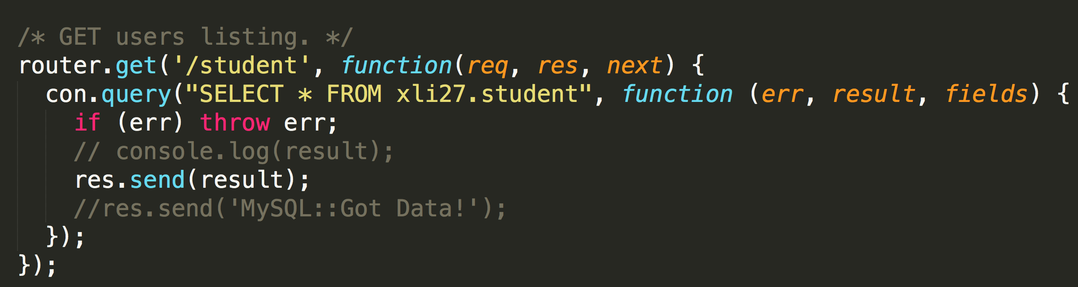
GET example //Backend

Slide 13
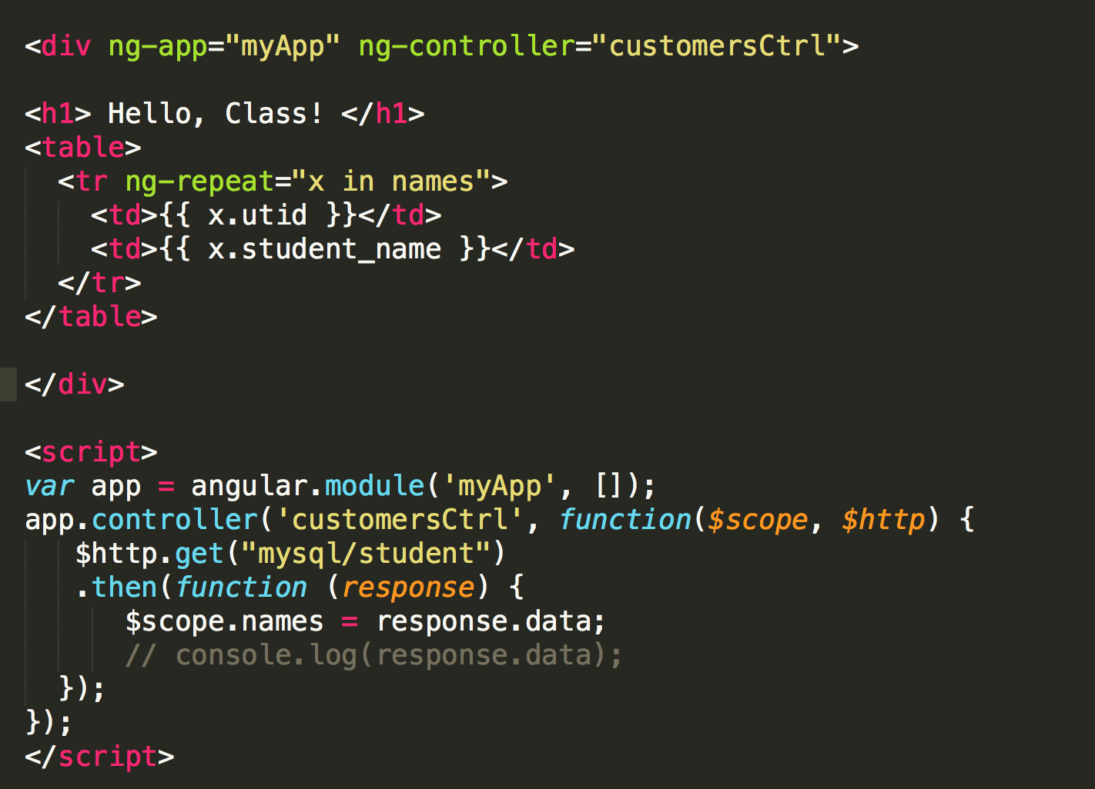
Front-End

Slide 14
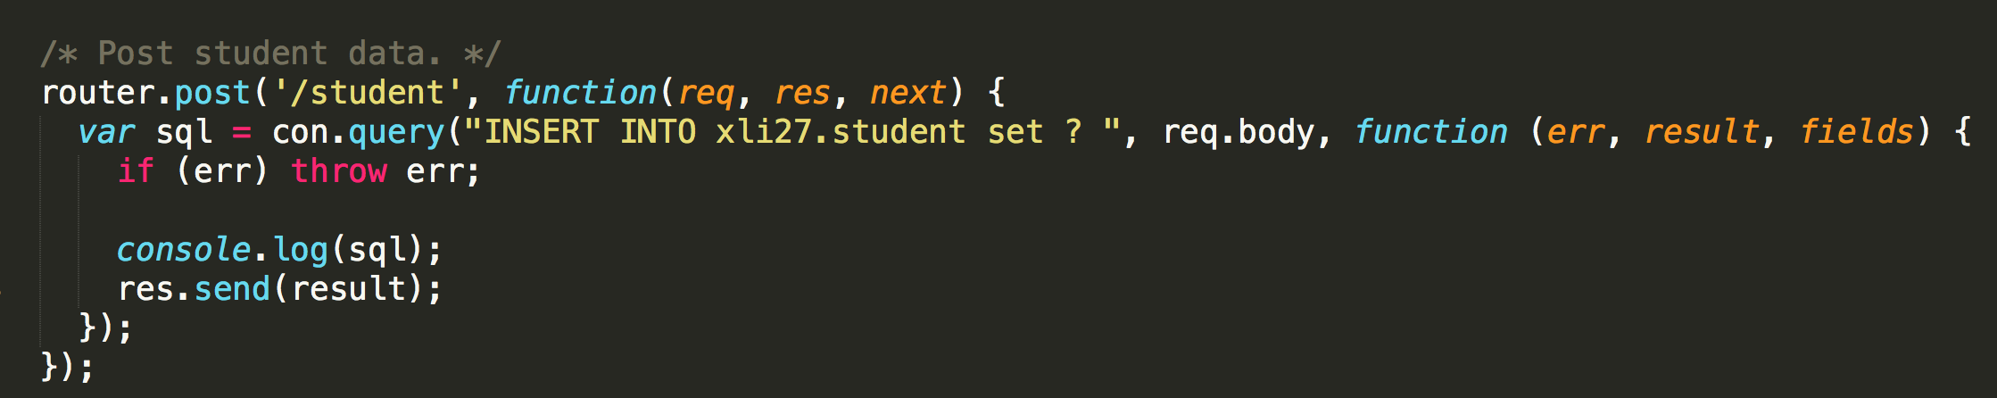
POST //Back-End

Slide 15
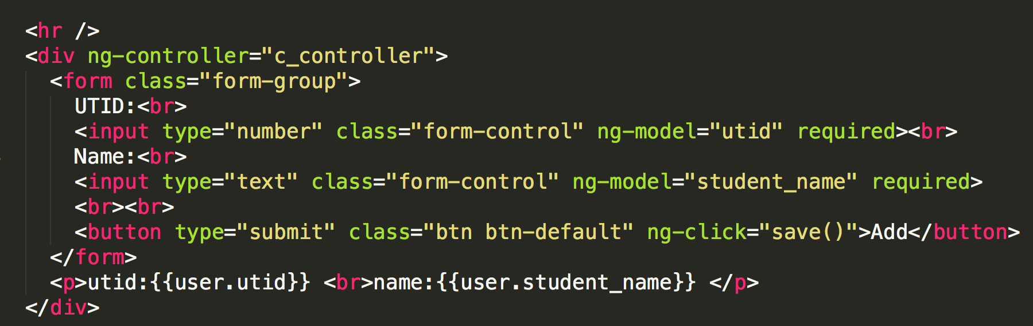
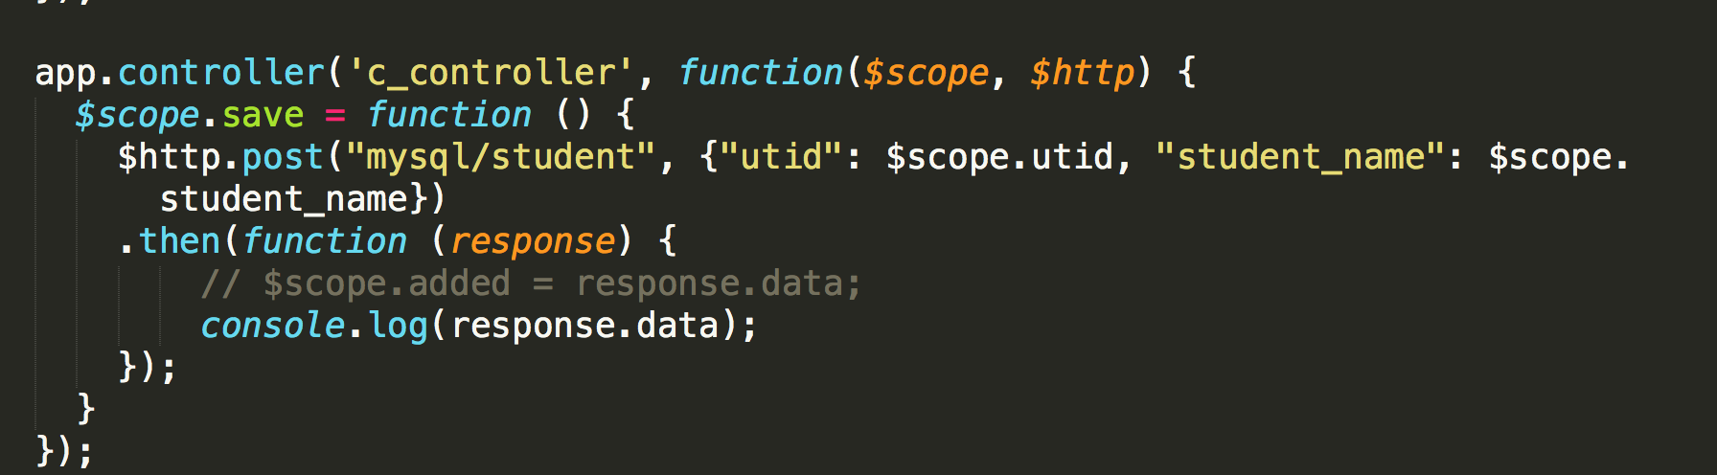
Front-End

Slide 16
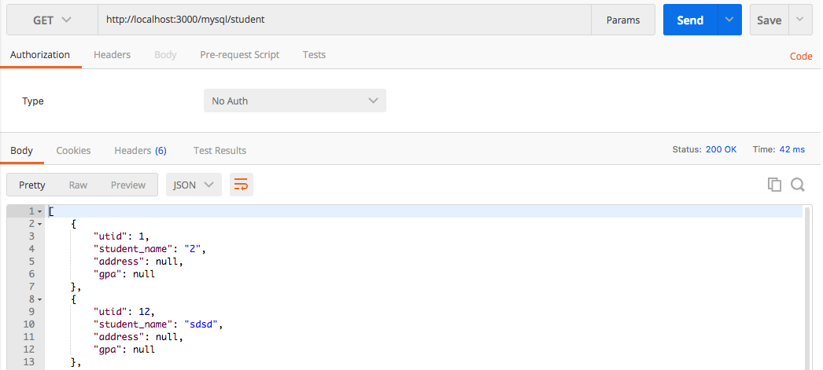
Postman? // Test backend
https://www.getpostman.com/

Slide 17
JSON
https://www.w3schools.com/js/js_json_intro.asp

