Slide 1
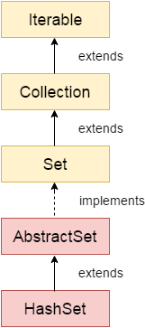
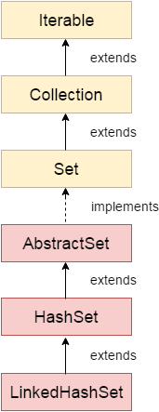
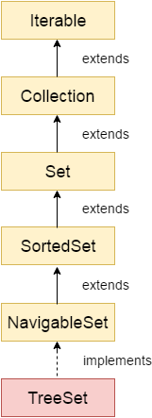
HashSet
LinkedHashSet
TreeSet
HashSet stores the elements by using a mechanism called hashing.
HashSet contains unique elements only.
HashSet allows null value.
HashSet class is non synchronized.
HashSet doesn't maintain the insertion order. Here, elements are inserted on the basis of their HashCode.
HashSet is the best approach for search operations.
The initial default capacity of HashSet is 16, and the load factor is 0.75
Java LinkedHashSet class contains unique elements only like HashSet.
Java LinkedHashSet class provides all optional set operation and permits null elements.
Java LinkedHashSet class is non synchronized.
Java LinkedHashSet class maintains insertion order.
Java TreeSet class contains unique elements only like HashSet.
Java TreeSet class access and retrieval times are quiet fast.
Java TreeSet class doesn't allow null element.
Java TreeSet class is non synchronized.
Java TreeSet class maintains ascending order.

Slide 2
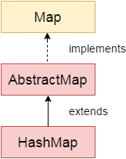
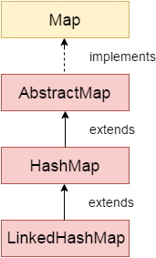
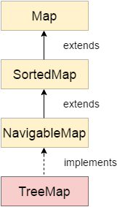
HashMap
LinkedHashMap
TreeMap
One null key and multiple null values.
HashMap is non synchronized.
HashMap maintains no order.
The initial default capacity of Java HashMap class is 16 with a load factor of 0.75.
One null key and multiple null values.
LinkedHashMap is non synchronized.
LinkedHashMap maintains insertion order.
The initial default capacity of Java HashMap class is 16 with a load factor of 0.75.
Cannot have null key but can have multiple null values.
TreeMap is non synchronized.
TreeMap maintains ascending order.
The initial default capacity of Java HashMap class is 16 with a load factor of 0.75.

