Slide 1
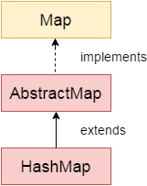
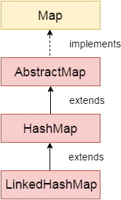
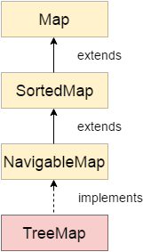
HashMap
LinkedHashMap
TreeMap
One null key and multiple null values.
HashMap is non synchronized.
HashMap maintains no order.
The initial default capacity of Java HashMap class is 16 with a load factor of 0.75.
One null key and multiple null values.
LinkedHashMap is non synchronized.
LinkedHashMap maintains insertion order.
The initial default capacity of Java HashMap class is 16 with a load factor of 0.75.
Cannot have null key but can have multiple null values.
TreeMap is non synchronized.
TreeMap maintains ascending order.
The initial default capacity of Java HashMap class is 16 with a load factor of 0.75.

