Slide 1
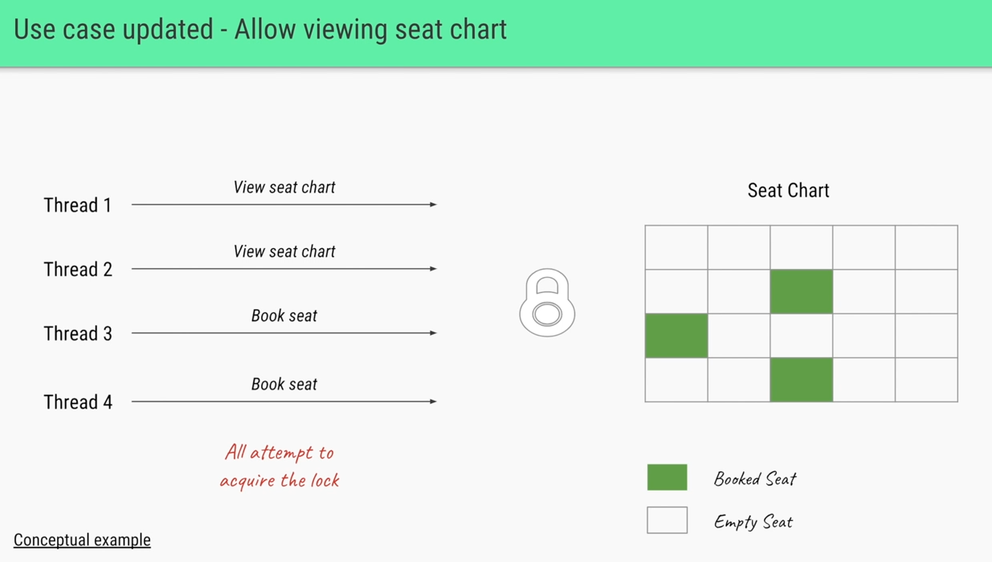
Real example use case
Where there users are trying view seats and book seats in theater.
When it’s a API call, then obviously it’s a request to server is a thread.
Now users1 made a request to view the seats where Thread1 is created.
Now users2 made a request to view the seats where Thread2 is created.
Now users3 made a request to book the seats where Thread3 is created.
Now users4 made a request to book the seats where Thread4 is created.

Slide 2
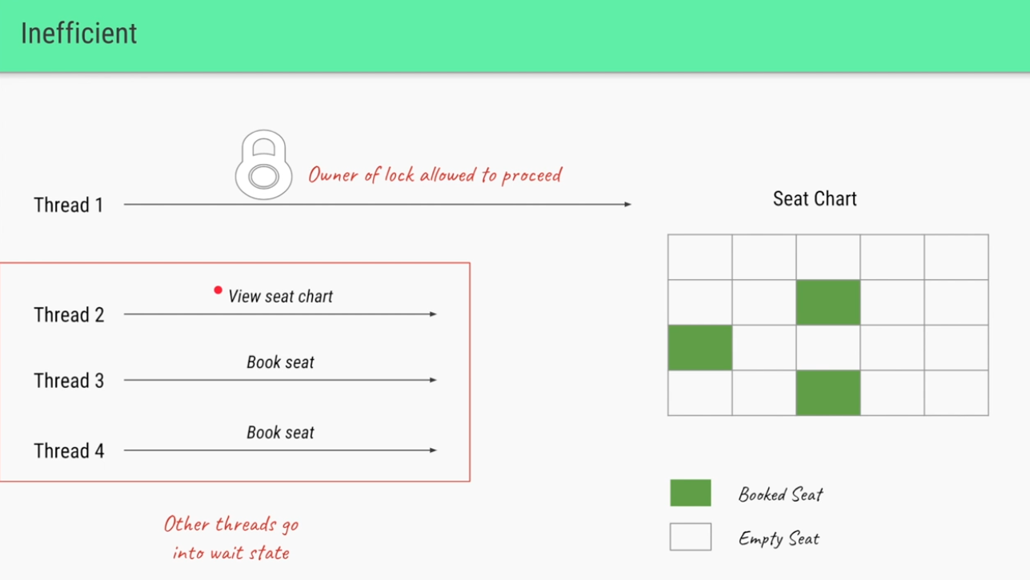
Worst (inefficient) use case
Here we allow only one User thread to view(Read Lock) the seats at a time, then it’s not best use case.
When User1(Thread1) acquired the lock on seats, then User2 who is also trying to view the seats will go to waiting state until User1 releases the lock on seats.

Slide 3
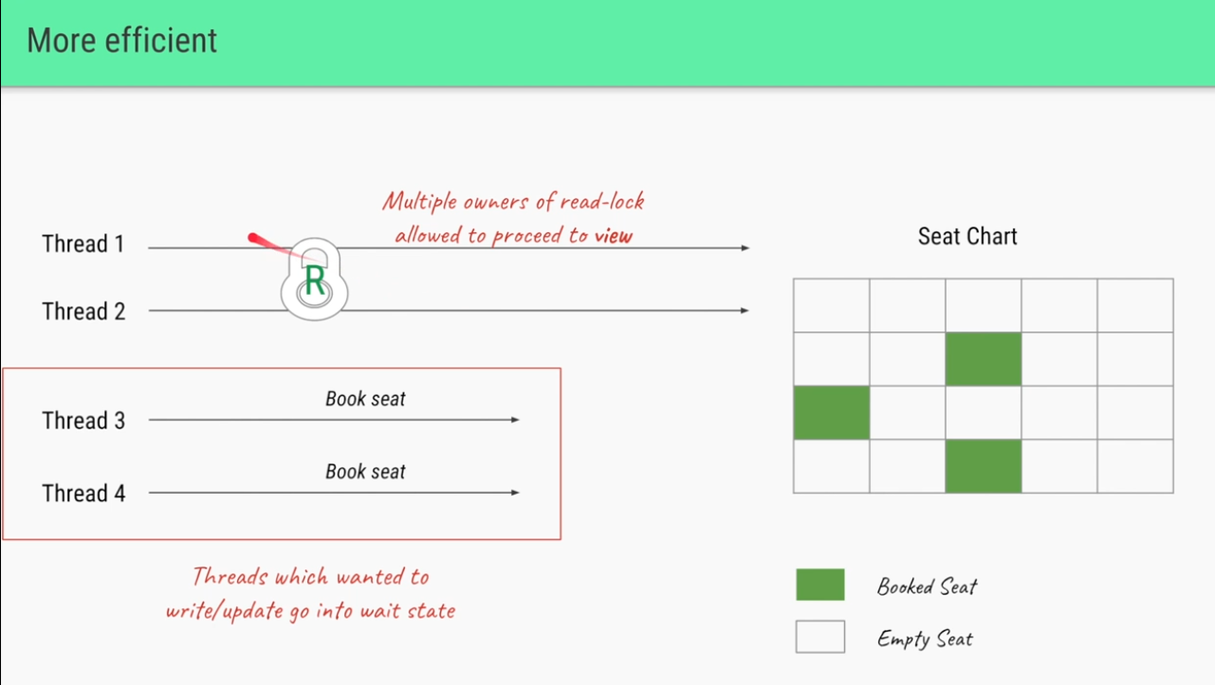
Best (More efficient) use case
Here we allow multiple Users who just view(Read Lock) the seats who are not trying to book.
Since User1(Thread1) and User2 (Thread2) trying to view the seats, then we are T1 and T2 to acquire the lock the shared resource at same time, so that they can view seats at same time.
Here If no thread has locked the SHARED RESOUREC(ReadWriteLock) for writing then multiple thread can access the read lock.

Slide 4
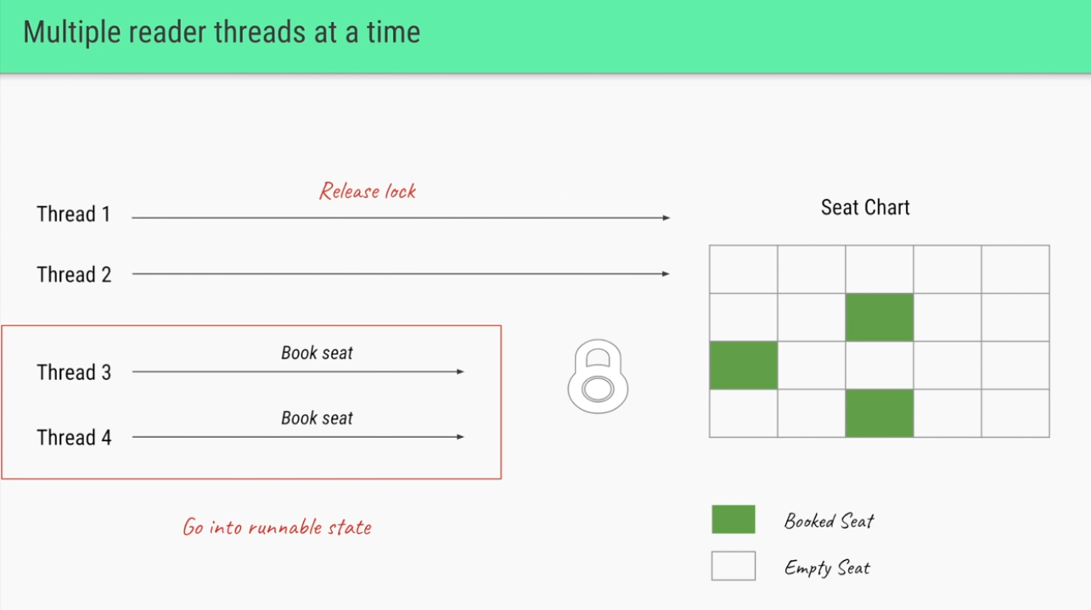
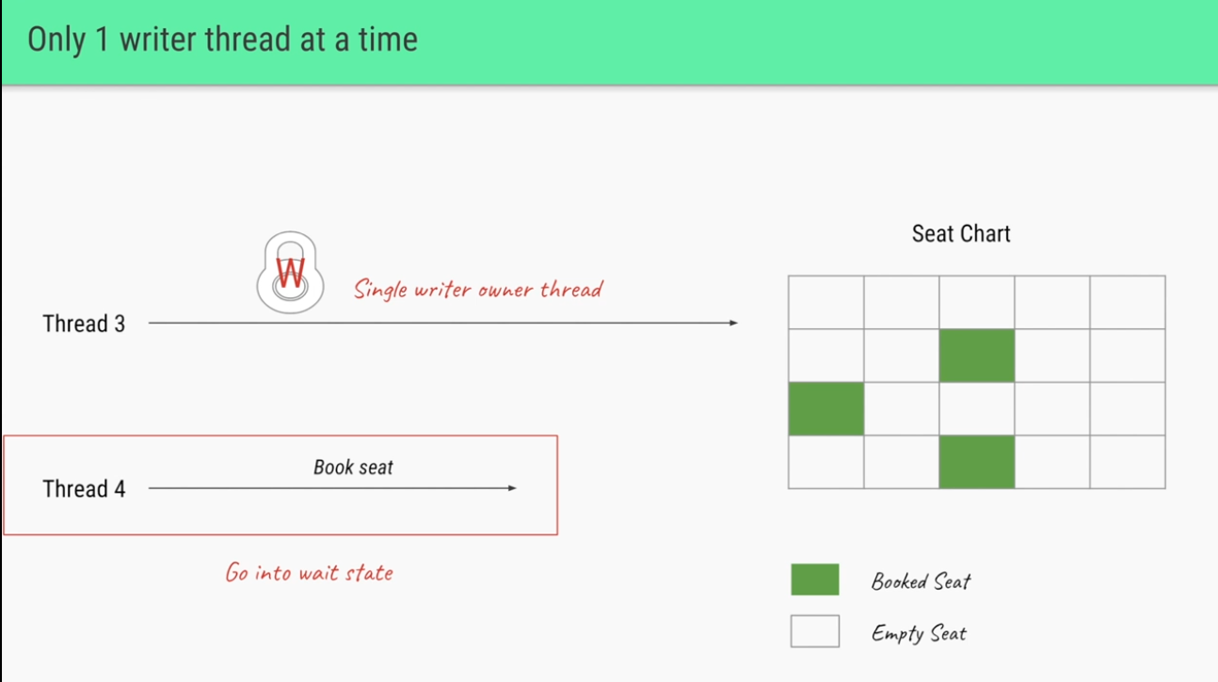

Once the Read threads release the Lock
Once all the thread(T1 and t2) that are reading releases the lock, then writing threads T3 and t3 will go to runnable state but only one writing thread can acquire the lock at a time as per Rules of Readwritelock.
So either T3 or T4 can acquire the lock. Once T3 or T4 acquire the lock, then other thread will got to waiting state.
Here is our example T3 got a chance of acquiring the write lock.
Once T3 releases the lock, then T4 acquire lock. (i.e) one writer thread at time.

Slide 5
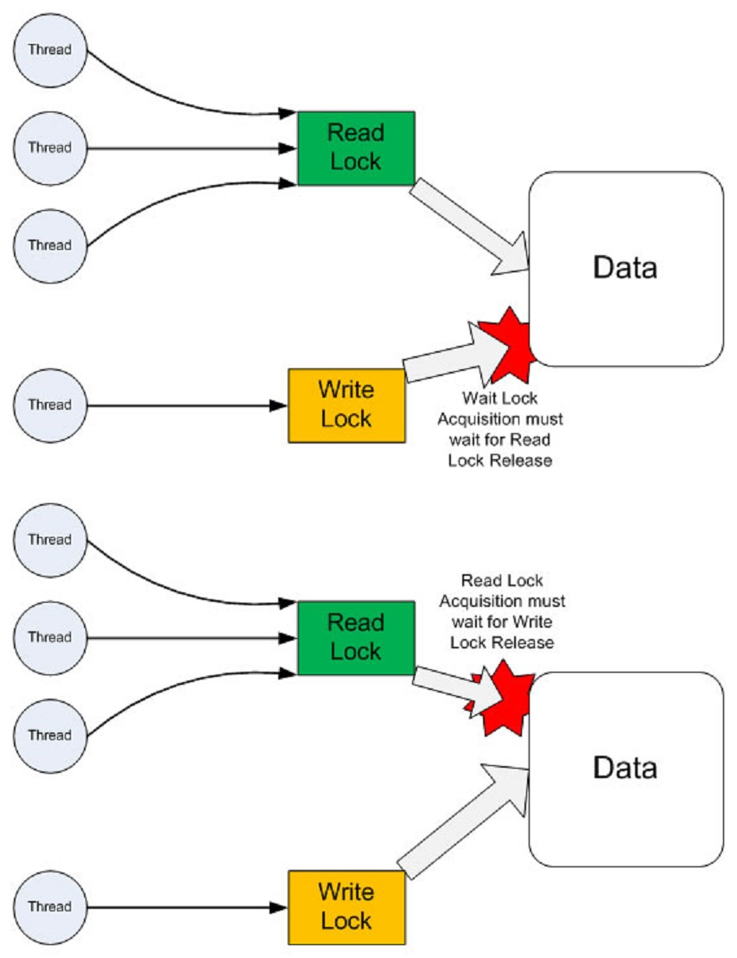
Readwritelock interface in java
A java.util.concurrent.locks.ReadWriteLock interface allows multiple threads to read a specific resource at a time but only one thread can write at a time.
Read Lock − If no thread has locked the SHARED RESOUREC(ReadWriteLock) for writing then multiple thread can access the read lock.
Write Lock − If no thread is reading or writing, then one thread can access the write lock.

Slide 6
Rules of Readwritelock
Read lock and Write lock which allows a thread to either read (or) write but can NOT do both.
Read lock: If no thread that has requested the write lock and the lock for writing, then multiple threads can lock the lock for reading. It means multiple threads can read the data at the very moment, as long as there’s no thread to write the data or to update the data.
Write Lock: If no threads are writing or reading, only one thread at a moment can lock the lock for writing. Other threads have to wait until the lock gets released. It means, only one thread can write the data at the very moment, and other threads have to wait.

Slide 7

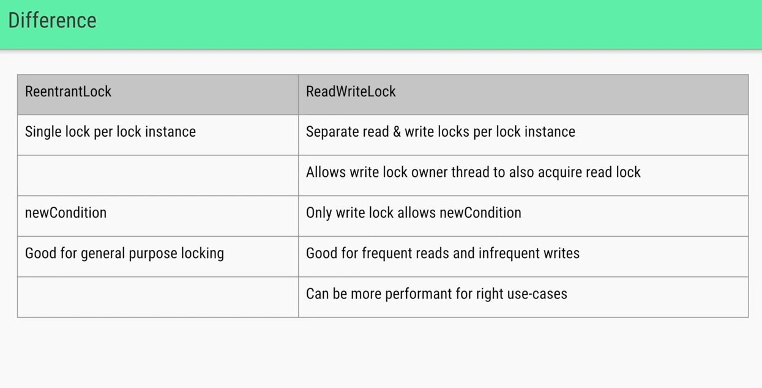
Reentrantlock VS Readwritelock

Slide 8
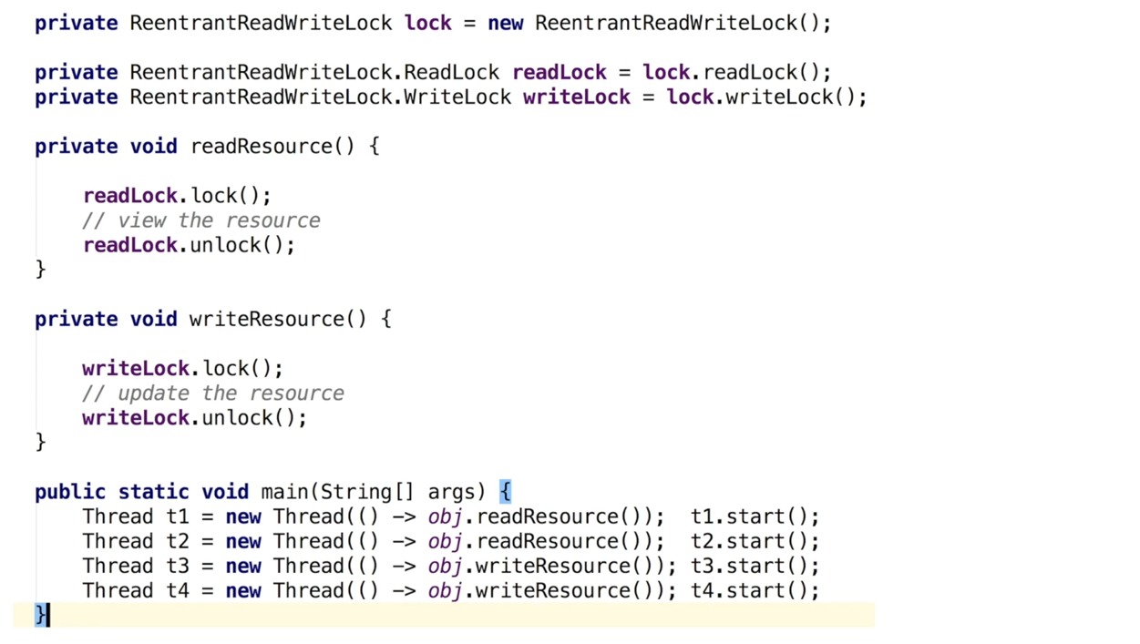
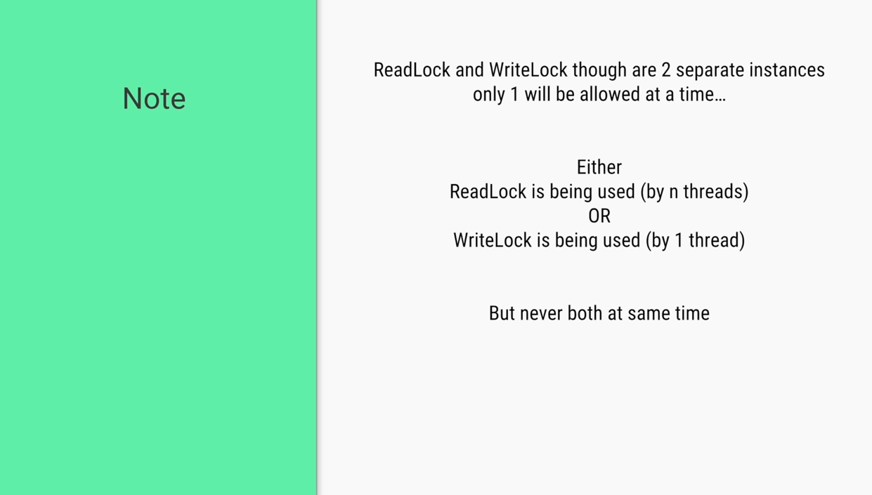
Coding looks like

