Slide 1
Semaphore

Slide 2
Use case where Semapohore is needed
Consider we have a web application where it can process only 3 request at a time.
But there n-number of users who has requested for some data to the application, so it mean that there are threads created for each request and trying to get the data.
So in this case even there are multiple request at same time, we wants to allow only 3 users threads to enter into the application. And make others threads to be waiting until the existing 3 users gets their response.
Once 3 users get the response, then next 3 users who are waiting are allowed to enter into the application.

Slide 3
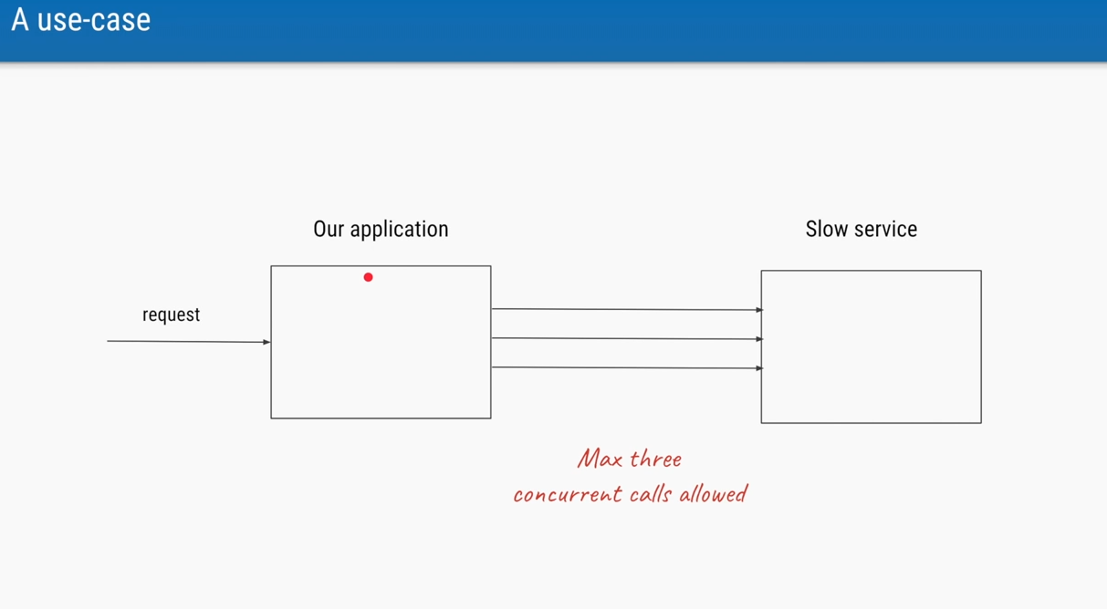
Use case as diagram
Our application connects to the service which is always slow and can process maximum of 3 concurrent(Parallel) calls at time

Slide 4
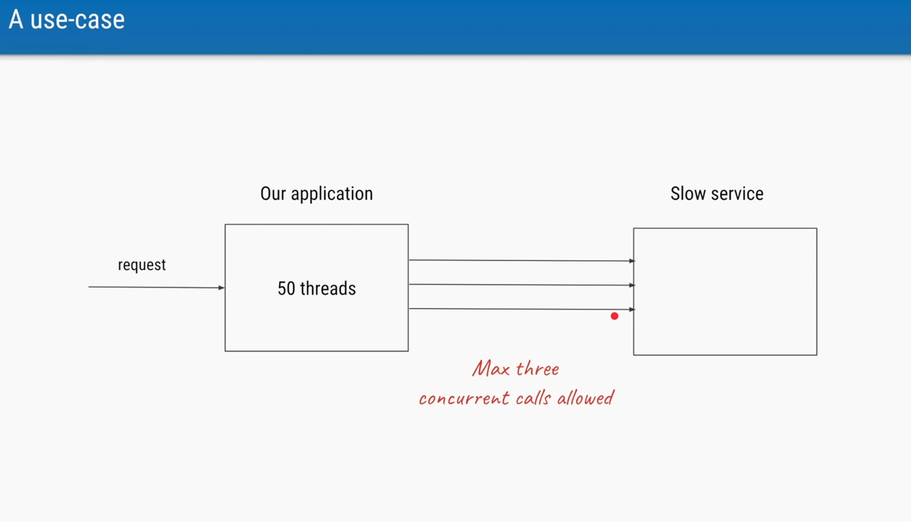
Let says our application has 50 threads trying to connect the slow service but we wanted to allow only 3 threads to connect with slow service.
And make the 47 threads to be waiting until those 3 threads completes their jobs.
Then Semaphore is the best option to use here

Slide 5
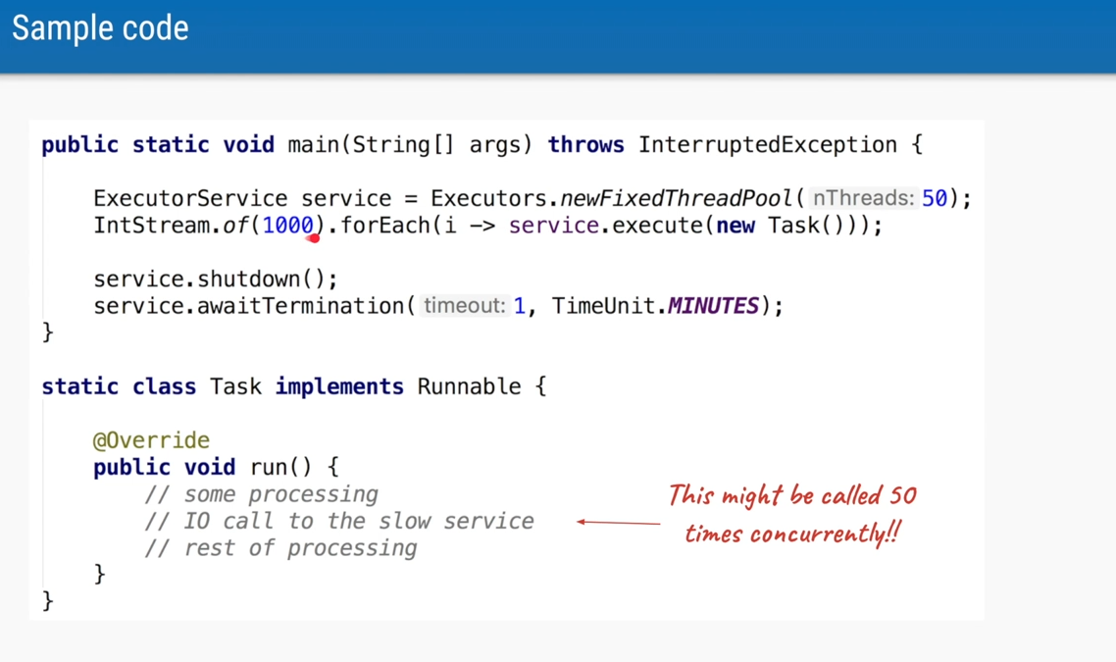
Code that creates 50 Threads and allow 50 parallel calls

Slide 6
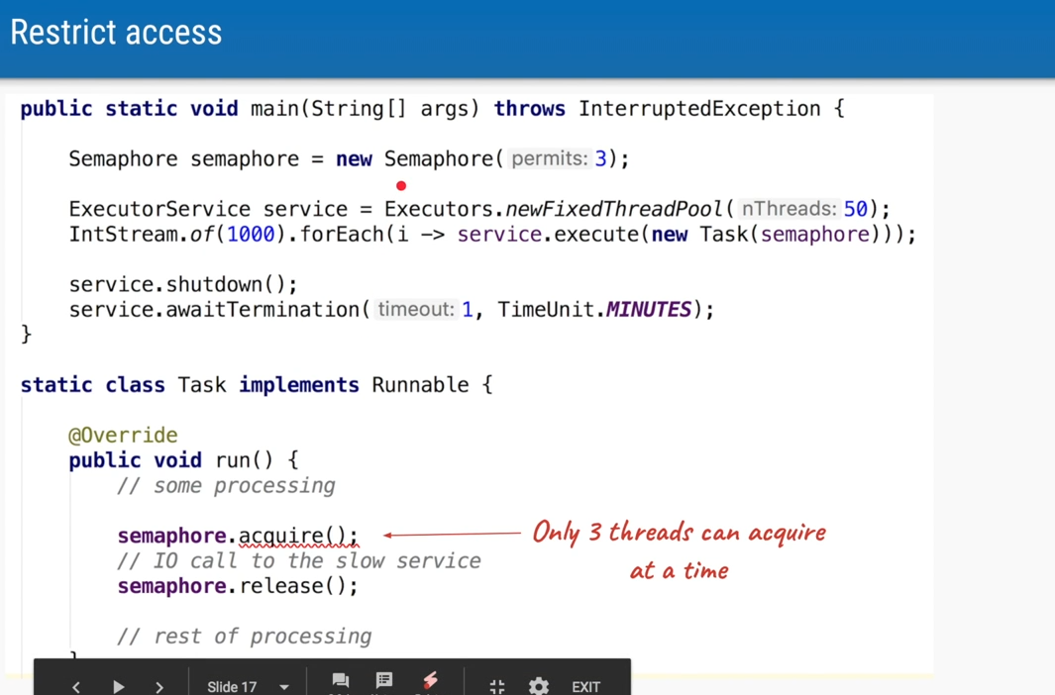
Code that creates 50 Threads and allow only 3 Threads to access the slow service
This acquire method will InterruptedException which mean If we interrupt It will throw an exception

Slide 7
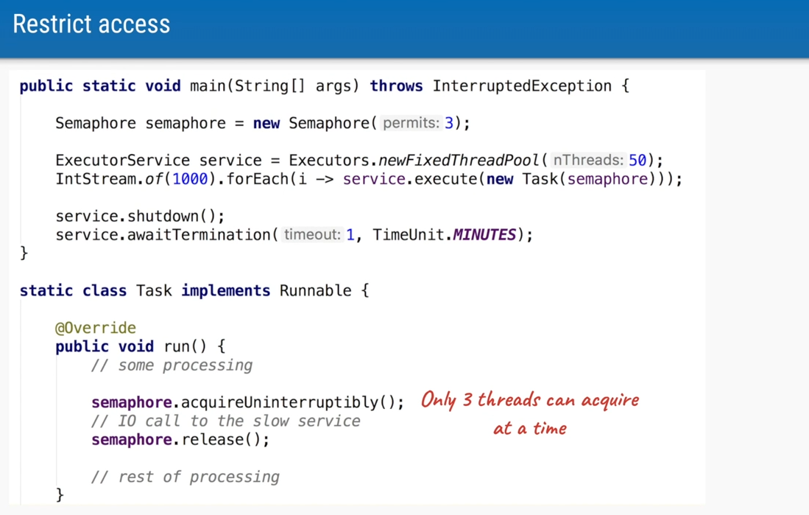
Code that creates 50 Threads and allow only 3 Threads to access the slow service
This acquireUninterruptibly method will NOT throw InterruptedException which mean You can not interrupt and If you don’t want to handle the exception then use this code.

Slide 8
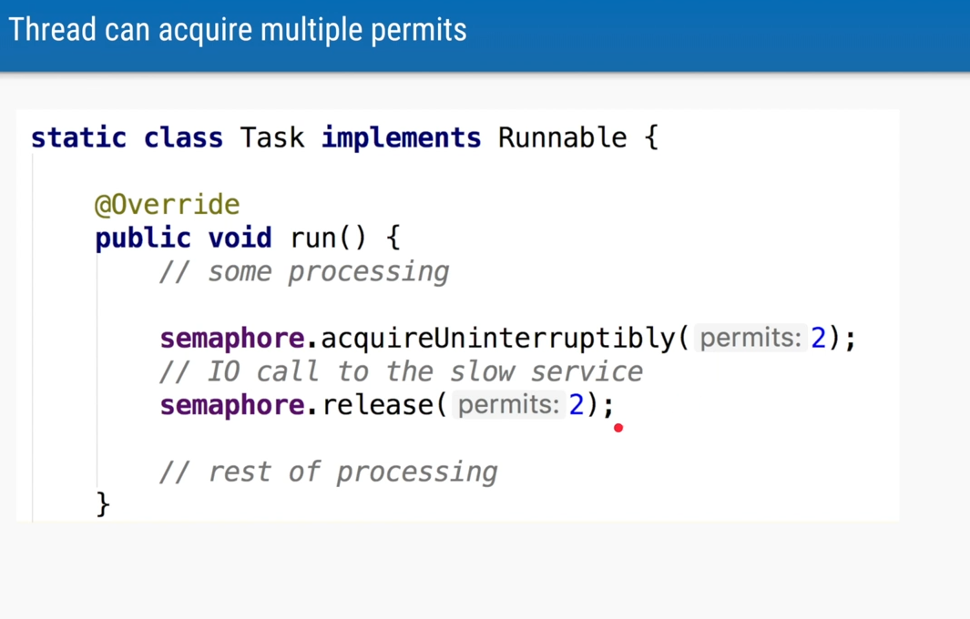
Lets say you 50 Permits and for some reason you want to allow 2 permits at a time use the code here.
And make sure number of permits acquired should be equal to number of release.

Slide 9
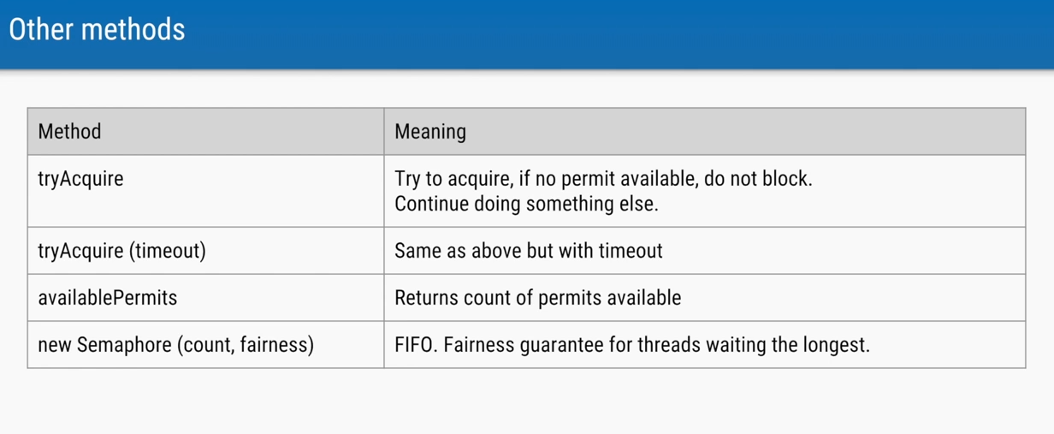
Method of Semaphore

