Slide 1
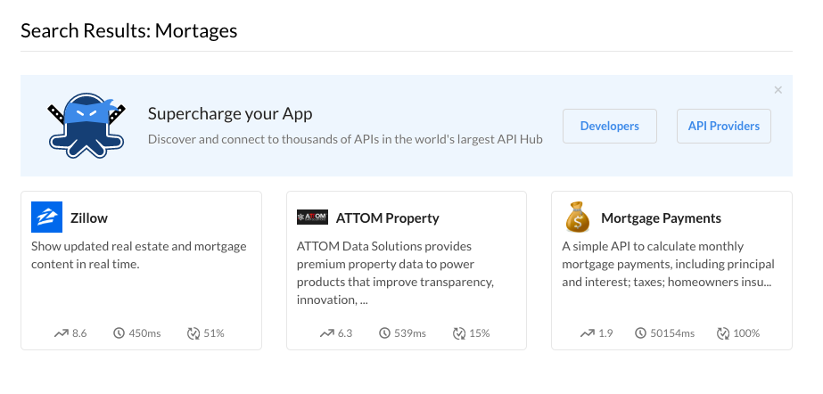
3rd Party Mortgage API providers

Slide 2
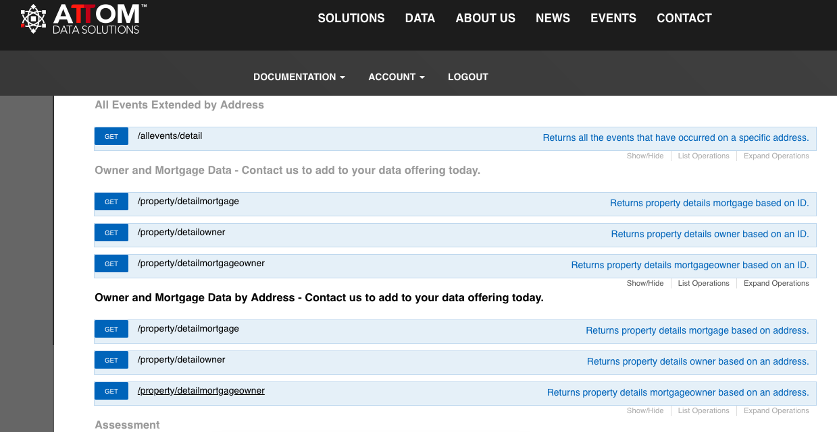
List of API provide by ATOM

Slide 3
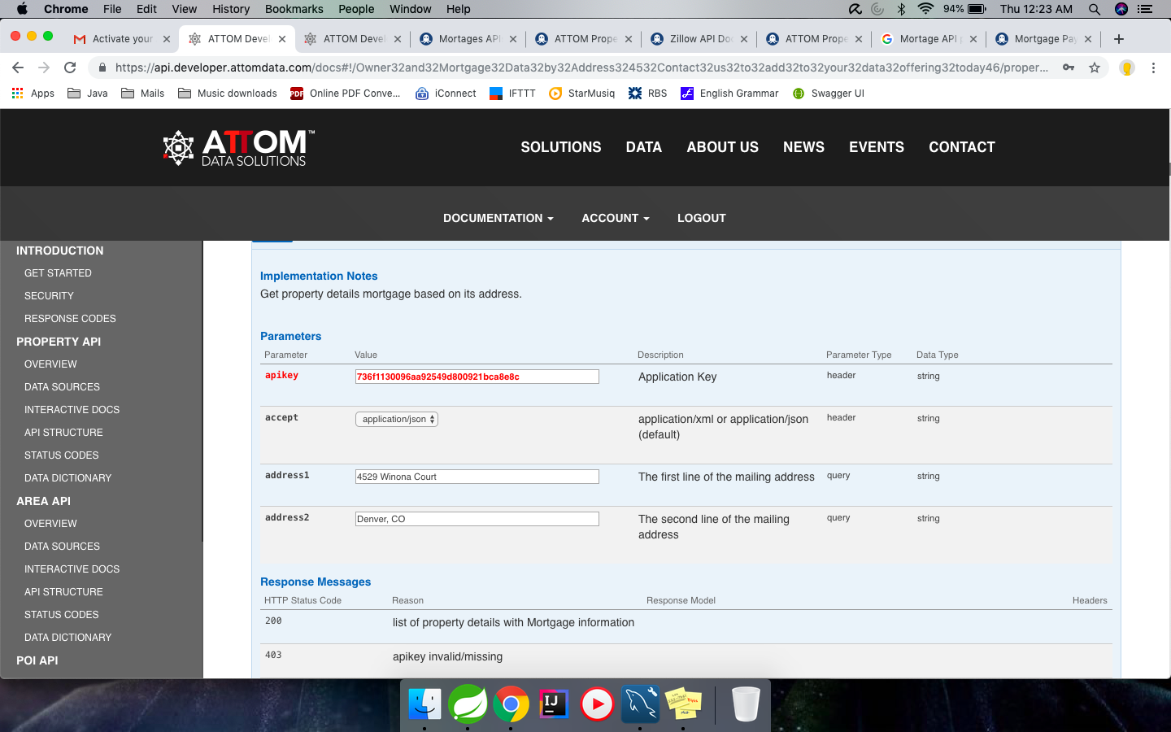
API request input

Slide 4
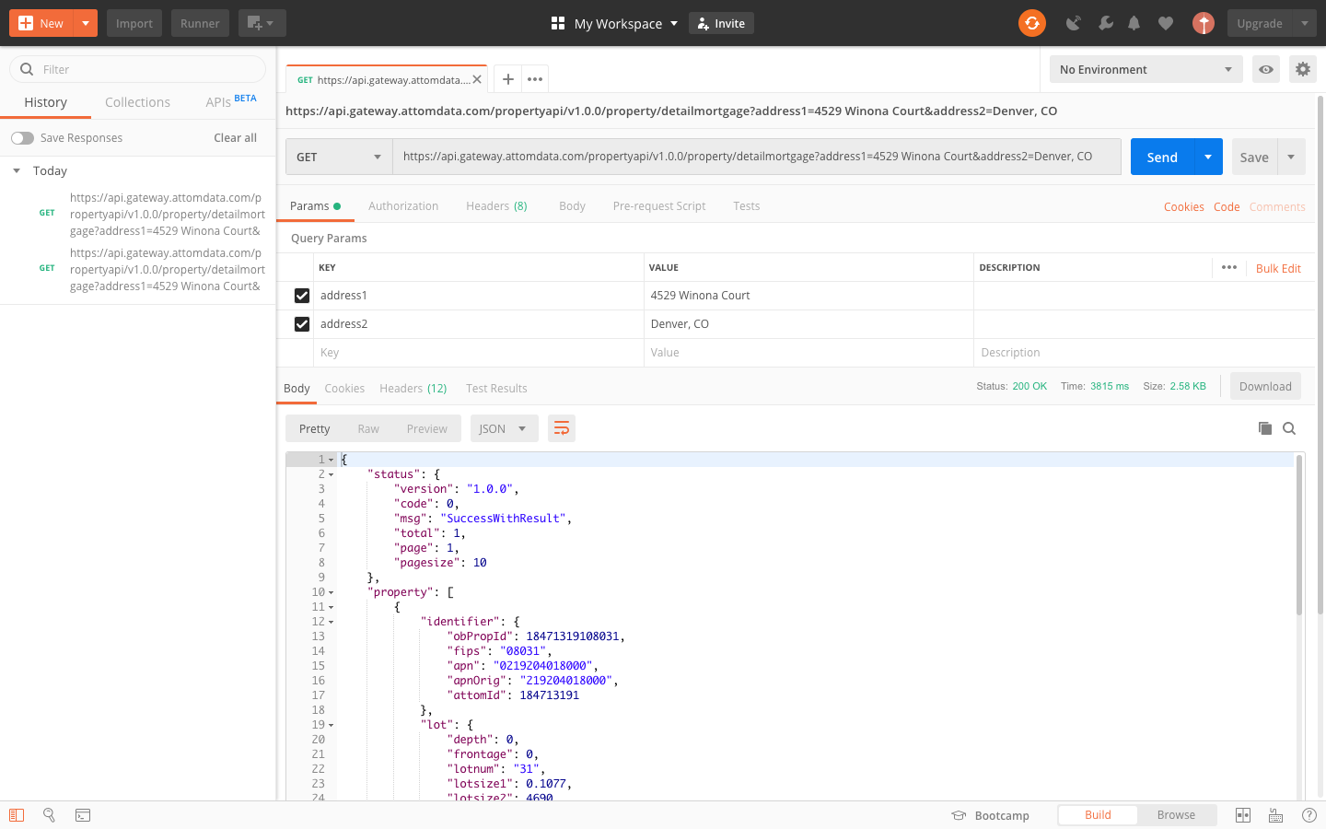
API Response in JSON

