Slide 1



Challenges and Advances in Constructing of Corpora
And
Linguistic Tools for the Moroccan Dialect
Nadia khlif nadia.khlif@ilc.cnr.it
Azzedine Mazroui azze.Mazroui@gmail.com
Ouafae Nahli ouafae.nahli@ilc.cnr.it
08/11/2024
Notes:
Good evening, everyone. I'm Nadia Khlif, a PhD student specializing in Natural Language Processing, currently based in Morocco. Additionally, I'm a researcher at CNR-ILC in Pisa, Italy, where I contribute to the CWALM project (A Lexical Corpus-based Model of Contemporary Written Arabic).
I’m excited to have this opportunity to share our work on Challenges and Advances in Constructing of Corpora And Linguistic Tools for the Moroccan Dialect

Slide 2
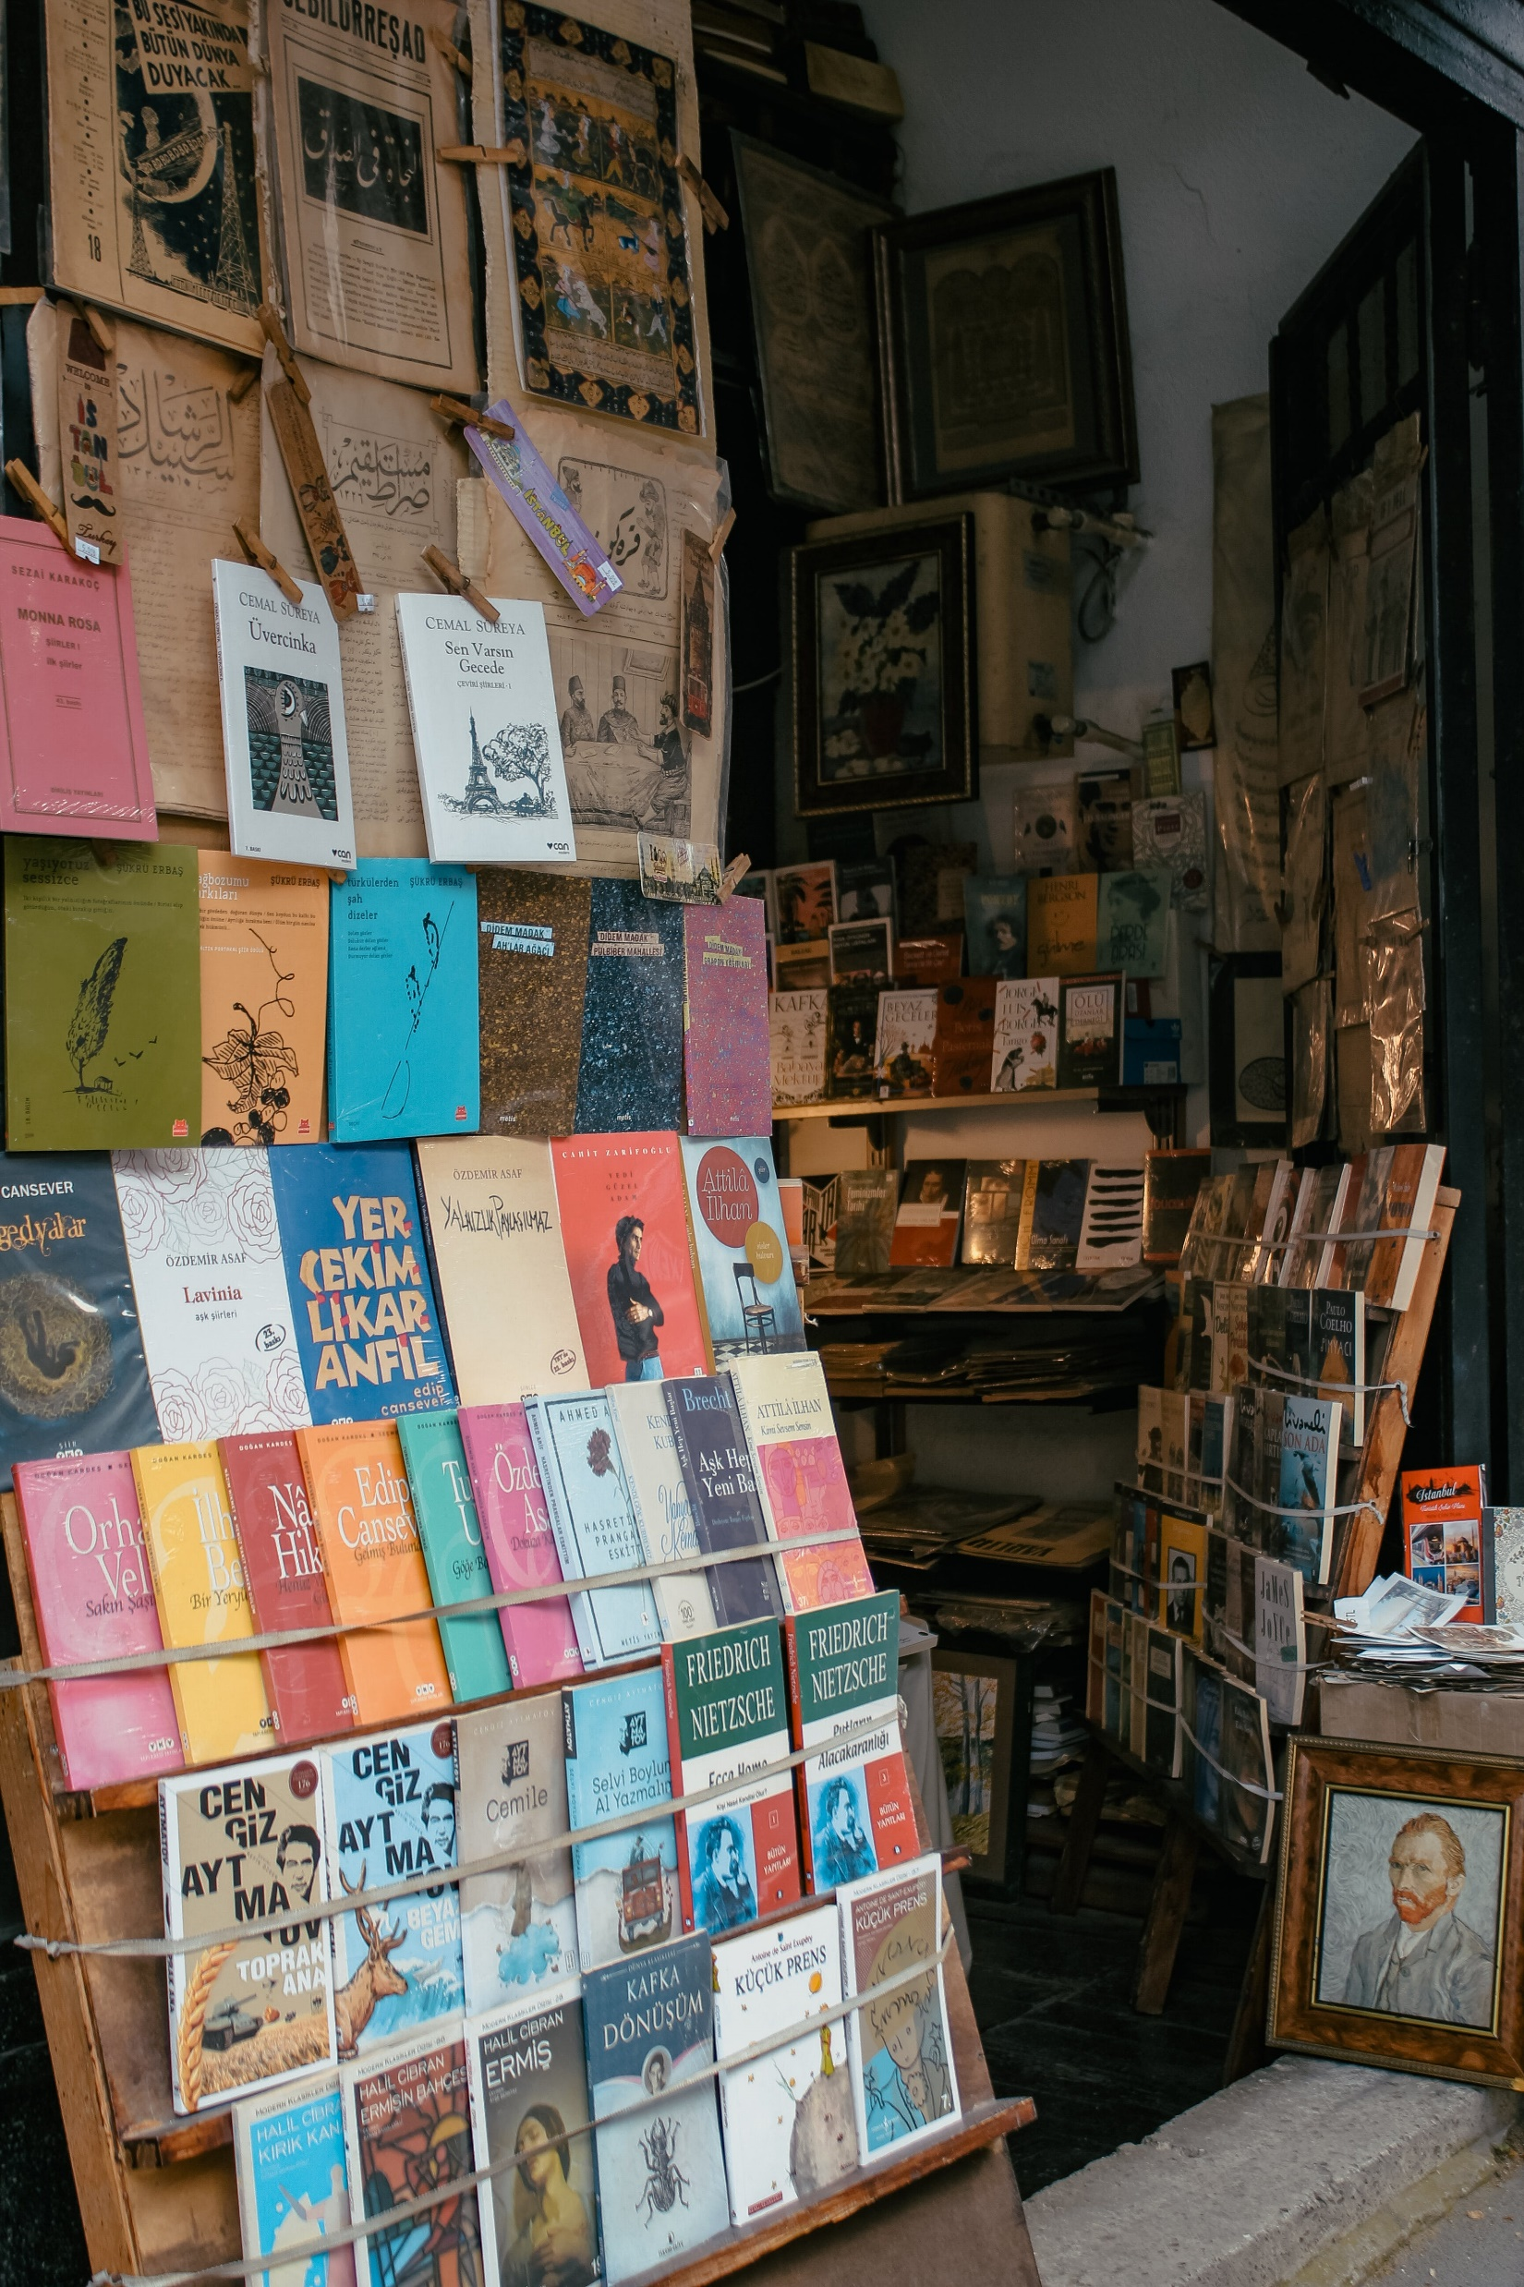
Introduction
Arabic language & Darija Dialect
Results & discussion
DiMorph
Darija’s Challenge
Linguistic features
Conclusions & Perspectives
PLAN
Notes:
Let's break down the presentation plan.
We'll begin with an introduction,
followed by a discussion on the differences between the Arabic language and the specific dialect known as Darija, which is specific to Morocco.
Afterward, we'll delve into the linguistic features of Darija and explore the challenges associated with it.
Next, we'll introduce DiMorph, the tools designed for analyzing Darija.
We'll then discuss the results obtained from using this tools.
Finally, we'll conclude by summarizing our findings and discussing future perspectives.

Slide 3






Introduction
Data Collection
Step1:
Collection of a Representative Corpus: establish a genuinely representative corpus of Colloquial Arabic Varieties.
Tools: DiMorph
Step2:
Tools Adaptation: enhance linguistic annotations within our corpora through the adaptation of the morphological Analyzer Aramorph for processing written dialectal words.
Manual disambiguation of a Subcorpus
Step3:
Corpus Annotation: manual disambiguation of a subcorpus collected and analyzed to adapt methodologies in deep learning for the Automatic Annotation of the Entire corpus.
Lexical Model
Step4:
Developing a Lexical Model: Bridging Corpus Data and Existing Lexical Sources.
3
Notes:
In the introduction, we'll outline the structure of the project, which is based on four main phases.
The first one is to collect a representative corpus.
The second step is to adapt a tool for processing dialectal words; for this purpose, we chose AraMorph.
The third step is to extract a sub-corpus collected and analyzed to manually disambiguate.
The last step is to construct a robust lexical model.

Slide 4
Arabic Language & Darija dialect
Classical Arabic
The Language of the Quran.
Modern Standard Arabic (MSA)
Foundation in Classical Arabic.
Arabic Dialects
Localization and Informality.
Adherence to Strict Grammatical Rules.
Religious Significance and Unique Dictionary.
Linguistic Authorities and Standardization.
Uniformity in Written Communication.
Organic Evolution within Communities.
Lacks of the formal recognition and standardized grammar rules.
4
Notes:
Concerning the Arabic language,
We have Classical Arabic, known as the language of the Quran, with strict grammar rules and its own dictionary due to its religious importance.
Next is Modern Standard Arabic (MSA), based on Classical Arabic, regulated by linguistic authorities for consistency in written communication across Arab countries.
Arabic dialects are spoken languages specific to certain areas, without official recognition or standardized rules like MSA. They evolve naturally within communities, reflecting unique linguistic traits shaped by local culture and history.

Slide 5
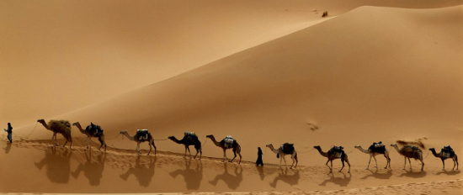
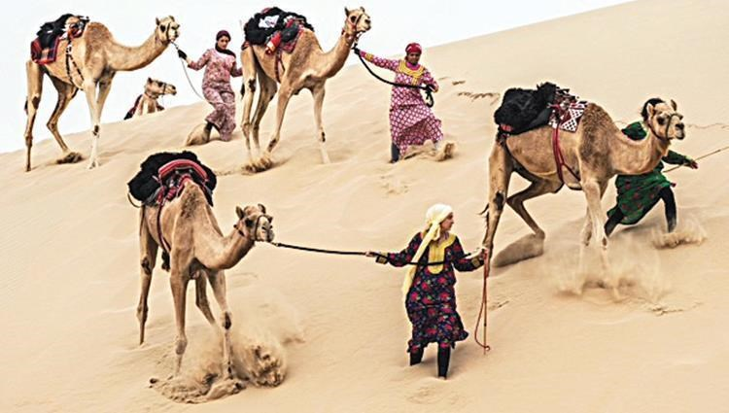


Arabic Language & Darija dialect
Arabic Classic
/qiTar/قطار
/sayyaːrat/سيارة
Camel Walking in sequence
Camel Walking in simultaneous
Word Time Shifts
MSA
/qiTar/قطار
/sayyaːrat/سيارة
Train
Car
Darija
/toraːn/ تران
/Tuːmuːbiːɫ/ طوموبيل
/sayyaːrat/سيارة
Train
Car
Lexical borrowing
5
Notes:
The following slide presents some special examples. The word 'qitar,' meaning a group of camels walking in order in Classical Arabic, translates to 'train' in Modern Standard Arabic (MSA).
However, in Darija, while it retains the same meaning, it is represented by a different token derived from a French word. Similarly, 'sayara,' which means 'camels walking simultaneously' in Classical Arabic, refers to 'cars' in MSA.
In Darija, it retains the same meaning as in MSA, but also has a representation transliterated from French.
This illustrates the phenomenon of lexical borrowing.

Slide 6
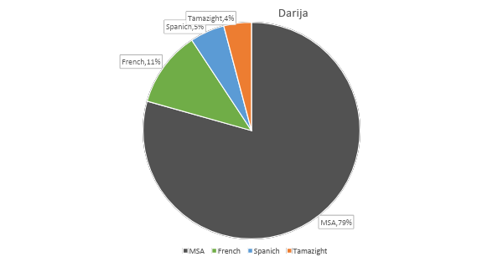
Arabic Language & Darija dialect
Article de reference:
Tachicart, Ridouane, Karim Bouzoubaa, and Hamid Jaafar. 2016. “Lexical differences and similarities between moroccan dialect and Arabic”.
6
Notes:
This slide presents some key roots of Darija. Darija has its roots in Modern Standard Arabic (MSA), making up about 80% of its vocabulary.
However, it’s not just Arabic; it also includes words from other languages.
For example, Tamazight, the Berber language, contributes around 4% of Darija's words. Additionally, due to Morocco's history, French has influenced about 11% of Darija's vocabulary, while Spanish contributes roughly 5%.
These statistics are sourced from the article.

Slide 7
Linguistic features
Surface realisation
The morpho-syntactic layer combines the inflected form with clitics (prepositions, conjunctions, definite articles, etc.) to shape a rich and complex surface form.
Alteration Rules
Clitics
Verbal Inflected Form
Nominal Inflected Form
The inflectional layer is the one where the lemma combines with inflectional affixes to give inflectional forms.
Alteration Rules
Inflection Affixes
Verbal Lemma
Nominal Lemma
The derivation layer is the deepest one. At this level, the root combines with the vowels, according to determined patterns, to produce a verbal or a nominal lemma.
Alteration Rules
Pattern
Root
Vocalic
7
Notes:
In this slide, when exploring linguistic features, we'll examine the morphological structure, which consists of three main levels.
First, there’s the derivation layer, followed by the inflectional layer, and finally, the morpho-syntactic layer.

Slide 8
Linguistic features
Example of Grammatical Aspects
w=ma= katb+at=u:=ʃ
And we didn’t write it
conj = NEG
write.PV
3SP = NEG
w
ma
katb+at
uː
ʃ
Example:
وتكتبه / wtktbh /
هُ
وَ
ُ
كْتُب
تَ
It
He writes
and
8
Notes:
Let’s visualize this with the following example the token is sub-tokenized as follows: the conjunction particle with the negation prefix, the perfect verb, and its conjugation to the third singular person with the negation enclitic. .

Slide 9
Linguistic features
In the two examples, the inflected form is surrounded by clitics and the morphological structure is:
Proclitics
Prefix
Stem
Suffix
Enclitics
By removing clitics, the remaining word form is a minimally autonomous inflected form whose structure consists of:
Prefix
Stem
Suffix
9
Notes:
Is the following
By removing clitics the minimally inflected form is this one

Slide 10




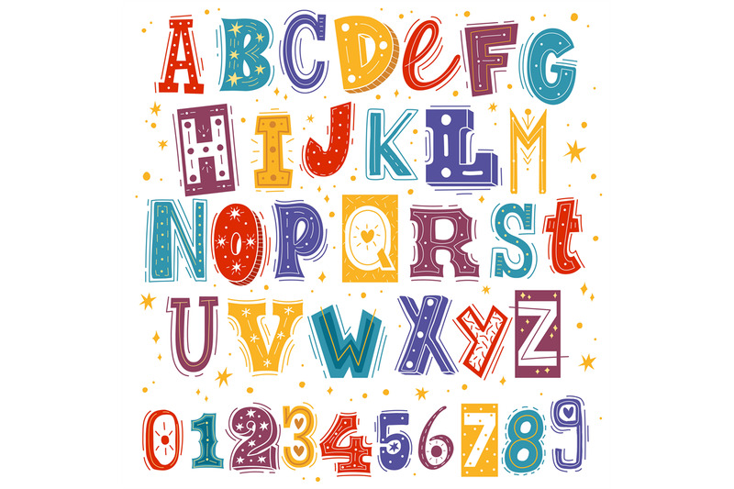
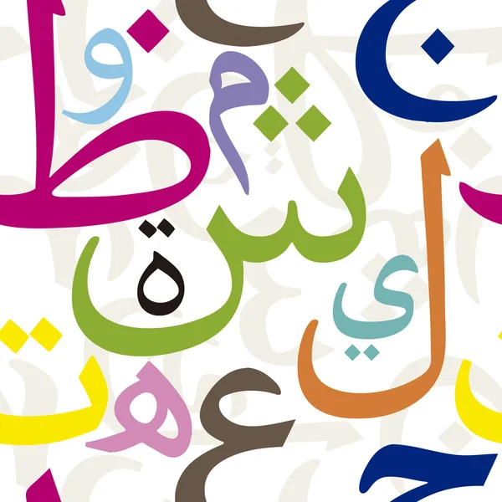
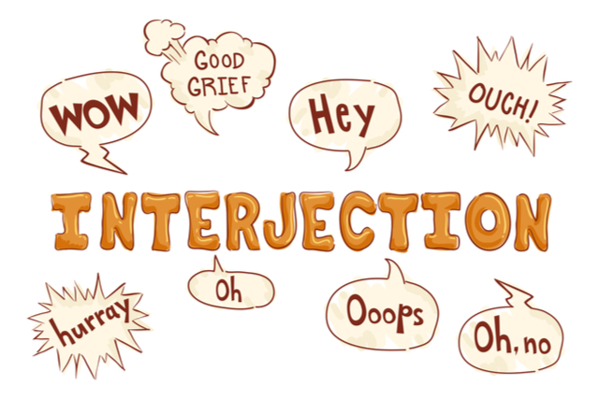
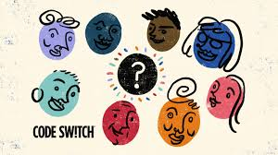
Darija’s Challenge
Poor resources
Challenges
Issues of Texts retrieved from social platforms
Inherent characteristic’s Daija
10
Notes:
On this slide, we highlight the challenges in working with Darija, which include limited linguistic resources,
especially annotated corpora and linguistic data.

Slide 11
Darija’s Challenge
Issues of Texts retrieved from social platforms
مبرووووك /mabru:u:u:u:k/
‘congratulation’
11
Notes:
Additionally, texts sourced from social media platforms present issues such as noise, informal language, and non-standardized spelling, posing challenges for data preprocessing and analysis. As this example present an elongation.

Slide 12
Darija’s Challenge
Inherent characteristic’s Daija
Lack of Orthographic and Grammatical Rules: Due to the absence of established orthographic and grammatical rules, words are often written as pronounced, leading to variations.
راس , رءس: instead of the standardized رأس
Early Technology Limitations: The lack of Arabic keyboards led users to adopt the Latin alphabet with numbers (Arabizi) to represent unique Arabic sounds, such as:
ع -> 3.
ح -> 7.
Use of Arabic Script with Limitations: With Arabic keyboards now available, people primarily use Arabic script. However, some sounds in Darija, like /g/ in ‘اطوg’ “cake" (a borrowed word from French "gateau“), aren't represented in standard Arabic script, leading to script mixing.
12
Notes:
Moreover, the inherent characteristics of Darija,
including the lack of orthographic and grammatical rules,
limited technologies in its early stages, which lead to the adoption of the Latin alphabet with a similar script representation to express unique Arabic sounds, for example
Regarding Darija, there is also a phenomenon of code-switching, which leads to some sounds that do not exist in the Arabic Latin script that cause users switch between scripts to represent the sounds, as in

Slide 13


Input: Text
Tokenization
PREPROCESSING
Script mixing normalization
Script mixing normalization
Processing Elongation
Processing Elongation
Automatic Tagging
POSTPROCESSING
Detection of Multi Words
MWs LR
Code mixing
MSA / Darija LR
Not Found
PROCESSING
Processing of Darija
Orthographic Variation
Darija LR
Not Found
Found
Found
Output: Results
Notes:
This slide present the second version of DiMorph which consisted of three main phase, the two that we discover previously and the new phase is the post processing
we've implemented a three-step analysis system to handle tokens not found:
Code Switching: Utilizes MSA resources.
Code Mixing: Integrates MSA with Darija clitics.
Orthographic Variation: Concerns certain norms in spelling, which will be discussed later

Slide 14

DiMorph
Script mixing normalization
Processing of numeral characters:
When each number can be directly replaced by an Arabic letter, we apply automated substitution.
For example:
فت7ها => فتحها /ftaHɦaː/ `he opened it’
Processing of literal characters:
In case where the Latin letter "g“ represents the phoneme /ɡ/, which does not exist in standard Arabic script, we apply automated substitution.
For example:
اطوg => گاطو /ɡaːTuː/ `cake’
14
Notes:
Which consist of
The number 7 is replaced by the letter Hae,
the letter g is replaced by the Persian letter.

Slide 15

DiMorph
Processing elongation
Elongated word | Normalized word | English translation
مبرووووك mabru:u:u:u:k | مبروك mabru:k | `congratulation'
بزااف bazza:a:f | بزاف bazza:f | `much'
15
Notes:
Then the processing of elongation In this phase, lengthened letters are replaced with a unique letter as shown in the table.
We have the token 'mabrok,' which becomes 'mbr'.

Slide 16

DiMorph
Automatic tagging
Implementation of an automatic tagging system to identify:
Punctuation/ number.
Emoticons.
Interjections.
Word Foreign.
Where the foreign number or word is preceded by a dialectal prefix (e.g., ب /b/ - ف/f/ - و /w/ - ال /Al/).
For example:
لPaola /l=Paola/ : ل /PREP+WORD_FOREIGN `for Paola’.
ب5000 /b=5000/ : ب/PREP+NUMBER `with 5000’.
16
Notes:
Concerning this phase We've created an automatic tagging system for punctuation and emoticons, along with a curated list of interjections that lack grammatical sense, all tagged automatically.
However, a more complex challenge arises with numbers and Latin letters in dialect texts, especially when they are preceded by a dialectal prefix.

Slide 17

DiMorph
Detection Multi Words
20
Notes:
Initially, DiMorph analyzes them using complete MSA resources to identify existing MSA words inflected according to MSA codes, indicating code-switching.
In the subsequent phase, the system identifies MSA words inflected according to Darija codes, indicative of code-mixing. DiMorph then employs both MSA-specific and Darija-specific resources to analyze the tokens, tagging them accordingly.

Slide 18


DiMorph
Processing
DET + Verb
ma=ka=n-ktab=u:=$
Suffix + Enclitics
Proclitics +Prefix
Compatibility between Prefix and Suffix
ma=ka=n-
ktab
=u:=$
Compatibility between Prefix and Stem
Stem
Compatibility between Stem and Suffix
17
Notes:
Here we will discuss the subtokenization process and the system's methodology.
In the example provided, the token is divided into three parts, each requiring specific resources for prefixes, stems, and suffixes.
Rules and compatibility checks are crucial to ensure the accuracy of each split during subtokenization.
This verification is necessary because a determiner particle cannot be combined with a verb.

Slide 19
DiMorph
Linguistic Resources & Processing
Darija LR
DictStem | NOUNS | VERBS | ADJECTIFS | ADVERBS | PRONOMS | FUNCTION WORDS
Darija | 5169 | 3132 | 1128 | 146 | 28 | 156
Foreign | 295 | 28 | 16 | 6 | - | 4
DictPrefix | DictSuffix | Compatibility Tables
proclitics + prefixes | suffixes + enclitics | Prefix=Stem | Stem=Suffix | Prefix=Suffix
297 | 570 | 770 | 780 | 1067
18
Notes:
Now, let’s have a look on some key statistics extracted from our linguistic resources.
We have two main tags: Darija and foreign, divided into 7 types of sub-tags, as shown in the table.
The second table illustrates
The list of Proclitics=prefix and suffix=enclitics
Also the number of rules that Compatibility tables use to check the subtokenization.
Function word: les la ni ni

Slide 20
DiMorph
Postprocessing
MSA-Darija Identification: Detecting Code-Mixing Tokens in DiMorph through Analysis of Clitics in Darija and Stem in MSA.
For example:
غنستوردو /ʁa=nstawrd-uː/ “We will import”.
Code mixing
MSA/Darija LR
20
Notes:
Initially, DiMorph analyzes them using complete MSA resources to identify existing MSA words inflected according to MSA codes, indicating code-switching.
In the subsequent phase, the system identifies MSA words inflected according to Darija codes, indicative of code-mixing. DiMorph then employs both MSA-specific and Darija-specific resources to analyze the tokens, tagging them accordingly.

Slide 21
DiMorph
Postprocessing
Orthographic Variation
Standardize written forms according to orthographic rules, ensuring that spelling variations are unified into a single, consistent form.
راس /ra:s/
رءس /raas/
‘Head’
رأس /raa:s/
‘Head’
21
Notes:
in this step, we Normalize written forms according to standardized orthographic rules, so that variations in spelling are unified into a single, consistent form.
This approach ensures that regardless of how a word is written, it aligns with the standardized orthography, providing a unique solution for each term. As the following example
We appely this normze to have a sigle form

Slide 22
Results & discussion
Evaluation
INV Rate (In-Vocabulary Rate): Measures the percentage of tokens successfully analyzed by the system.
OOV Rate (Out-of-Vocabulary Rate): Measures the percentage of tokens the system could not analyze.
DiMorph using | Total Tokens | INV rate | OOV rate
With Preprocessing and Postprocessing | 105 064 | 96% | 3,95%
22
Notes:
To evaluate our system, we use two main metrics:
INV rate and OOV rate.
These metrics reflect the system's ability to handle known terms and identify areas with unknown or dialectal terms, helping to uncover linguistic gaps.
By incorporating both preprocessing and postprocessing components, DiMorph achieves an impressive text recognition and analysis rate of 96%.

Slide 23
Results & discussion
Evaluation
22
Notes:
To evaluate our system, we use two main metrics:
INV rate and OOV rate.
These metrics reflect the system's ability to handle known terms and identify areas with unknown or dialectal terms, helping to uncover linguistic gaps.
By incorporating both preprocessing and postprocessing components, DiMorph achieves an impressive text recognition and analysis rate of 96%.

Slide 24
Conclusion
DiMorph's Analysis Capacity
Average Analyses per Token:
DiMorph provides, on average, 2.45 possible analyses for each token.
This metric highlights the system's current capability to generate multiple solutions per token, indicating flexibility in interpretation.
Challenges:
Out-of-Context Issue: While DiMorph generates multiple analyses, it often lacks the ability to determine the correct analysis in context, leading to potential ambiguity.
23
Notes:
DiMorph generates an average of 2.45 possible analyses per token, reflecting its flexibility in offering multiple interpretations.
However, a challenge is the out-of-context issue, where the system struggles to determine the correct analysis in context, leading to potential ambiguity.

Slide 25
Perspectives
Enrich the Moroccan DiMorph linguistic resources.
Apply deep learning models to provide context-aware solutions and accurately annotate the Moroccan corpus.
24
Notes:
For future works, we plan to:

Slide 26
Thank you for your attention
Nadia khlif nadia.khlif@ilc.cnr.it
Azzedine Mazroui azze.Mazroui@gmail.com
Ouafae Nahli ouafae.nahli@ilc.cnr.it

