Slide 1



A Robust Morphological Analysis System for the Moroccan Dialect: Design and Evaluation
Nadia Khlif nadia.khlif@ump.ac.ma
Azzeddine Mazroui azze.Mazroui@gmail.com
Ouafae Nahli ouafae.nahli@ilc.cnr.it
25/04/2025
Notes:
Good evening, everyone. I'm Nadia Khlif, a PhD student specializing in Natural Language Processing, currently based in Morocco. Additionally, I'm a researcher at CNR-ILC in Pisa, Italy, where I contribute to the CWALM project (A Lexical Corpus-based Model of Contemporary Written Arabic).
I’m excited to have this opportunity to share our work on Challenges and Advances in Constructing of Corpora And Linguistic Tools for the Moroccan Dialect

Slide 2

Introduction
Arabic Language & Darija Dialect
Darija’s Challenge
PLAN
DiMorph
Results & Discussion
Conclusions & Perspectives
Notes:
Let's break down the presentation plan.
We'll begin with an introduction,
followed by a discussion on the differences between the Arabic language and the specific dialect known as Darija, which is specific to Morocco.
Afterward, we'll delve into the linguistic features of Darija and explore the challenges associated with it.
Next, we'll introduce DiMorph, the tools designed for analyzing Darija.
We'll then discuss the results obtained from using this tools.
Finally, we'll conclude by summarizing our findings and discussing future perspectives.

Slide 3
Introduction
Arabic NLP faces significant challenges due to diglossia with Modern Standard Arabic (MSA) used in writing and dialects in spoken communication.
With social media, dialects now appear widely in written form, but their lack of standardization and limited resources hinder NLP development.
To address this gap, our work within the CWALM project focuses on developing tools for Contemporary Written Arabic.
As part of this effort, we have developed DiMorph, a morphological analyzer specifically designed to dialectal Arabic.
3

Slide 4
Arabic Language & Darija dialect
The Language of the Quran
Adherence to Strict Grammatical Rules
Religious Significance and Unique Lexicon
Classical Arabic
Foundation in Classical Arabic
Linguistic Authorities and Standardization
Uniformity in Written Communication
Modern Standard Arabic (MSA)
Localization and Informality
Organic Evolution within Communities
Lack of the formal recognition and standardized grammar rules
Arabic Dialects
4
Notes:
Concerning the Arabic language,
We have Classical Arabic, known as the language of the Quran, with strict grammar rules and its own dictionary due to its religious importance.
Next is Modern Standard Arabic (MSA), based on Classical Arabic, regulated by linguistic authorities for consistency in written communication across Arab countries.
Arabic dialects are spoken languages specific to certain areas, without official recognition or standardized rules like MSA. They evolve naturally within communities, reflecting unique linguistic traits shaped by local culture and history.

Slide 5
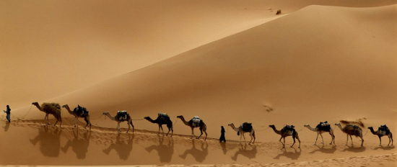
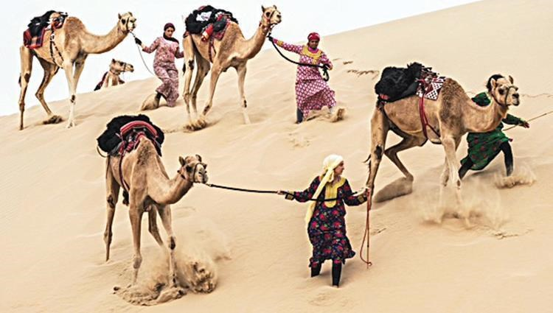
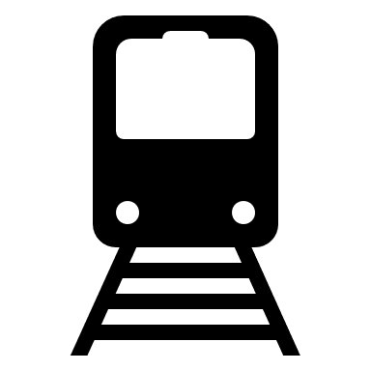
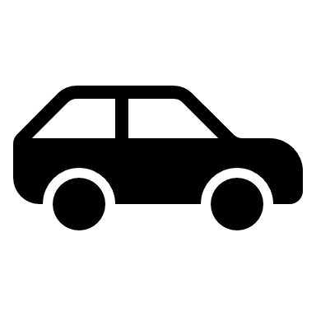
Arabic Language & Darija dialect
Classical Arabic
/qiTar/قطار
/sayyaːrat/سيارة
Camel walking in sequence
Camel walking in simultaneous
Word Time Shifts
MSA
/sayyaːrat/سيارة
/qiTar/قطار
Train
Car
Darija
/toraːn/ تران
/Tuːmuːbiːɫ/ طوموبيل
/sayyaːrat/سيارة
Train
Car
Lexical borrowing
5
Notes:
The following slide presents some special examples. The word 'qitar,' meaning a group of camels walking in order in Classical Arabic, translates to 'train' in Modern Standard Arabic (MSA).
However, in Darija, while it retains the same meaning, it is represented by a different token derived from a French word. Similarly, 'sayara,' which means 'camels walking simultaneously' in Classical Arabic, refers to 'cars' in MSA.
In Darija, it retains the same meaning as in MSA, but also has a representation transliterated from French.
This illustrates the phenomenon of lexical borrowing.

Slide 6
Arabic Language & Darija dialect
Reference article:
Tachicart, Ridouane, Karim Bouzoubaa, and Hamid Jaafar. 2016. “Lexical differences and similarities between moroccan dialect and Arabic”.
6
Notes:
This slide presents some key roots of Darija. Darija has its roots in Modern Standard Arabic (MSA), making up about 80% of its vocabulary.
However, it’s not just Arabic; it also includes words from other languages.
For example, Tamazight, the Berber language, contributes around 4% of Darija's words. Additionally, due to Morocco's history, French has influenced about 11% of Darija's vocabulary, while Spanish contributes roughly 5%.
These statistics are sourced from the article.

Slide 7



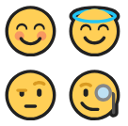
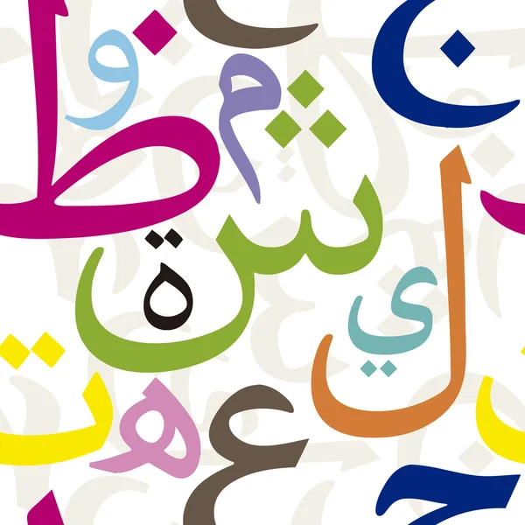
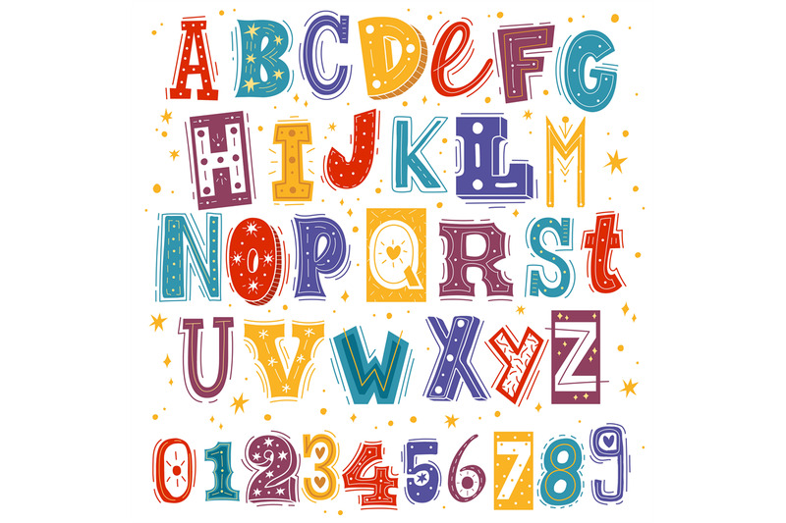
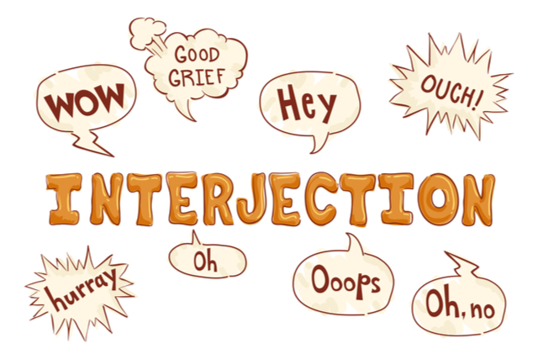
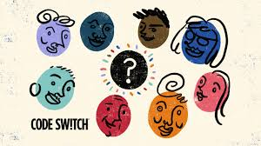
Darija’s Challenge
Poor resources
Challenges
Issues of Texts retrieved from social platforms
Inherent characteristic’s Daija
7
Notes:
On this slide, we highlight the challenges in working with Darija, which include limited linguistic resources,
especially annotated corpora and linguistic data.

Slide 8
Darija’s Challenge
Poor resources
The lack of available linguistic resources and annotated corpora significantly hinders progress.
Issues of Texts retrieved from social platforms
Elongation: مبرووووك ‘congratulation’
Interjection: اوف ‘ohf’
Emoticon.
Lack of Orthographic and Grammatical Rules:
راس ,رءس ,رأس
Early Technology Limitations: ع -> 3, ح -> 7
Code/Script-mixing: اطوg
Inherent characteristic’s Daija
8
Notes:
Additionally, texts sourced from social media platforms present issues such as noise, informal language, and non-standardized spelling, posing challenges for data preprocessing and analysis. As this example present an elongation.
Moreover, the inherent characteristics of Darija,
including the lack of orthographic and grammatical rules,
limited technologies in its early stages, which lead to the adoption of the Latin alphabet with a similar script representation to express unique Arabic sounds, for example
Regarding Darija, there is also a phenomenon of code-switching, which leads to some sounds that do not exist in the Arabic Latin script that cause users switch between scripts to represent the sounds, as in
Lack of Orthographic and Grammatical Rules: Due to the absence of established orthographic and grammatical rules, words are often written as pronounced, leading to variations.
راس , رءس: instead of the standardized رأس
Early Technology Limitations: The lack of Arabic keyboards led users to adopt the Latin alphabet with numbers (Arabizi) to represent unique Arabic sounds, such as:
ع -> 3.
ح -> 7.
Use of Arabic Script with Limitations: With Arabic keyboards now available, people primarily use Arabic script. However, some sounds in Darija, like /g/ in ‘اطوg’ “cake" (a borrowed word from French "gateau“), aren't represented in standard Arabic script, leading to script mixing.

Slide 9


DiMorph
Input: Text
Tokenization
PREPROCESSING
Script mixing normalization
Script mixing normalization
Processing Elongation
Processing Elongation
Automatic Tagging
POSTPROCESSING
MWs LR
Detection of Multi Words
Code mixing
MSA / Darija LR
Not Found
PROCESSING
Processing of Darija
Orthographic Variation
Darija LR
Not Found
Found
Found
Output: Results
9
Notes:
This slide present the second version of DiMorph which consisted of three main phase, the two that we discover previously and the new phase is the post processing
we've implemented a three-step analysis system to handle tokens not found:
Code Switching: Utilizes MSA resources.
Code Mixing: Integrates MSA with Darija clitics.
Orthographic Variation: Concerns certain norms in spelling, which will be discussed later

Slide 10


DiMorph
Script mixing normalization
Numeral character processing:
For example:
فت7ها => فتحها /ftaHɦaː/ `he opened it’
Literal character processing:
For example:
اطوg => گاطو /ɡaːTuː/ `cake’
Elongation processing
بزاافbazza:a:f => بزاف ‘much’
10
Notes:
Which consist of
When each number can be directly replaced by an Arabic letter, we apply automated substitution.
The number 7 is replaced by the letter Hae,
In case where the Latin letter "g“ represents the phoneme /ɡ/, which does not exist in standard Arabic script, we apply automated substitution.
The letter g is replaced by the Persian letter.

Slide 11

DiMorph
Automatic tagging
Implementation of an automatic tagging system to identify:
Punctuation/number
Emoticons
Interjections
Word Foreign
Where the foreign number or word is preceded by a dialectal prefix
(e.g., ب /b/ - ف/f/ - و /w/ - ال /Al/).
For example:
لPaola /l=Paola/ : ل /PREP+WORD_FOREIGN `for Paola’.
ب5000 /b=5000/ : ب/PREP+NUMBER `with 5000’.
11
Notes:
Concerning this phase We've created an automatic tagging system for punctuation and emoticons, along with a curated list of interjections that lack grammatical sense, all tagged automatically.
However, a more complex challenge arises with numbers and Latin letters in dialect texts, especially when they are preceded by a dialectal prefix.

Slide 12

DiMorph
Multi-Word detection
MWs LR
قولي اسي أحمد اش طرى وجرا في قضية الفقيه بن صالح
Tell me Mr Ahmed what happened concerning the Sidi Kacem case
Detection and segmentation
الفقيه بن صالح
Fquih Ben Salah
اش طرى وجرا
what happened
Compound proper noun
Multi-word expression
12
Notes:
This first slide introduces the mechanism we use for segmenting multi-word expressions, or MWEs. These expressions often carry meanings that can't be directly inferred from their individual parts—so treating them as isolated tokens could lead to errors in analysis. To address this, we integrated a multi-word detection component in our preprocessing pipeline. This mechanism relies on a rule-based lexical resource that lists known MWEs along with their meanings. During preprocessing, the system scans the text, identifies these patterns, and processes them as single lexical units before moving on to syntactic or semantic analysis.

Slide 13
DiMorph
Multi-Word detection
MWs LR
 | Multi-Word expressions | Compound proper nouns
Number of Units | 153 | 511
13
Notes:
This slide presents statistics on the presence and distribution of multi-word expressions in our corpus. These figures help us understand how frequently MWEs occur and how essential it is to handle them properly. By quantifying these expressions, we can better assess the impact of our segmentation component on the overall performance of the morphological analysis system.

Slide 14
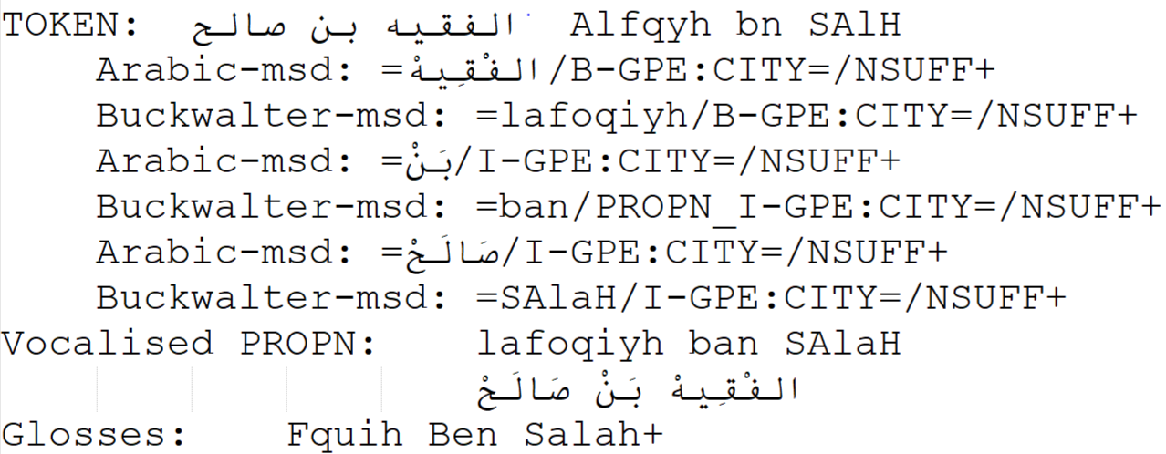
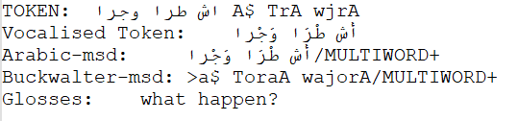
DiMorph
MWs LR
Multi-Word detection
الفقيه بن صالح
Fquih Ben Salah
Compound proper noun
Analyzing
اش طرى وجرا
what happened
Multi word expression
14
Notes:
Now, let's look at how this mechanism plays out in practice. Figure 6 shows an example where a recognized multi-word expression is detected during preprocessing and passed on as a single unit to the analysis module, ensuring accurate interpretation. Figure 7 highlights how we handle named entities. If they appear as a single word, they are managed directly through the lexicon. But when they consist of multiple words, they are also detected during preprocessing—using specialized resources tailored for named entity recognition. Together, these strategies help us maintain both semantic coherence and morphological accuracy throughout the analysis pipeline.

Slide 15


DiMorph
Processing
مَكَنكْتَبش
DET + Verb
Suffix + Enclitics
Proclitics +Prefix
Compatibility between Prefix and Suffix
كْتَب
ن+ كَ+ مَ
ش
Compatibility between Prefix and Stem
Stem
Compatibility between Stem and Suffix
15
Notes:
Here we will discuss the subtokenization process and the system's methodology.
In the example provided, the token is divided into three parts, each requiring specific resources for prefixes, stems, and suffixes.
Rules and compatibility checks are crucial to ensure the accuracy of each split during subtokenization.
This verification is necessary because a determiner particle cannot be combined with a verb.

Slide 16
DiMorph
Linguistic Resources & Processing
Darija LR
DictStem | NOUNS | VERBS | ADJECTIFS | ADVERBS | PROPER NOUNS | PRONOMS | FUNCTION WORDS
Darija | 8760 | 11647 | 1674 | 214 | 931 | 92 | 153
Foreign | 675 | 122 | 33 | 8 | 100 | - | 3
DictPrefix | DictSuffix | Compatibility Tables
proclitics + prefixes | suffixes + enclitics | Prefix=Stem | Stem=Suffix | Prefix=Suffix
394 | 641 | 770 | 780 | 1067
16
Notes:
Now, let’s have a look on some key statistics extracted from our linguistic resources.
We have two main tags: Darija and foreign, divided into 7 types of sub-tags, as shown in the table.
The second table illustrates
The list of Proclitics=prefix and suffix=enclitics
Also the number of rules that Compatibility tables use to check the subtokenization.
Function word: les la ni ni

Slide 17
DiMorph
Postprocessing
MSA / Darija LR
MSA Token Processing in Darija: Detecting Code-Mixing Tokens in DiMorph through Analysis of Clitics in Darija and Stem in MSA.
For example:
كيستفزها
/kayastafazzha/ “He is provoking her”
17
Notes:
the system identifies MSA words inflected according to Darija codes, indicative of code-mixing. DiMorph then employs both MSA-specific and Darija-specific resources to analyze the tokens, tagging them accordingly.

Slide 18
DiMorph
Postprocessing
Orthographic Variation
Standardize written forms according to orthographic rules, ensuring that spelling variations are unified into a single, consistent form.
Type | Variation | Example
Hamza Normalization | ء, أ, ئ, إ, ؤ → unified form | سأل → سءل, سال
Phonological Shifts | ث → ت | ثلاثة → تلاتة
 | ذ → د | ذهب → دهب
 | ظ → ض | ظلام → ضلام
Word-Final Changes | و → ه | عنده → عندو
 | ة → ا | ركبة → ركبا
18
Notes:
in this step, we Normalize written forms according to standardized orthographic rules, so that variations in spelling are unified into a single, consistent form.
This approach ensures that regardless of how a word is written, it aligns with the standardized orthography, providing a unique solution for each term. As the following
This table summarizes the three main types of orthographic variation handled by DiMorph when analyzing Darija.
First, Hamza normalization, where inconsistent uses of the Hamza are unified
Second, phonological shifts, such as interdental sounds turning into dental stops
Third, word-final changes, where endings are altered

Slide 19
Results & discussion
Evaluation
In-Vocabulary Rate (INV Rate): Measures the percentage of tokens successfully analyzed by the system.
Out-of-Vocabulary Rate (OOV Rate): Measures the percentage of tokens the system could not analyze.
 | Total Tokens | INV rate | OOV rate
DiMorph with Preprocessing and Postprocessing | 11 085 | 97.84% | 2.16%
19
Notes:
To evaluate our system, we use two main metrics:
INV rate and OOV rate.
These metrics reflect the system's ability to handle known terms and identify areas with unknown or dialectal terms, helping to uncover linguistic gaps.
By incorporating both preprocessing and postprocessing components, DiMorph achieves an impressive text recognition and analysis rate of 96%.

Slide 20
Results & discussion
Evaluation
Further statistical analysis reveals that:
89.71% of the cases corresponds to instances of homography.
9.31% of the cases corresponds to instances of polysemy.
0.98% of the ambiguity is due to the absence of vocalization.
20
Notes:
Looking at the lexical ambiguity in our corpus, we find that around 40.5% of the tokens are unambiguous, meaning each has a single, clear interpretation. For instance, the word تبرهيش is uniquely interpreted as 'stupidity'. However, the remaining 59.5% of the tokens show multiple interpretations, which we can break down into three categories: First, the majority—nearly 90%—are cases of homography. These are words that look the same in writing but differ in meaning and syntactic role. For example, غير can be an adverb meaning 'only' or a verb meaning 'be jealous'. Second, about 9.3% are polysemous, where one form with the same morphosyntactic description carries related meanings. An example is عاود, which can mean either 'tell' or 'repeat'. Finally, around 1% of ambiguity is due to lack of vocalization, leading to morphological syncretism. In this case, the form is the same, but context changes its interpretation. Take كتبت—it could mean 'I wrote', 'you wrote', or 'she wrote' depending on the syntactic context. This analysis highlights the importance of morphological disambiguation in processing Darija.

Slide 21
Conclusion
DiMorph's Analysis Capacity
Average Analyses per Token:
DiMorph provides, on average, 1.45 possible analyses for each token.
This metric highlights the system's current capability to generate multiple solutions per token, indicating flexibility in interpretation.
Challenges:
Out-of-Context Issue: While DiMorph generates multiple analyses, it often lacks the ability to determine the correct analysis in context, leading to potential ambiguity.
21
Notes:
DiMorph generates an average of 1.45 possible analyses per token, reflecting its flexibility in offering multiple interpretations.
However, a challenge is the out-of-context issue, where the system struggles to determine the correct analysis in context, leading to potential ambiguity.

Slide 22
Perspectives
Enrich the Moroccan DiMorph linguistic resources.
Apply deep learning models to provide context-aware solutions and accurately annotate the Moroccan corpus.
22
Notes:
For future works, we plan to:
Link open sources

Slide 23
Thank you for your attention
Nadia khlif nadia.khlif@ump.ac.ma
Azzeddine Mazroui azze.Mazroui@gmail.com
Ouafae Nahli ouafae.nahli@ilc.cnr.it

