Slide 1
JAMHURIYA UNIVERSITY OF SCIENCE AND TECHNOLOGY
Linux Practical Project
Student Name: ILYAS IBRAHIM YUSUF
Student ID: C6240179

Slide 2
Contents
Chapter 1
Introduction to Linux and Ubuntu
Questions, answers and commands
Chapter 2
Linux System Architecture and Management
Questions, answers and commands
Chapter 3
Text Processing, Searching, Archiving and Editing
Questions, answers and commands
Chapter 4
Process, Service and System Management
Questions, answers and commands

Slide 3
MAIN QUESTIONS AND ANSWERS
Chapter 1: Introduction to Linux and Ubuntu
Q1. Run cat /etc/os-release and write down what you see. (Lab sheet, slide 50)
The file says NAME="Ubuntu", VERSION="24.04 LTS (Noble Numbat)", ID=ubuntu and ID_LIKE=debian. So the distribution is Ubuntu 24.04 LTS, from the Debian family.
Q2. Open a terminal and explain each part of your prompt. (Practical exercise 1)
darsade@ubuntu:~$ means: darsade is the user, ubuntu is the host name, ~ is the current directory (my home), and $ shows a normal user. If it were root the last sign would be #.
Q3. Why do uname -r and /etc/os-release give different answers? (Practical exercise 2)
Because they describe two different layers. uname asks the running kernel for its release; /etc/os-release is a text file written by the distribution. One Ubuntu version can run many kernel releases.
Q4. Run command -v apt dnf. Which family does the system belong to? (Practical exercise 3)
Only /usr/bin/apt was printed; dnf gave nothing and typing dnf said command not found. A system with apt and dpkg but no dnf is in the Debian family, and ID_LIKE=debian confirms it.
Q5. Is the release LTS? In which year and month was it released? (Practical exercise 4)
Yes. lsb_release shows 24.04 and the description says LTS. Reading YY.MM, 24.04 means April 2024.
Q6. What is the licence of bash? Is it copyleft or permissive? (Practical exercise 5)
The copyright file says License: GPL-3+, the GNU GPL version 3 or later. The GPL is copyleft, so changed versions must keep the same freedoms.
Q7. What do you do if the VM is stuck on "remove installation medium"? (Lab, slide 48)
Go to Settings → Storage, remove the Ubuntu ISO from the virtual optical drive, then press Enter in the VM. It restarts from the virtual disk and you can log in.

Slide 4
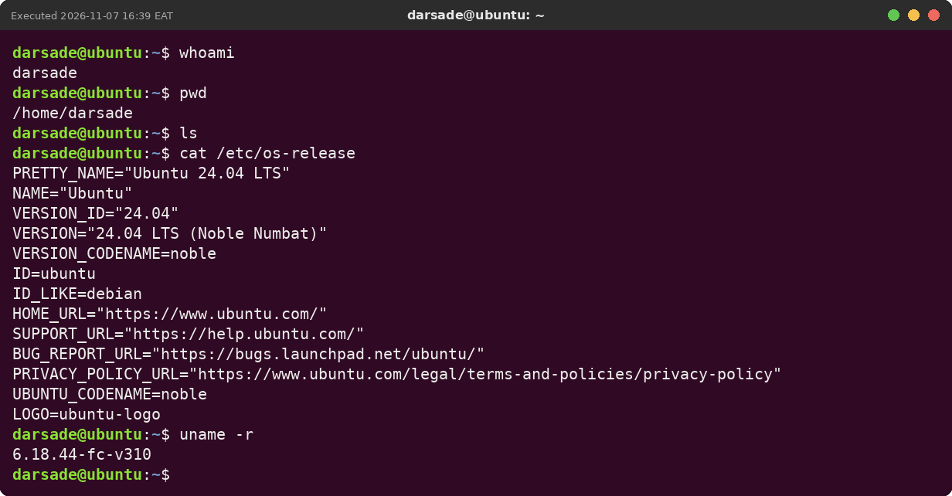
CHAPTER 1
First lab commands: who, where, which system
whoami
prints the user running the shell (darsade)
pwd
prints the current directory as a full path
ls
lists the files in the current directory
cat /etc/os-release
shows the distribution: Ubuntu 24.04 LTS, Debian family
uname -r
shows the kernel release — not the same thing as the distribution

Slide 5
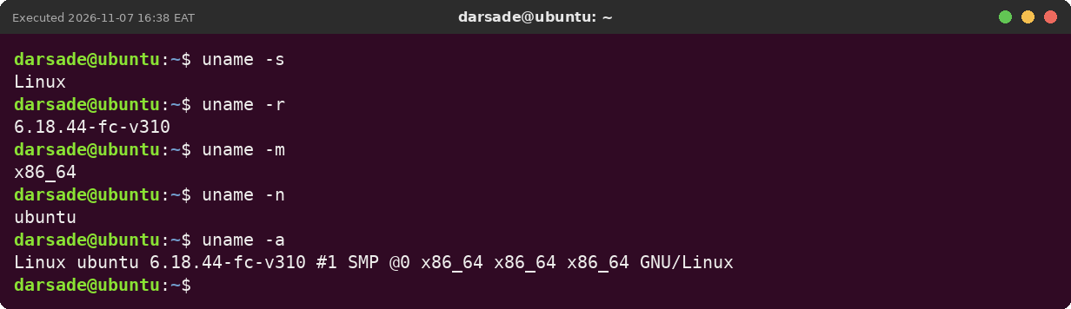
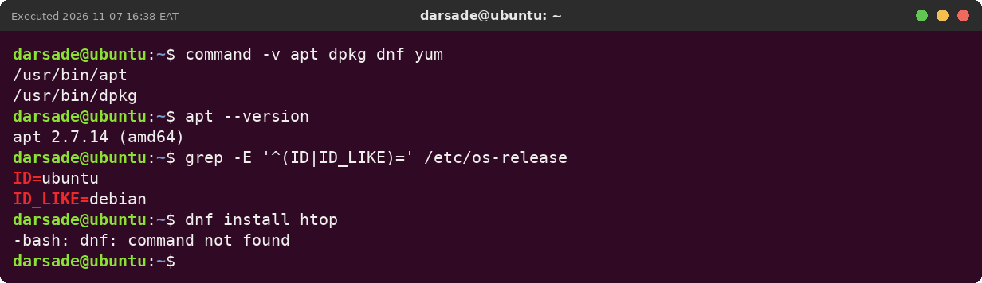
CHAPTER 1
Kernel facts and the package toolbox
uname -s / -m / -n / -a
kernel name, CPU type, host name, everything
command -v apt dnf yum
only apt exists: this is a Debian-family system
dnf install …
fails with command not found — Red Hat commands don't work on Ubuntu

Slide 6
MAIN QUESTIONS AND ANSWERS
Chapter 2: Linux System Architecture and Management
Q1. You install a new program. Which two directories are most likely to change? (Slide 10)
/usr, where the program files go (for example /usr/bin), and /etc, where its configuration goes. Logs or data may later appear in /var as well.
Q2. Your VM has a network card called enp0s3. Where would the kernel publish information about it? (Slide 11)
In /sys, under /sys/class/net/enp0s3. /sys is for devices and drivers, /proc is mainly for processes. In the lab the same folder existed for eth0 and showed its MAC address.
Q3. Label each part of: cp -i notes.txt backup (Slide 20)
cp is the command, -i is the option (ask before overwriting), notes.txt and backup are the two arguments: the source and the destination.
Q4. Write two different ways to cd into a directory called My Files. (Slide 29)
cd "My Files" and cd My\ Files. Both work, and pwd then shows the path ending in /My Files.
Q5. What is the difference between rm *.txt and rm * .txt? (Slide 31)
rm *.txt removes only the .txt files. rm * .txt (with a space) removes every file in the folder and then tries a file called .txt. echo rm * .txt showed the full list it would delete.
Q6. When you type ls, how does Bash know which file to run? (Slide 32)
It looks through the directories in PATH from left to right and runs the first file called ls. Here that is /usr/bin/ls (after first checking aliases and built-ins).
Q7. What does echo 'Home is $HOME' print? And with double quotes? (Slide 28)
With single quotes: Home is $HOME, exactly as typed. With double quotes: Home is /home/darsade, because $HOME is expanded.
Q8. Which is safer while learning, rm -r or rm -ri, and what do you lose by using it? (Slide 49)
rm -ri is safer because it asks before each file. The cost is time: you must answer y or n many times in a big folder.

Slide 7
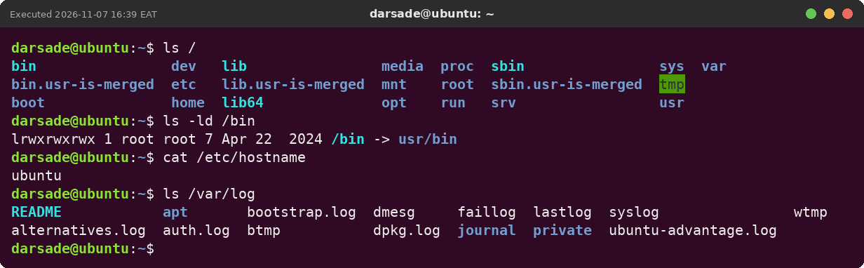
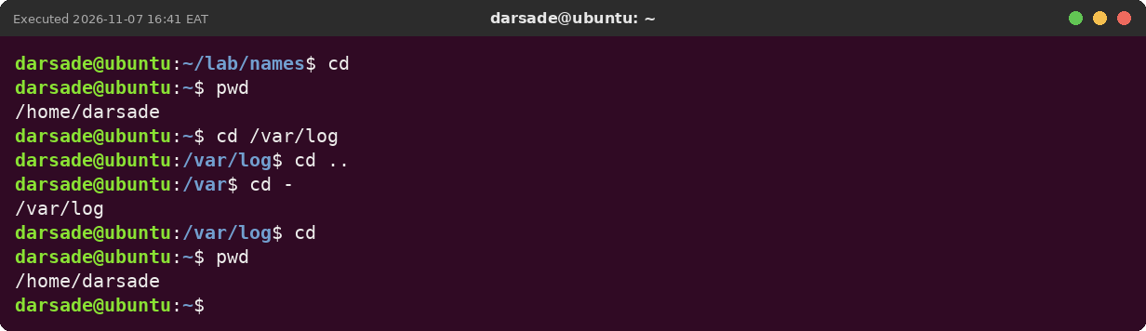
CHAPTER 2
The filesystem tree and moving around
ls /
top of the single tree — no drive letters
ls -ld /bin
/bin is only a link to /usr/bin
cat /etc/hostname
settings are plain text files in /etc
cd /var/log · cd .. · cd - · cd
absolute path, up one level, back, home
pwd
confirms where you are

Slide 8
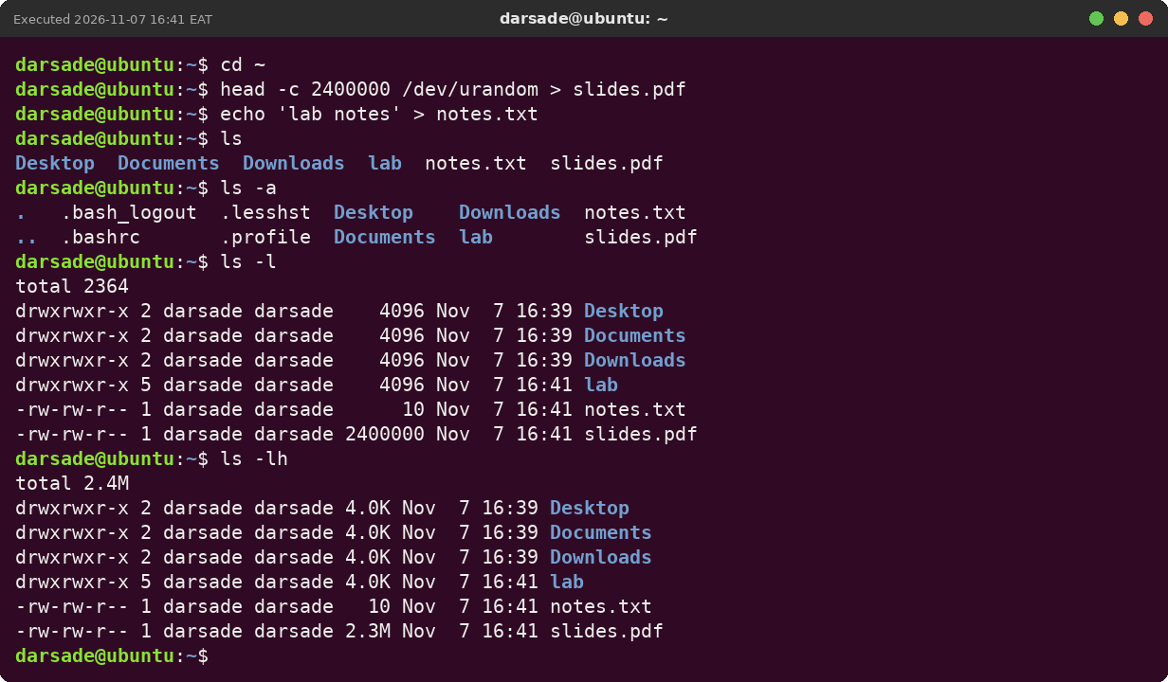
CHAPTER 2
ls options: -a, -l, -h
ls -a
also shows hidden dot-files
ls -l
one line per file: type, permissions, owner, size, date
ls -lh
sizes in K/M/G (2400000 → 2.3M)

Slide 9
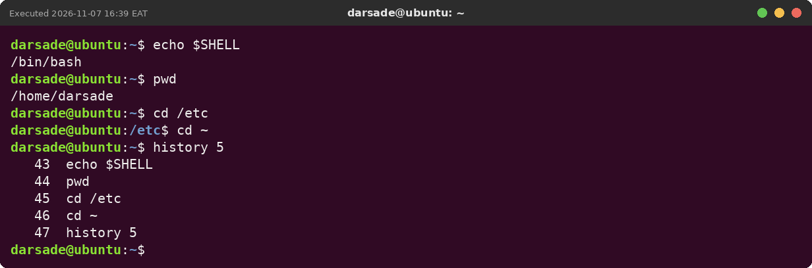
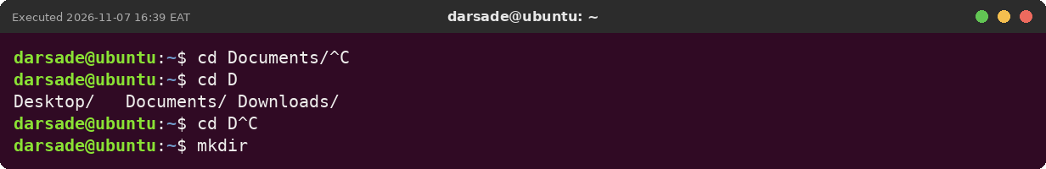
CHAPTER 2
History and Tab completion
echo $SHELL
the shell is /bin/bash
history 5
the last five commands, numbered
Tab / Tab Tab
complete a name / list all matches

Slide 10
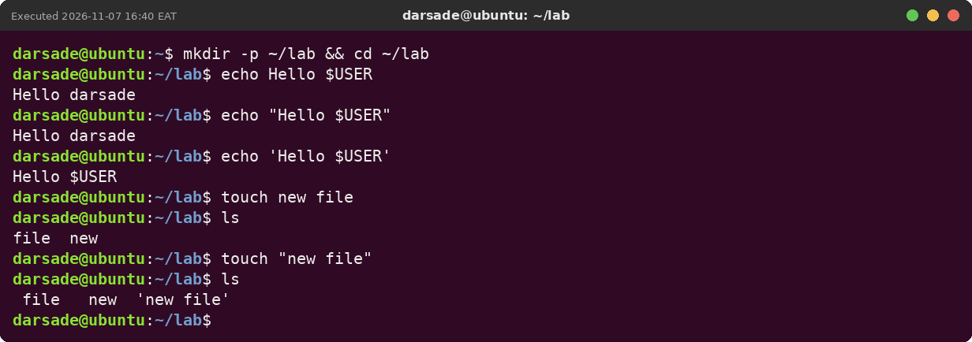
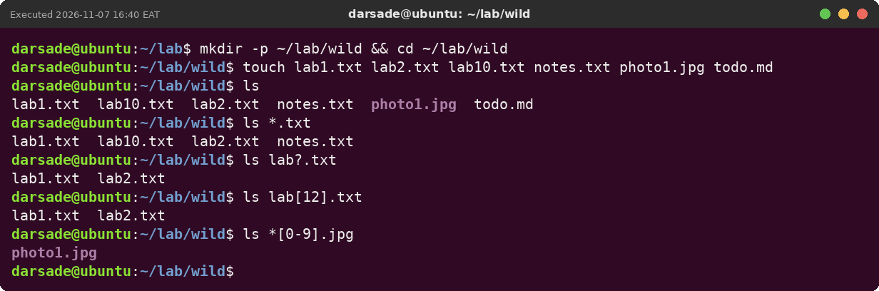
CHAPTER 2
Quotes and wildcards
echo "Hello $USER" vs 'Hello $USER'
double quotes expand $, single quotes don't
touch new file vs touch "new file"
two files vs one file with a space
ls *.txt · lab?.txt · lab[12].txt
any chars · exactly one char · one from a set

Slide 11
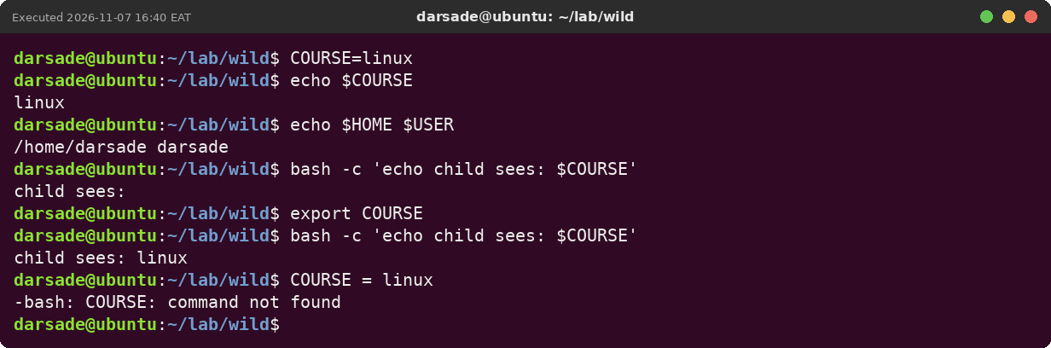
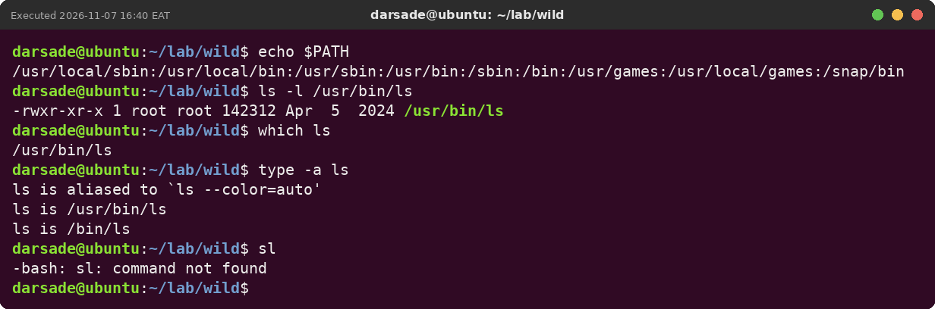
CHAPTER 2
Variables and PATH
COURSE=linux · echo $COURSE
set and read a variable (no spaces around =)
export COURSE
child programs now see it
echo $PATH · which ls
where Bash looks for programs; ls is /usr/bin/ls
sl
not in any PATH folder → command not found

Slide 12
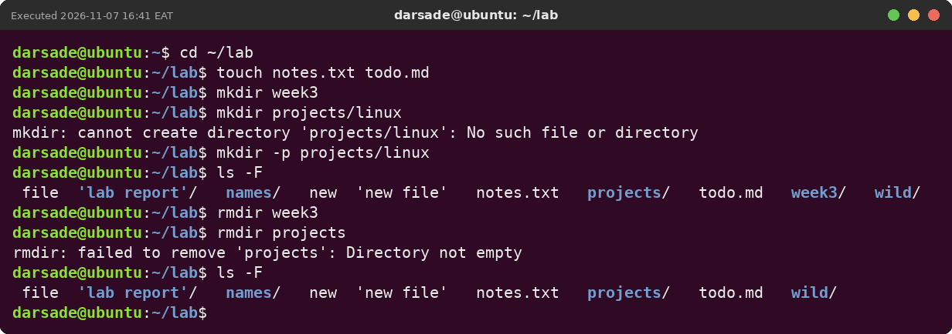
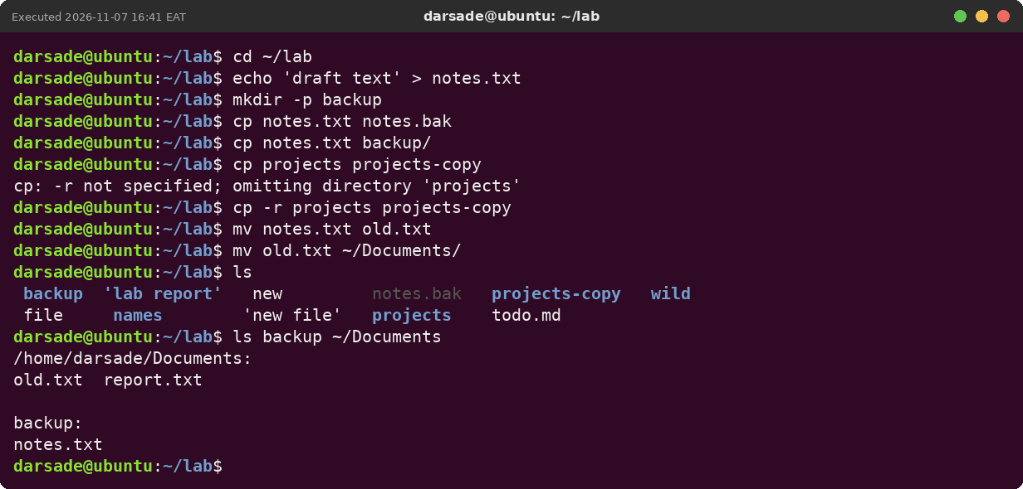
CHAPTER 2
Creating, copying and moving
touch · mkdir -p · rmdir
empty file · whole path · only empty folders
cp · cp -r
copy a file · copy a whole directory
mv
rename, or move into another folder

Slide 13
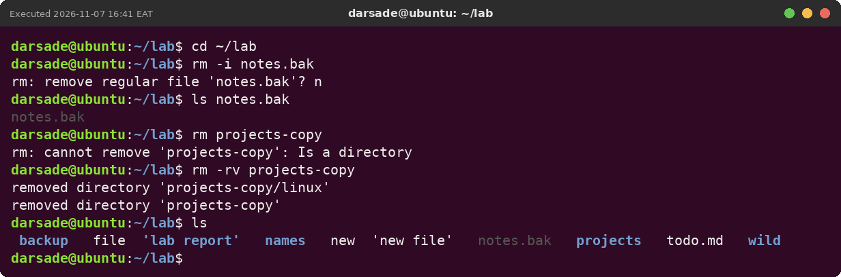
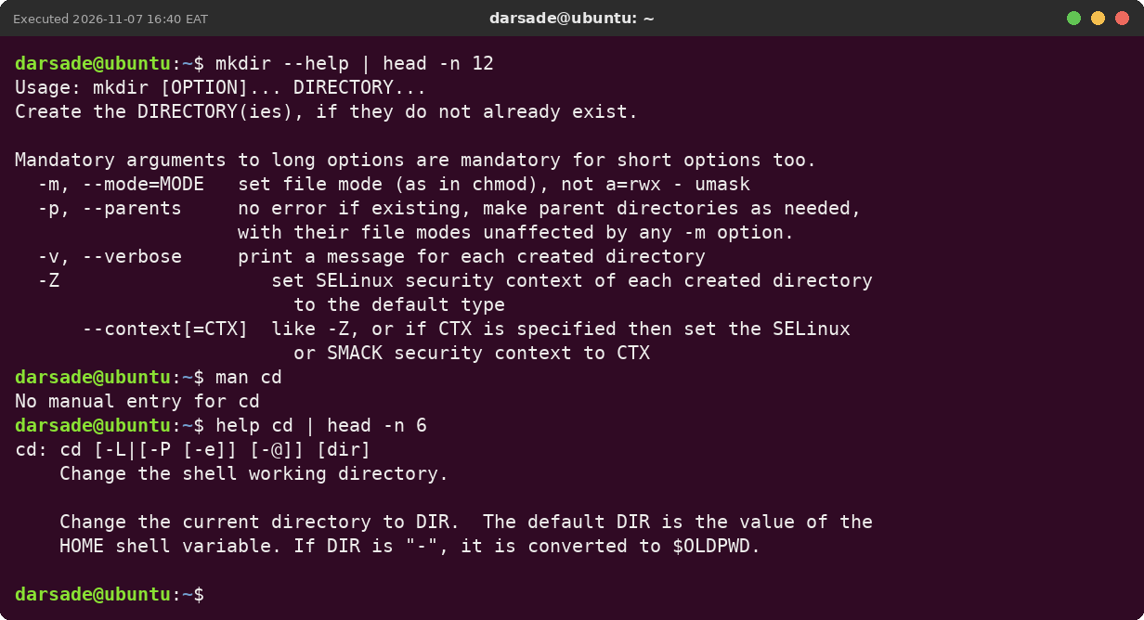
CHAPTER 2
Removing safely and getting help
rm -i
asks before each file (we answered n)
rm -r
needed for directories; there is no Trash
mkdir --help · help cd
quick help; cd is a Bash built-in, so man cd has no page

Slide 14
MAIN QUESTIONS AND ANSWERS
Chapter 3: Text Processing, Searching, Archiving and Editing
Q1. Save ls names.txt nothing.txt: output to ok.txt, error to bad.txt. (Practical exercise 4)
ls names.txt nothing.txt > ok.txt 2> bad.txt. Nothing appeared on screen; ok.txt holds names.txt and bad.txt holds the cannot access message.
Q2. Why does uniq alone not remove all duplicates? (Slide 37 (uniq))
It only compares neighbouring lines. Mogadishu was not next to its copies, so it stayed twice until the file was sorted first.
Q3. Why did sort put 100 before 7? (Slide 36 (sort))
Without -n, sort compares text character by character, and the character 1 comes before 7. sort -n compares the numbers.
Q4. What happens if you type :q after changing a file in Vim? (Slide 60 (Vim))
Vim refuses with E37: No write since last change. Use :wq to save or :q! to throw the change away.
Q5. After renaming the target, why does the symbolic link fail but the hard link would not? (Slide 64–66 (links))
A symbolic link stores a path, and that path no longer exists. A hard link points to the inode itself, so the data stays reachable under any of its names.
Q6. What is conditional command chaining? (Slide 34)
Joining commands so the next one runs depending on the last one's exit status: ; always runs it, && only after success (status 0), || only after failure. In the lab, test -f missing.txt || echo 'Not found' printed Not found.
Q7. Should you use find or locate? (Slide 20)
find when you need fresh results or conditions like size, type or age; locate when you just want a fast name search and the index is up to date.
Q8. What is the difference between archiving and compression? (Slide 47)
Archiving (tar) puts many files into one file but does not make them smaller. Compression (gzip, bzip2, xz) makes data smaller. tar -czf does both at once.

Slide 15
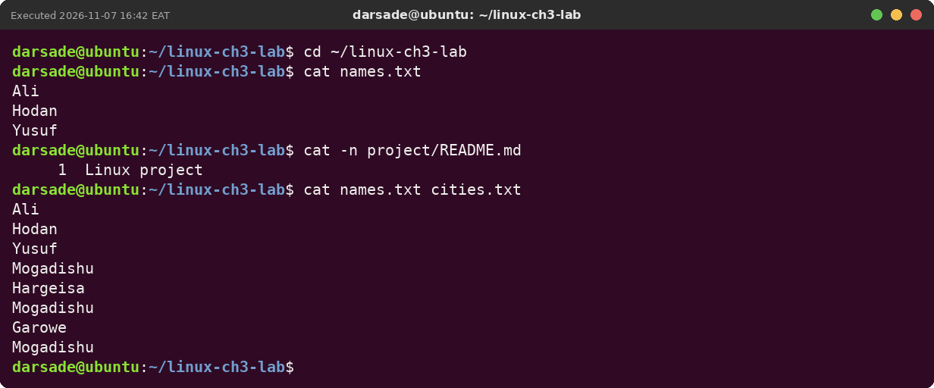
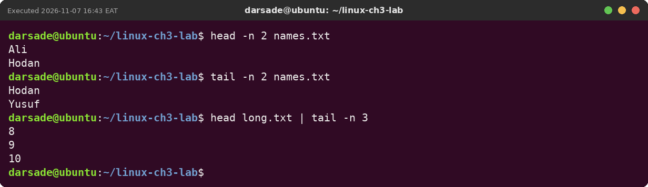
CHAPTER 3
Viewing files: cat, head, tail
cat -n FILE
print a file, with line numbers
head -n 2 · tail -n 2
first / last lines
tail -f app.log
follows a log live (Ctrl+C to stop)

Slide 16
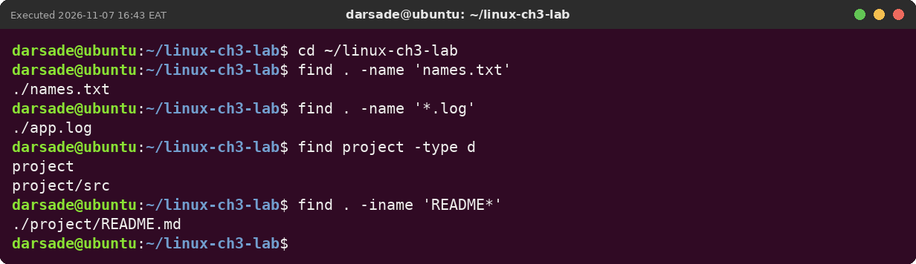
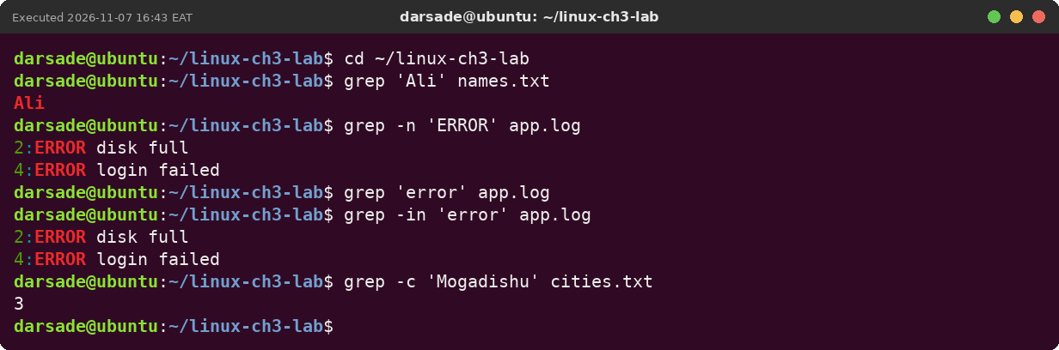
CHAPTER 3
Finding files and searching inside them
find . -name '*.log'
search by name (quote the pattern)
find project -type d
only directories
grep -n 'ERROR' app.log
matching lines with numbers
grep -i · grep -c
ignore case · count matches

Slide 17
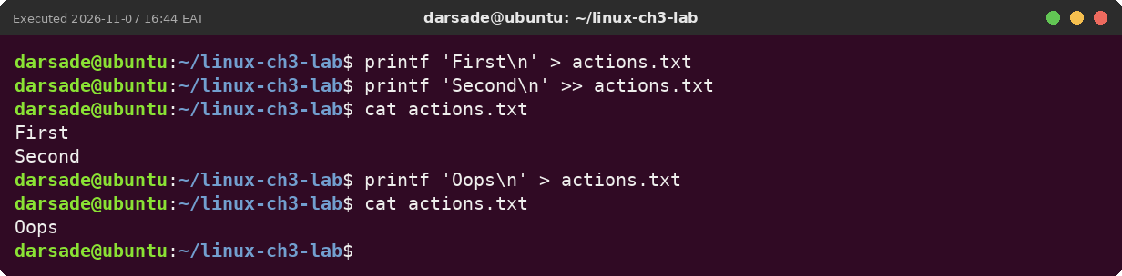
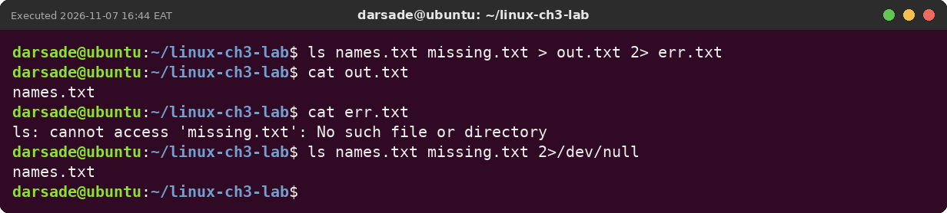
CHAPTER 3
Redirection: > >> 2>
> and >>
overwrite / append to a file
> out.txt 2> err.txt
results and errors into separate files
2>/dev/null
throw error messages away

Slide 18
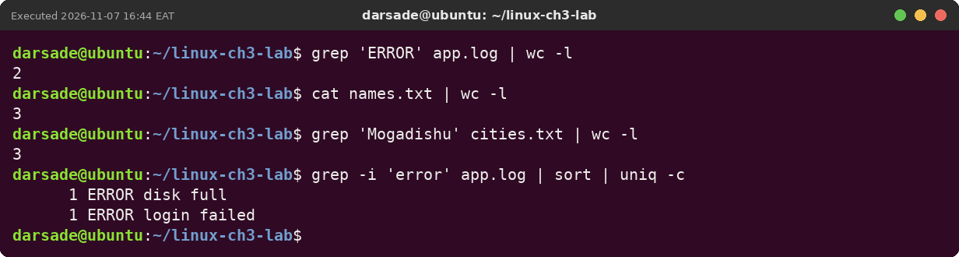
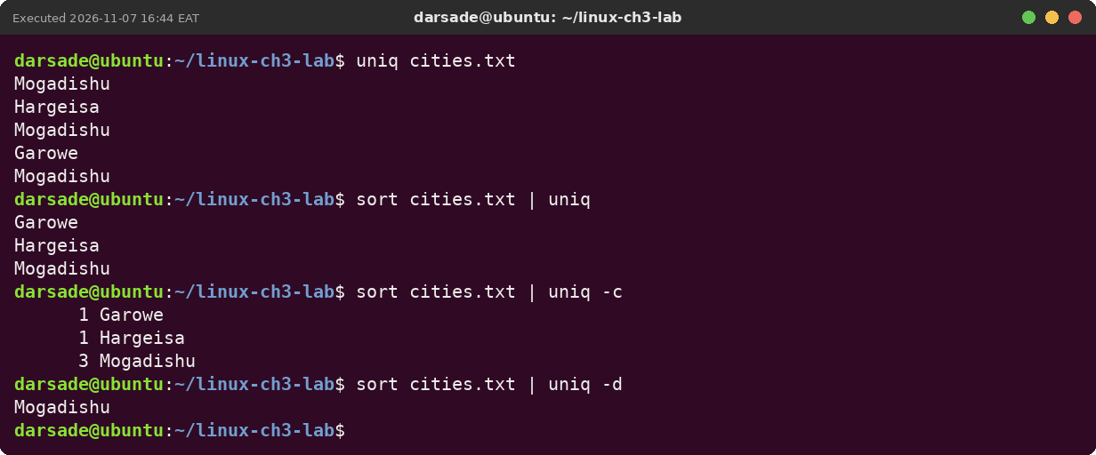
CHAPTER 3
Pipes, sort and uniq
grep 'ERROR' app.log | wc -l
count matching lines → 2
sort | uniq
uniq only removes neighbours, so sort first
uniq -c
count each value → 3 Mogadishu

Slide 19
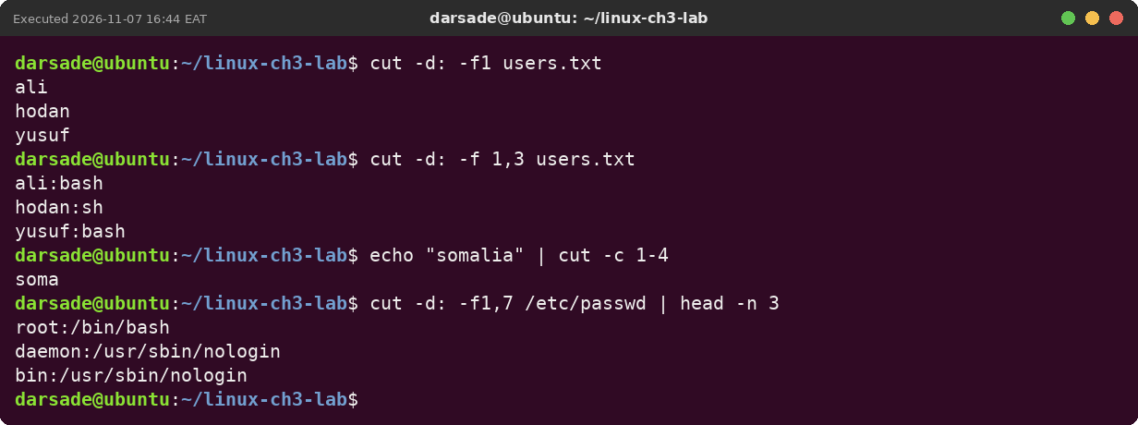
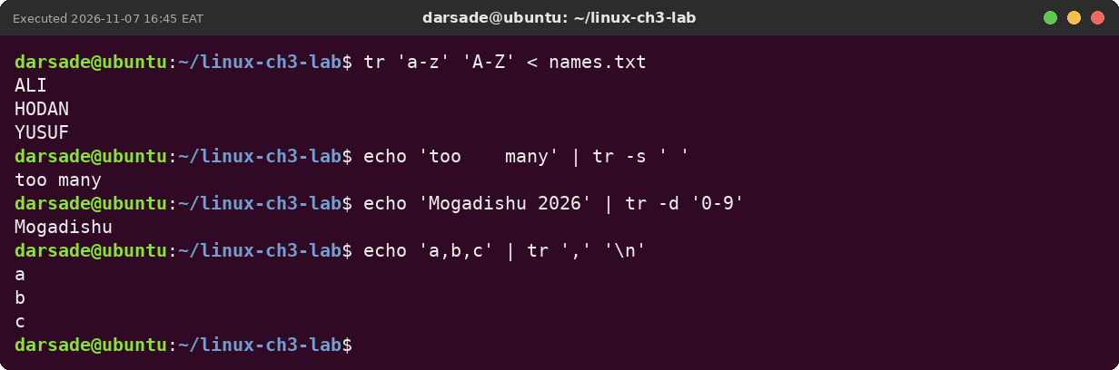
CHAPTER 3
cut, paste and tr
cut -d: -f1 users.txt
pick one field
cut -c 1-4
pick characters
tr 'a-z' 'A-Z' < file
change characters (reads stdin only)
tr -s ' ' · tr -d '0-9'
squeeze repeats · delete characters

Slide 20
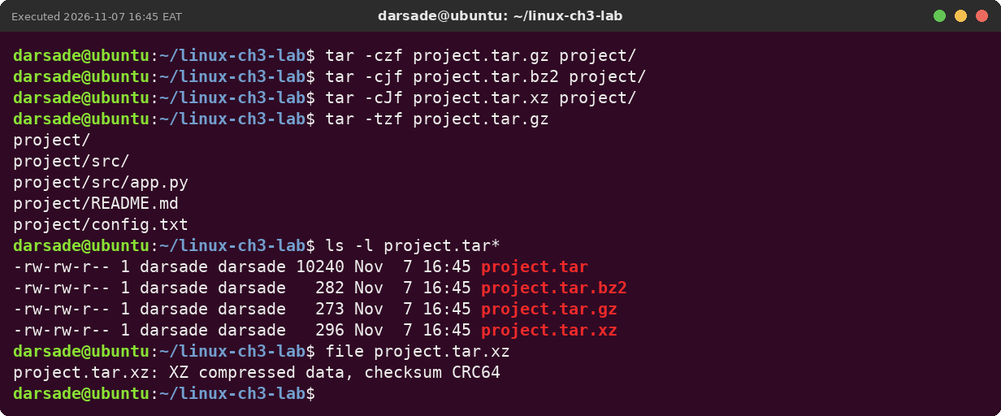
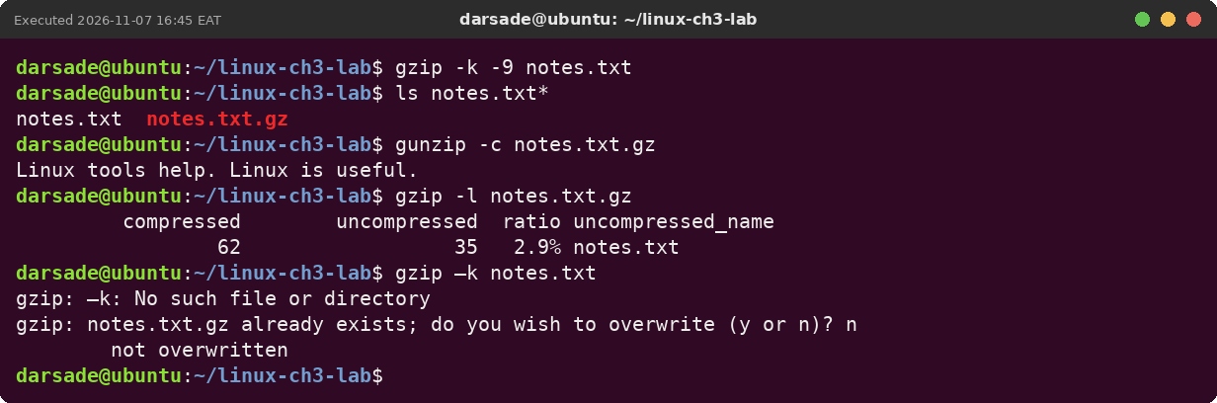
CHAPTER 3
Archives and compression
tar -czf / -cjf / -cJf
archive + gzip / bzip2 / xz
tar -tzf
look inside before extracting
gzip -k -9 · gunzip -c
compress keeping the original · read back
gzip –k
the slide's long dash breaks the option — type a normal -

Slide 21
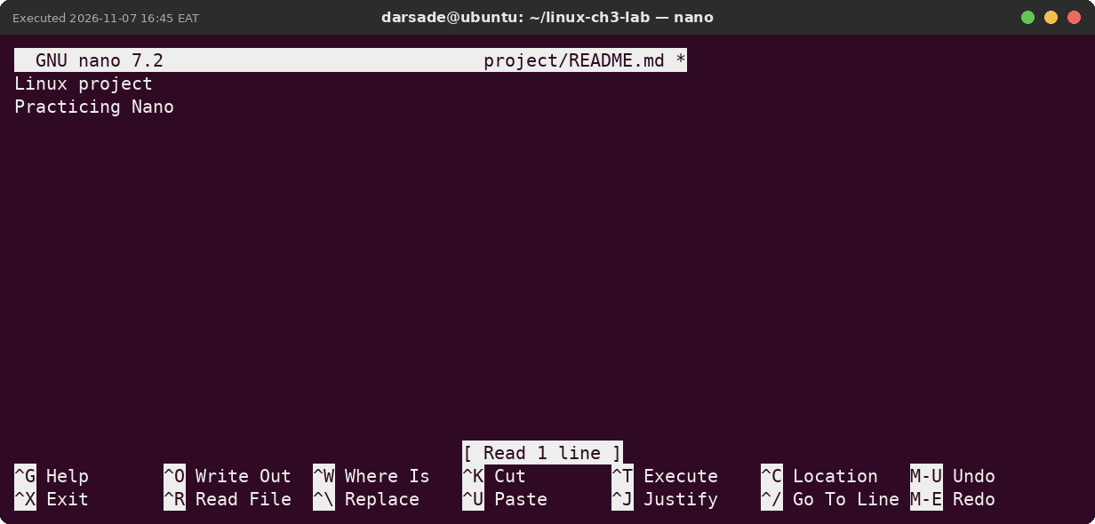
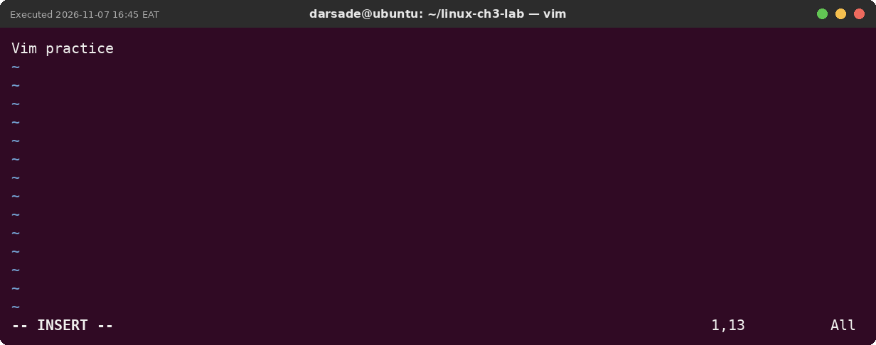
CHAPTER 3
Editing in nano and Vim
nano FILE
type directly; Ctrl+O saves, Ctrl+X exits
vim FILE · i · Esc
Insert mode to type, Esc back to Normal
:wq · :q!
save and quit · quit without saving

Slide 22
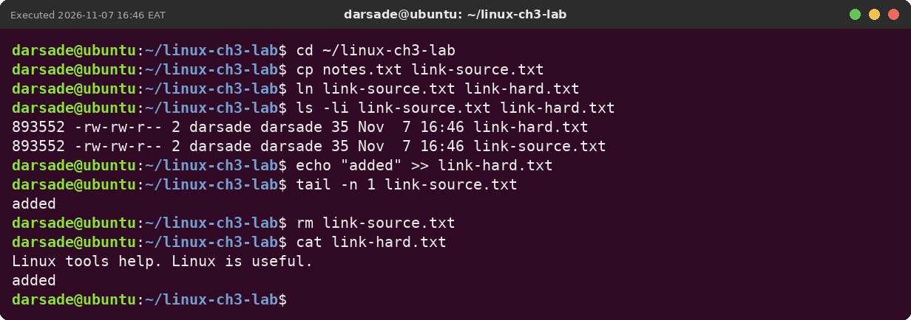
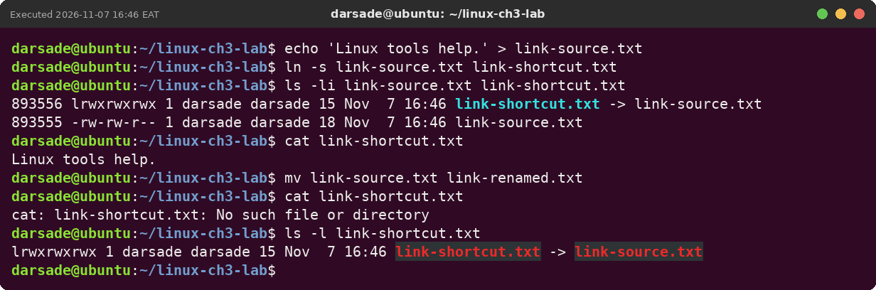
CHAPTER 3
Hard links and symbolic links
ln FILE NAME
second name, same inode (link count 2)
ln -s FILE NAME
a shortcut that stores a path
ls -li
shows inode numbers; a renamed target breaks the symlink

Slide 23
MAIN QUESTIONS AND ANSWERS
Chapter 4: Process, Service and System Management
Q1. Start sleep 900, pause it with Ctrl+Z, resume it in the background, then end it with kill %1. (Practical exercise 2)
Ctrl+Z printed Stopped, bg printed [1]+ sleep 900 &, jobs -l showed it Running, and kill %1 ended it (Terminated).
Q2. Start a job with nice -n 15, then renice it to 5 with and without sudo. (Practical exercise 3)
Without sudo renice failed with Permission denied, because lowering niceness makes a process greedier. With sudo it changed 15 → 5 and ps showed NI 5.
Q3. Why should you try kill (TERM) before kill -9? (Slide 17 (TERM first))
TERM lets the program save files and clean up. -9 cannot be caught, so unsaved work and lock files are lost. In the lab a program ignored TERM and only -9 removed it.
Q4. Which column of free should you read, and why does "free" look small? (Slide 26 (free))
available. Linux uses spare RAM as cache (buff/cache) and gives it back when programs need it, so free alone looks smaller than what is really usable.
Q5. What is the difference between stop and disable? (Slide 39 (stop vs disable))
stop ends the service now but it starts again at boot if enabled. disable only changes the boot behaviour and leaves it running now.
Q6. A service misbehaves. In which order do you investigate? (Slide 49 (calm order))
systemctl status → journalctl -u (find the first error) → the configuration in /etc, tested before restarting (for ssh: sudo sshd -t).
Q7. The machine is slow. In which order do you investigate? (Slide 50 (calm order))
uptime (load vs nproc) → free -h (available memory) → top (P or M, note the PID), then wait, renice, or TERM.
Q8. Reload or restart? (Slide 37)
reload makes the running service re-read its config without stopping (same PID). restart stops it and starts a new process. In the lab ssh could reload, but cron answered "reload is not applicable", so restart was needed.

Slide 24
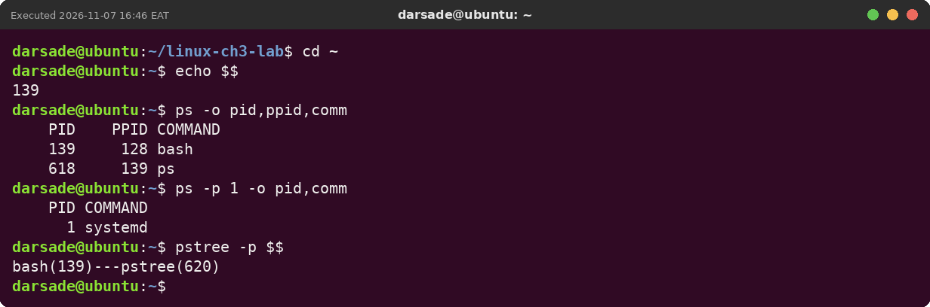
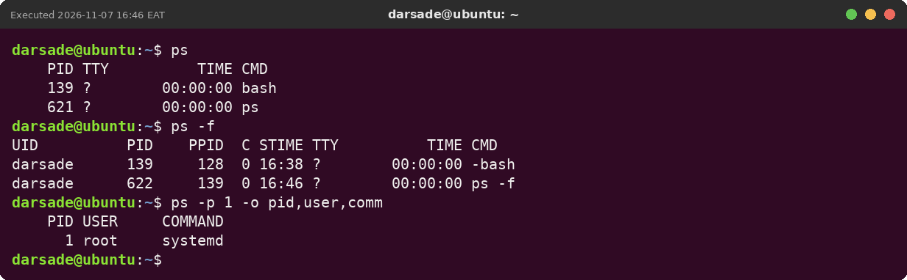
CHAPTER 4
Processes: PID, PPID and ps
echo $$
PID of your own shell
ps -o pid,ppid,comm
ps is a child of bash
ps -p 1
PID 1 is systemd
ps -f
adds owner, PPID and start time

Slide 25
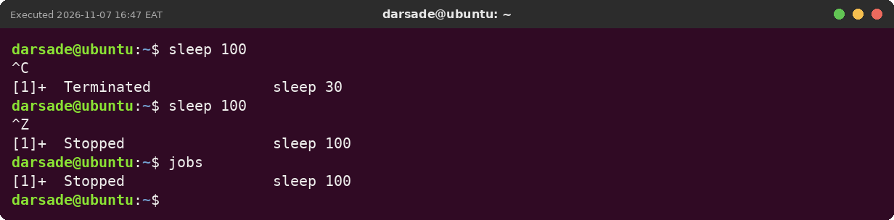
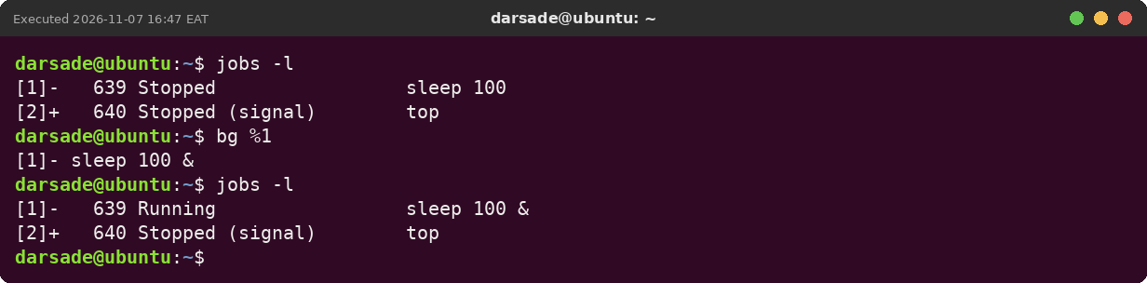
CHAPTER 4
Jobs: Ctrl+C, Ctrl+Z, jobs, bg, fg
Ctrl+C
ends the foreground job
Ctrl+Z
pauses it (Stopped)
jobs -l · bg %1 · fg
list, resume in background, bring back

Slide 26
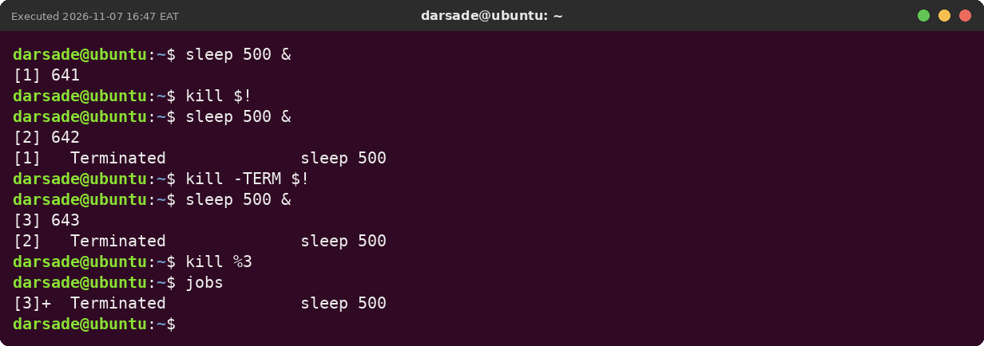
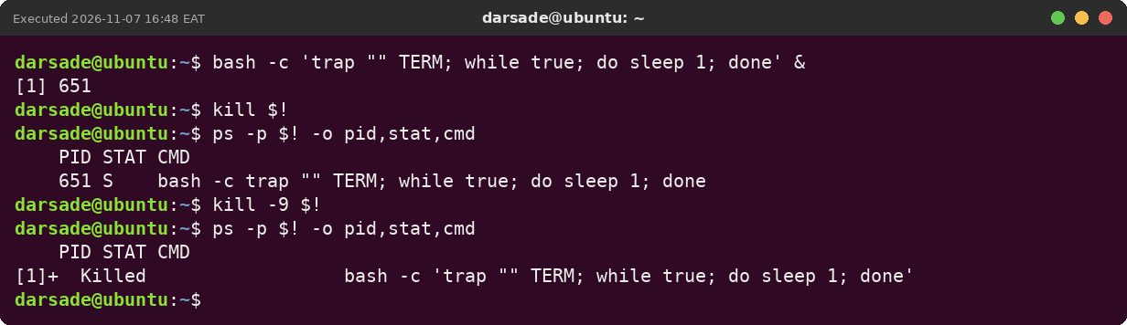
CHAPTER 4
Signals: kill, TERM first, KILL last
kill PID · kill %3
send SIGTERM by PID or job number
kill -9 PID
SIGKILL — the program ignored TERM, -9 removed it
ps -p PID
check if it is still there

Slide 27
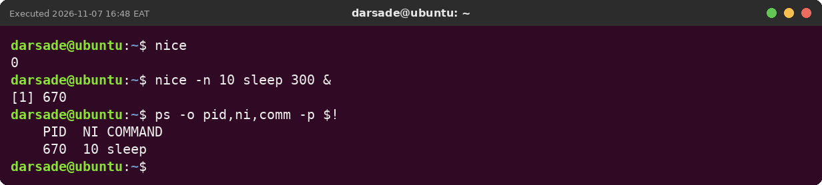
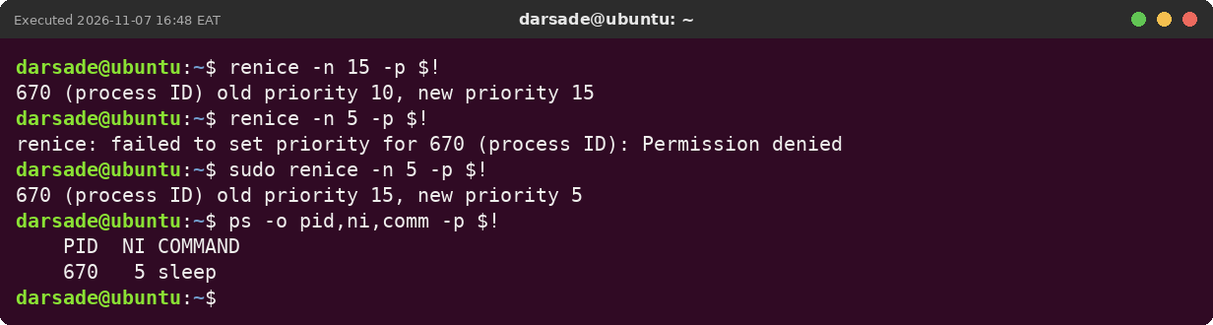
CHAPTER 4
Priority: nice and renice
nice -n 10 cmd &
start with lower priority
renice -n 15 -p PID
kinder: allowed for any user
renice -n 5 (needs sudo)
greedier: Permission denied without sudo

Slide 28
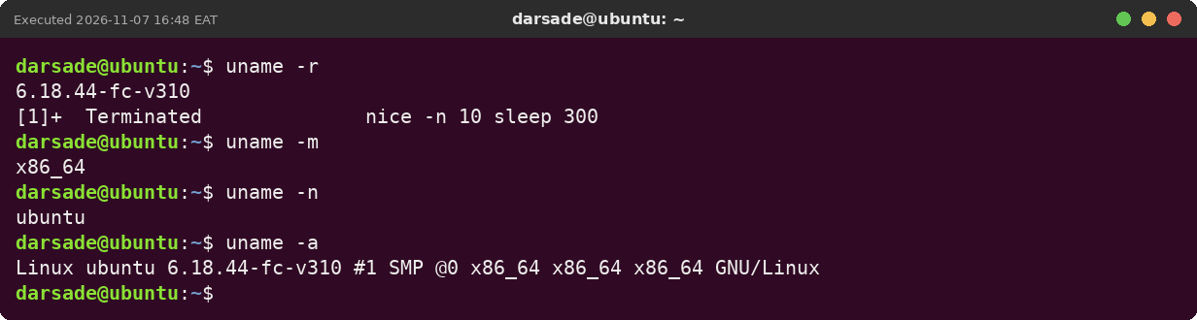
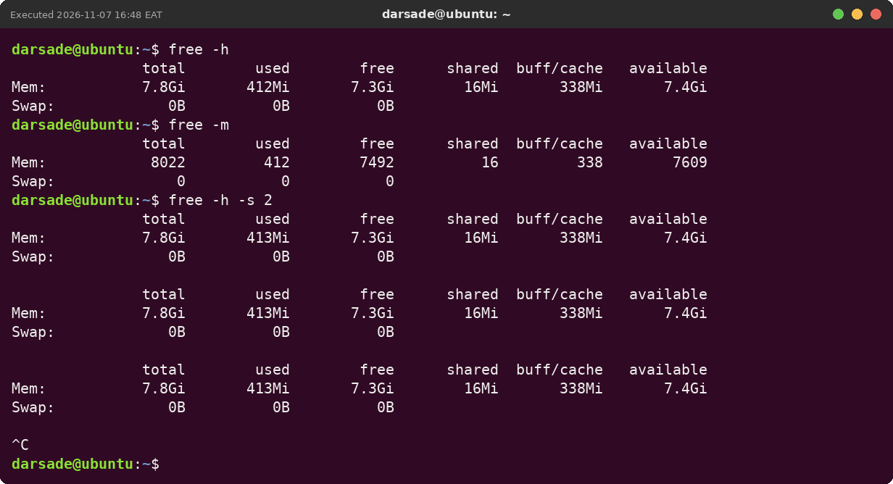
CHAPTER 4
System information
uname -r -m -n -a
kernel release, CPU type, host name
free -h
memory; read the available column
free -h -s 2
repeat every 2 seconds

Slide 29
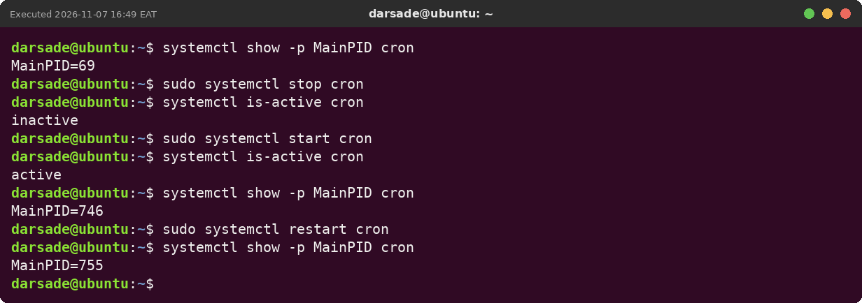
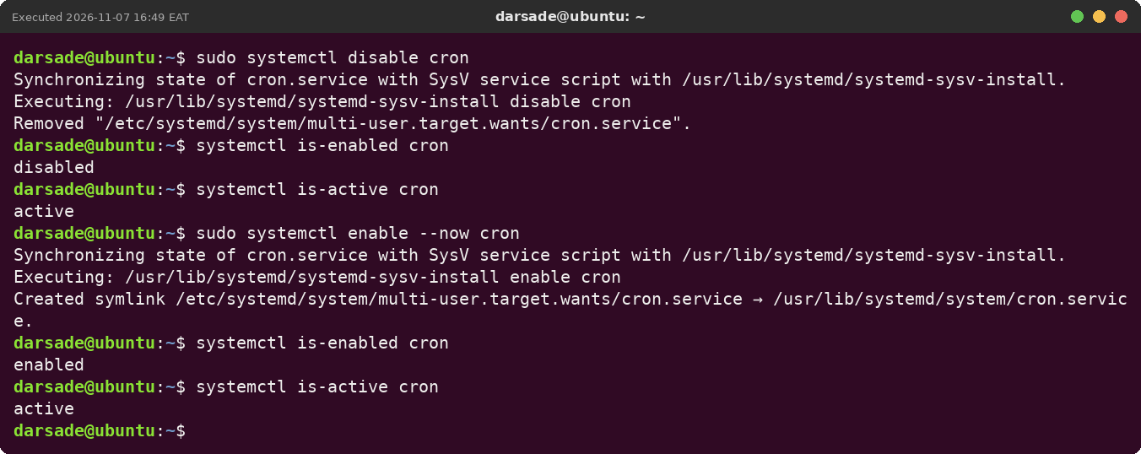
CHAPTER 4
Services with systemctl
sudo systemctl stop / start / restart
act now; restart gives a new PID
systemctl is-active / is-enabled
running now? starts at boot?
disable · enable --now
boot setting only · boot setting + start now

Slide 30
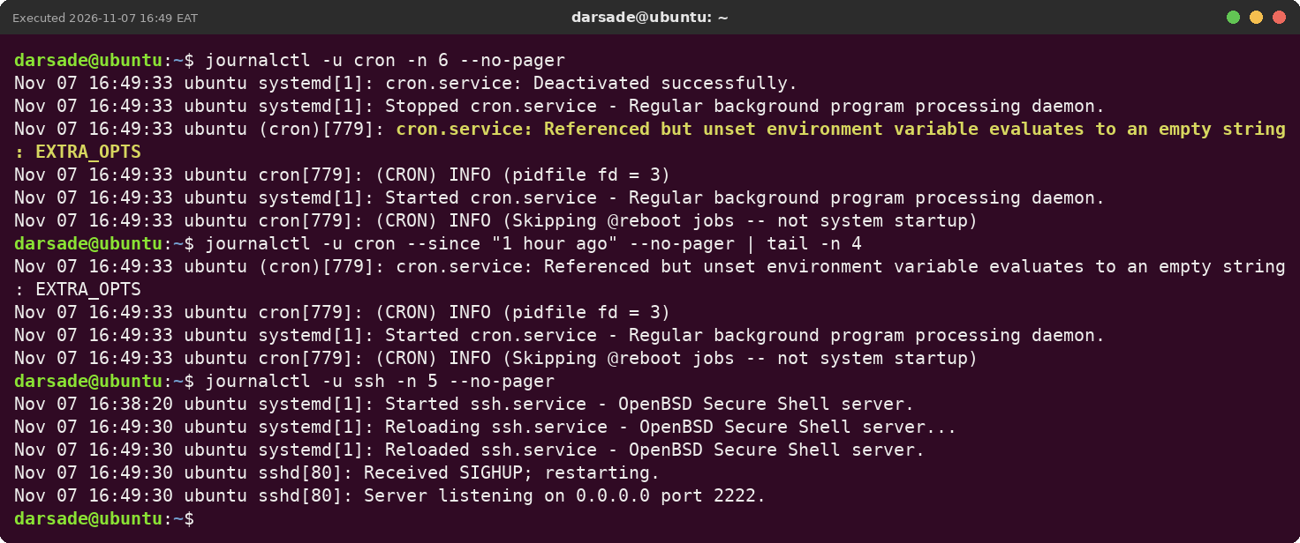
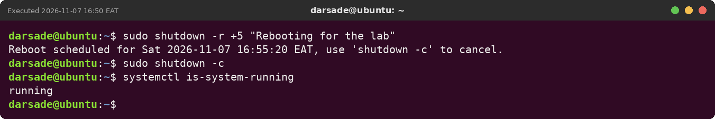
CHAPTER 4
Logs and shutdown
journalctl -u cron -n 6
one service's log
sudo shutdown -r +5 "msg"
schedule a reboot
sudo shutdown -c
cancel it

Slide 31
Notes on the practical work
Not run | Reason
Installing VirtualBox / Ubuntu, snapshot week1-clean | done in the VirtualBox window on your own PC
gnome-calculator | no desktop on the lab system — it was run and gave command not found
sudo reboot | not run, to avoid restarting mid-lab; sudo poweroff was run instead
VirtualBox names (sda, enp0s3, oracle) | the lab ran on a cloud server, so it shows vda and eth0
The screenshots were taken on an Ubuntu 24.04 LTS lab system (user darsade, host ubuntu). The items above could not be run there. On a VirtualBox VM the commands are the same; values such as PIDs, disk names, network names and times will differ.

