Slide 1
Ads, logos, websites and Print Materials

Slide 2
Logos

Slide 3


Slide 4


Slide 5


Slide 6


Slide 7


Slide 8
Ads

Slide 9


Slide 10


Slide 11
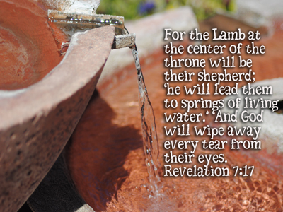

Slide 12


Slide 13


Slide 14


Slide 15


Slide 16
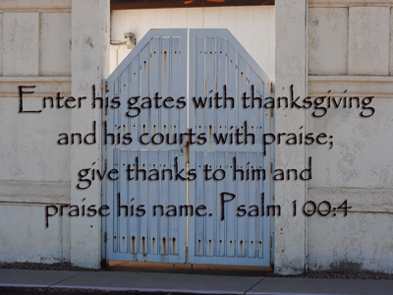

Slide 17


Slide 18
Print Materials

Slide 19


Slide 20


Slide 21


Slide 22
Websites

Slide 23
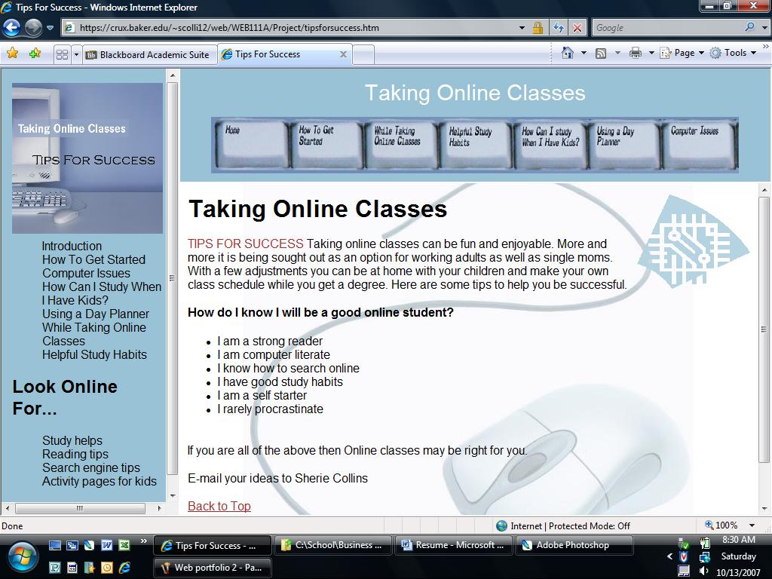

Slide 24

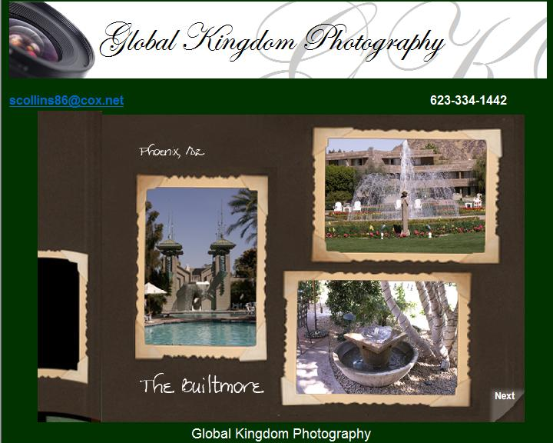

Slide 26
