Slide 1
Medicare Overall Hospital Ratings accross the US
By Sherie Kimble
11/05/2022

Slide 2
The ASK

Slide 3
What do we need to solve?
How can I know I will be taken care of in an emergency if I have Medicare?
What if I am traveling?
How can we choose a hospital or providers we can trust?

Slide 4
What do we need to know?
How does my state rank?
What other states rank where I am traveling?
How many states are above average?
How to choose high quality hospitals?.

Slide 5
The Data

Slide 6
Data Info
Every year CMS gathers information of over 100 data points from the following categories
Mortality
Safety and Care
Readmission
Patient Experience
Timely & Effective care
Notes:
Readmission is if you have to return to the hospital for some reason

Slide 7
Overall Ratings
Scale of 1 (lowest) to 5 (highest)
Rankings are not based on cost
Notes:
Readmission is if you have to return to the hospital for some reason

Slide 8
Data Weaknesses
Not all hospitals have enough reported information to qualify to have a rating
Covid-19 has desterbed some of the data points collected for the rankings
Notes:
Readmission is if you have to return to the hospital for some reason

Slide 9
Data cleaning
Data included extra info like addresses and phone numbers, Those were excluded
Hospitals without a ranking were excluded
Notes:
Readmission is if you have to return to the hospital for some reason

Slide 10
How Does Your State Rank?

Slide 11
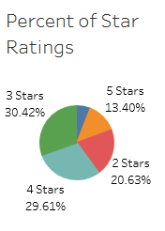
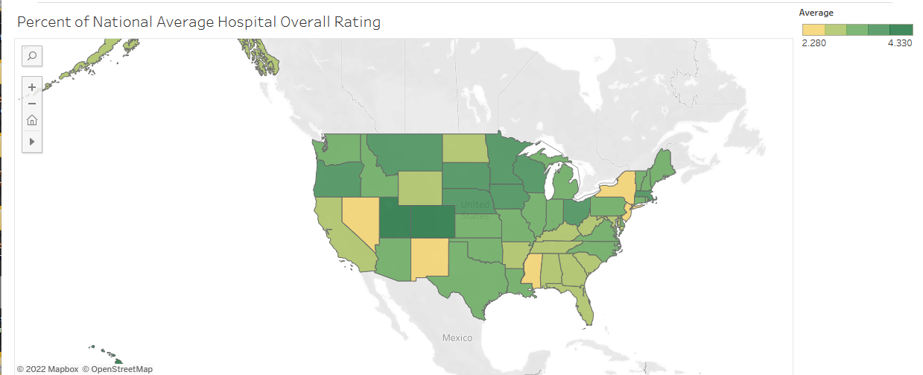
US Average is 3.24

Slide 12
Percent of hospitals with each rating

Slide 13
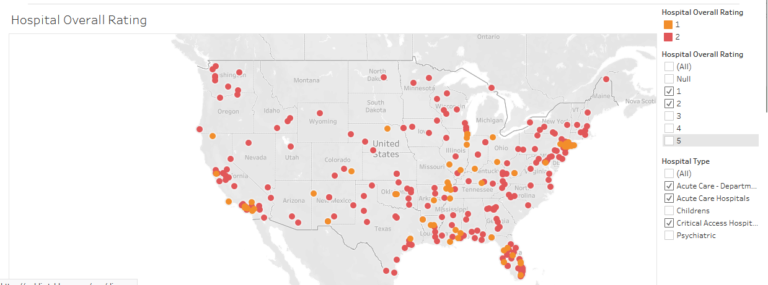
Hospitals Ranking below 3

Slide 14
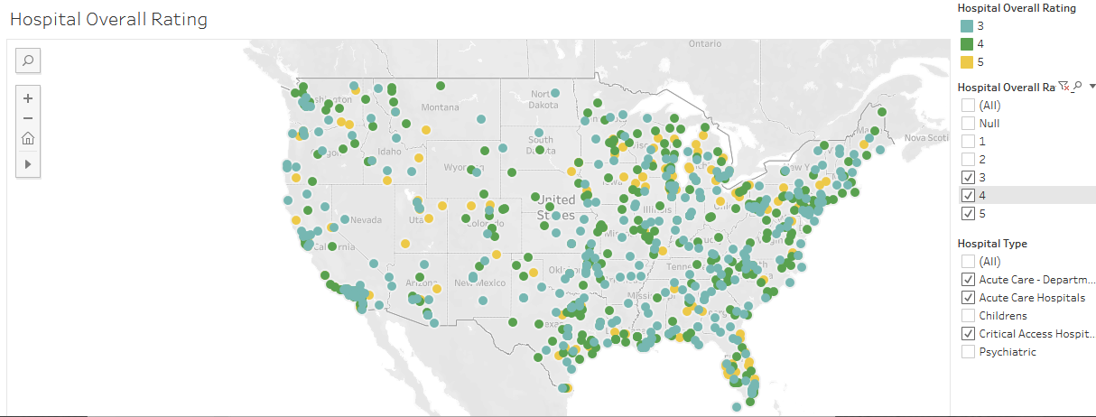
Hospitals with a ranking of 3 or above

Slide 15
Top 10 Best

Slide 16
BEST
State Average
Nebraska 3.59
Oregon 3.73
South Dakota 3.82
Ohio 3.82
Minnesota 3.83
State Average
Wisconsin 3.85
Montana 3.90
Colorado 3.94
Utah 4.12

Slide 17
#1 Best State

Slide 18
Average Rate
Hawaii 4.33

Slide 19
Top 10 to Avoid

Slide 20
States to Avoid
State Average
Nevada 2.28
New York 2.46
Mississippi 2.57
New Jersey 2.67
New Mexico 2.69
State Average
Arkansas 2.89
Maryland 2.86
Alaska 2.89
Kentucky 2.89
Georgia 2.91

Slide 21
Further Exploration

Slide 22
Other things to explore
Types of hospitals
City centers they are near
The effect of Covid on the rankings

