Slide 1


Linux 101
But I just installed Windows 10 though
Hosted by:

Slide 2
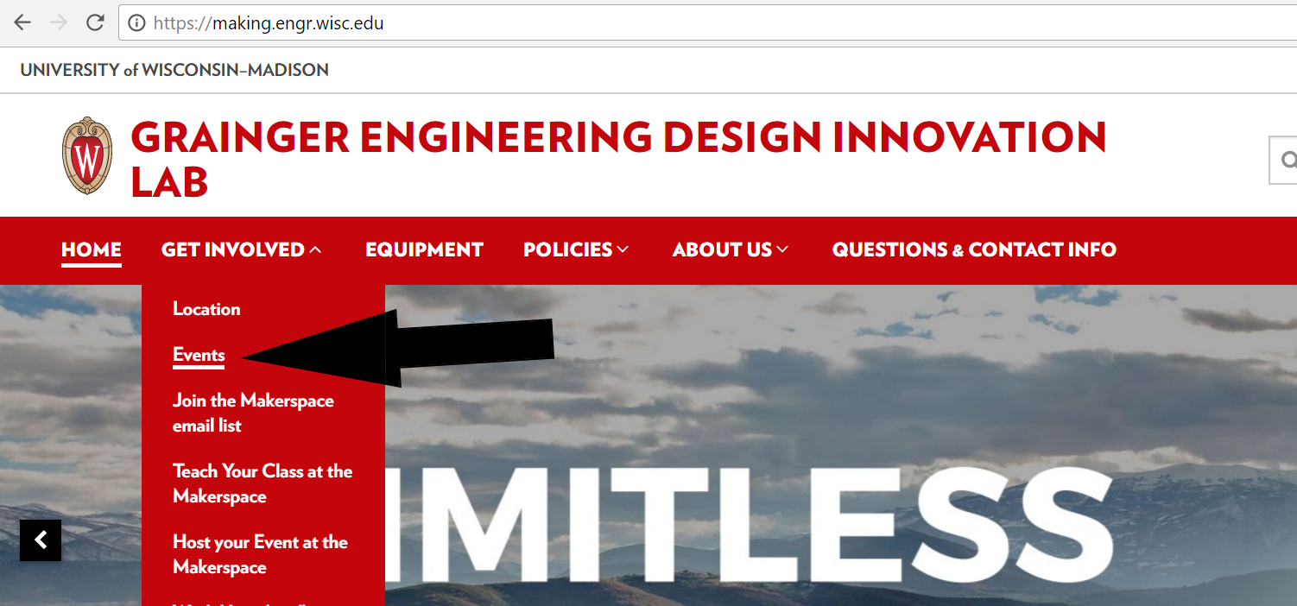
More Workshops This Year!
https://making.engr.wisc.edu

Slide 3
2 Minute History Lesson
Unix
Created at Bell Labs in 1969
Richard Stallman
Started the Open Source movement (1989)
GPL
Built programs, but no kernel
Kernel? Take CS 537
Linus Torvalds
Smart dude from Finland, low key built a kernel (1991)
Also built git

Slide 4
Unix or Linux
What is an operating system?
Lets hardware and software communicate
Handles memory and processes on CPU
Linux is a “Unix-like” OS
Macs are Unix-like, not Linux
Android is Unix
has modified Linux Kernel
Windows is its own monster
Linux is just the kernel

Slide 5
What makes it Unix
 | Windows | Unix
Root location | C:\ | /
Slash used | \ (backslash) | / (frontslash)
Case sensitive | No | Yes
Open Source | No | Yes
Size | Large | Small

Slide 6
Caution to all Window users
/ is not the same as \
/ is a forward slash
\ is a back slash
EVERYONE uses a forward slash...except Windows
Also Windows is NOT case sensative
“Test” != “test” in the unix world
Don’t copy and paste commands in from Windows to Linux!!! #YouHaveBeenWarned

Slide 7
Acroymns Frenzy Uno
GNU
GNU’s Not Unix!
Recursive jokes, ECE majors try to be funny when possible
Most programs found on Linux
GCC, Emacs, Bash, Git, etc.
Like Unix programs, but written from sctatch under GPL
POSIX
A set of IEEE standards
Mainly because of the number of Linux/Unix distros that popped up

Slide 8
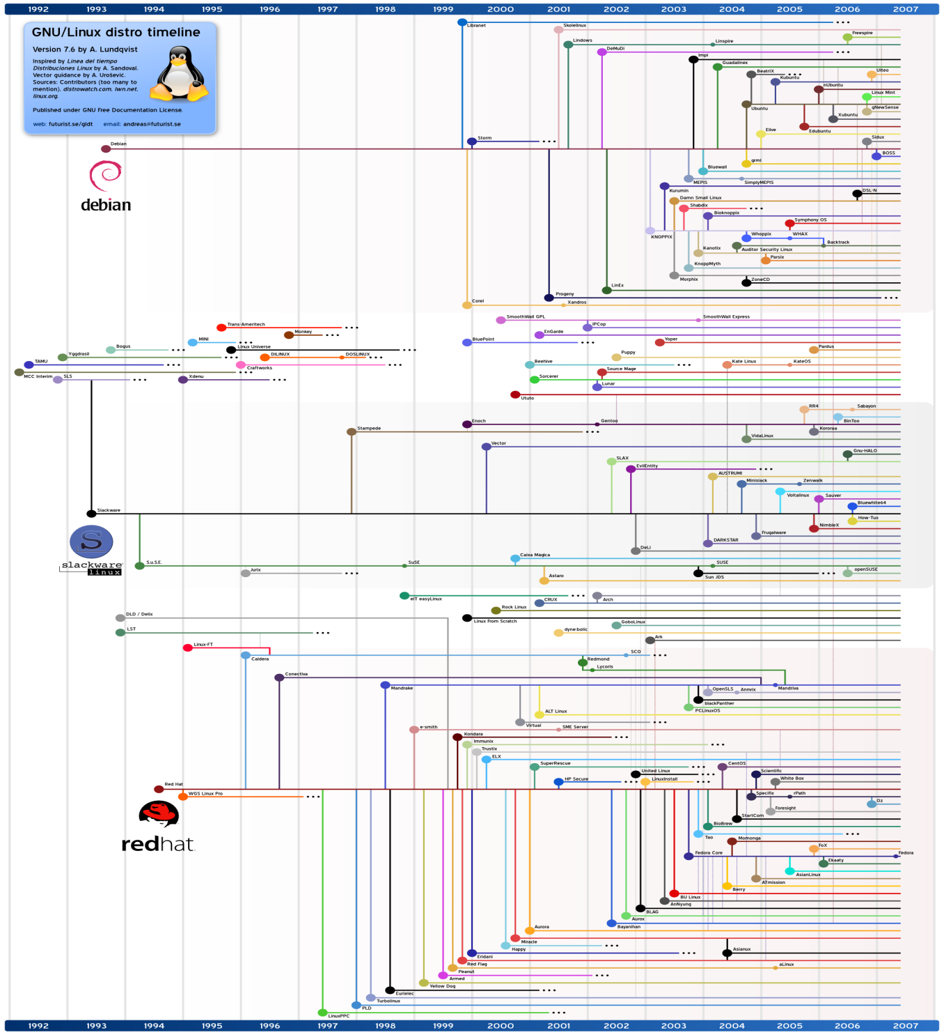
Distros
Everyone wants something different
Many options for many different needs
No “best” distro

Slide 9
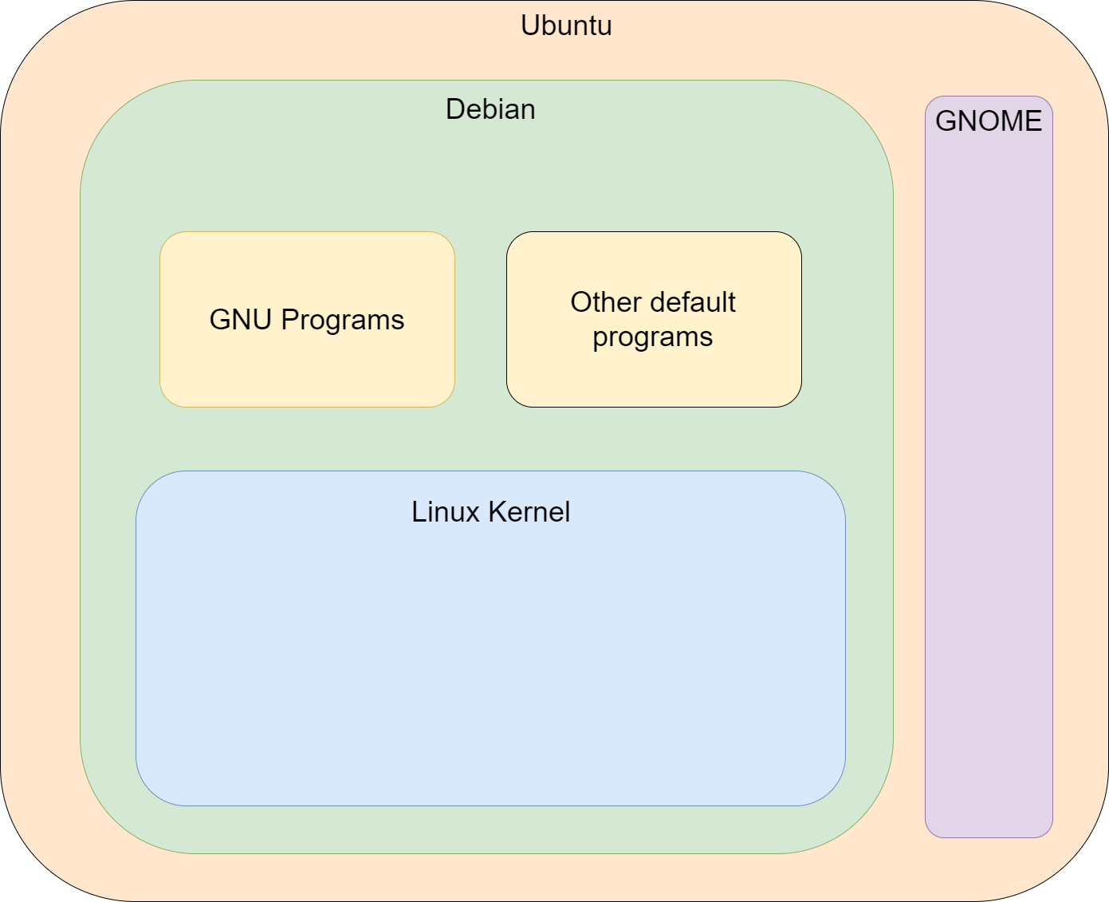
Ubuntu Example

Slide 10
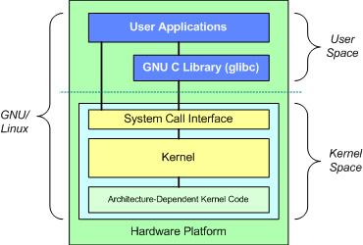

Slide 11

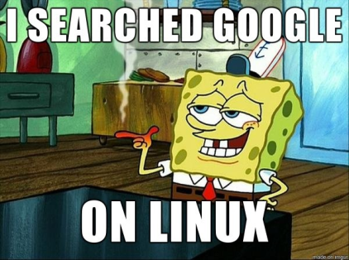
GUI and what it caused
Computers didn’t always have Graphical User Interfaces
Apple tried suing Microsoft over this stuff
Most “Engineering” tools are command line based
We are only talking command line from here out

Slide 12
SSH and Putty
SSH
Secure Shell Protocol
Way of gaining access to a terminal of another machine
Can’t SSH INTO a Windows machine, but can SSH FROM a Windows machine
You will need a SSH Client
Putty, MobaXterm, etc
Macs are Unix based so can just run ssh in terminal

Slide 13
Before we start - keywords
Commands are seperated by spaces
Thats_why_people_use_underscores
The first word is the program name
Flags
Ways of turning on optional settings to command programs
Will either be look like “-a” or “--off”
These are set by developer, not “official” system used
When in doubt “--help” will probably list options

Slide 14
Keywords continued
User
Everyone is a user with set of permissions
“root” is FULLY in charge
sudo
Lets you run root commands without being root

Slide 15
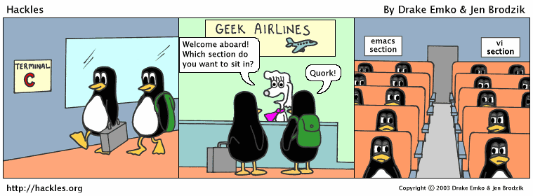
Text Editor
Many editors
Vi vs Emacs
Nano
The easier cop-out for today
Two things to know
^ means CTRL key
M means ALT key
^X means CTRL+X to quit

Slide 16
Piping
Unix programs designed to be small programs that can be “piped” together
Every program has an input and out
Can send output from one program to the input of another

Slide 17
The File System
Linux is much more hierarcal than Windows
Everything starts at the root
“Folder” == “Directory”
/ vs ./ vs ../
/ is the root directory (the top part)
./ is the current directory
../ is the parent directory
Can compound these like ../../../../../
~
Your home directory
~/ is the start of your home directory

Slide 18
Bash
Is a terminal program
Created with GNU tools in 1989
Can write “Bash Scripts”
Will do commands for you
.sh files usually
Stands for “shell script”

Slide 19
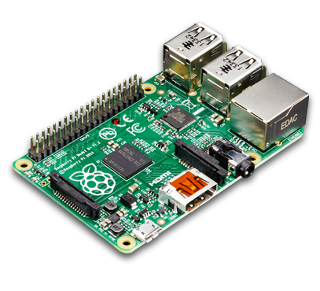
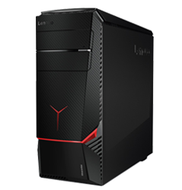
Linux and my Pi
Whats the difference?
VS

Slide 20
GPIO PINS!!!
Take ECE 353
Way to send data
Can interact with board
“Raspbian” is a distro made for this

Slide 21
Time to get some practice!
tinyurl.com/LinuxWorkshopIEEE
[ Note: it’s case sensitive ]

