Slide 1
Linux 101
But I just installed Windows 10 though

Slide 2
5 Minute History Lesson
Unix
Created at Bell Labs in 1969
Richard Stallman
Started the Open Source movement (1989)
GPL
Built programs, but no kernel
Kernel? Take CS 537
Linus Torvalds
Smart dude from Finland, low key built a kernel (1991)

Slide 3
Acroymns Frenzy Uno
GNU
GNU’s Not Unix!
Recursive jokes, ECE majors try to be funny when possible
Most programs found on Linux
GCC, Emacs, Bash, Git, etc.
Like Unix programs, but written from sctatch under GPL
Linux
A Linux kernel running together with the GNU Operating System
Today, anything not Mac or Windows.
Free!
POSIX
A set of standards
Mainly because of the number of Linux/Unix distros that popped up

Slide 4
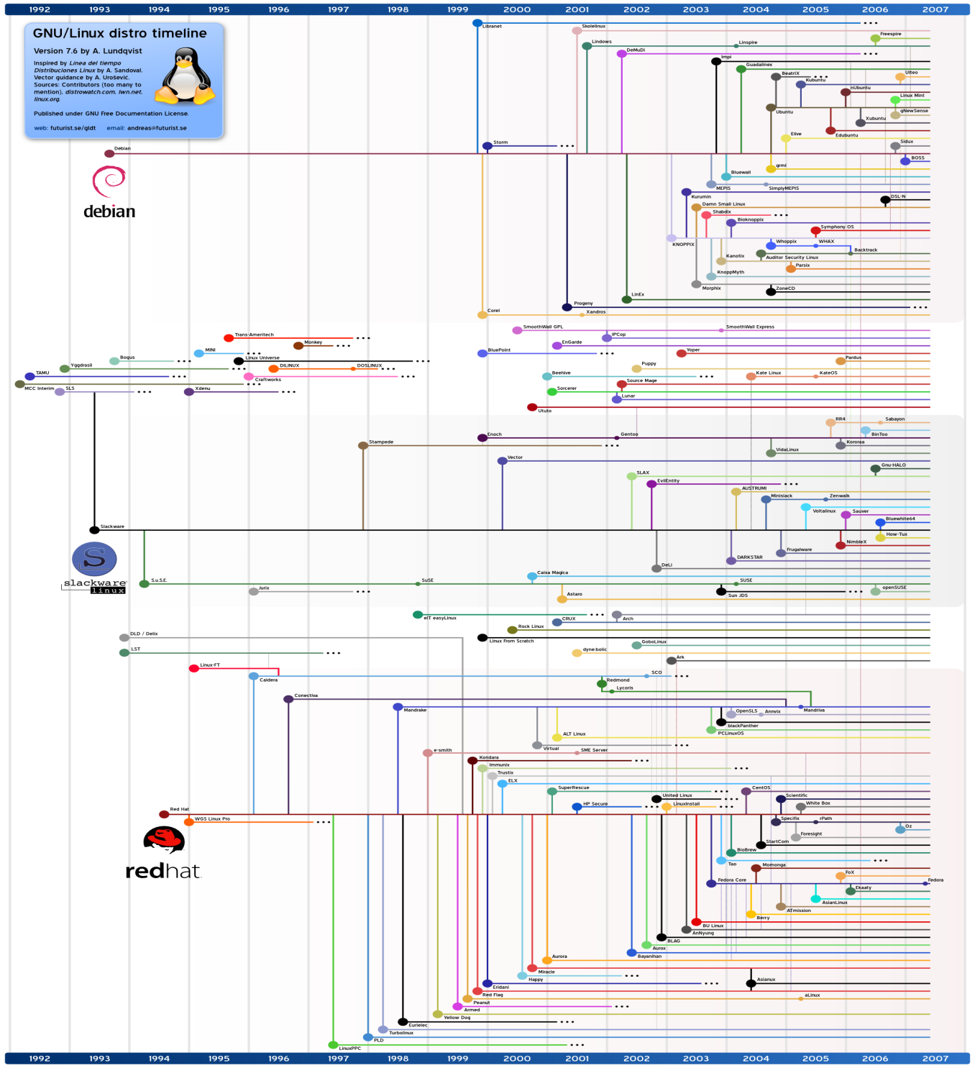
Distros
Everyone wants something different
Many options for many different needs
No “best” distro

Slide 5

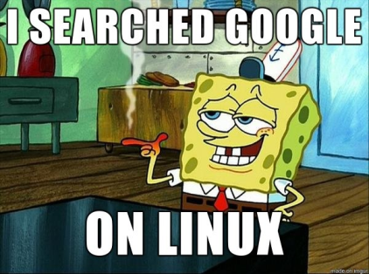
GUI and what it caused
Computers didn’t always have Graphical User Interfaces
Apple tried suing Microsoft over this stuff
Most “Engineering” tools are command line based
We are only talking command line from here out

Slide 6
SSH and Putty
SSH
Secure Shell Protocol
Way of gaining access to a terminal of another machine
Can’t SSH INTO a Windows machine, but can SSH FROM a Windows machine
You will need a SSH Client
Putty, MobaXterm, etc
Macs are Unix based so can just run ssh in terminal

Slide 7
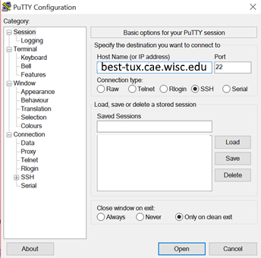
SSH into your CAE Lab computers
Can follow along from here on out
best-tux.cae.wisc.edu

Slide 8
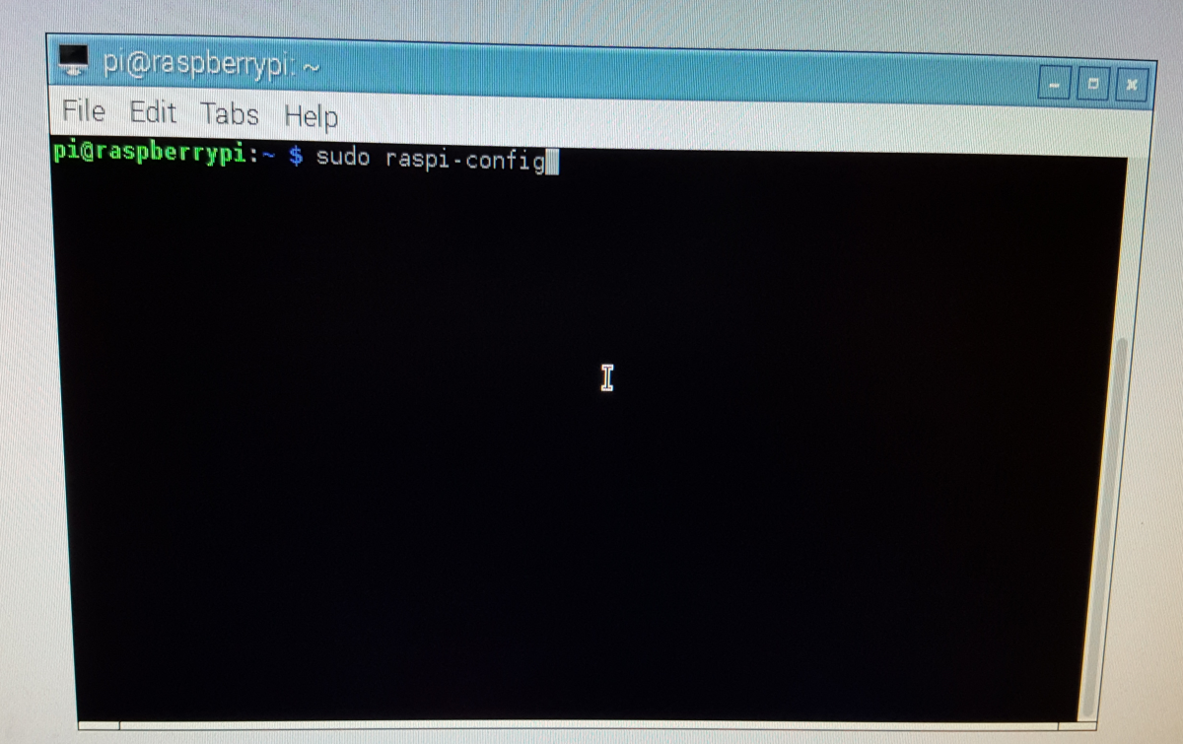
If on a Linux GUI
Type “Ctrl+Alt+T” to open a terminal

Slide 9
Before we start - keywords
Commands are seperated by spaces
Thats_why_people_use_underscores
The first word is the program name
Flags
Ways of turning on optional settings to command programs
Will either be look like “-a” or “--off”
These are set by developer, not “official” system used
When in doubt “--help” will probably list options
User
Everyone is a user with set of permissions
“root” is FULLY in charge
sudo
Lets you run root commands without being root

Slide 10
Caution to all Window users
/ is not the same as \
/ is a forward slash
\ is a back slash
EVERYONE uses a forward slash...except Windows
Also Windows is NOT case sensative
“Test” != “test” in the unix world
Don’t copy and paste commands in from Windows to Linux!!! #YouBeenWarned

Slide 11
Getting around
ls
Will list all items in directory
Try with the –a and/or –l flag
pwd
Will show you where you are on the system
cd
Changes directory
/ vs ./ vs ../
/ is the root directory (the top part)
./ is the current directory
../ is the parent directory
Can compound these like ../../../../../
~
Your home directory
When in doubt just do a cd ~

Slide 12
File fun
mkdir
Makes directory, make a test folder for this fun to keep your files clean
touch
Will make a file but it will be empty
cp
Copy
cp <source> <destination>
mv
Move
mv <source> <destination>
rm
Remove
rm <file(s)>

Slide 13
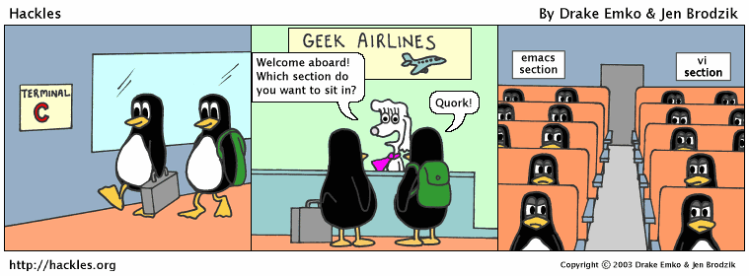
Text Editor
Many editors
Vi vs Emacs
Nano
The easier cop-out for today
Two things to know
^ means CTRL key
M means ALT key
^X means CTRL+X to quit

Slide 14
More Fun
cat
Will list all the contents of the file
Also use “more”, “head” or “tail”
grep
Lets you search inside folder
“grep test ./ -r”
wildcard
*
Means “everything”
“grep *.txt ./ -r” grabs all text files

Slide 15
Piping
Unix programs designed to be small programs that can be “piped” together
Every program has an input and out
Can send output from one program to the input of another

Slide 16
Piping tools
>
Will save into file
“cat myText.txt > newText.txt”
>>
Will append to file
|
The “pipe”
ls | head -3

Slide 17
The File System
3 letters, not a fan neither
Linux is much more hierarcal than Windows
Everything starts at the root
/
Boot -- contains the kernel and system map
Bin -- contains the basic system binaries
Dev -- all the device entries
Etc -- can't think of any other place to put it
Home -- where all the users live
Lib -- system libraries
Mnt -- place to mount filesystems
Proc -- system information
Root -- the root user's home
Sbin -- system binaries
Usr -- where user accessible programs go
Var -- logs and such

Slide 18
Bash
Is a terminal program
Created with GNU tools in 1989
Can write “Bash Scripts”
Will do commands for you
.sh files usually
Stands for shell script

Slide 19
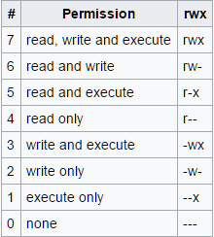
Before we Bash
chmod
Way to set permissions of files
File uesr, group user, other user
We will want to “execute” our scripts
“chmod u+x <scriptName>

Slide 20
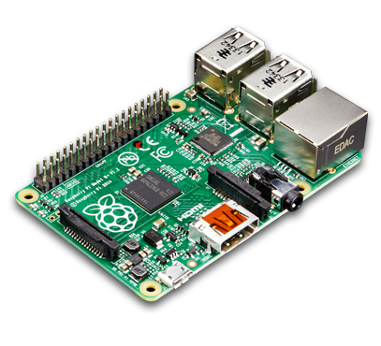

Linux and my Pi
Whats the difference?
VS

Slide 21
GPIO PINS!!!
Take ECE 353
Way to send data
Can interact with board
“Raspbian” is a distro made for this

Slide 22
Questions

