Slide 1
On premises/hybrid
Amazon Web Services
Microsoft Azure
Google Compute Engine
Rackspace
. . .
NWheels.Domains.DevOps
NWheels.Domains.Security
NWheels.Domains.ECommerce NWheels.Domains.Booking
NWheels.Domains.Marketing
NWheels.Domains.Crm
NWheels.Domains.Exchange
NWheels.Domains.Accounting . . .
?
Declare microservices
Declare environments
Reuse building block domains
+
{:}
VM Docker, DC/OS, …
DB MySQL, MongoDB, EventStore, SQL Server, …
UI ASP.NET + HTML5 SPA + React (web), React Native (mobile), Electron + React (desktop), …
MQ MSMQ, RabbitMQ, WebSphere, …
. . .
?
nwheelsfile
Declare UI apps
Pick technology stacks
?
$ nwheels new /path/to/nwheelsfile
?
Initial structure of projects
+
NuGet packages restored
pull

Slide 2
Declare microservices
Declare UI apps
Reuse building block domains
Configure source code repository
{:}
nwheelsfile
Declare environments
Pick technology stacks
$ nwheels new /path/to/nwheelsfile
Source working directory + skeleton structure of projects
$ git clone http://github.com/felix-b/nwheels nwheels
$ cd demo
$ nwheels clone hello-world
$ nwheels run

Slide 3

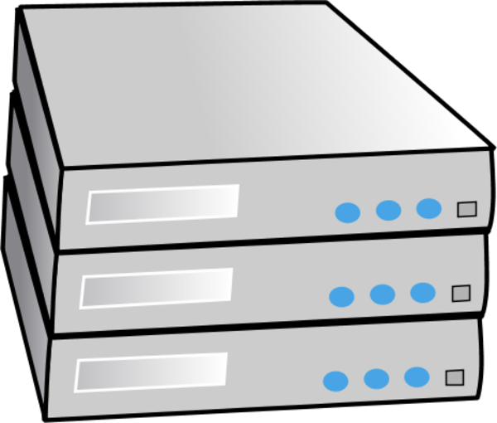


Monitoring and analytics
Source code repository
Developer’s working directory
BUILD & TEST
commit
Test environments
STAGE
Staging environments
RELEASE
Production environments

Slide 4
Declare microservices
Declare UI apps
Reuse building block domains
{;}
{;}
{:}
nwheelsfile
Declare environments
Pick technology stacks
Security
Licensing
DevOps
Building Block Domains
CRM
ECommerce
and more…
Scalability
& HA
Kernel
20-80 Frameworks
DDD
Workflow
{
app
from starters/
UIDL
Initial structure of projects
$ nwheels new /path/to/nwheelsfile
UIDL
DDD
Platform & Kernal
Work- flow

Slide 5
Declare microservices
Declare UI apps
Reuse building block domains
{:}
nwheelsfile
Declare environments
Pick technology stacks
Raft consen- sus
Swarm ingress routing mesh
Swarm Manager replica 1 LEADER
DR Replicator replica 1 LEADER
Swarm Manager replica 2 follower
Swarm Manager replica 2 follower
NGINX replica 1 ACTIVE
NGINX replica 2 ACTIVE
Raft consen- sus
DR Replicator replica 2 follower
Swarm Manager replica 1 LEADER
Swarm Manager replica 2 follower
Service A replica 1 LEADER
Service B replica 2 LEADER
Raft consensus
Service A replica 2 follower
Service A replica 3 follower
Service B replica 3 follower
Service B replica 1 follower
NGINX replica 1 ACTIVE
NGINX replica 2 ACTIVE
Raft consensus
Raft consensus
Service A replica 1 LEADER
Service B replica 3 LEADER
Service A replica 3 follower
Service A replica 2 follower
Service B replica 2 follower
Service B replica 1 follower

Slide 6
Ingress routing mesh
Inbound LB/Router In.Router.1 ACTIVE
Inbound LB/Router In.Router.2 ACTIVE
Service A replica 1 LEADER
Service B replica 3 LEADER
Service A replica 2 follower
DR Replicator replica 1 LEADER
Service B replica 1 follower
Service A replica 3 follower
DR Replicator replica 2 follower
Service B replica 2 follower
DR Replicator replica 3 follower
DB Server A DB.A.1 PRIMARY
DB Server B DB.B.1 PRIMARY
DB Server A DB.A.2 secondary
DB Server B DB.B.2 secondary

Slide 7
Frameworks programming models for application code
DDD
UIDL
REST
Workflow
Platform services transparently plugged in
High Availability
Elastic Scale
Core Facilities infrastructure APIs which upper layers tightly coupled to
Authorization
Sessions
Endpoints
Messages
Channels
Caching
Localization
Kernel
base infrastructure layer, upper layers are tightly coupled to
Host Capsule & Bootstrap
Meta Type System
Late Compilation
Configuration
Logging
Application
Frameworks
Kernel
Platform
Technology Stack
Platform

