Slide 2
OpenMP is a set of compiler directives as well as an API for programs written in C, C++, or FORTRAN that provides support for parallel programming in shared-memory environments.
OpenMP identifies parallel regions as blocks of code that may run in parallel.
Application developers insert compiler directives into their code at parallel regions, and these directives instruct the OpenMP run-time library to execute the region in parallel.
The following C program illustrates a compiler directive above the parallel region containing the printf() statement

Slide 3
THREAD Vs PROCESS A process is created by the OS to execute a program with given resources(memory, registers); generally, different processes do not share their memory with another.
A thread is a subset of a process, and it shares the resources of its parent process but has its own stack to keep track of function calls.
Multiple threads of a process will have access to the same memory.

Slide 4
#include <omp.h>
#include <stdio.h>
int main(int argc, char *argv[])
{ /* sequential code */
#pragma omp parallel
{
printf("I am a parallel region.");
}
/* sequential code */
return 0;
}

Slide 5
#pragma omp parallelI
creates as many threads which are processing cores in the system.
Thus, for a dual-core system, two threads are created, for a quad-core system, four are created; and so forth.
Then all the threads simultaneously execute the parallel region.
When each thread exits the parallel region, it is terminated.
OpenMP provides several additional directives for running code regions in parallel, including parallelizing loops.

Slide 6
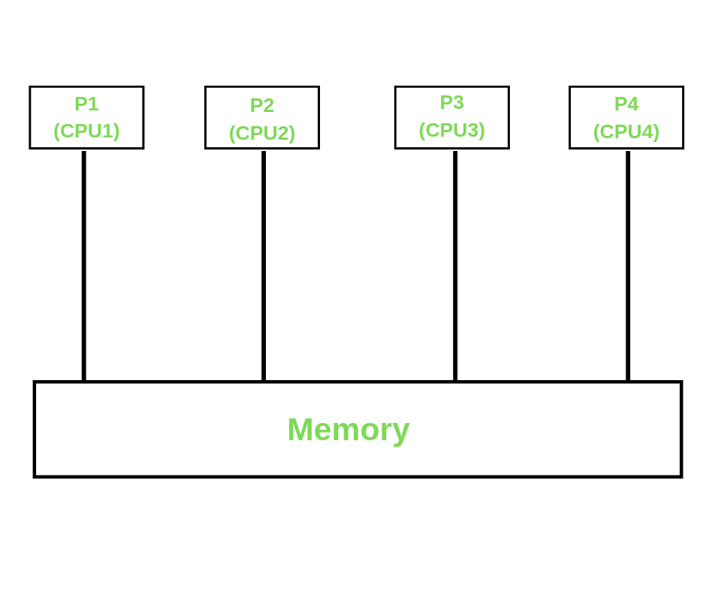

Slide 7
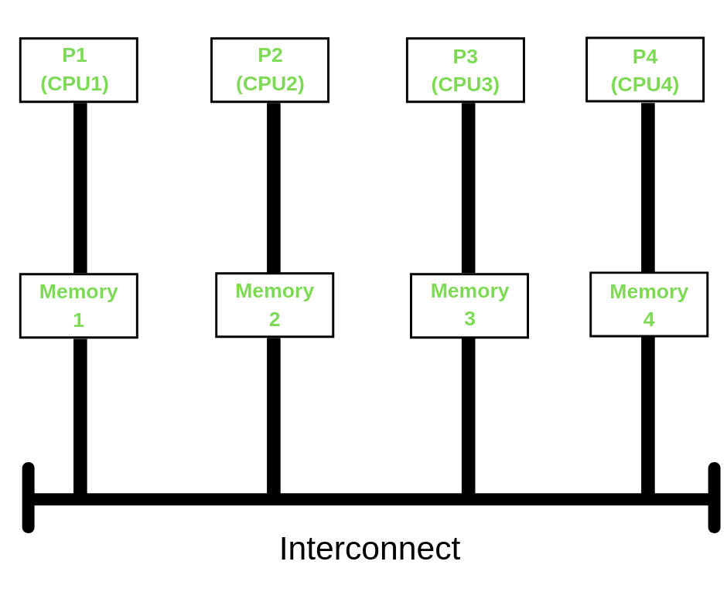

Slide 8
Steps for Installation of OpenMP
STEP 1: Check the GCC version of the compiler
gcc –version
GCC provides support for OpenMP starting from its version 4.2.0.
So if the system has GCC compiler with the version higher than 4.2.0, then it must have OpenMP features configured with it.

Slide 9
If the system doesn’t have the GCC compiler, we can use the following command
sudo apt install gcc

Slide 10
STEP 2: Configuring OpenMP We can check whether the OpenMP features are configured into our compiler or not, using the command
echo |cpp -fopenmp -dM |grep -i open

Slide 11
If OpenMP is not featured in the compiler, we can configure it use using the command
sudo apt install libomp-dev

Slide 12
Compile
gcc -o hello -fopenmp hello.c
Execute
./hello

