Slide 1
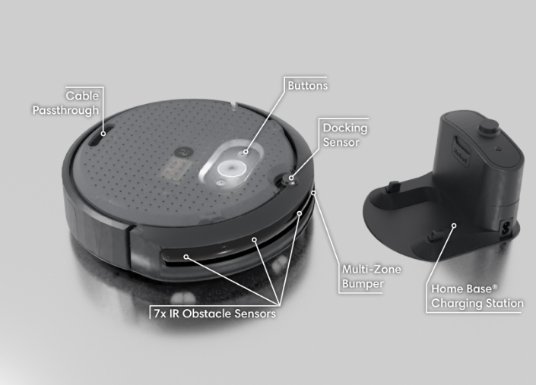
Introduciton to mobile Robotics
Project – 2026
Tatiana, Laura Gómez, Daniel Gebauer
Notes:
Overview - Create® 3 Docs for the picutre

Slide 2
Table of Contents
Project Definition
Architecture
Implementaiton
Results

Slide 3
Project Defintion
goals and Requirements

Slide 4
Desired Behaviour
Initial Boot & Undocking
Autonomous Exploration
Proportional Obstacle Avoidance:
AWARE zone: slowdown. WARNING zone: braking CLOSE zone: stop and turn
Hazard Recovery:
Recover from bumper contact with obstacle
Timed Return-to-Dock
Human Override:
TELEOP for manual control

Slide 5
Architecture
Design Decisions

Slide 6
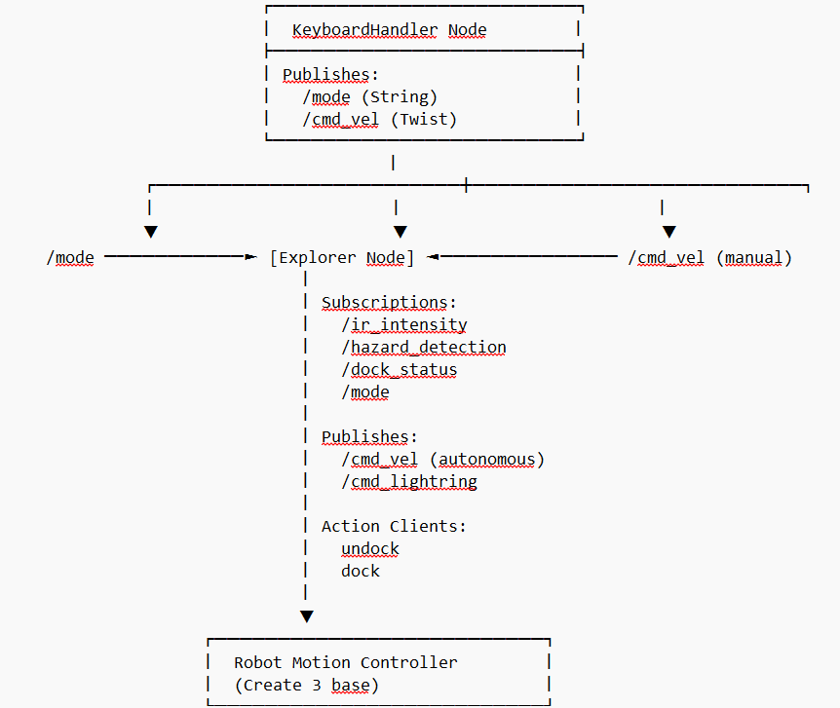

Slide 7
Design Decisions
2 Node achitecture:
Manual control
Exploration and obstactle avoidance
Communication via topics
Subsciber and publisher
Organisation of communication
Callback methods on message receive

Slide 8
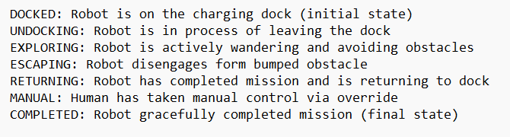
Design Decisions
Global State of the Explorer
Easy conditional Behaviour
Extendable framework for additional features

Slide 9
Implementation

Slide 10
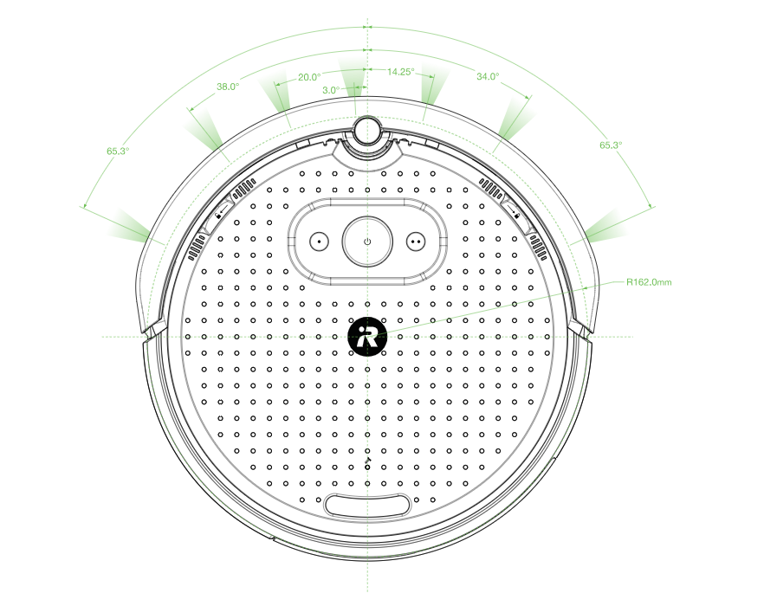
Obstacle Avoidance
Subscribe to ir-sensor topic
On message arrival, execute obstacle check:
7 different sensors
Check returns against threshold
Determine direction from sensor position
On detection initiate avoidance

Slide 11
Manual Control
keyboard logger running constantly
On interrupt:
sent message to change status of the explorer node
In manual mode:
Read commands from keystrokes
Relay commands to robot
Return to automatic:
Change mode of explorer node

Slide 12
Return to Dock
Final docking handled by docking server
Only works in proximity to Station
Navigate back to Dock
Explore Until Dock is detected
Keep obstacle avoidance active on way to dock
Seperate state to keep tack of docking goal
Manual mode for accelerated docking

Slide 13
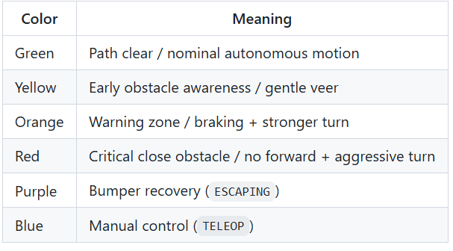
LED Status
Indicate Status of the Robot

Slide 14
Results
Demonstration

Slide 15
Anyone got a video?

Slide 16
Sources
The pictures are taken form the create3 website: Create® 3 Docs

