Slide 1
Current Software Issues
Jinlin
12/10/2016

Slide 2
Current Software Issues
Collision avoidance algorithm maybe fall into deadlock.
Cannot arrive at the target point at once.
Turning angle function which use vTaskDelay() is not accuracy.
Software scalability

Slide 3


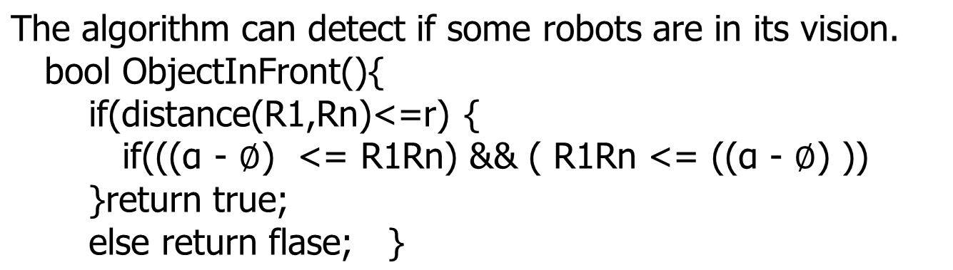
1. Collision Detection Algorithm
y
F
R3(x3,y3)
L
R2(x2,y2)
R
r
r
R4(x4,y4)
R1(x1,y1)
x
x

Slide 4
Collision Avoidance Algorithm
Rotate to a direction until there is no obstacles.
void rotateToSafe(){
for(i=0;i<ROBOTS;i++){
if(ObjectInFront()){
rotate(œ);
}
}
}

Slide 5
2. Waypoint Navigation
s
e
The different speed although you set the same speed for each wheels.
So we do the way point navigation like this:
int side = whichSide(x, y); if (side == RIGHT_HAND) { // right side speedL = speed; speedR = speed + cell; } else if (side == LEFT_HAND) { // left side speedL = speed + cell; speedR = speed; } else { speedL = speedR = speed; }

Slide 6
3. Rotating Algorithm
The vTaskDelay() method is used for rotating.
//(L = n*PI*r/180)
timeInterval = 1000*givenAngle*(WHEEL_L_R_DISTANCE)/(2*speed); vTaskDelay((unsigned long)timeInterval);

Slide 7
Software scalability
The software architecture should be more scalability.
Any suggestion?

Slide 8
Welcome anyone to send me a email giving me a better suggestion for the current algorithms.

Slide 9
Thank You!
Q&A
page <number>

