Slide 1
Collision Avoidance in Multi-Robot System
27/20/2015

Slide 2
Conditions
1. Current Location(two beacons build the Coordinate System)
North Angle
We can get the north angle from mag sensor.
Broadcast Information
We can broadcast information through Zigbee.
y
R(x,y)
x

Slide 3
Conditions
1. Two beacons build a coordinate system, but the north angle isn’t in this system.
2. What should we do?
make the north direction to be –y axis in our real time coordinate system.
±α in different quadrants
y
α
x
North

Slide 4
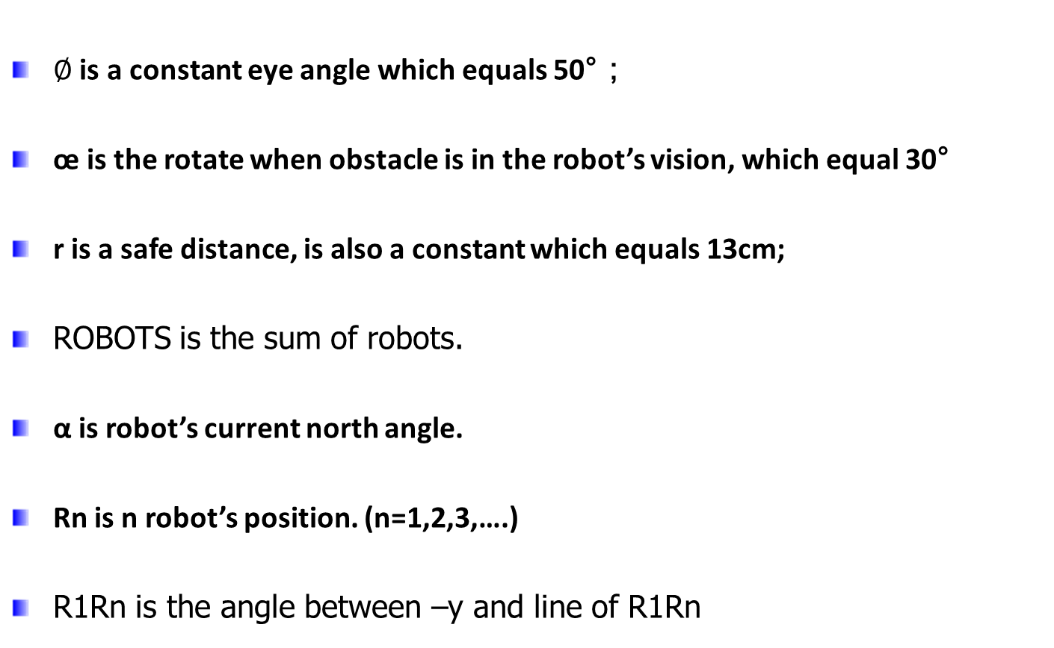
Algorithm Parameters

Slide 5


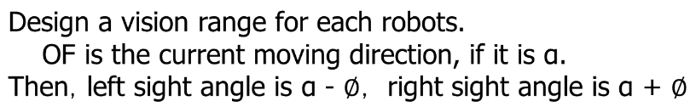
Algorithm Sketch
y
F
L
R
O(x,y)
x
x

Slide 6
Algorithm Sketch
y
F
R3(x3,y3)
L
R2(x2,y2)
R
r
r
R4(x4,y4)
R1(x1,y1)
x
x
In this case, assume that we have 4 robots.

Slide 7


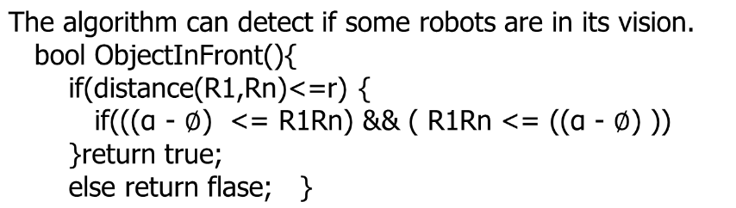
Algorithm –ObjectInFront()
y
F
R3(x3,y3)
L
R2(x2,y2)
R
r
r
R4(x4,y4)
R1(x1,y1)
x
x

Slide 8
Algorithm-rotateToSafe()
void rotateToSafe(){
for(i=0;i<ROBOTS;i++){
if(ObjectInFront()){
rotate(œ);
}
}
}

Slide 9
Algorithm-goToTarget()
while (1) {
for(i = 0;i < CHECK; i++){
rotateToSafe(x,y);
SetLeftWheelGivenSpeed(speed);
SetRightWheelGivenSpeed(speed);
vTaskDelay(500);
if(GoalInFront(x,y) == true)
return;
}
rotateTo(x,y,ANGLESPEED);
} /* end of while */

Slide 10

Challenges
The accuracy of locating the robot’s location.
  x axis has 10mm errors, y axis has 20mm errors.
Drop of broadcast information.
  95% is perfect
  Rotate is not accurately if the rotate speed is too large,
  the rotate speed is 8mm/seconds now.

Slide 11
Thank You!
Q&A
page <number>

