Slide 1
Self Service with FME Server: Part I
FME 2017

Slide 2
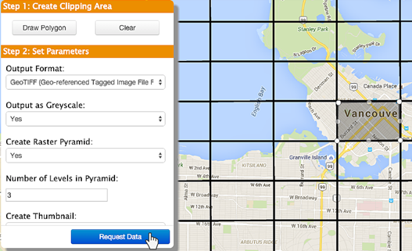
Self Serve I
In this Section
What is Self Serve?
FME Server Services
Implementing Self Serve
Self Serve and Parameters
Published Parameters
Key Parameter Types
Format and Coordinate System Selection
Layer Selection and Handling

Slide 3
What is Self Serve?
Self-Serve Types
Data Uploads
Data Downloads

Slide 4


FME Server Services
What is a Service?
Available Services
Workspaces and Services
Administrator

Slide 5
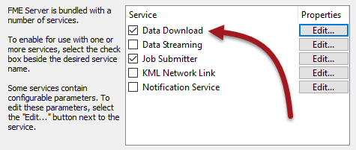
Implementing Self Serve
Creating Data Download
Creating Data Upload

Slide 6
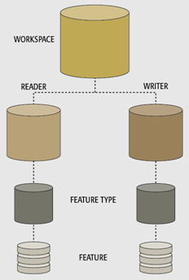
Self Serve and Parameters
What are Parameters?
Published Parameters
Parameter Uses in FME Server

Slide 7
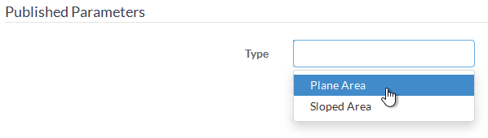
Published Parameters
Miscellaneous Published Parameters
Publishing a Parameter

Slide 8
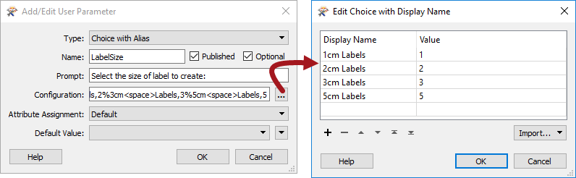
Key Parameter Types
Choice with Alias
Scripted

Slide 9
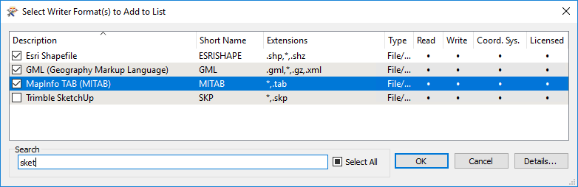
Format and Coordinate System Selection
Format Selection
Coordinate System Selection
Using Choice with Alias

Slide 10
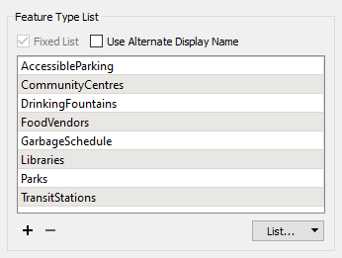
Layer Selection and Handling
Selecting Layers
Grouped Layers

