Slide 1
Real Time with FME Server
FME 2017

Slide 2
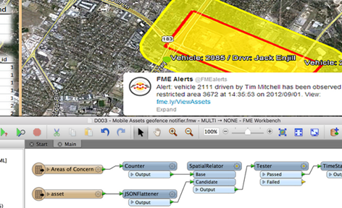
Real Time with FME Server
In this Section
The Notification Service
Publications and Subscriptions
Notification Topics and Protocols
Email Notifications
Notifications and Workspaces
Workspace Publications/Subscriptions
Message Streams

Slide 3
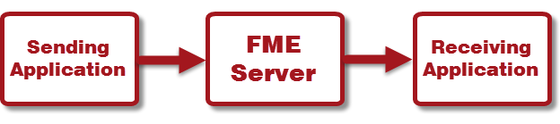
The Notification Service
What is a Notification?
When to use Notifications

Slide 4
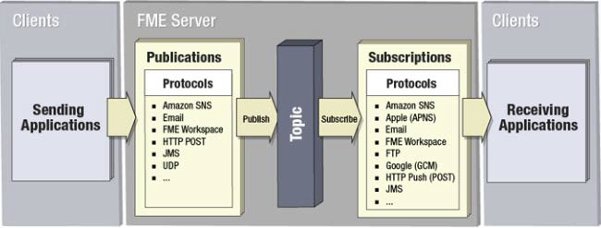
Elements of the Notification Service
Clients
Publications
Subscriptions
Topics
Protocols

Slide 5
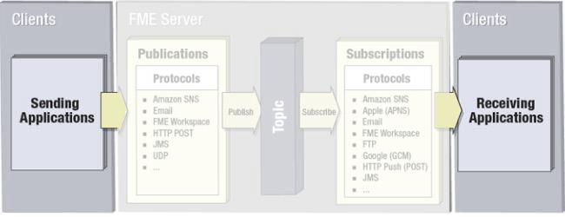
Notification Clients
Clients
Publishers vs Subscribers

Slide 6
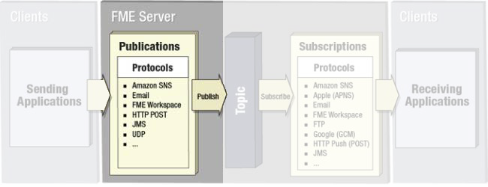
Publications and Subscriptions
Publications
Subscriptions

Slide 7
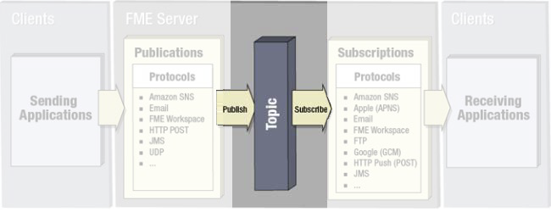
Notification Topics
Topics
Publications and Topics
Subscriptions and Topics

Slide 8
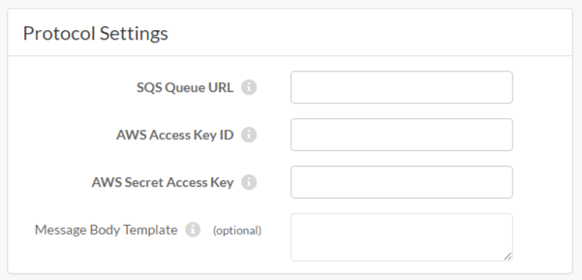
Notification Protocols
What is a Protocol?

Slide 9
Available Protocols
Watch Notifications
Mobile Notifications
Amazon Notifications
WebSocket Notifications

Slide 10
Email Notifications
Email Protocols

Slide 11
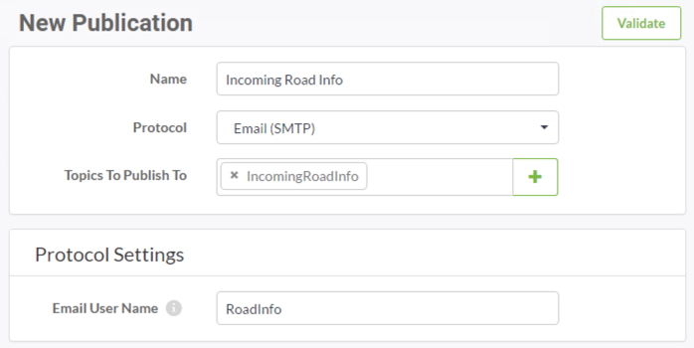
Email Publications: SMTP
Creating an SMTP Publication

Slide 12
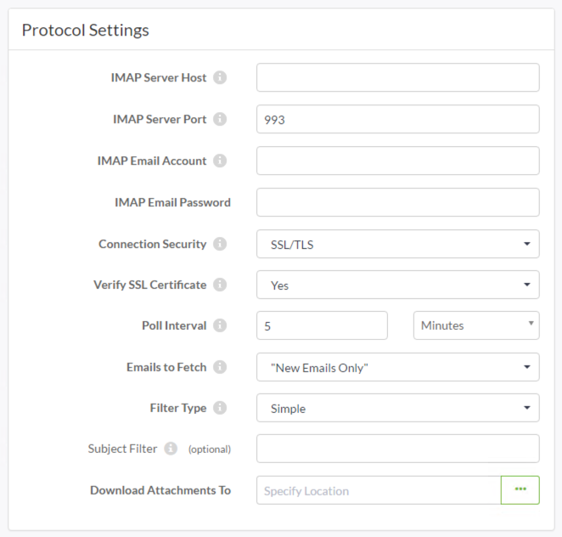
Email Publications: IMAP
Creating an IMAP Publication

Slide 13
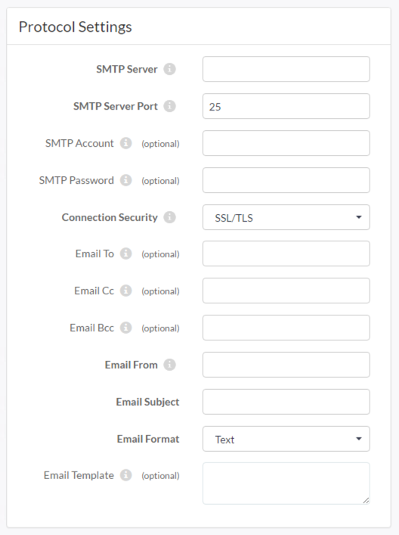
Email Subscriptions
Setting up an Email Subscription

Slide 14
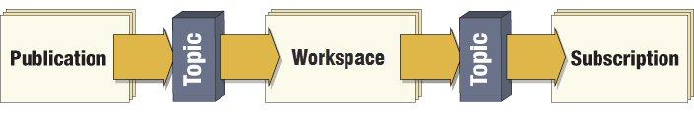
Notifications and Workspaces
Message Transformation
Partial Systems

Slide 15

Workspace Subscriptions
Registering a Workspace
Passing Messages

Slide 16
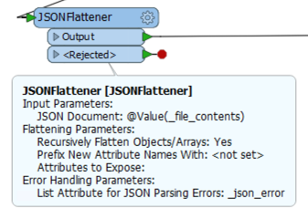
Incoming Message Handling
Message Content
Interpreting the Message
Using the Message

Slide 17

Workspace Publications
Workspaces as a Publisher

Slide 18
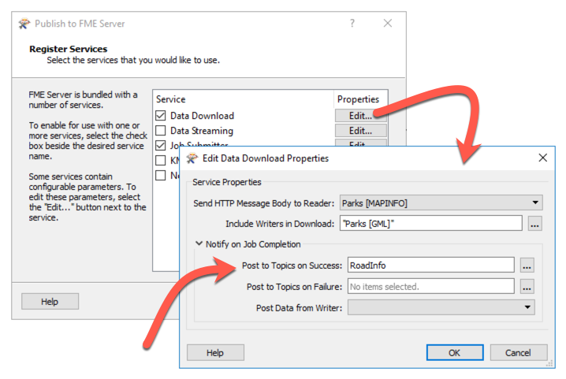
Registering Workspace Publications
Registering a Workspace Publication

Slide 19
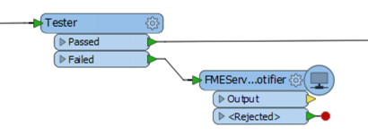
Workspace Publications with Transformers
FMEServerNotifier

Slide 20
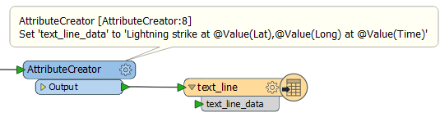
Outgoing Message Handling
Outgoing Message Content
Content Format
Email Content in a Workspace

Slide 21

Workspace as Subscription AND Publication
Workspace as Subscription AND Publication

Slide 22
Message Streams
Why Use a Message Stream?

Slide 23
Elements of a Message Stream
Transformers and Protocols
Receivers
Senders
Python

Slide 24
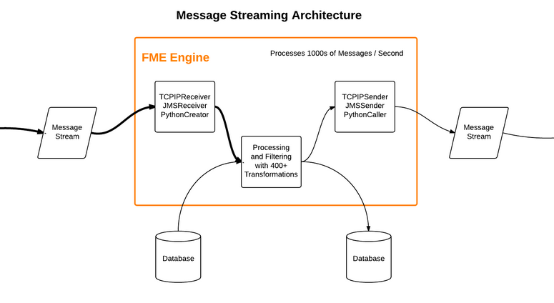
Message Streaming Architecture
Architecture
Databases

