Slide 1
Self Service with FME Server: Part II
FME 2017

Slide 2
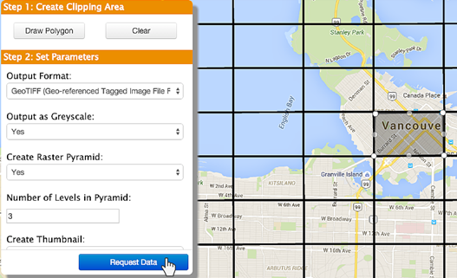
Self Serve: II
In this Section
Geographic Selection
Selection by Bounding Box
Selection by Existing Geographic Area
Selection by Ad-Hoc Geographic Area
Other Self-Serve Services

Slide 3
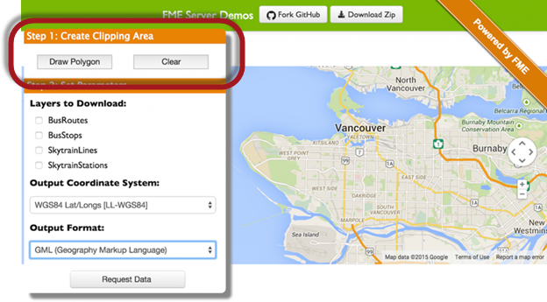
Geographic Selection
Geographic Selection Methods

Slide 4
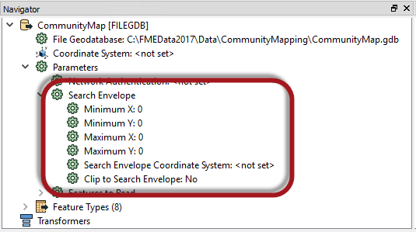
Selection by Bounding Box
Bounding Boxes
Web Mapping and Bounding Boxes

Slide 5
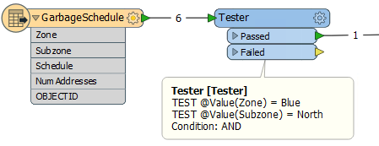
Selection by Existing Geographic Area
Selecting the Existing Area
FeatureReader
Clipper

Slide 6
Selection by Ad-Hoc Geographic Area
An Ad-Hoc Boundary
Passing an Ad-Hoc Boundary to FME

Slide 7
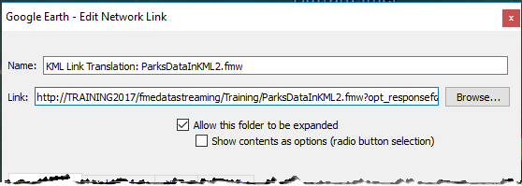
Other Self-Serve Services
Data Streaming
KML Network Link

