Slide 1
FME Server Projects
FME 2017

Slide 2

FME Server Projects
In this Section
Creating Projects
Sharing a Project
Exporting Projects
Removing Projects
Importing Projects

Slide 3
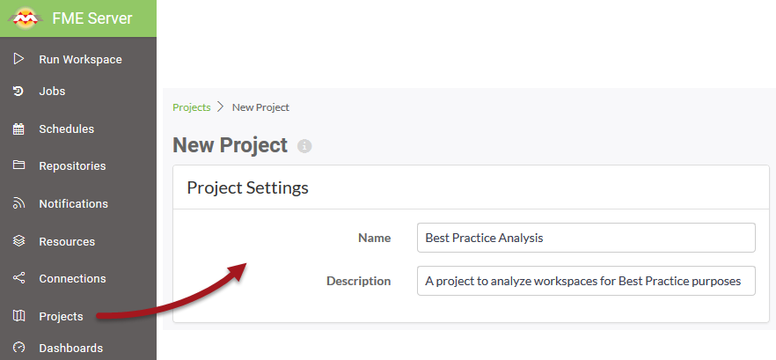
Creating Projects
Create Projects

Slide 4
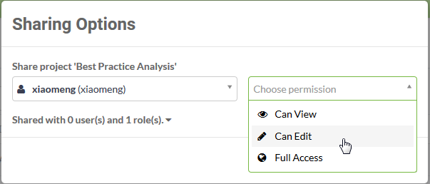
Sharing a Project
Share Projects

Slide 5
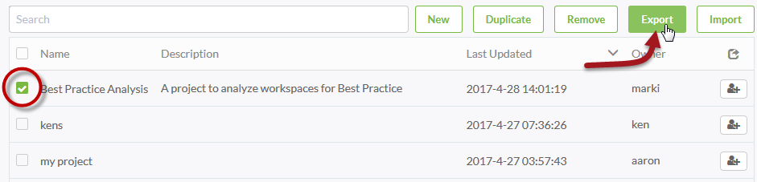
Exporting Projects
Export a Project

Slide 6
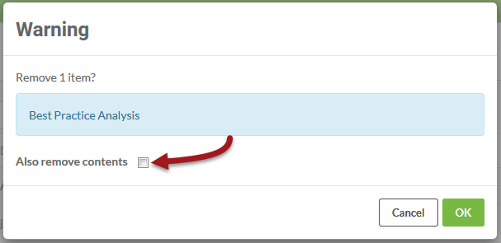
Removing Projects
Remove a Project

Slide 7
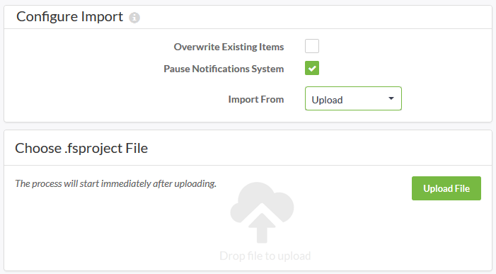
Importing Projects
Import a Project

