Slide 1
Introduction to FME Server
FME 2017

Slide 2
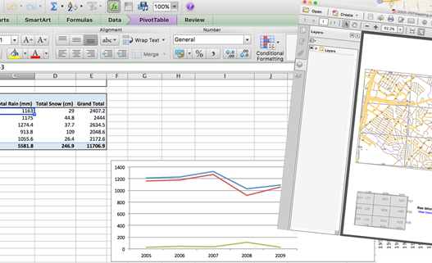
Introduction to FME Server
In this Section
What is FME Server?
FME Server Roles and Architecture
Workbench and Publishing Workspaces
Web Interface Basics and Licensing
Running a Workspace and Job History
Source Data Management
Web Connections and Publishing Data
Resource Filesystem

Slide 3

What is FME Server?
Self-Serve
Real-Time
Automation

Slide 4
FME Server Roles
Author
User
Developer
Administrator

Slide 5
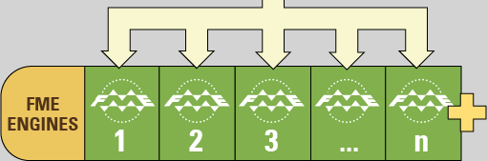
FME Server Architecture
Engines
Core
Web Services

Slide 6
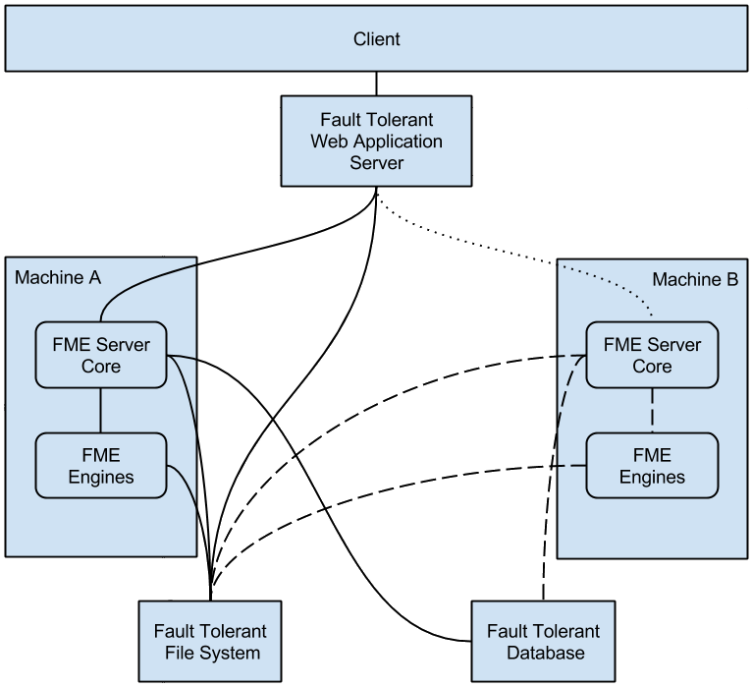
Deploying FME Server
Platforms
Distributed Systems

Slide 7
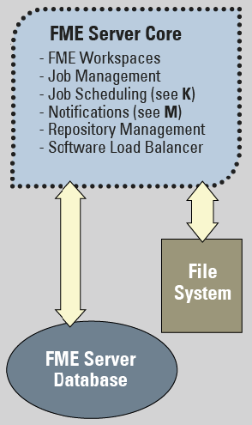
Workbench and FME Server
Shared Parameters
Embedded Parameters
Scripted Parameters

Slide 8
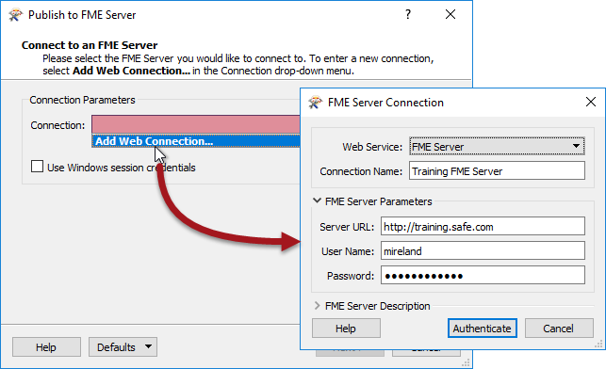
Publishing Workspaces
Connecting
Repositories
Connections
Registration

Slide 9
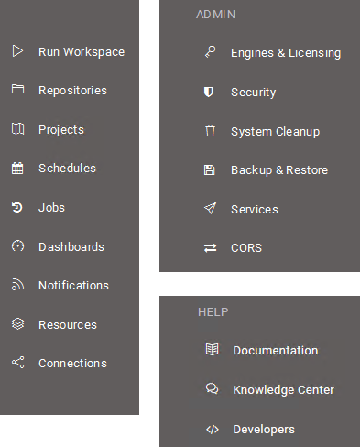
Web Interface Basics
Menus
Getting Started

Slide 10
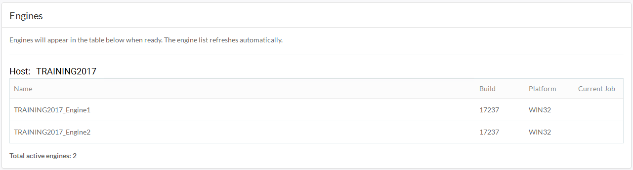
Engines and Licensing
Licensing
Engines
Hosts

Slide 11
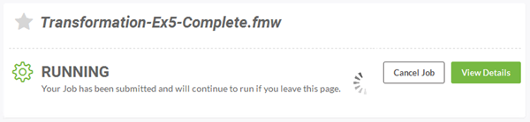
Running a Workspace
Run Workspace

Slide 12
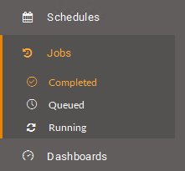
Jobs
Completed
Queued
Running

Slide 13
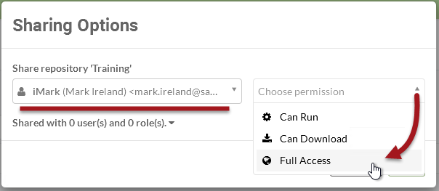
Sharing in FME Server
Sharing a Repository

Slide 14
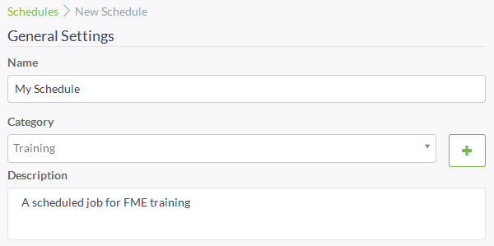
FME Server Scheduling
Managing Scheduled Tasks
Creating Scheduled Tasks

Slide 15
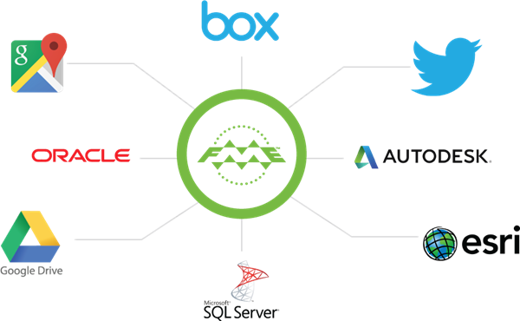
Source Data Management
Web-Based
Local File-System

Slide 16
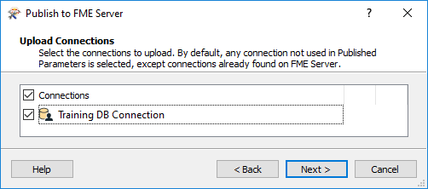
Database Connections
Creating Database Connections
Managing Database Connections
Using Database Connections

Slide 17
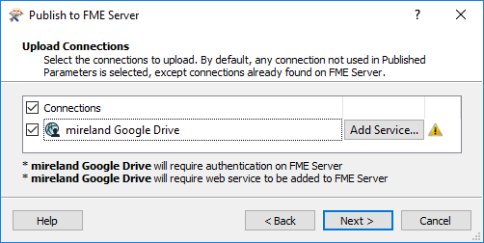
Web Connections
Creating Web Connections
Managing Web Connections
Using Web Connections

Slide 18
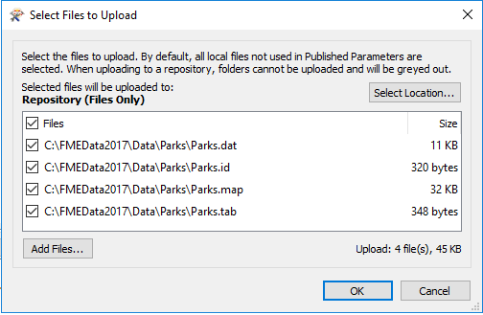
Publishing Data
Publishing Source Data
Using Published Source Data

Slide 19
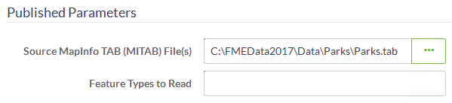
Temporary Uploads
Uploading Source Data
Cautions and Limitations

Slide 20
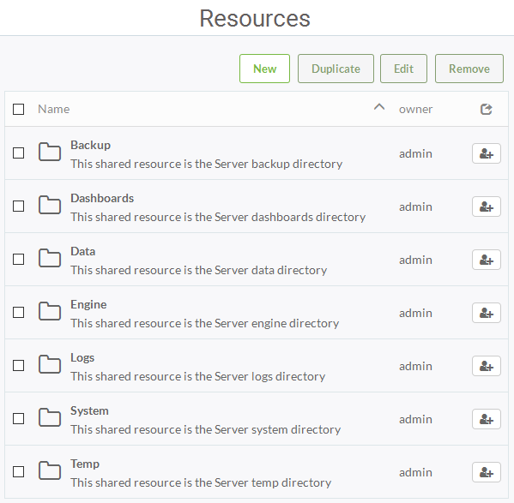
Resource Filesystem
What are Resources?
Other Upload Methods
Using Uploaded Data
Benefits for Data Management

Slide 21
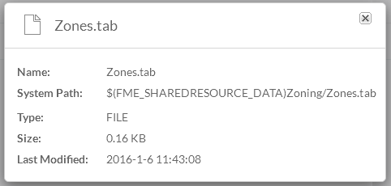
Authoring for Resources
FME Server Parameters
FME_SHAREDRESOURCE_DATA
Shortcuts to Resource Paths

Slide 22
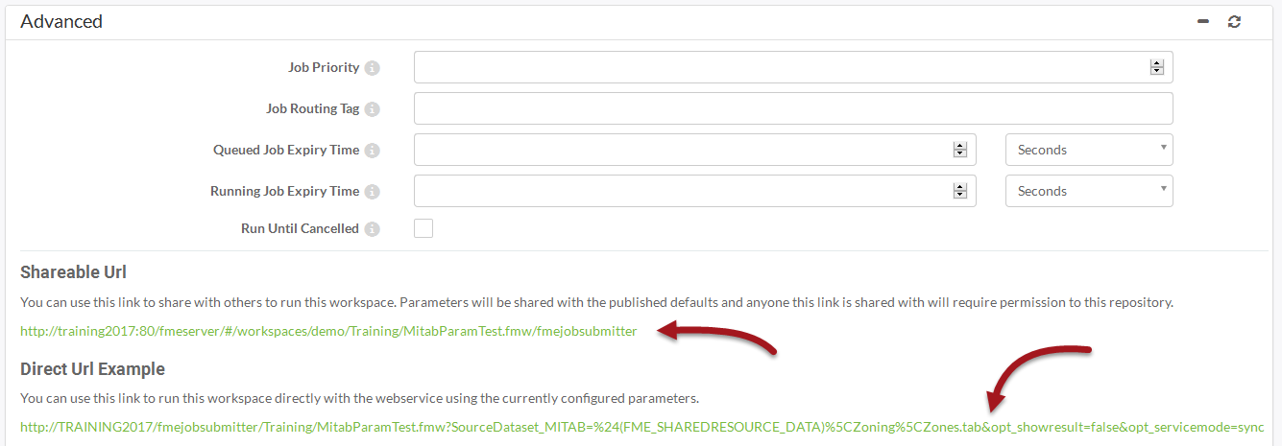
Running the JobSubmitter with a URL
HTTP Request

Slide 23
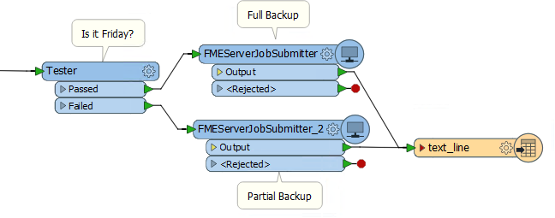
Authoring Job Chains
What are Job Chains?
The FeatureWriter Transformer
A Simple Chain
A Parent-Child Approach
Conditional Processing
FMEServerJobSubmitter and Portability

