Slide 1
Evaluating French Language Proficiency with Fuzzy Logic
Master Class 1: Advanced Artificial Intelligence and Robotics
Abstract
The aim of this project is to create an application on Mat lab to evaluate the French language level of a user. The brain of the application is based on fuzzy logic and the inputs of the user are his/her oral, written, and comprehension exam scores.
Created By :
IMHAMED&HASSAN
Notes:
(imhamed)
Good morning everyone,
I’m Imhamed and I am here today with my partner Hassen Fatnassi to present our project on the development of a French level evaluation software with Matlab based on fuzzy logic.
As many of you may know, French is an important language in many countries and it is essential for individuals to know their level of mastery of this language.

Slide 2
OVERVIEW
Interface
GUI interface
Transfer Data
Coding On Matlab
Fuzzy Logic System
Make Decision
Notes:
First, we would like to give a brief overview of the project.
Our goal was to create an application that could accurately evaluate a user's profichiency in the French language. The application takes into account the user's scores on oral, written, and comprehension exams and uses fuzzy logic to determine their level of mastery.
Hassen will now explain the methodology we used to develop the application.

Slide 3
Methodology
AI
01
Research
User interface
02
Evaluation criteria, Tests, Expert
HASSAN’s MacBook
Designing the layout,creating input fields, adding sections
03
development of fuzzy logic system
Integration of the fuzzy logic system with the user interface
04
Fuzzy rules,memberships functions,test,
05
Coding and testing with Matlab
Fine-tuning and optimization of the application
06
Notes:
Thank you Imhamed,
The methodology used to create the French level evaluation software with Matlab based on fuzzy logic involved several steps.
First, we did research and selected standard tests and evaluation criteria for French language profichiency.
We then developed fuzzy rules for mapping test scores to language proficiency levels by defining linguistic variables and fuzzy sets for each profichiency level, and creating rules to determine the membership of a test score to a particular level.
Finally, we coded and tested the application in Matlab, and fine-tuned it based on the results of user testing.

Slide 4
Specifications of the experts
 | Ranking & Level Outputs
A1 | Beginner | 0<Scores<1 / map10
A2 | Beginner | 1<Scores<3 / map10
B1 | intermediate | 2<Scores<5 / map10
B2 | intermediate | 4<Scores<7/ map10
C1 | Advanced | 6<Scores<9/ map10
C2 | Adcanced | 9<Scores<10/ map10
Level | Class | Scores(Spoken,Written,Comprehension)
Notes:
(Imhamed)
Thank you Hassen.
Now, I would like to give a more detailed explanation of the fuzzy logic system used in the application.
The rule base is created based on the expert knowledge.

Slide 5
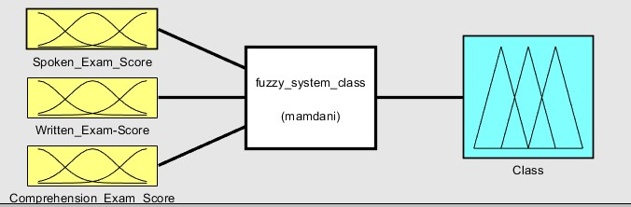
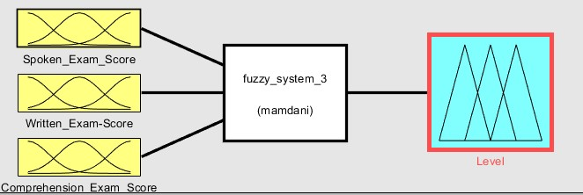
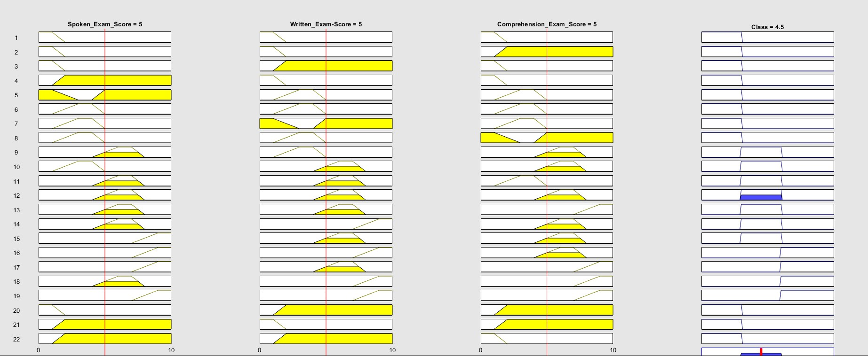
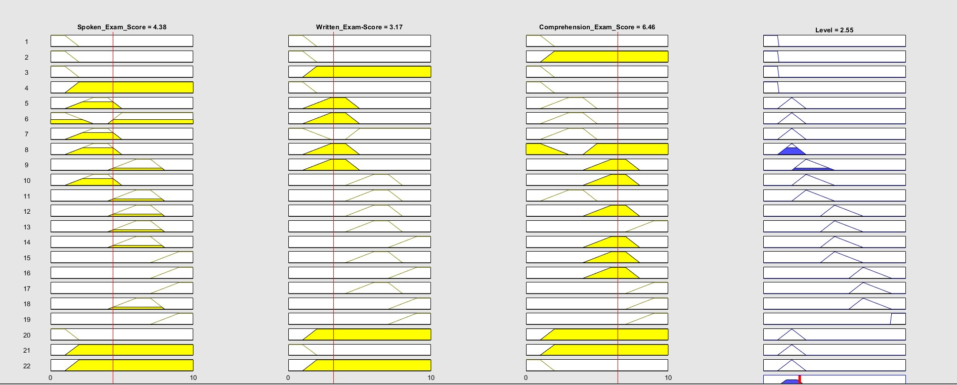
Fuzzy System
A Look
Notes:
The system is based on the Mamdani type, where the inputs are the oral, written, and comprehension scores and the output is the level of proficiency in the French language.
The inputs are transformed into fuzzy sets using the fuzzification process and the output is defuzzified using the centroid method.
We also added an interface for the user to make it easy for them to use the application.

Slide 6
User interface design
01
02
03
Spoken,Written,Comprehension score
Easy to Understand
User-Friendly
Section of 3 inputs
04
05
View Results ans Reset
2 Button for manipulation
Section of 2 outputs and Advice
Notes:
The user interface of our software is designed to be user-friendly and easy to understand.
We have created three input fields for the user to enter their oral, written, and comprehension exam scores. Additionally, we have included a section to display the user's proficiency level, the closest level to the user's score, and a section to show the user's level class (beginner, intermediate, advanced).
We have also added a section for advice and motivation for the user, as well as two buttons for the user to view their results and reset the information.

Slide 7
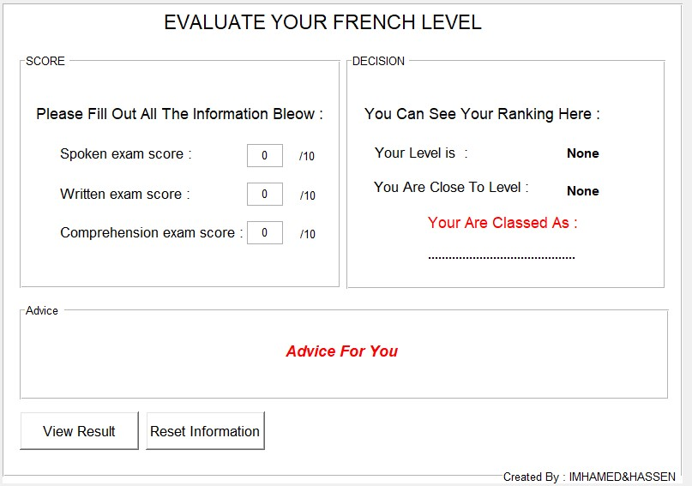
User interface design
Inputs Section
Outputs Section
A Look
Manipulate
Advice Section
Notes:
And We can see here the interface clearly,
The inputs Section
- the outputs
Advice
And finally, the two button for manipulation,

Slide 8
Integration of our fuzzy system with GUI
Fuzzy Logic System
Callback Function
Get
Inputs User
Outputs
Set
Tag
User interface
Notes:
In terms of the integration of our fuzzy logic system with the user interface,
we have used callback functions in Matlab to link the two.
We have used the get and set handles functions to transfer data between the interface and the fuzzy logic system.
This allows for seamless communication between the two, ensuring accurate and efficient results for the user.
I'll now pass the floor to my colleague Imhamed who will further explain the fuzzy logic system.

Slide 9
Fuzzy Logic System
Inputs
Outputs
Spoken
Level
Written
Class
Compre
Close_To_Lev
M,Ship,Func
MSHF 1
MSHF 2
MSHF 1
MSHF 3
MSHF 2
MSHF 4
MSHF 3
Notes:
I will explain the details of the fuzzy logic system that we used in our application.
We used 3 inputs corresponding to the scores of the oral, written, and comprehension exams.
We then created 4 membership functions for each input based on the evaluation criteria set by experts. And 3 membership functions for each class outputs
Also based on the evaluation criteria set by experts,
The outputs of our system are the level, class and close_to_level. Level ranges from A1 to C2,
class ranges from beginner to advanced, and close_to_level is the nearest level to the one obtained.
We used Mamdani type fuzzy logic and the centroid method for defuzzification,

Slide 10
The Centroid method
Method of defuzzification in fuzzy logic
The Centroid Method
Convert Foutput to crips value
one of the most accurate methods of defuzzification
easy to implement
Notes:
BTW (“The centroid method is a method of defuzzification in fuzzy logic.
It is used to convert the fuzzy output of a fuzzy system into a crisp value.
The centroid method calculates the center of gravity of the fuzzy output set and the crisp value is the value that corresponds to the center of gravity.
The centroid method is considered to be one of the most accurate methods of defuzzification because it takes into account the entire fuzzy output set and not just the maximum value.
It is also computationally efficient and easy to implement”).

Slide 11
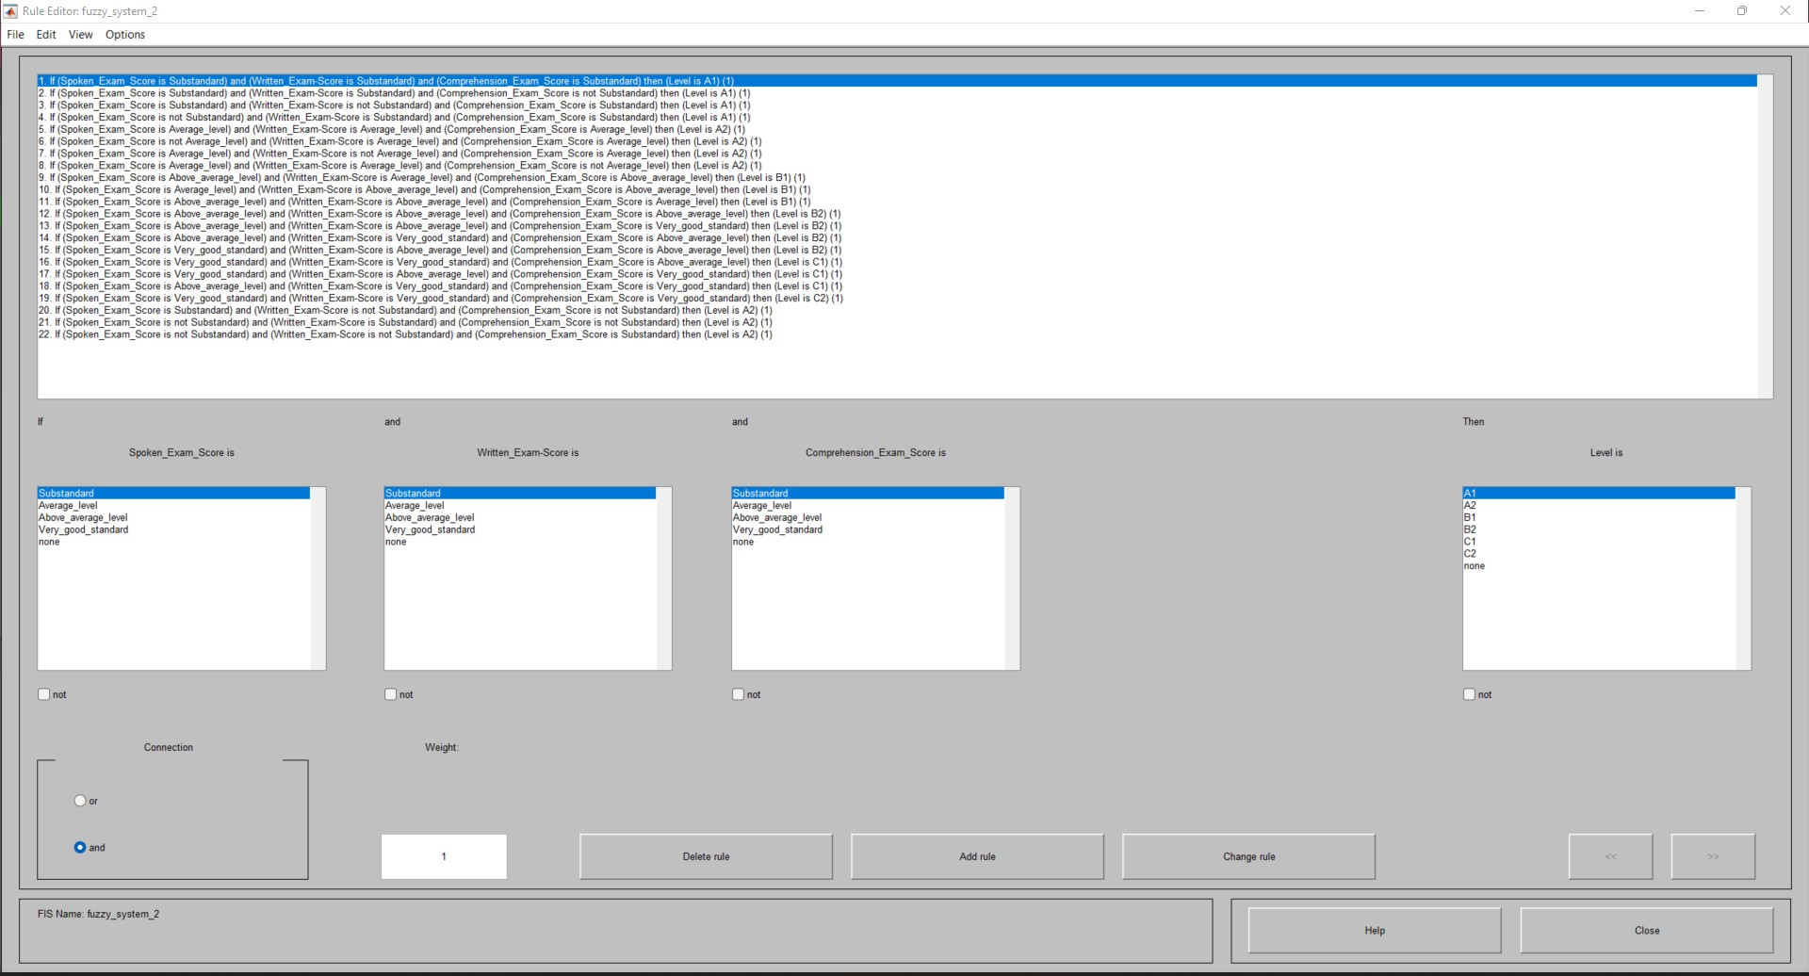
Rules
https://github.com/IMHAMEDBOUJEMAA/French_Language_Evaluater/tree/master
Notes:
. We also created a set of rules based on expert knowledge to map the input scores to the corresponding level and class.
We also made the code available on Github for anyone who wishes to use or improve upon our application.
In conclusion, we are proud to have developed an application that can accurately evaluate a user's proficiency in the French language.
We hope that our application will be useful for anyone who wants to improve their French language skills.

Slide 12

Thank you for Listening
Notes:
Thank you for listening and we would be happy to answer any questions you may have.
(Hassen)
Thank you.

