Slide 1



IMIC
INDIAN MEDICAL INSURANCE COMPANY

Slide 2
PROBLEM STATEMENT
To develop a web application in which user can buy a health insurance policy and can apply for claim.

Slide 3
Work Distribution
HIMANSHU KHATRI
Agent
Admin Dashboard
Home page and policies
NISHI AGARWAL
Policyholder
Uploading documents
Mailing credentials
SHIVANGI RAI
Admin
Agent dashboard
Add new agent
Notes:
Good Quality: Meet the purpose, Defect free, Easy to use, Superiority of a product
Testing and its Importance: To make sure that a product is of good quality we test it.
It’s one of the most important phase of products development life cycle. If not done properly it may result in to business loss, profitability or even it can be life threatening!
Everyone should know: Quality is everyone’s responsibility and not just Test engineer. Everyone should know about quality criteria’s and how to meet it.
If developers are also aware of quality criteria’s and takes quality responsibility it will help them. A developers work is also judged based on numbers of defects found in his code!

Slide 4
Technology
Working hours spend on the project:
90-95 hours
TECHNOLOGIES:
HTML
CSS
Angular
Bootstrap
Java (Springboot)
MongoDB
AWS
Notes:
Good Quality: Meet the purpose, Defect free, Easy to use, Superiority of a product
Testing and its Importance: To make sure that a product is of good quality we test it.
It’s one of the most important phase of products development life cycle. If not done properly it may result in to business loss, profitability or even it can be life threatening!
Everyone should know: Quality is everyone’s responsibility and not just Test engineer. Everyone should know about quality criteria’s and how to meet it.
If developers are also aware of quality criteria’s and takes quality responsibility it will help them. A developers work is also judged based on numbers of defects found in his code!

Slide 5
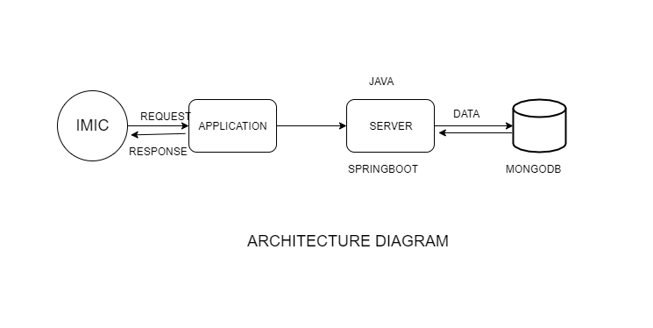

Slide 6
Completion of project
WORK DONE:
User can request for a policy.
Admin can add new agents.
Agents would be able to initialize request form of the user and than user can submit further details and document
Admin can reject or accept the form based upon the document verification
WORK NOT DONE:
Claim module
Notes:
Good Quality: Meet the purpose, Defect free, Easy to use, Superiority of a product
Testing and its Importance: To make sure that a product is of good quality we test it.
It’s one of the most important phase of products development life cycle. If not done properly it may result in to business loss, profitability or even it can be life threatening!
Everyone should know: Quality is everyone’s responsibility and not just Test engineer. Everyone should know about quality criteria’s and how to meet it.
If developers are also aware of quality criteria’s and takes quality responsibility it will help them. A developers work is also judged based on numbers of defects found in his code!

Slide 7
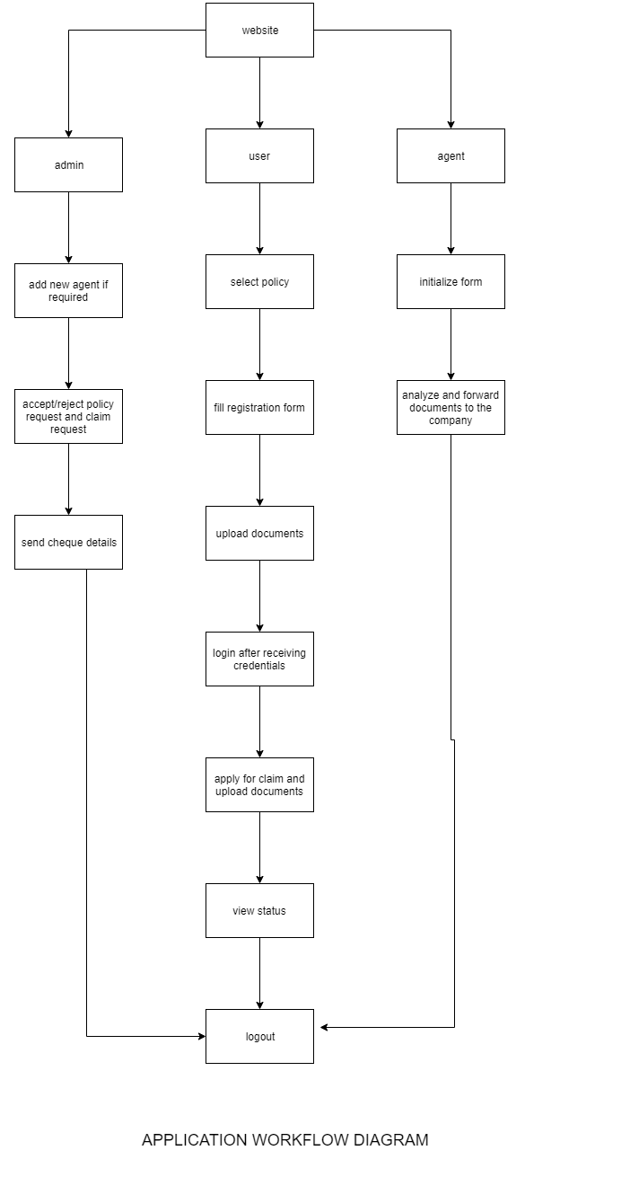

Slide 8
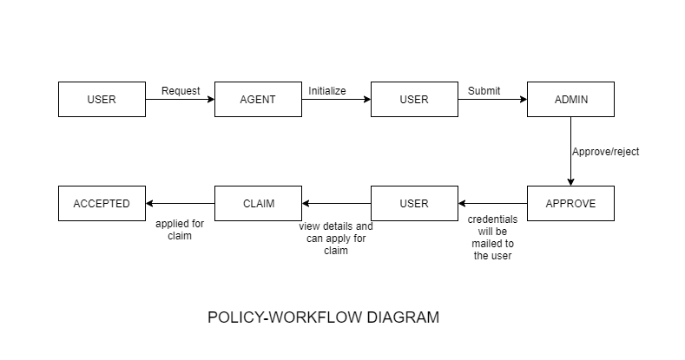

Slide 9

Thank You!

