Slide 1
Theraplane

Slide 2
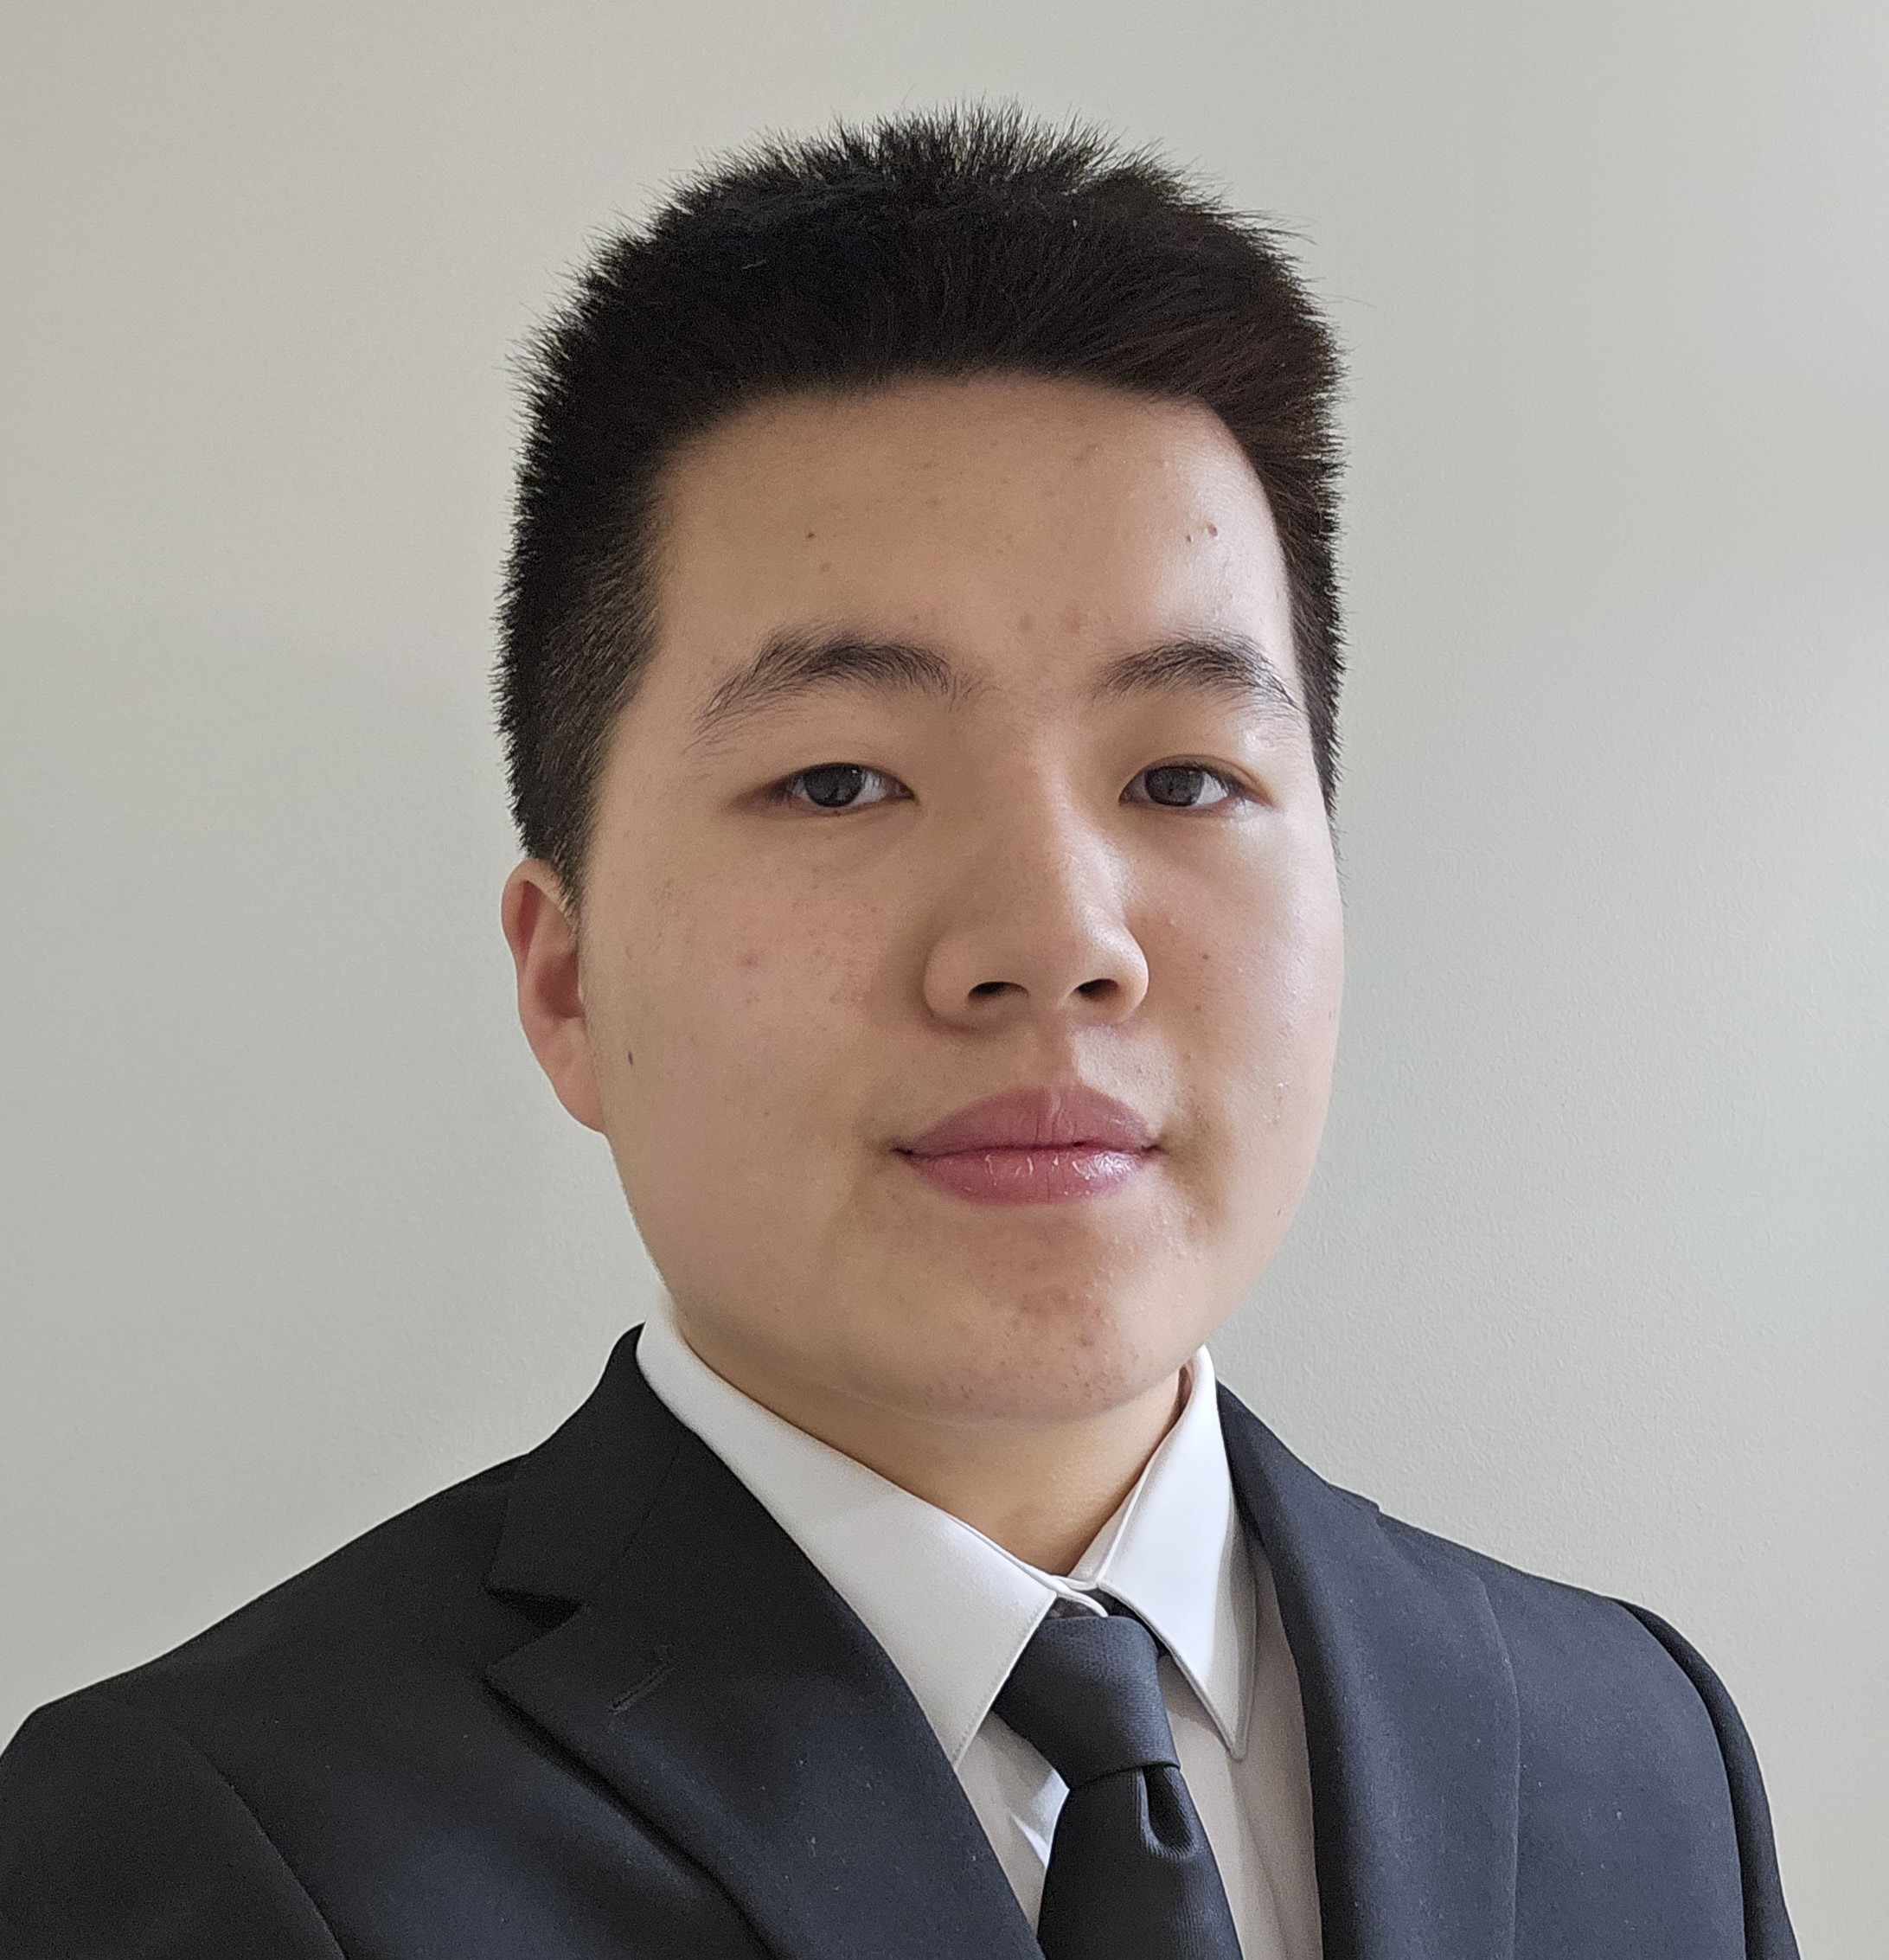



Meet the team
Alex Zou
Iminabo Roberts
Melika El-Wadany
Farzana Chowdhury

Slide 3





What is the Problem?
12.6 million people between the ages of 18 and 25 experienced a mental health issue in the past year
More than 55% of counselors and therapists experience burnout due to administrative tasks which can lead to a decline in the quality of care
13.6% of adults from ages 18-25 had serious thoughts of suicide in the past year
https://jedfoundation.org/mental-health-and-suicide-statistics/

Slide 4

Our solution
We are developing an AI-powered appointment booking platform for healthcare professionals focused on students' mental health needs. The platform features a chatbot that communicates with students, summarizes their concerns, and relays this information to specialists, facilitating seamless appointment scheduling.
We aim to enhance access to mental health resources and foster a supportive community for students seeking help.

Slide 5
How it works
Students discuss with the chatbot to answer a set of question
Responses categorize mental health concerns
Chatbot connects students to specialists efficiently
Efficient management of appointments through integration with calendars

Slide 6


Benefits
Therapists
Students
Manage caseloads effectively
Focus on urgent and high-risk cases
Reduce burnout and improve job satisfaction
Easier access to counseling services
Faster response to mental health needs
Tailored support based on individual concerns

Slide 7
Demo

