Slide 1

Transformation of a CSV data set to HL7 FHIR
Architecture of IS in GW / Information management in clinical research
Leipzig, date

Slide 2
CONTENTS
Background
Communication server
FHIR
NextGen Connect (formerly Mirth Connect)
Transformation process
FHIR templates
Channels
Filters &amp; Transformers
Exercise

Slide 3
COMMUNICATION SERVER
Function
Central distribution of messages
Filter
Transformation
Avoidance of n*m communication interfaces
Software products:
eGate
Kodix (UKL)
NextGen Connect (formerly Mirth Connect)

Slide 4
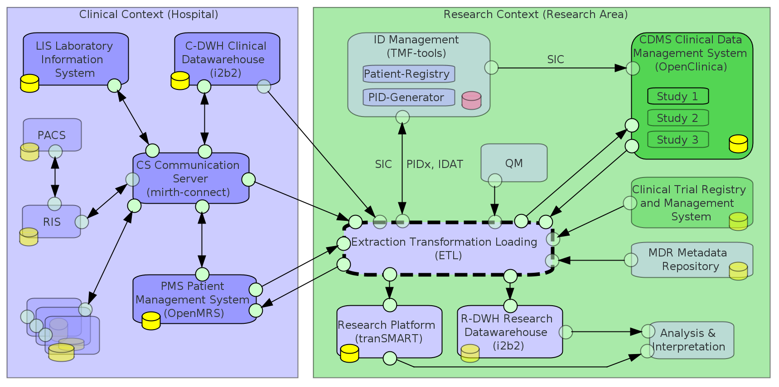
COMMUNICATION SERVER
Notes:
https://www.3lgm2.de/. Reading direction: left to right.
3LGM2 explanations:
Squares: Individual application systems (AS)
Yellow cylinders: Databases of the AS
Green circles: Interfaces of an AS. The arrows between the interfaces show a communication path between the AS.
On the left in purple is the context of a hospital and on the right in green is the context of a research institution.
Communication server: The communication server is marked with a red circle.
Has interfaces to all AS in the clinical context =&gt; collects the data and prepares it
Sends data via an ETL pipeline to research systems (right side)

Slide 5
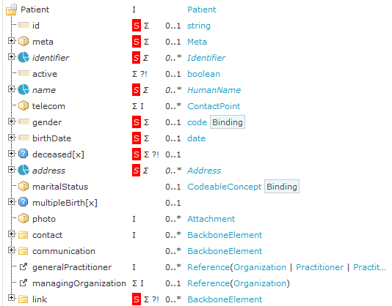
FAST HEALTHCARE INTEROPERABILITY RESOURCES (FHIR)
Consisting of consistent, easy-to-understand resources
80-20 principle: the standard (currently R4) covers most applications, with the rest covered by extensions
Web technology (Restful API) + human readability
Open source (specification, tools, servers, libraries)
Maintained by HL7
Used in Germany as part of the MII (core data set)
https://www.medizininformatik-initiative.de/Kerndatensatz/Modul_Person_Version_2/MIIIGModulPerson-TechnischeImplementierung-FHIR-Profile-PatientInPatient.html
Notes:
For more information on FHIR, see: https://www.hl7.org/fhir/.
Medical Informatics Initiative (MII) Core Data Set:
See https://www.medizininformatik-initiative.de/de/der-kerndatensatz-der-medizininformatik-initiative
Definition of data scope and standardization of medical data
This is a central prerequisite for the shared use of data in the MII
Divided into modules, see Basic Modules
In this exercise, we will use the Patient and Encounter modules
Image on the right:
This profile describes a patient in the Medical Informatics Initiative
Structure of a patient resource from the MII core data set Patient module
On the left are the names of the individual FHIR elements that belong to the resource
The red S indicates elements that are mandatory for the patient resource
On the right are the data types of the respective element

Slide 6
PURPOSE OF THE EXERCISE
Transformation from CSV to FHIR
Mapping to FHIR with MII-KDS
Creating channels with Mirth-Connect
Receiving data
Transforming
Outputting data in FHIR format
Sending FHIR data to a FHIR server
Verifying the transformed FHIR data with ClinFHIR

Slide 7
TRANSFORMATION FROM CSV TO FHIR WITH MIRTH-CONNECT
PROCESS
Input data
CSV data set
Transformation with Mirth-Connect
Mapping of CSV columns to FHIR attributes
Based on FHIR message template
Output
JSON bundle in FHIR format
For sending to a FHIR server

Slide 8
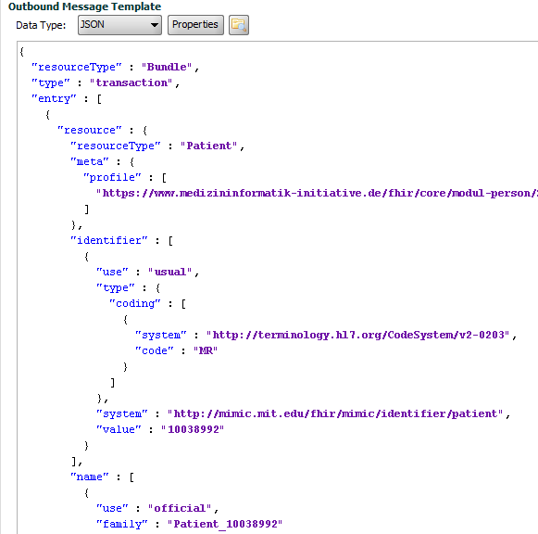
TRANSFORMATION FROM CSV TO FHIR WITH MIRTH-CONNECT
Template for FHIR messages to be sent
FHIR TEMPLATE: MII PATIENT
https://www.medizininformatik-initiative.de/Kerndatensatz/Modul_Person_Version_2/MIIIGModulPerson-TechnischeImplementierung-FHIR-Profile-PatientInPatient.html
Mirth-Connect Patient Source Transformer
Notes:
In order to send the mapped FHIR data to a FHIR server in Mirth-Connect, the structure of the FHIR JSON message to be sent must be defined in advance.
The FHIR template for the patient and case/encounter is provided for both in the exercise. The templates provided can be found at:https://github.com/IMISE/MI-Lab-E02-CSV-to-FHIR/tree/main/Material/Transformer/Complete
Nevertheless, this slide briefly explains the process of creating a FHIR message template for Mirth-Connect from the structure of a FHIR resource.
Image on the right: Structure of a FHIR resource of the Patient module from the MII KDS (MII Patient)
Image on the left: Complete FHIR message template as a screenshot from Mirth-Connect
Identifier: The red circles show how a patient's identifier from the MII Patient can be found in the FHIR message template.

Slide 9
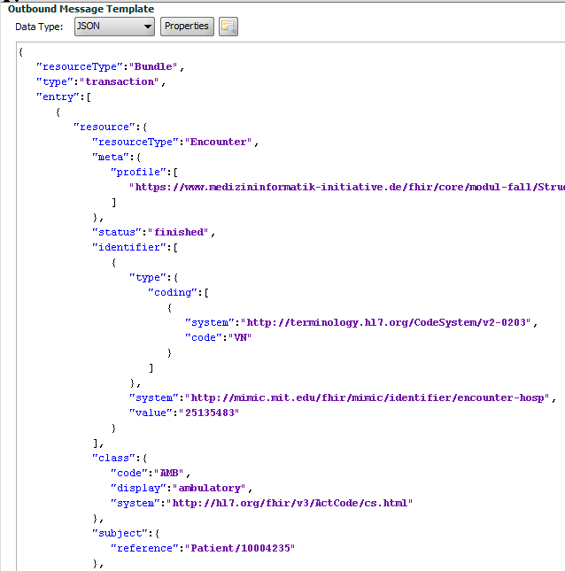
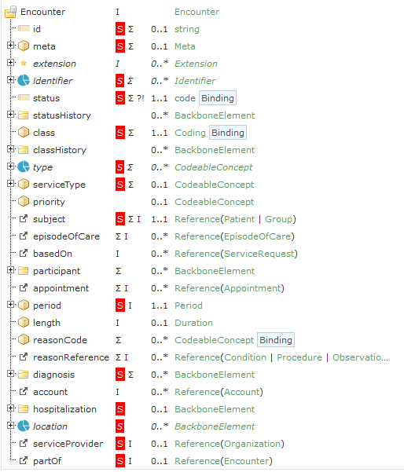
TRANSFORMATION FROM CSV TO FHIR WITH MIRTH-CONNECT
FHIR TEMPLATE: MII ENCOUNTER
Code system: https://www.medizininformatik-initiative.de/Kerndatensatz/Modul_Fall_Version_2/MIIIGModulFall-TechnischeImplementierung-FHIRProfile-EncounterKontaktGesundheitseinrichtung.html
https://www.medizininformatik-initiative.de/Kerndatensatz/Modul_Fall_Version_2/MIIIGModulFall-TechnischeImplementierung-FHIRProfile-EncounterKontaktGesundheitseinrichtung.html
https://www.medizininformatik-initiative.de/Kerndatensatz/Modul_Fall_Version_2/MIIIGModulFall-TechnischeImplementierung-FHIRProfile-EncounterKontaktGesundheitseinrichtung.html
Notes:
Creation of the FHIR message template for the MII Case module. Here is an example of the mapping of the attribute "class" and its "code" (outlined in red).
These are based on a code system that defines a standardized list of values for the attribute.
The code system for our example attribute is: EncounterClassDE (https://simplifier.net/packages/de.basisprofil.r4/1.4.0/files/656744)
Code: AMB, Display: ambulatory
Code: IMP, Display: inpatient encounter
etc.
Here, the code is "AMB," so it is an outpatient case.
Important: The identifier is not equivalent to the ID of a resource. Here, the identifier is the admission number! The ID is automatically transferred by the FHIR server. The identifier is the unique identifier of the case.

Slide 10
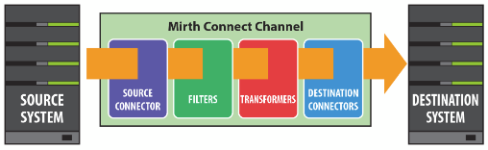
MIRTH-CONNECT
CHANNEL STRUCTURE
Source (input)
Read CSV data set
File Reader (defined folder)
Filters & Transformer (processing)
Transforming input data CSV to FHIR template
Mapping CSV columns to FHIR attributes
Destination (output)
Send the transformed FHIR JSON messages to the FHIR server (REST API)
Http sender
https://www.adldata.org/download/Manuals/Mirth_Connect_3.4_Users_Guide.pdf

Slide 11
MIRTH-CONNECT
2. SOURCE TRANSFORMER
Transformation of the data set to FHIR
Mapping CSV columns to FHIR attributes
Transformer Step: attribute to be mapped
Input: CSV file
Output: FHIR message template

Slide 12
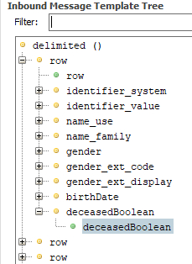
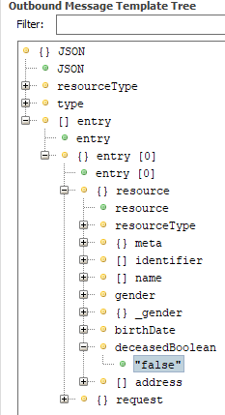
TRANSFORMATION FROM CSV TO FHIR WITH MIRTH-CONNECT
MII PATIENT TRANSFORMATION: EXAMPLE
Input: CSV file
All rows and columns as tree structure
Mapping of the first row sufficient
Output: FHIR JSON template
A JSON tree

Slide 13
TRANSFORMATION FROM CSV TO FHIR WITH MIRTH-CONNECT
MII PATIENT TRANSFORMATION: EXAMPLE
Mirth-Connect Transformer
Input CSV:
Mirth-Connect syntax
msg['row'][0]['deceasedBoolean'].toString()
Target variable
Notes:
The mapping in the Mirth Connect Transformer has a special syntax.
Here, the syntax for the input CSV is explained using the example "deceasedBoolean."
msg[‘row’][0] remains at the front for all Transformer steps:
msg: Our input CSV that is read in
['row']: The CSV is structured (see image) into a list of all rows in Mirth-Connect
When you expand a row, you can see all column attributes (see image)
[0]: Shows that we are reading the values of the first row
Mapping one row (0) is sufficient!
Mirth-Connect iterates through the other rows itself
[‘deceasedBoolean’] now specifies our target variable to be mapped
This must be changed depending on the attribute to be mapped
.toString() remains at the end of all transformer steps:
This saves the previously defined target variable as text
Data or numbers should also have a .toString()!
This is because we write the target variable into the FHIR message template, which is a JSON text

Slide 14
TRANSFORMATION FROM CSV TO FHIR WITH MIRTH-CONNECT
MII PATIENT TRANSFORMATION: EXAMPLE
Mirth-Connect Transformer
Output FHIR message template:
Mirth-Connect Syntax
tmp['entry'][0]['resource']['deceasedBoolean']
Target variable
Notes:
The mapping in the Mirth Connect Transformer has a special syntax.
Here, the syntax for the output FHIR message template, which is subsequently sent to a FHIR server,
using the example "deceasedBoolean."
tmp[‘entry’][0][‘resource’] remains at the front in the Transformer steps:
tmp: The temporary FHIR message template that is to be filled
[‘entry’]: A FHIR message always consists of an entry containing the attributes of the patient/case
[0]: Since our FHIR message template only consists of one patient/case, we only take the first entry (in computer science, counting starts at 0)
[‘resource’]: Each entry consists of a “resource” and “request” (see image)
Resource: Data structure containing the attributes =&gt; These attributes must be mapped!
Request: Action associated with the resource
Creating the resource in the FHIR server
[‘deceasedBoolean’] now specifies our target variable to be mapped
This must be changed depending on the attribute to be mapped

Slide 15
TRANSFORMATION FROM CSV TO FHIR WITH MIRTH-CONNECT
TRANSFORMATION TERMS
Transformer Step
1 step for each attribute to be mapped
Step Type: Message Builder
Replaces attribute in FHIR template with attribute from CSV data record
Message Segment (Output)
Text field for attribute from FHIR template
Mapping (Input)
Text field for attribute from CSV data record

Slide 16
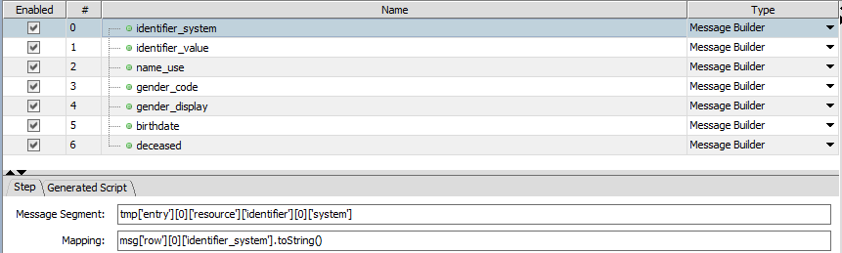
TRANSFORMATION FROM CSV TO FHIR WITH MIRTH-CONNECT
MII PATIENT TRANSFORMATION: EXAMPLE
Notes:
Screenshot of the Patient Transformer in Mirth-Connect:
Individual Transformer steps with type: "Message Builder"
First red circle: Step identifier_value -&gt; Maps the attribute identifier_value to FHIR
Second red circle:
Message segment: See syntax for output FHIR message template (slide 13)
Mapping: See syntax for input CSV (slide 12)

Slide 17
TASKS (SEE EXERCISE SHEET)
Mirth Connect
1.1 - 1.2 Create channel
1.3.1 Source connector
1.3.2 Destination connector
1.4 - 1.5 Extend transformer
1.6 Deploy channels and send FHIR messages
ClinFHIR
2.1 View transformed patients and cases
2.2 - 2.3 Answer questions

Slide 18
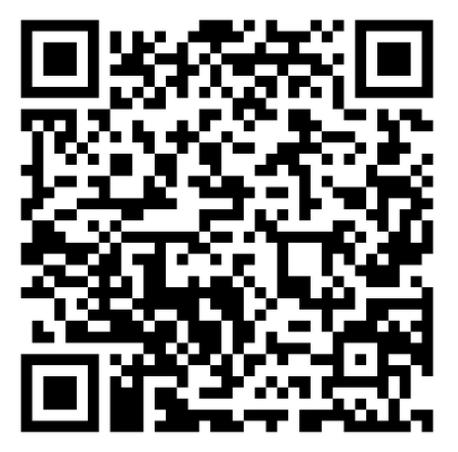
TASKS (SEE EXERCISE SHEET)
Exercise sheet in GitHub:
https://github.com/IMISE/MI-Lab-E02-CSV-to-FHIR
Under /Exercise/Exercise_sheet.pdf

Slide 19
THANK YOU!
Mona Perbix
Institute for Medical Informatics, Statistics, and Epidemiology (IMISE)

