Slide 1

MI-Lab Exercise: ARX as an anonymization tool
Information management in clinical research
Leipzig, Datum

Slide 2
DISCLAIMER
The exercise is largely based on a presentation of the functionalities of ARX by (then) Dr. Fabian Prasser from the Institute for Medical Statistics and Epidemiology, Technical University of Munich
The rights to the content are held by TMF Technologie und Methodenplattform für die vernetzte medizinische Forschung e.V. Berlin
No further distribution without the permission of the above entities!

Slide 3
CONTENTS
Preparation
Introduction and installation
Basic functionalities
Task 1: Protection against re-identification with k anonymity
Task 2: Demonstrating the optimal transformation and finding the second-best solution
Task 3: Comparing identification risks before/after transformation
Task 4: Creating your own generalization hierarchy
Task 5: Effect of the generalization hierarchy on the distribution of individual features

Slide 4
CONTENTS
Transformation models
Task 6: Impact of suppression
Task 7: Effect of microaggregation

Slide 5
INTRODUCTION
Task
Create an ARX project file for a given data set.
Files
Input data
MIMIC Ü3 full.csv
Hierachies
Age.csv, insurance.csv, language.csv, martial-status.csv, race.csv, weight.csv

Slide 6
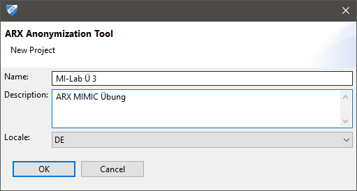
CREATE PROJET
Open ARX and select from the application menu
„File“ → „New project…“
Enter a project name and click “OK”

Slide 7
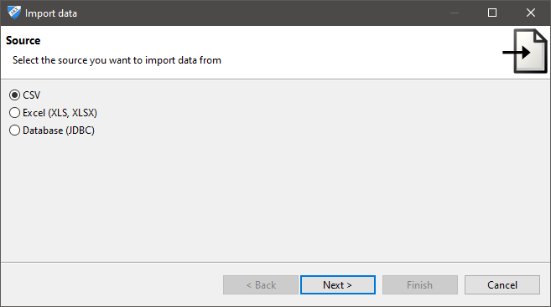
IMPORT DATA (1)
Select "File" → "Import data" from the application menu.
Select "CSV" and click "Next."
Select "Browse..." and select the file "MIMIC Ü3.csv"

Slide 8
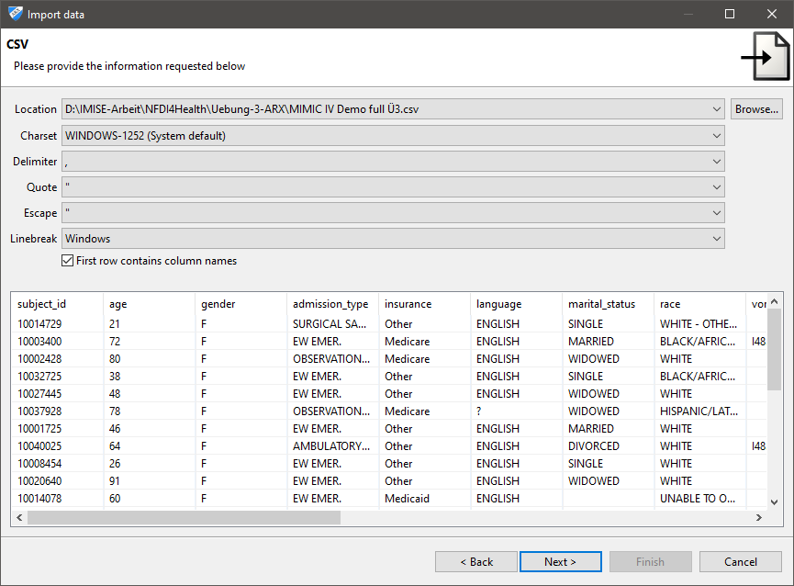
IMPORT DATA (2)
The syntax of the file is recognized automatically.

Slide 9
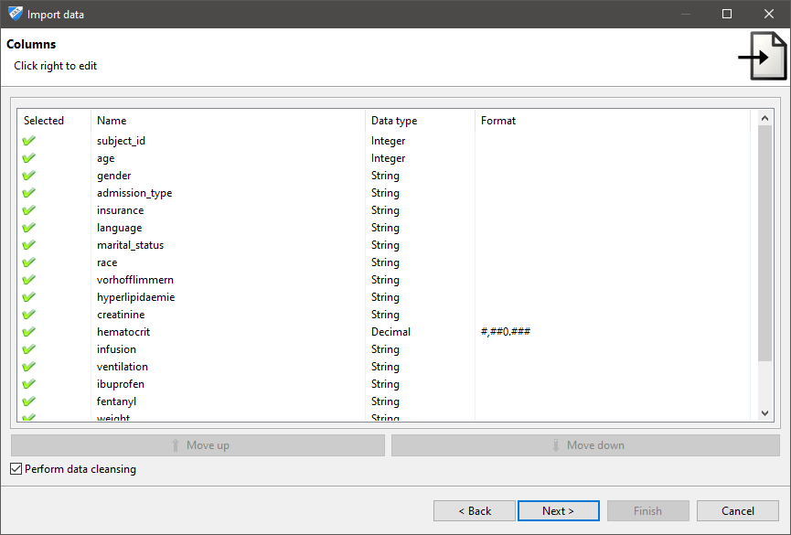
CONFIGURE INPUT FILE
In the following dialog, you can configure the input file

Slide 10
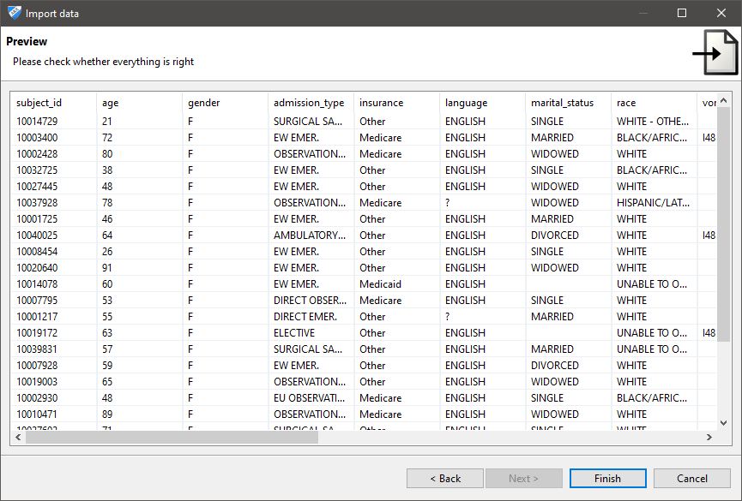
PREVIEW
An overview of the data set appears

Slide 11
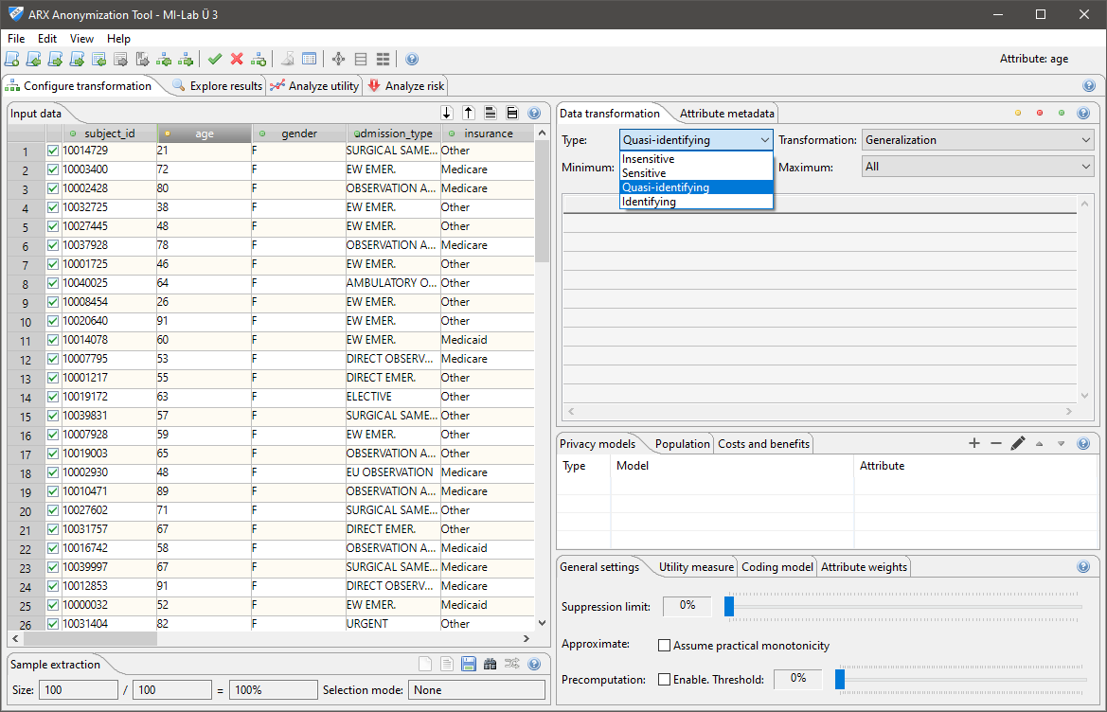
ARX GUI
Click on the attributes (columns) and change the type

Slide 12
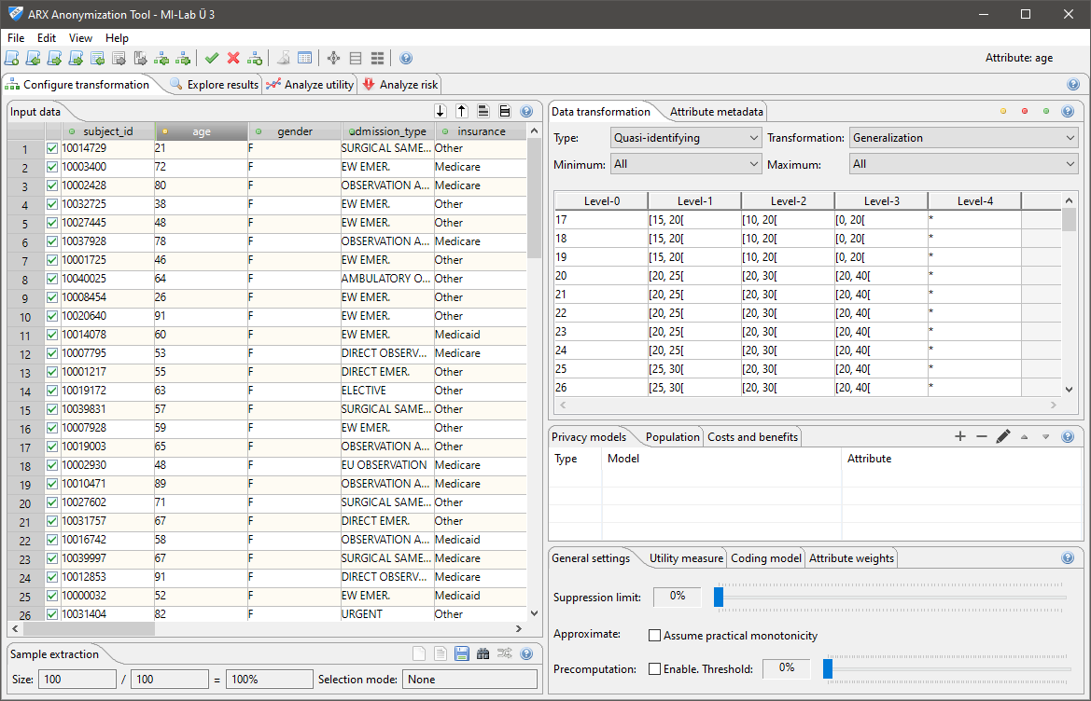
IMPORTING HIERARCHIES
„File“ → „Import hierarchy ...“ for all attributes

Slide 13

TASKS (SEE EXERCISE SHEET)
Exercise sheet in GitHub:
https://github.com/IMISE/MI-Lab-E03-Privacy
Under /Exercise/Exercise_sheet_en.pdf

Slide 14
THANK YOU!
Mona Perbix
Institut für Medizinische Informatik, Statistik und Epidemiologie (IMISE)
www.imise.uni-leipzig.de

