Slide 1

MI-Lab Lecture / Exercise Local Data Hub (LDH)
Information management in clinical research
Leipzig, Date
Mona Perbix

Slide 2
PURPOSE OF THE EXERCISE
Upload in ein Forschungsdatenmanagementsystem (FDMS)
Studiendokumente
Datensatz
Metadaten
Ausfüllen von Metadatenschema für eine Studie

Slide 3

INTRODUCTION
WHY UPLOAD TO AN FDMS?
Data from clinical trials often do not comply with FAIR principles
Lack of international standards for registration and publication
Possibilities for data use often unclear
Restrictions on reusability
Databases are often not interoperable
https://de.wikipedia.org/wiki/FAIR-Prinzipien

Slide 4
INTRODUCTION
LOCAL DATA HUB (LDH)
Open source software for data management
Networking of complementary resources from clinical studies
Study protocols, data sets, references to publications, etc.
Project-specific access controls and rights assignment
Archiving and versioning
Citation & referencing

Slide 5
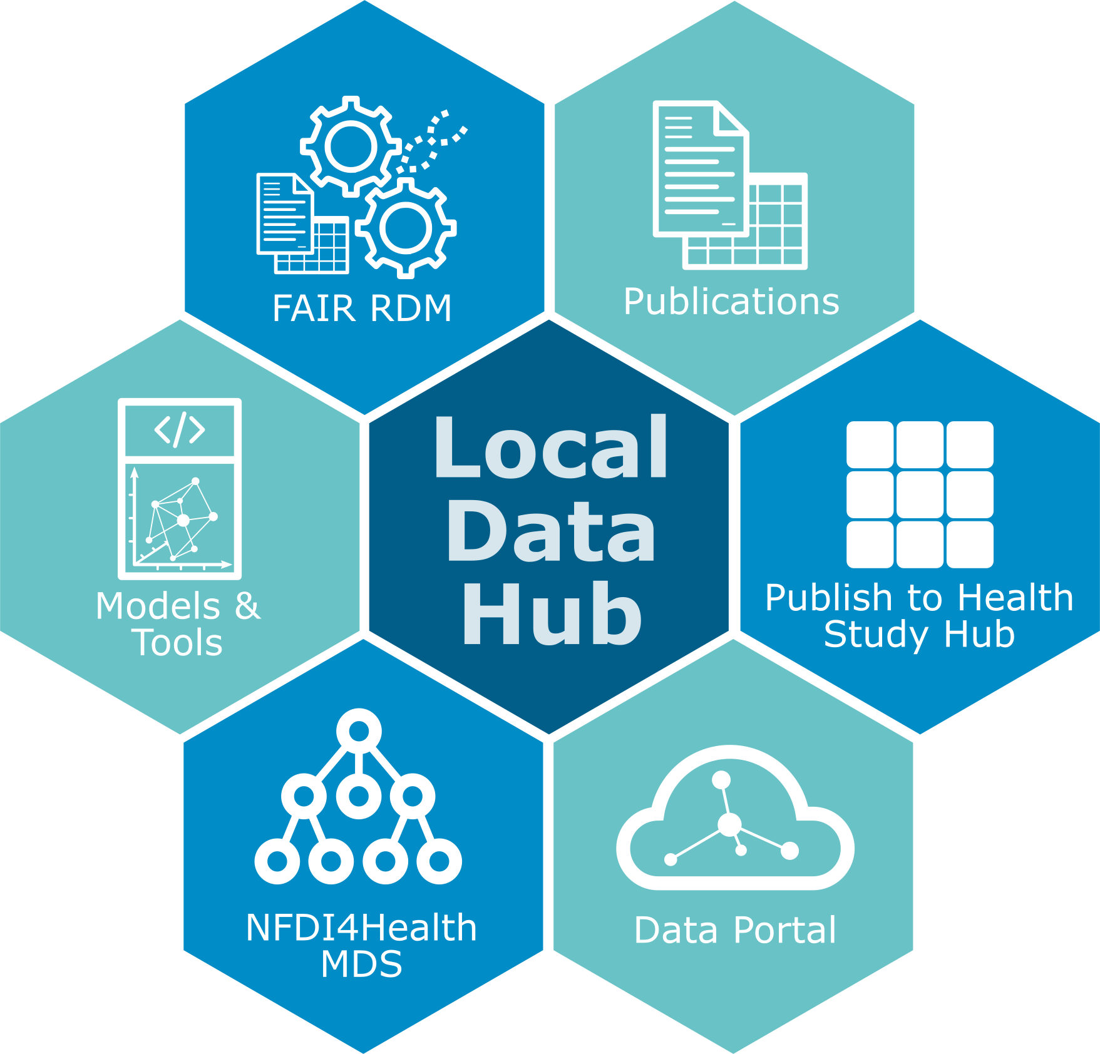
INTRODUCTION
LDH STRUCTURE
Direct publication of content in the NFDI4Health German Central Health Study Hub
NFDI4Health metadata schema for standardized publications
https://www.nfdi4health.de/en/service/local-data-hub.html

Slide 6

The FAIRDOM SEEK Plattform
Tooling
FAIRDOM-SEEK is an open source web-based cataloguing and commons platform, for sharing heterogeneous scientific research datasets, models or simulations, processes and research outcomes. It preserves associations between them, along with information about the people and organisations.
Underpinning FAIRDOM-SEEK is the ISA infrastructure, a standard framework for describing how individual experiments are aggregated into wider studies and investigations. Within FAIRDOM-SEEK, ISA has been extended and is configurable to allow the structure to be used outside of Biology.
Flexible and detailed sharing permissions are available to manage the catalogued items from early collaborations within projects, through to the publishing of final research results
https://www.nfdi4health.de/en/service/local-data-hub.html

Slide 7
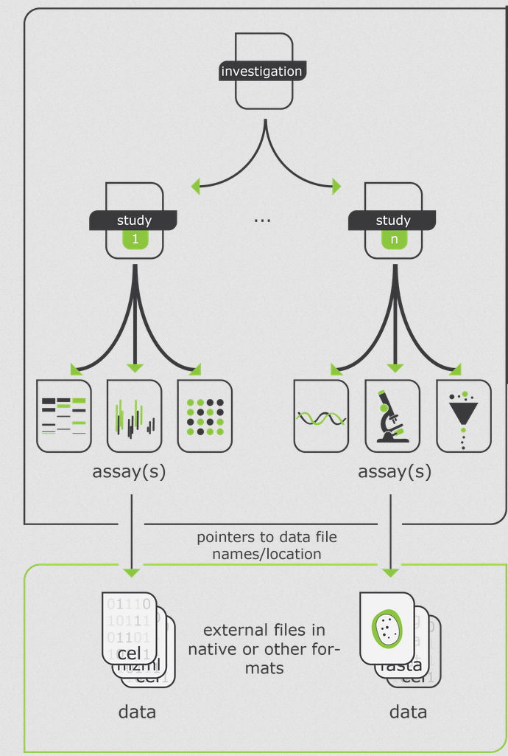
INTRODUCTION
INVESTIGATION, STUDY, ASSAY (ISA) FRAMEWORK
Investigation
High level concept
Links related studies
Study
Central unit
Contains information on the subject
Has associated assays
Assay
Tests performed which produce data
https://isa-tools.org/format/specification.html

Slide 8
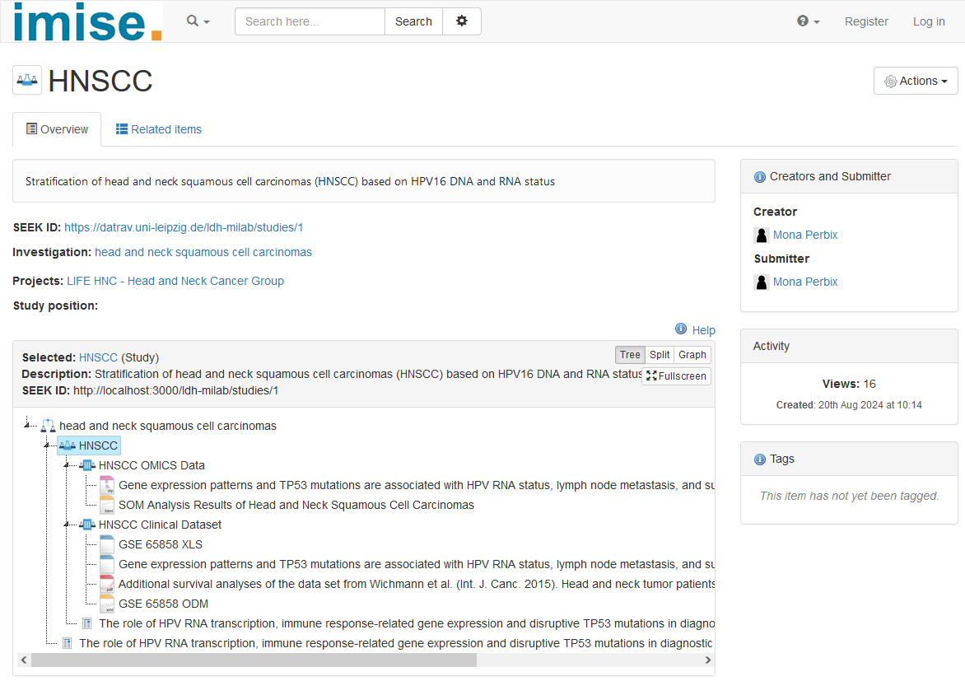
LDH CASE STUDY
Name of the study
Related investigation and project
Files for download
https://datrav.uni-leipzig.de/ldh-milab/studies/1

Slide 9
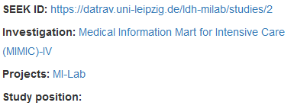
Why Extended Metadata?
Resources only have a few fixed attributes:
Goal: Add your own metadata attributes
Summarized as a metadata schema for easy import

Slide 10
NFDI4HEALTH METADATA SCHEMA
For standardized publication on the German Central Health Study Hub
Study resources
Metadata
FAIR publication of health studies
https://www.nfdi4health.de/service/datenharmonisierung-und-publikationen?format=html

Slide 11
DOCUMENTS TO BE UPLOADED
Document | Description
Research Data Management Plan (FDMP) | How research data is created, processed, stored, and shared
Study protocol | Contains the objective, design, and methodology of the study
Data quality rules | Standards and criteria for data quality
Data Dictionary | Structure and variables of the data set. Facilitates interpretation of the data
See GitHub: Material/Study_documents

Slide 12
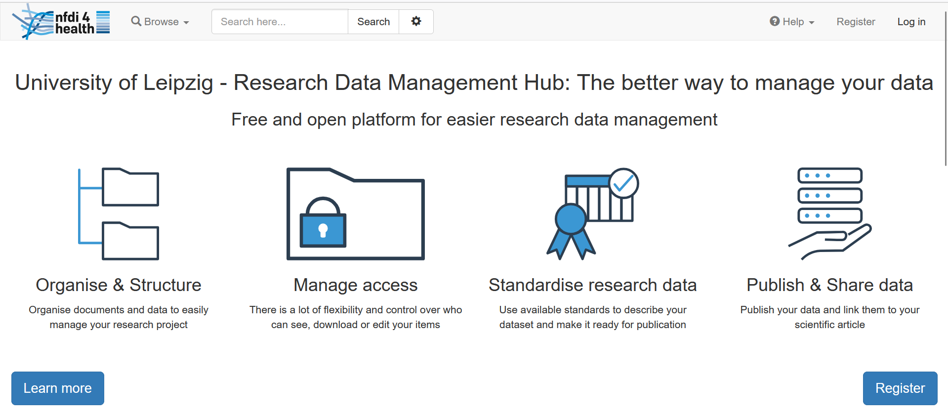
REGISTRATION LDH
https://ldh.imise.uni-leipzig.de/

Slide 13
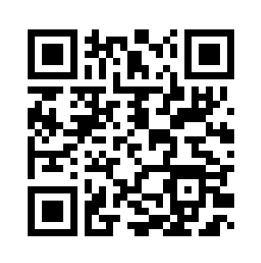
Exercise: GitHub
GitHub: MI-Lab-E04-FDM
Exercise sheet under /Exercise

Slide 14
Exercise: Task 1
Institution and project
Search for the institution "Institute for Medical Informatics, Statistics and Epidemiology (IMISE)".
Question: Which projects are listed under this institution?

Slide 15
Exercise: Task 2.1
Creating an investigation
Add a new investigation called "Medical Information Mart for Intensive Care (MIMIC)-IV" to the "MI-Lab" project.
Extended metadata schema
Select the extended metadata schema "MIAPPE metadata v1.1."
Add the required metadata for the investigation.

Slide 16
Exercise: Task 2.2
Access rights
Configure the access rights for this investigation so that only people from your project can access it.
Questions
Why are there access rights for clinical studies?
Why should you not make all data from a clinical trial openly available?

Slide 17
Exercise: Task 3
Creating a study
Add a new study called "MIMIC IV Study" under the investigation you have already created.
3.1 Extended metadata schema
Select the extended metadata schema "MIMCT Metadata V0.7 for object type Study" and add the required metadata.
3.2 Access rights
Define the access rights for the study so that only people from your project can access it.

Slide 18
Exercise: Task 4.1
Creating an experimental assay
Add a new experimental assay called "MIMIC IV Clinical Dataset" to your study. Then upload the following files that are available for this study:
4.1 Publications
Click Create and add several publications. The PubMed IDs are:
36596836 and 36688534
Link the publications to the study you have already created.

Slide 19
Exercise: Task 4.2
Documents
Add several documents to the experimental assay you have already created. These can be found in GitHub under "Material/Study_documents":
MIMIC IV FDMP
MIMIC IV study protocol
MIMIC IV Data Quality Rules
MIMIC IV Data Dictionary
Edit the access rights for the files.
Questions:
Why should these documents be uploaded in addition to the data set?
What are these documents used for in a clinical study?

Slide 20
Exercise: Task 4.3
Data
Add the MIMIC IV data set to the experimental assay you have already created. This can be found in GitHub under "Material/Dataset":
MIMIC_IV_Dataset.csv

Slide 21
THANK YOU!
Mona Perbix
Institut für Medizinische Informatik, Statistik und Epidemiologie (IMISE)
www.imise.uni-leipzig.de

