Slide 1
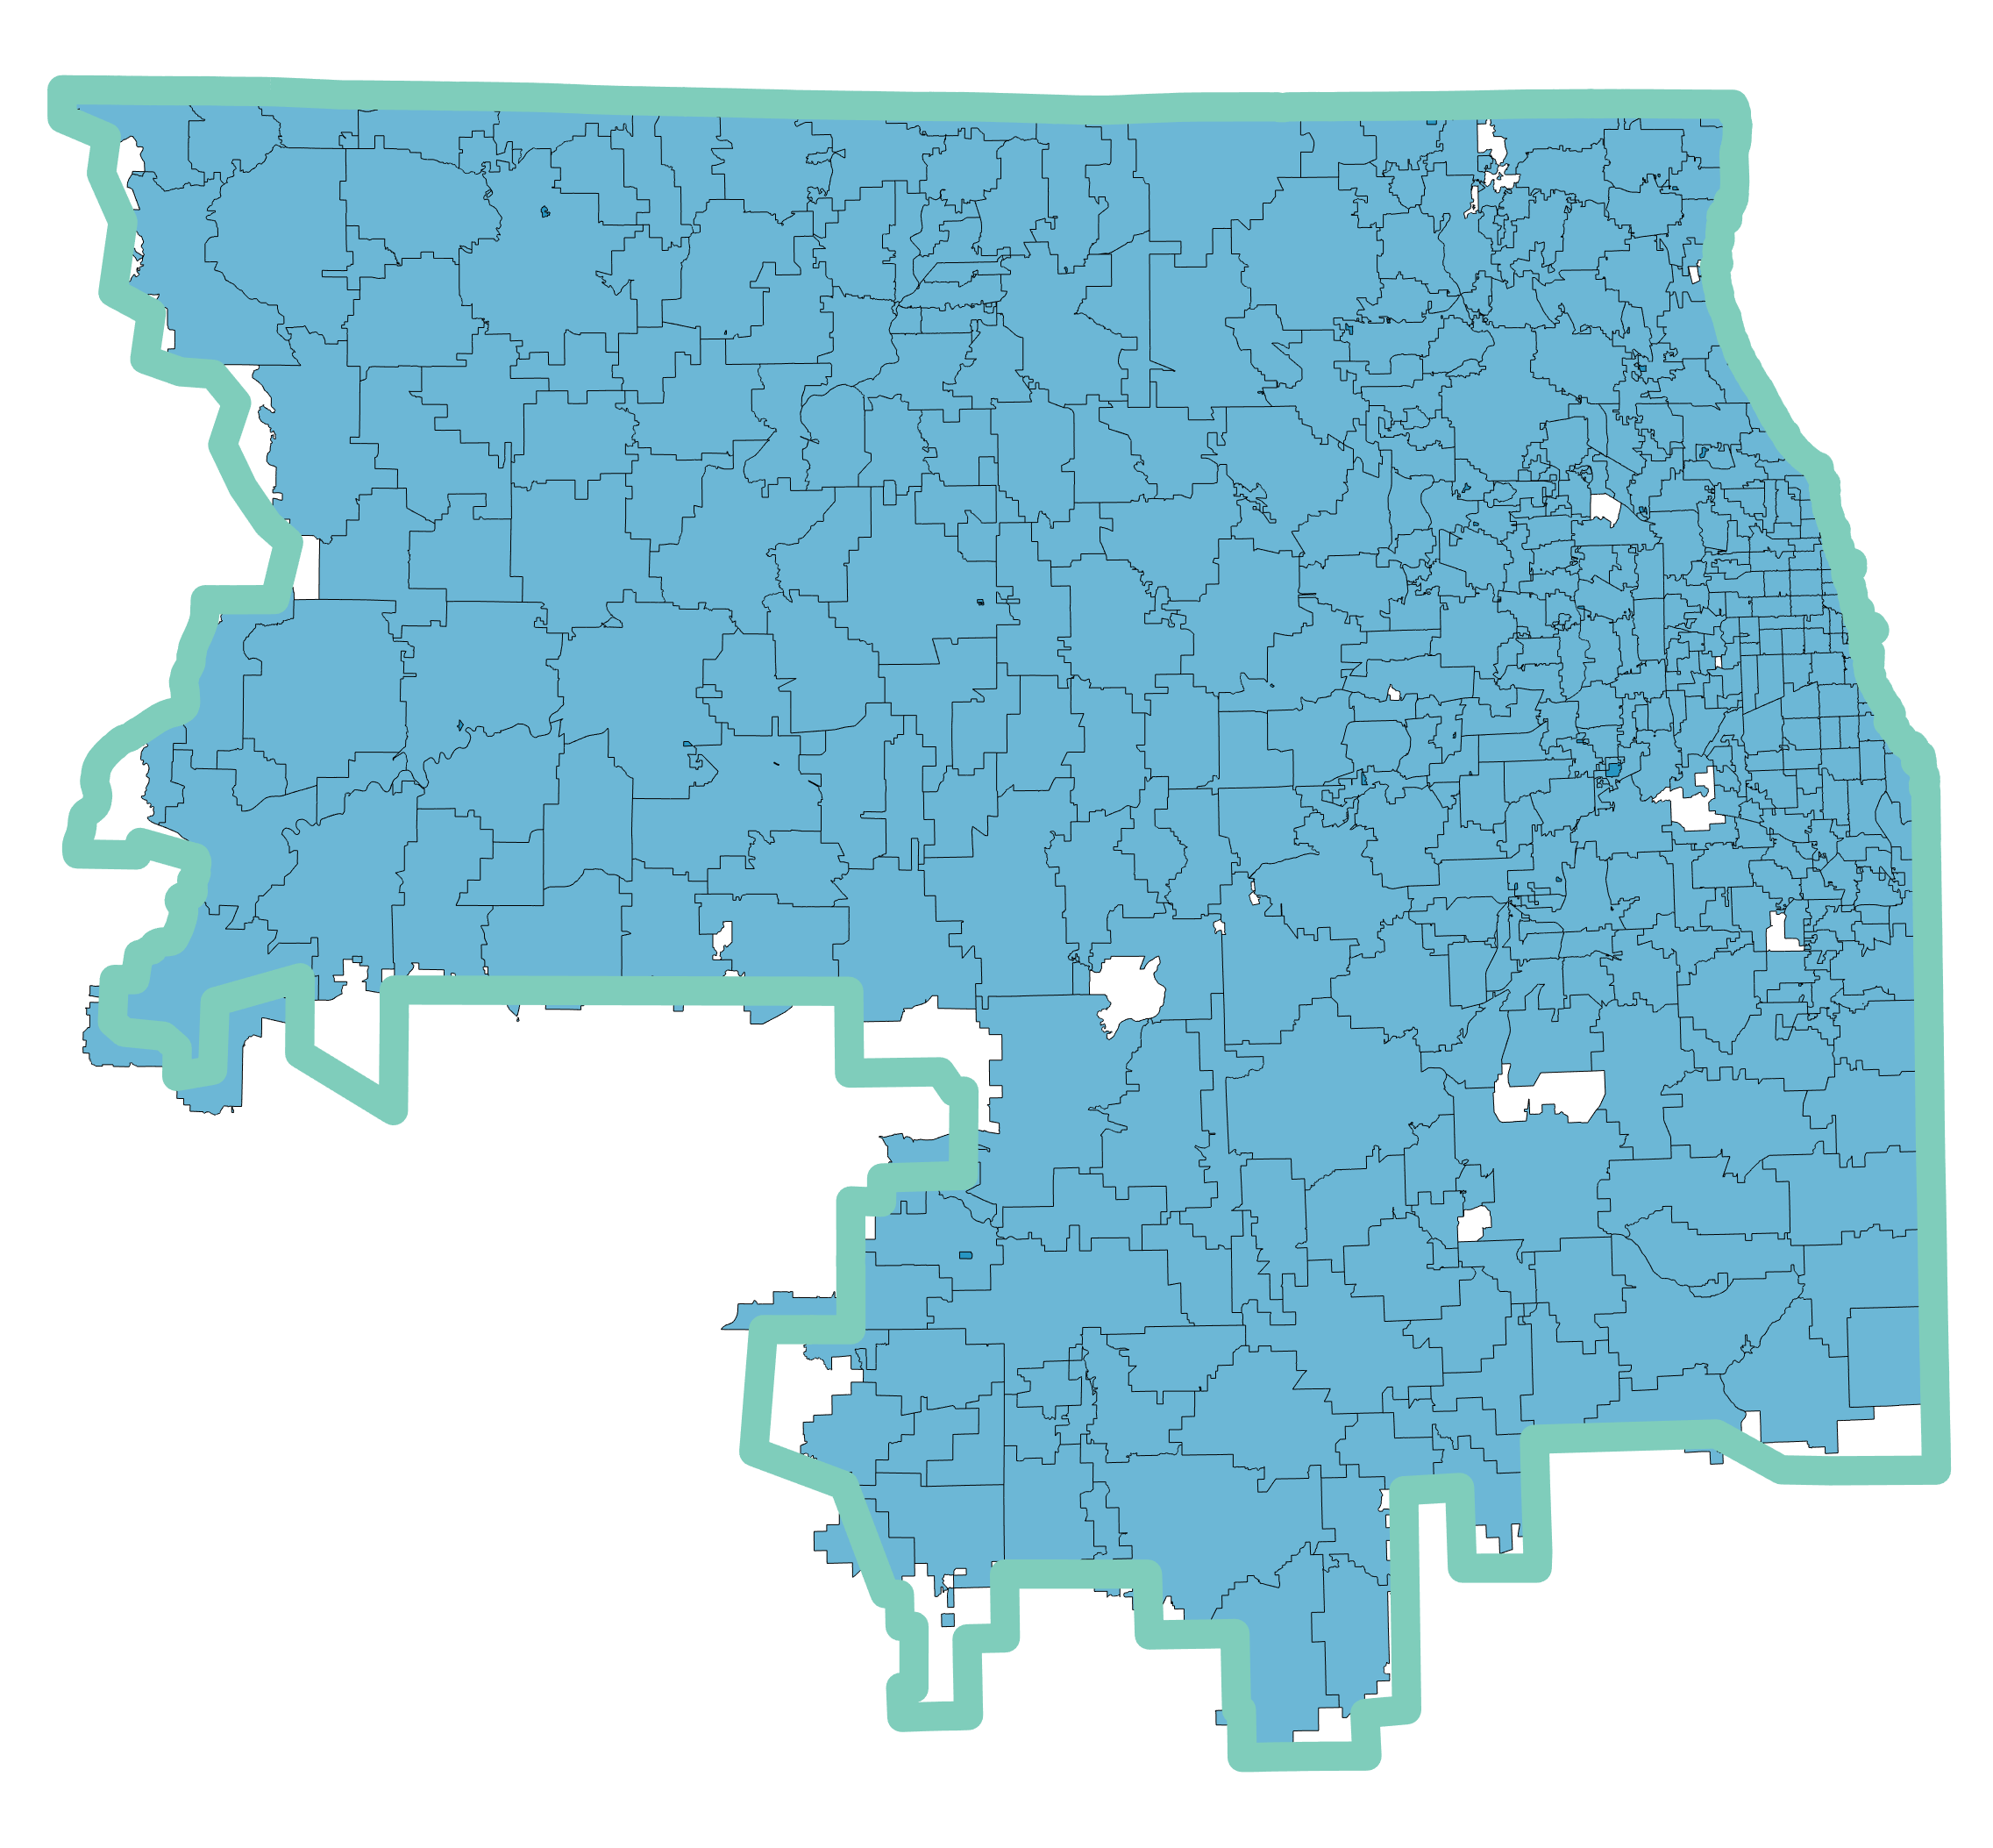
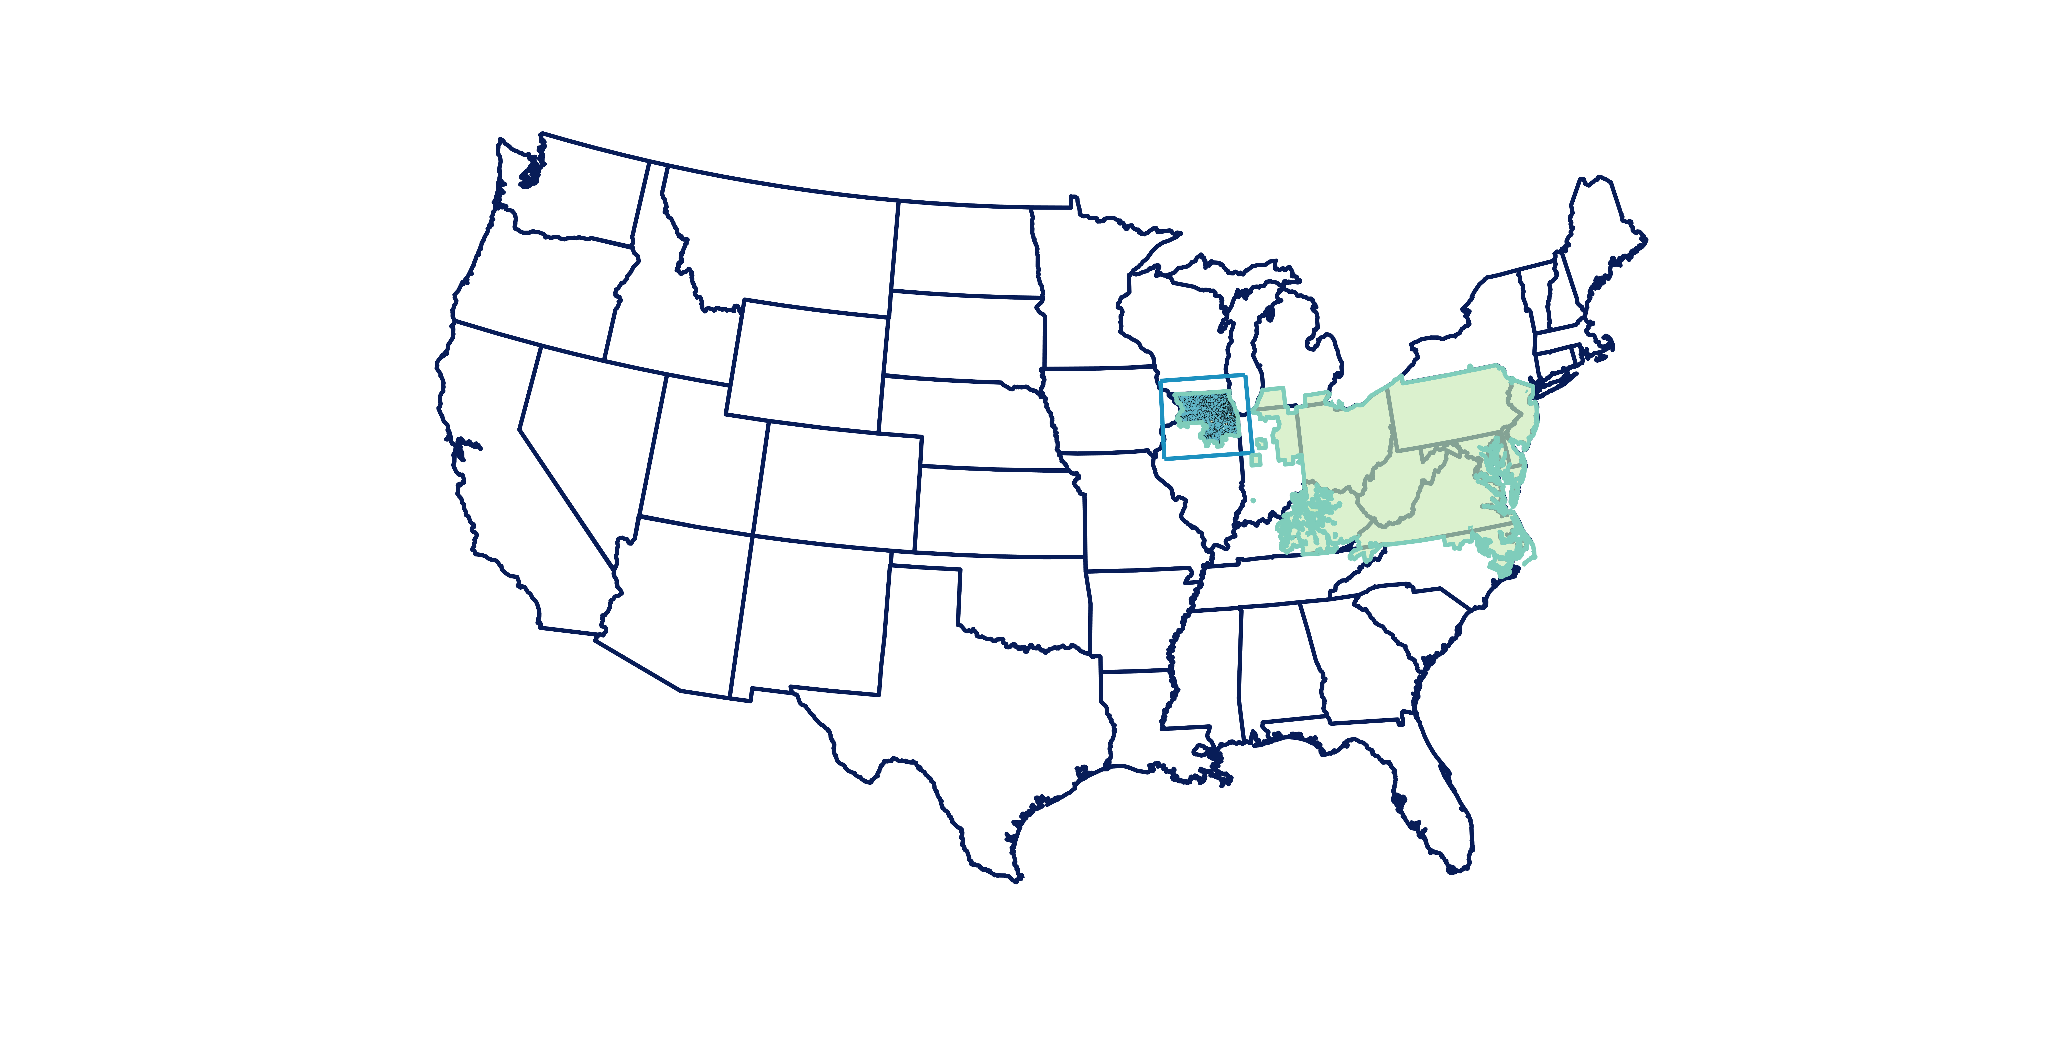
ComEd Data
Purpose: Characterize the changes in residential and non-residential hourly load profiles after the onset of COVID-19.
Impact: Load forecasting; rate design
PJM Balancing Authority Data
Purpose: Characterize the impact of COVID-19 on hourly total load profiles at an operational scale.
Impact: Load forecasting; grid operations
State Data
Purpose: Characterize the nationwide impact of COVID-19 on monthly sales of electricity for residential and commercial customers.
Impact: Policy; long-term planning

