Slide 1
Intro to Git
Benjamin Stuermer
Software Engineer III

Slide 2


Who am I?
Software engineer (mostly web) since 2006
At PNNL since 2015
Home Energy Score
Atmospheric Radiation Measurement (ARM)
DataHub
Git teacher for PNNL’s Software Carpentry
Educator with Office of STEM Education
WSU - Computational Thinking for Educators
Fun facts:
Three kids! (Josie - 9, Elijah - 7, Jonathan - 2)
I do have a Master’s, but it’s in Japan Studies
I sing with Mid Columbia Mastersingers and in musicals with community theater groups

Slide 3
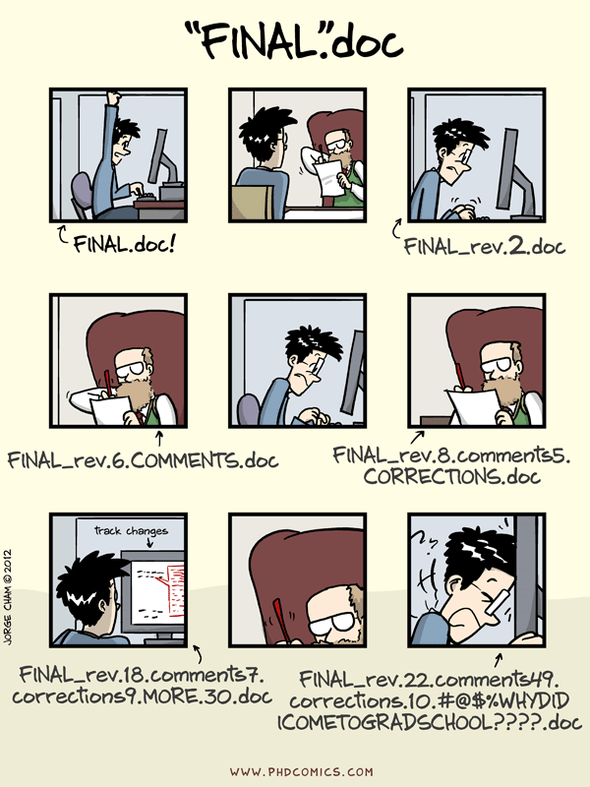
Why use a Version Control System?

Slide 4
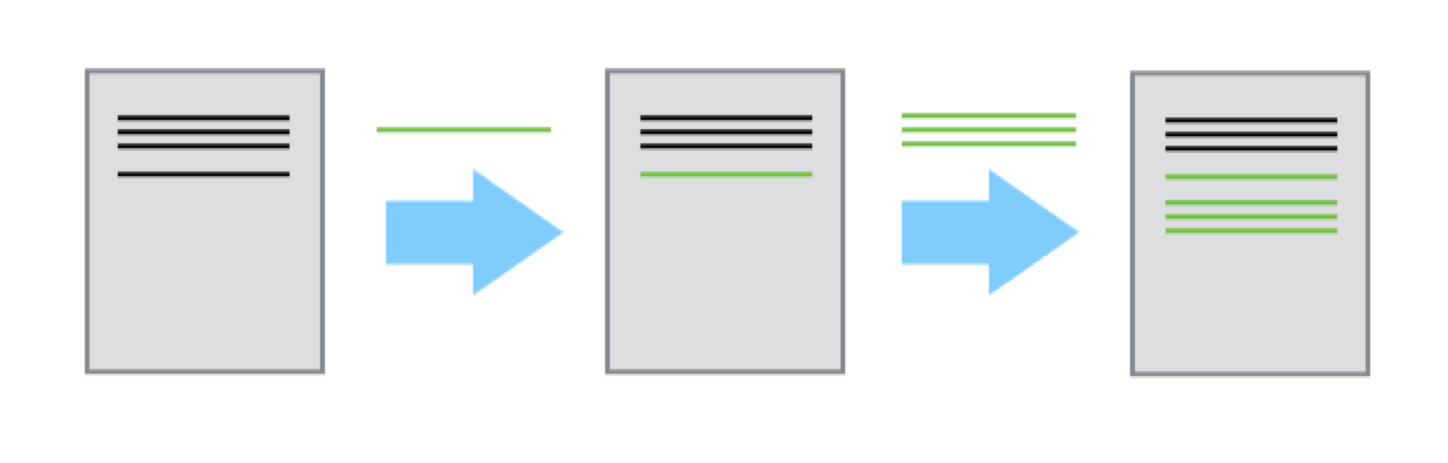
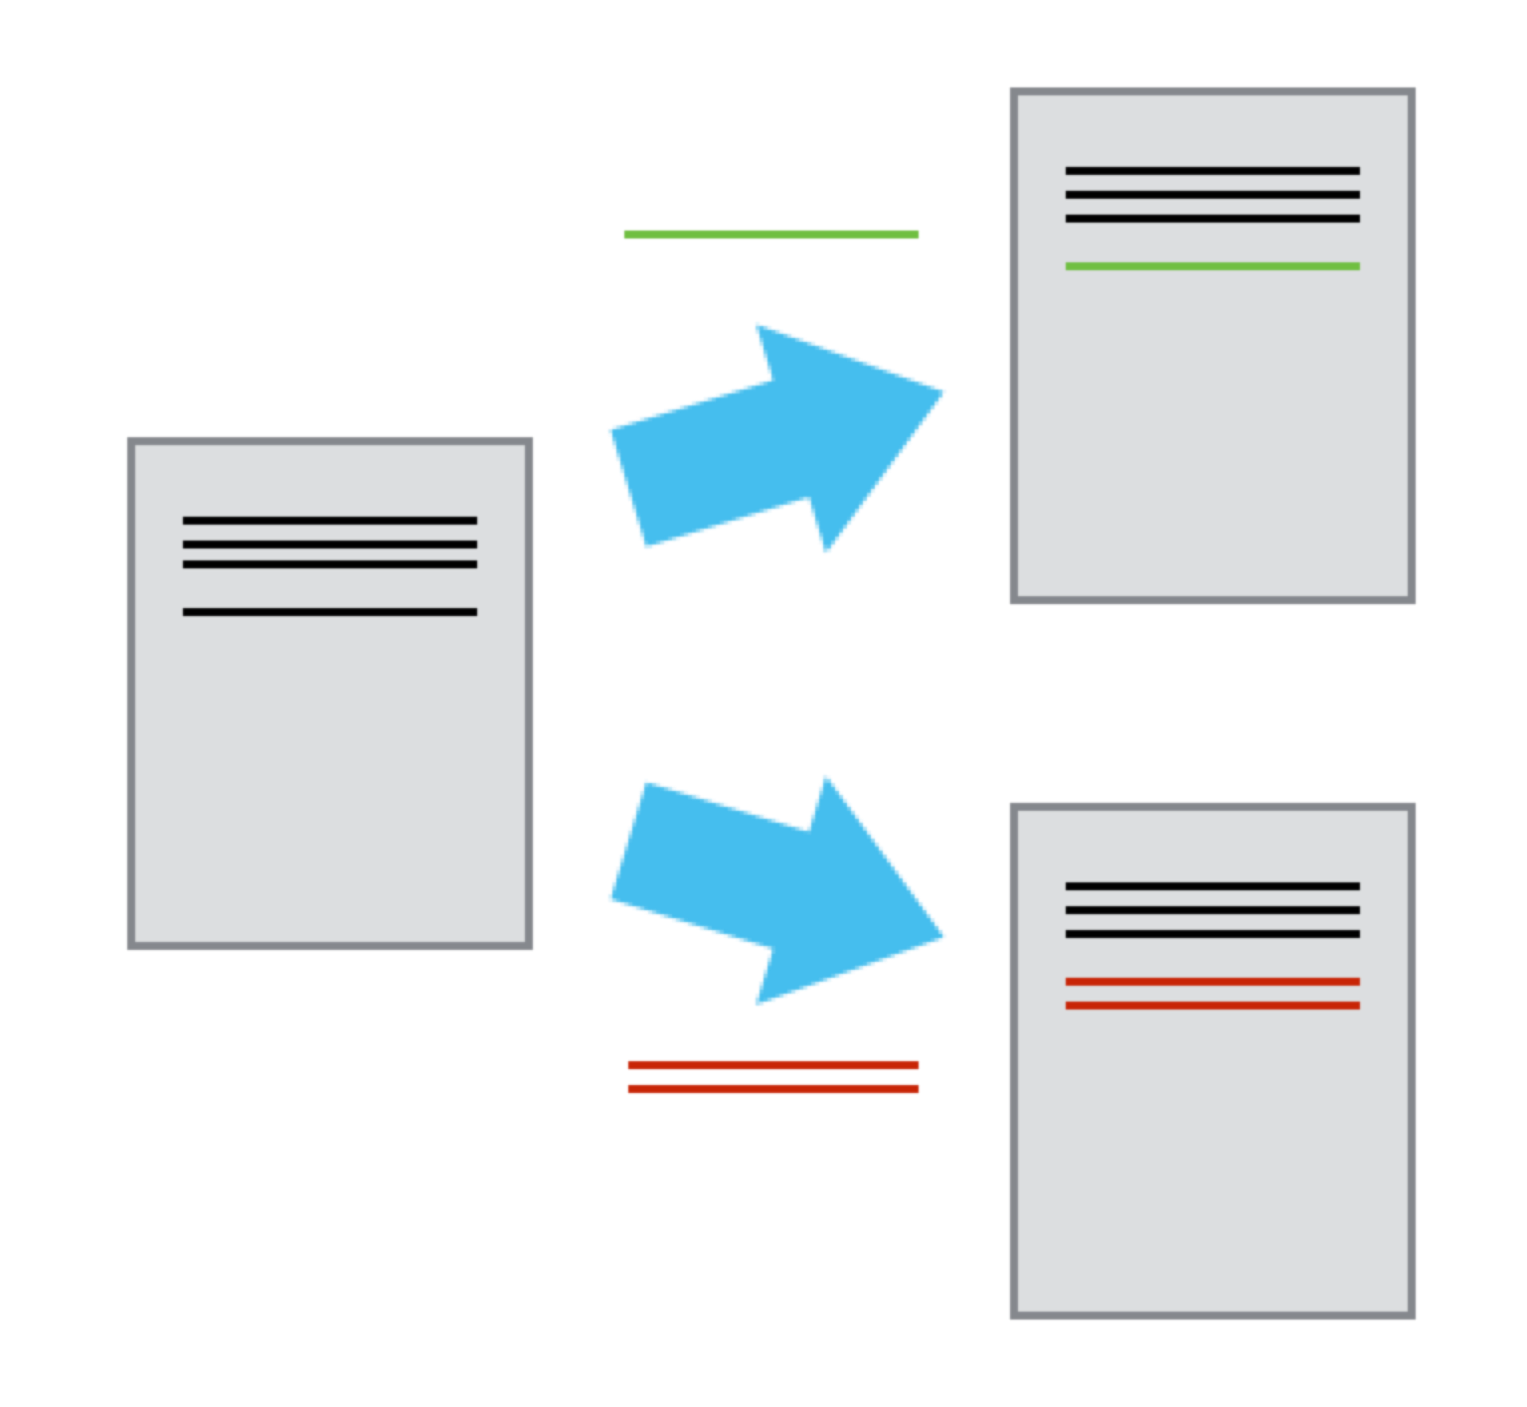
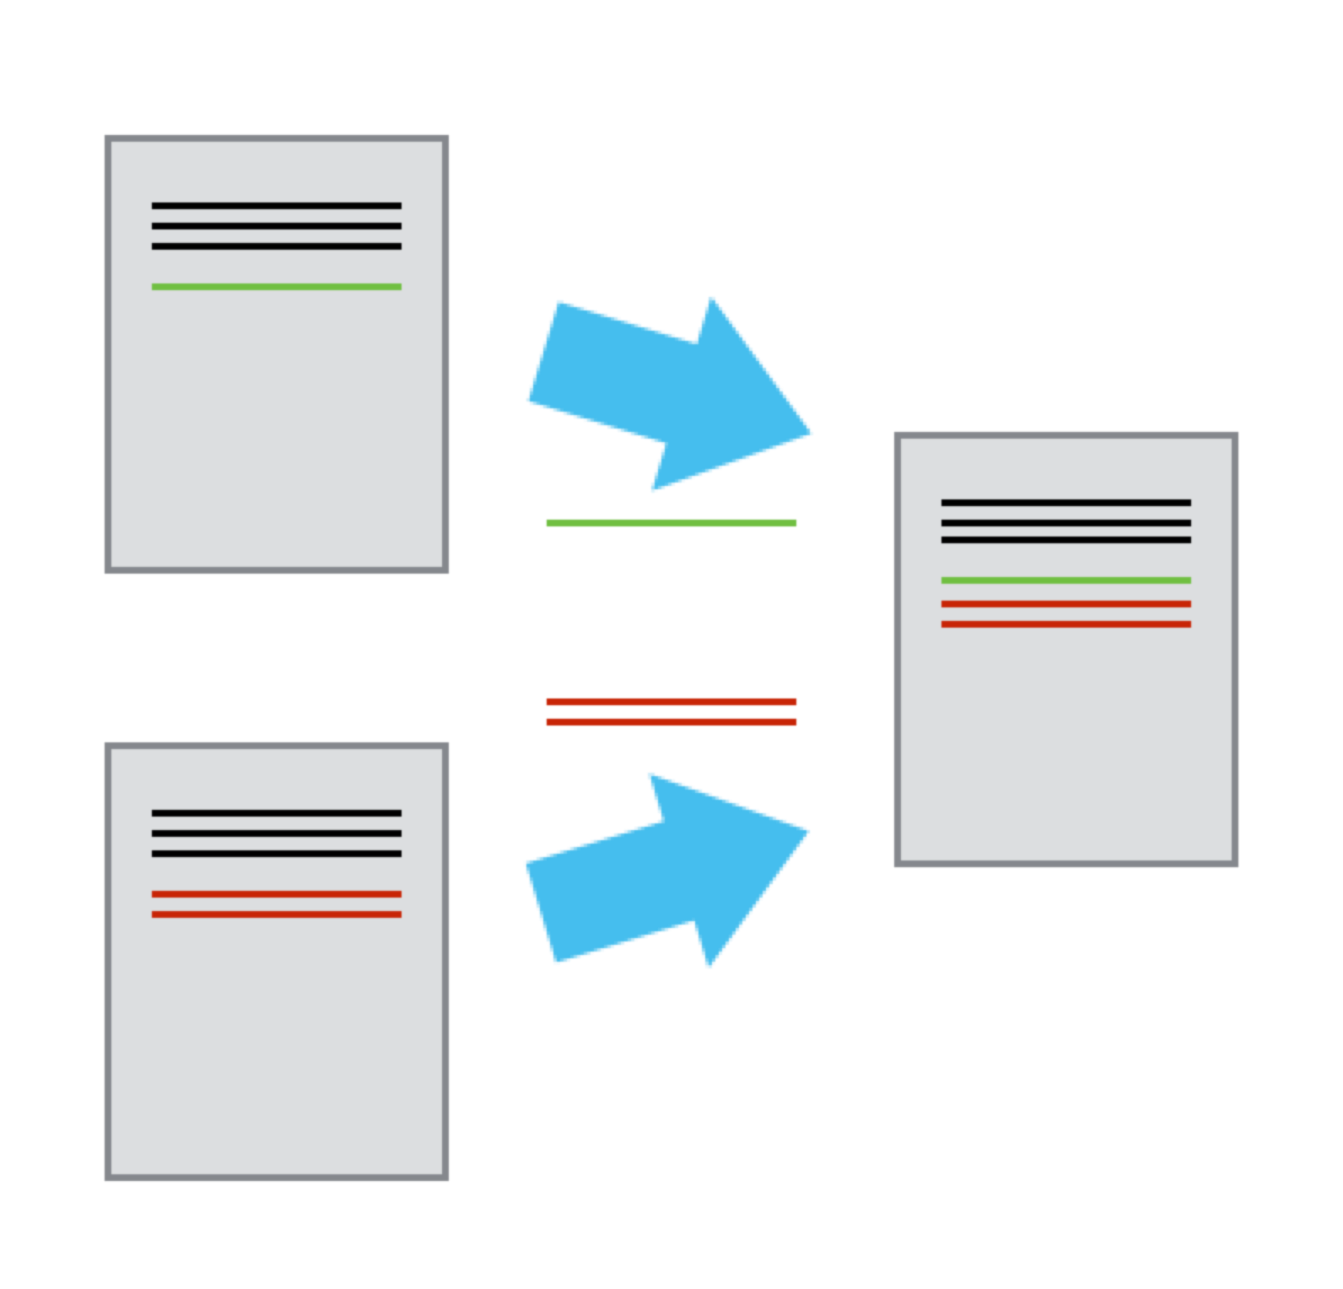
With Git you can…
Track every change made to your files
Retrieve any version of your files from the past
Create a reference to the exact set of files that created a given result
See who made every change, and why
Allow multiple people to make changes at the same time

Slide 5
Getting started
Log onto Constance
ssh constance.pnl.gov
Create your own training directory, and navigate into it mkdir /projects/im3/git-training/<your-name> cd /projects/im3/git-training/<your-name>
Clone the training project (https://github.com/IMMM-SFA/git-training)
git clone git@github.com:IMMM-SFA/git-training.git
Now enter ls into your terminal; you should see a new directory called “git-training,” which contains the Git project we’ll be working with. cd into that directory.

Slide 6
Getting started
A little bit of Git setup: git config --global user.name "<Your Name>" git config --global user.email <Your E-mail>
(The --global flag means you won’t have to set this configuration again for every Git project you work on on this machine.)

Slide 7
The Basic Git Workflow
“Pull” any changes others have made
git pull
Make your changes with the tool(s) of your choice
Add the changes to your “staging area”
git add <path_to_file>
Use git status to confirm that your staging area has everything you want in your commit
Commit the changes in your staging area – this bundles them all up and moves them into the project’s history in your local repository
git commit -m “<A useful description of the changes that you made>”
“Push” your updated local repository to your GitHub server so everyone else can see your changes
git push

Slide 8
Where is my data?
Unstaged changes
Staged changes
Local Repository
Remote Repository (GitHub)
git add
git commit
git push
git reset HEAD <file>
git pull
git reset --soft HEAD~1

Slide 9
Give it a try - creating a file
Create a new file (name it after yourself so it doesn’t conflict with others’)
Use git status – it should appear under “untracked files”
Add it to your staging area (git add <file>)
Commit it (git commit -m “<descriptive commit message>”)
Push your changes (git push)
When everyone is done, pull and see everyone else’s files appear (git pull)

Slide 10
Give it a try - changing a file
Now change your file and repeat the process:
Use git status – it should appear under “unstaged changes”
Add it to your staging area (git add <file>)
Commit it (git commit -m “<descriptive commit message>”)
Push your changes (git push)
When everyone is done, pull and update with others’ edits (git pull)
Try git log and see the list of commits from everyone in the class

Slide 11
Git Status
$ git status
What branch are we on?
# On branch master
The staging area: What is set to be included in your next commit?
# Changes to be committed:
# (use "git reset HEAD <file>..." to unstage) <- Note the instructions in each section in parentheses!
#
# modified: README.md
Unstaged changes: What changes have you made but not yet added to the staging area?
# Changes not staged for commit:
# (use "git add <file>..." to update what will be committed)
# (use "git checkout -- <file>..." to discard changes in working directory)
#
# modified: gettysburg-address.txt
Untracked files: New files that Git has never seen before – these are basically like unstaged changes, but get listed in their own section
# Untracked files:
# (use "git add <file>..." to include in what will be committed)
#
# new-document.txt

Slide 12
Git Log – Read the history of your repository
$ git log commit 245809da8eb7d2d77d9ca02ddbdf2ce87e829e41 Author: Benjamin Stuermer benjamin.stuermer@pnnl.gov Date: Tue Jul 16 10:53:54 2019 -0700 Added Gettysburg Address
commit 2dff9f663dc8640fac54027b6ffcf72a63da7472 Author: Benjamin Stuermer benjamin.stuermer@pnnl.gov Date: Thu Jul 11 09:59:41 2019 -0700 Initial commit
The top entry is the most recent
The long string of numbers and letters at the top is a “commit hash” that uniquely identifies the commit
There are many many options for enhancing this command. Some examples:
git log -p Include diff for each commit
git log --name-status List files affected
git log –S battle Search for commits that added or removed the string “battle”
Full documentation here: https://git-scm.com/docs/git-log

Slide 13
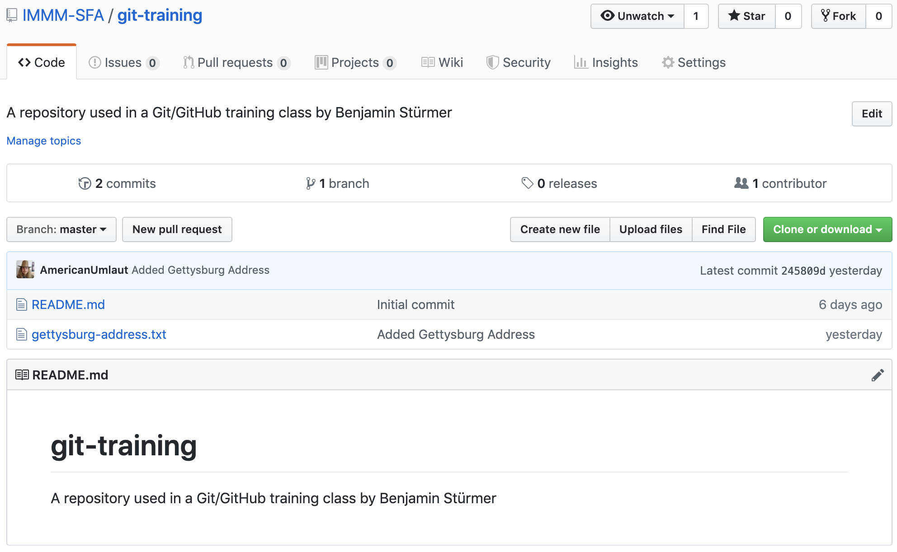
GitHub (https://github.com/IMMM-SFA/git-training)
Your files
Branches and Pull Requests!
Pretty version of git log

Slide 14
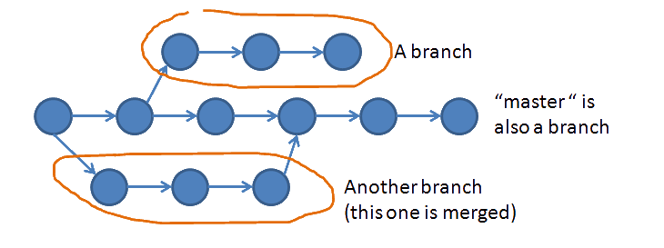
Branches

Slide 15
Branches - How to make one
The first command is to create a new branch in your local repository
$ git checkout -b <branch_name>
Then you need to tell the remote repository (GitHub) about your new branch
$ git push --set-upstream origin <branch_name>
You can switch between branches with git checkout:
$ git checkout master (By convention, the “main” branch of every project is always called “master”)
$ git checkout feature/my_cool_feature (Branches are often grouped with path-like prefixes like “feature/”)
Don’t forget that you have to run git pull to see new branches that others have created!

Slide 16
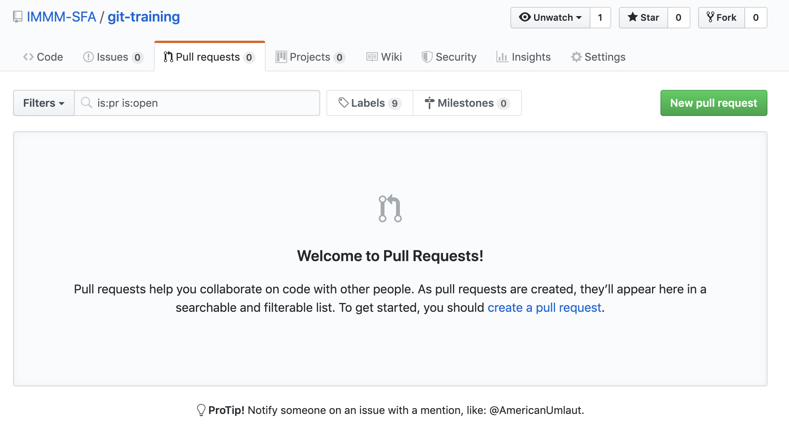
Branches - Merging using a Pull Request

Slide 17
Merge Conflicts
Four score and seven years ago our fathers brought forth, upon this continent, a new nation, conceived in liberty, and dedicated to the proposition that all men are created equal.
Branch A
Branch B
Eighty-seven years ago our fathers brought forth, upon this continent, a new nation, conceived in liberty, and dedicated to the proposition that all people are similar.
Four score and seven years ago our fathers brought forth, upon this continent, a new nation, where everyone loves waffles, dedicated to the proposition that everything is awesome.
A conflict occurs when merging branches that make different changes to the same line in a file.
Merge Result
Eighty-seven years ago our fathers brought forth, upon this continent, a new nation, where everyone loves waffles, dedicated to the proposition ?????????????????????????????????

Slide 18
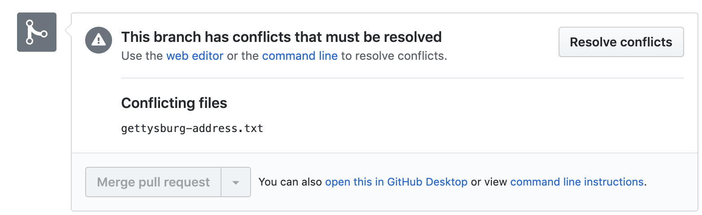
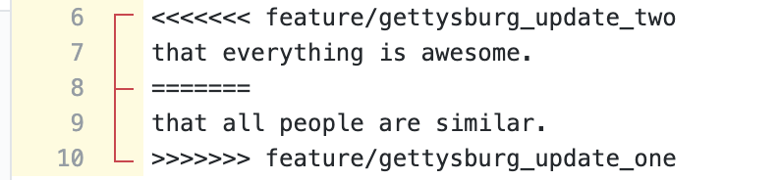


Recipe for Resolving a Conflict in GitHub
1. Click here
2. Replace all conflicts with the desired line(s), ideally in conversation with the author(s) of both sides of the conflict.
Merge conflicts can be a real challenge to resolve. Avoid them where you can, and follow these steps to resolve them when they occur.
3. Click here
4. Click here

Slide 19
Best Practices
Put groups of related changes into a single commit, and avoid putting unrelated changes into a commit.
Write descriptive commit messages
Use branches and pull requests when working collaboratively
While not strictly necessary, these practices can make managing your Git project easier, and make Git a more powerful tool.

