Slide 1
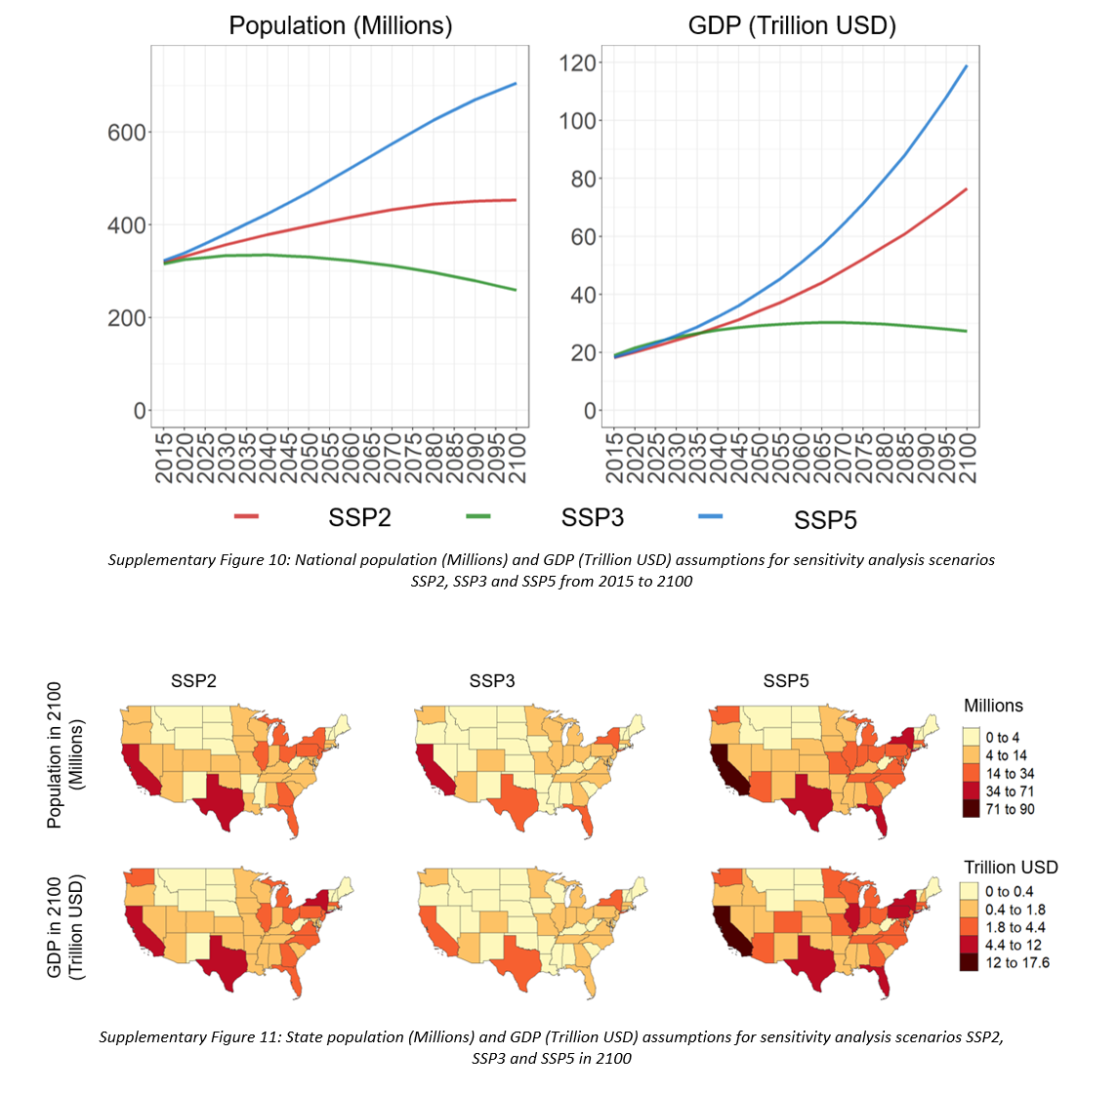
Figure 1: Human Drivers National

Slide 2
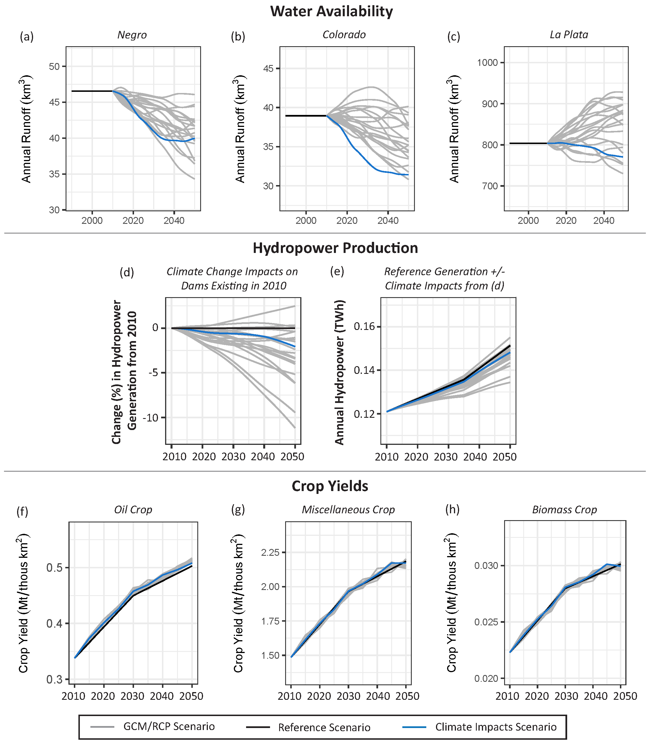
Figure 2: Climate Implications

Slide 3
Figure 3: National Results

Slide 4
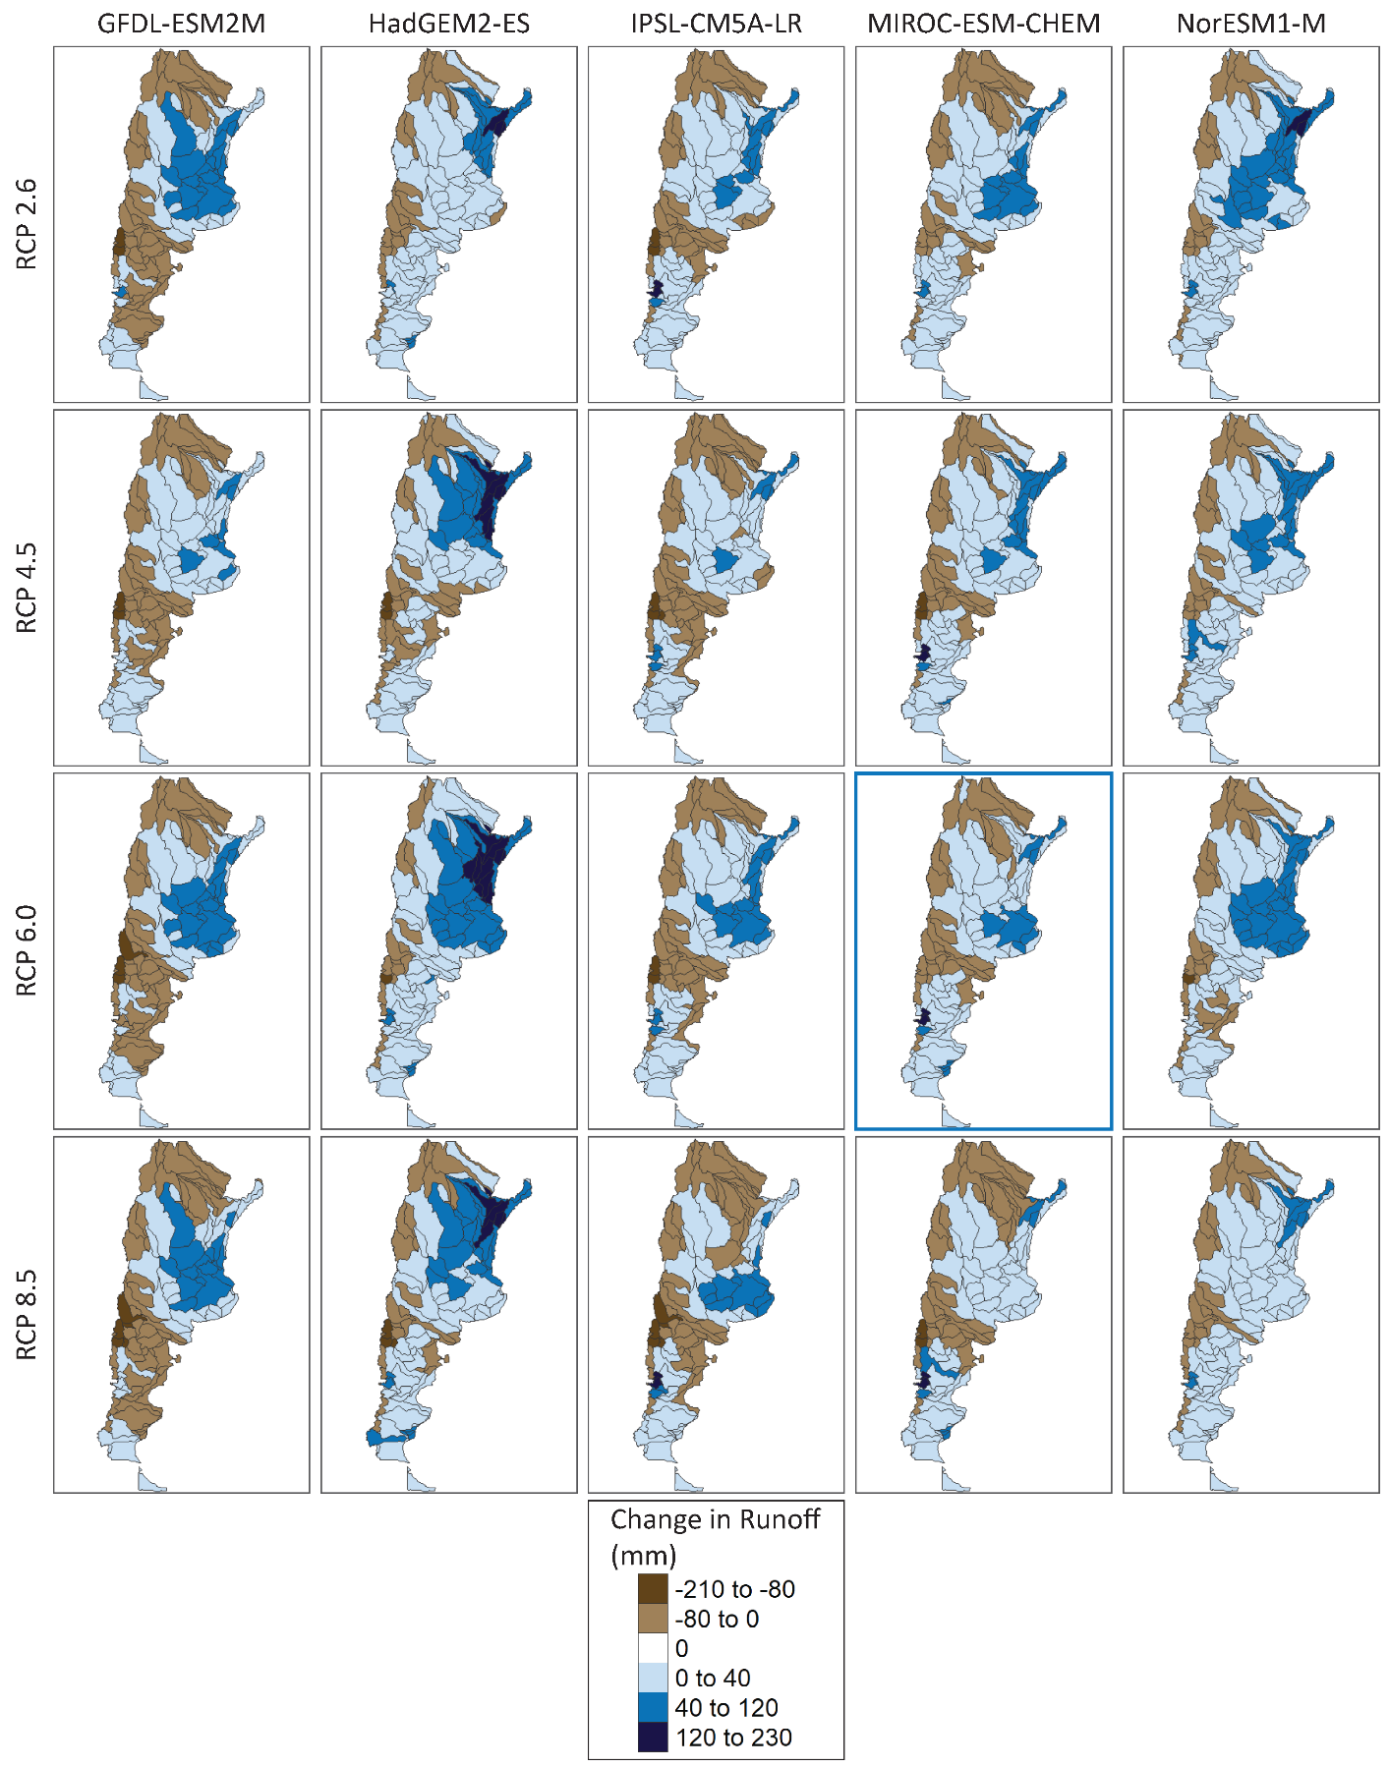
Figure 4: Spatial Results
a) Electricity Generation (TWh)
b) Water Demands (km3)
RCP 4.5 mod RCP 4.5 ext RCP 8.5 mod RCP 8.5 ext
RCP 4.5 mod RCP 4.5 ext RCP 8.5 mod RCP 8.5 ext
SSP 5 SSP 3 SSP 2
SSP 5 SSP 3 SSP 2

