Slide 1
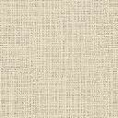
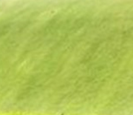

(a)
(b)
ln(z)
T_{A}
T_{A}
∆T_{A}
r_{R}
r_{C}
∆T₂
r_{GRASS}
T_{R}
T_{W}
r_{W}
T_{C}
H
r_{G}
T_{G}
T_{GRASS}
∆T_{surface}
R
G
furban
1 − furban
T
(c)
(d)
ln(z)
T_{A}
T_{A}
∆T_{A}
r_{R}
r_{C}
∆T₂
r_{GRASS}
T_{R}
T_{W}
r_{W}
T_{C}
H
r_{G}
T_{G}
T_{GRASS}
∆T_{surface}
R
G
furban
1 − furban
T

Slide 2

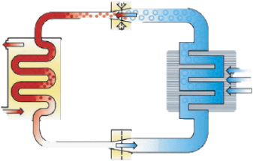
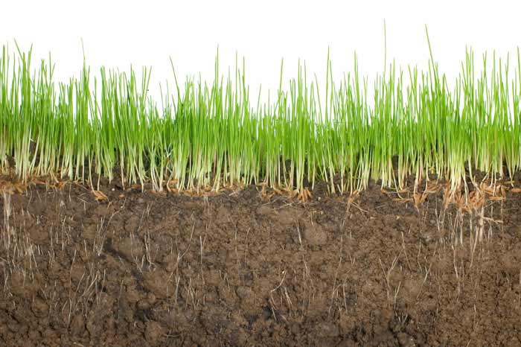
Sensible Heat
Sensible Heat
Evaporation
Radiation
Regular Roof
Cool Roof
Green Roof
Conductive Heat
Conductive Heat
Sunlit Wall
Anthropogenic Heat
AC
AC
Pervious ground
Road

