Slide 1

Sign Language Recognition
Harsh Gajera-22104099
Sekhar Gauda-22104044
Aditya Gupta-22104155
Paresh Gupta-22104089
Project Guide
Ms. Sneha Dalvi

Slide 2
Contents
Introduction
Objectives
Scope
Literature Survey
Proposed System
Project Outcomes
Block Diagram
E-R/DFD
Technology Stack
Suggestions in Review-1
Result and Discussion
Conclusion and Future Scope
References

Slide 3
1. Introduction
Problem statement :
Communicating effectively with individuals who are deaf or unable to speak requires understanding their unique language and culture, as gestures and symbols play a crucial role. Misinterpretation can occur without proper context, highlighting the need for cultural sensitivity. Sign language interpreters can bridge this gap, enhancing comprehension.
Solution:
The project aims is to develop/create a sensor-free virtual talking system, accessible to those who struggle with verbal communication.
By Applying image processing and human hand gestures as input, it provides a practical solution for individuals facing speech disabilities, medical conditions, or language barriers.
This Automatic system promotes equal opportunities by enabling effective expression and seamless communication, potentially enhancing the quality of life for those with communication difficulties.

Slide 4
2. Objectives
To detect the hand gesture using the camera module on the device.
Using appropriate datasets for recognizing and interpreting data using LSTM algorithm.
To deliver accurate text output for the respective hand gesture sign language.
To achieve better accuracy.

Slide 5
3. Scope
It can be used for an in-depth analysis of python programming, covering functions, control statements, data structures, and object-oriented ideas.
It can be used for deploying models in production environments and understanding evaluation metrics for Machine Learning (ML) and Deep Learning (DL) models.
It can be used for recognizing a predefined set of common sign language gestures representing basic words and phrases.
It can be used for recognizing single-handed sign language gestures, with a primary focus on maximizing accuracy.

Slide 6
4. Literature Survey
Sr no. | Title of Research Paper | Key findings | Author | Publication Year
1. | Realtime Sign Language Detection and Recognition | The research paper presents a real-time sign language recognition system for Indian Sign Language (ISL) based on deep learning models such as TensorFlow, Keras, and LSTM for training. | Aakash Deep Aashutosh Litoriya Akshay Ingole Vaibhav Asare Shubham M Bhole Shantanu Pathak | 2022
2. | Comparative analysis of deep learning image detection algorithms | This research paper evaluates and compares three major image processing algorithms - Single Shot Detection (SSD), Convolutional Neural Networks (CNN), and You Only Look Once (YOLO) - using the Microsoft COCO dataset. | Shrey Srivastava, Amit Vishvas Divekar, Chandu Anilkumar, Ishika Naik, Ved Kulkarni & V. Pattabiraman | 2022
3 | How to Improve the Accuracy of Your Image Recognition Models | This Research paper provides strategies to improve image recognition models include data augmentation, adding more layers, adjusting image size, increasing epochs, reducing color channels, employing transfer learning, and fine-tuning hyperparameters | Jason D’souza | 2023

Slide 7
5. Proposed System
Hand Gesture Recognition: Our system utilizes the MediaPipe framework for gesture recognition, employing machine learning techniques. It detects hands through palm detection, accurately identifies 3D hand keypoints using a landmark model, and if necessary, reverts to palm detection for localization.
Model Comparison: MediaPipe offers versatile live media solutions, while TensorFlow focuses on neural network training. Our system combines MediaPipe for hand keypoint capture and TensorFlow for machine learning, optimizing hand gesture recognition.
Hardware Compatibility: MediaPipe is compatible with both CPU and GPU, requiring no additional processing power.
Dataset Creation: The experimental dataset, created with the MediaPipe open-source library, consists of 26 alphabets represented by hand gestures, each captured across 100 frames. Parameters recorded include the (x, y, z) coordinates of hand joints.
Training LSTM Model: LSTM, a feed-forward neural network, recognizes continuous hand gestures, training on sequences with hand keypoints. It achieves high accuracy in 2000 epochs with RELU/TANH activation for CPU/GPU efficiency, using Adam Optimizer for adaptive learning rates.

Slide 8
6. Outcome of Project
Camera Gesture Detection: Hand gesture detection is captured through the utilization of the device's camera module.
Gesture Translation: To translate the detected hand gestures in to text.
Accuracy of detection: Achieved maximum possible accuracy in recognizing and interpreting hand gestures.
Framework Integration: Utilization of frameworks and libraries including MediaPipe, TensorFlow, OpenCV, and others to facilitate model training and implementation.

Slide 9
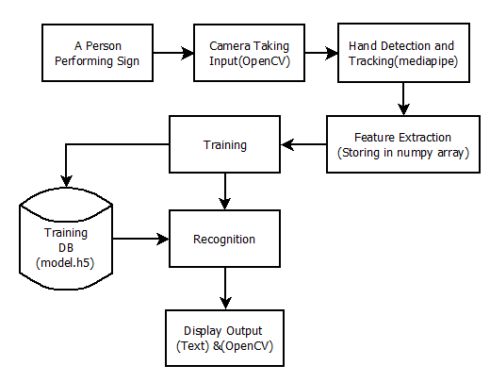
7. Block Diagram

Slide 10
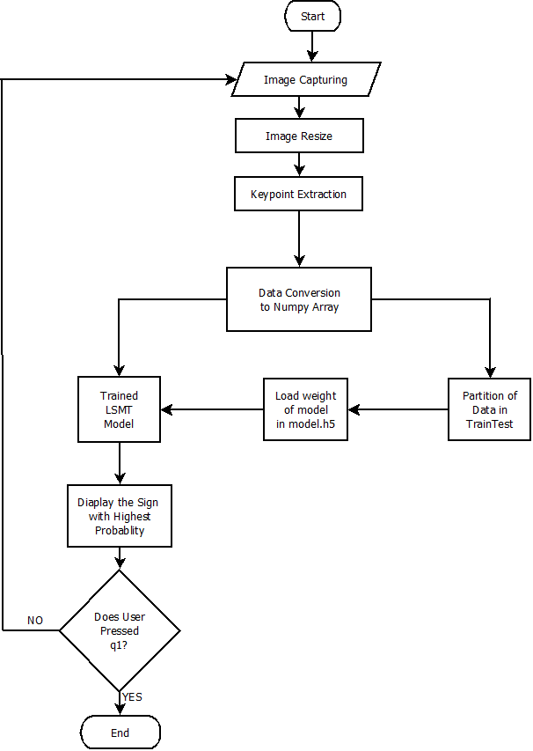
8. System Architecture

Slide 11
9. Technology Stack
Functional Requirement:
Machine Learning Model:
Long Short-Term Memory (LSTM)
Programming Environment:
Python: Version 3.9.0
Jupyter Notebook
Libraries and Frameworks:
OpenCV: Version 4.2.0
TensorFlow Object Detection API
Time
Uuid
Non-Functional Requirement:
Operating System:
Windows 11
Hardware:
Processor: AMD Ryzen 5 5500H 3.30GHz
Memory: 8 GB
Webcam: HP TrueVision HD camera with 0.31 MP and 640x480 resolution

Slide 12
10. Suggestions in Review-1
The outcome requires revision to ensure accuracy and alignment with project goals.
Enhanced clarity on the project concept is required for better understanding and execution.
None of the objectives have been effectively implemented, leading to an update of the project's approach and execution strategy.

Slide 13
11. Result and Discussion:
An open-source library called Mediapipe can be used to identify hand movements and locations. A machine learning pipeline comprising of a hand detection model and a hand landmark model is used in its operation. The hand in the picture is located using the hand detection model, and its 21 keypoints are located using the Mediapipe holistic model.
A model that is trained to recognise hand gestures can likewise be trained using Mediapipe. In order to achieve this, a Long Short-Term Memory (LSTM) model is trained using a dataset of hand motions. Then, real-time hand gesture recognition using the LSTM model is possible. Statistics like these can be used to assess the hand gesture recognition model's accuracy.

Slide 14
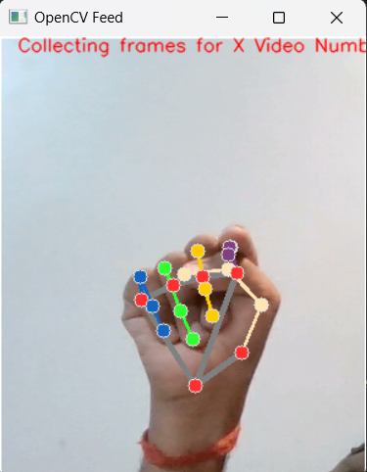
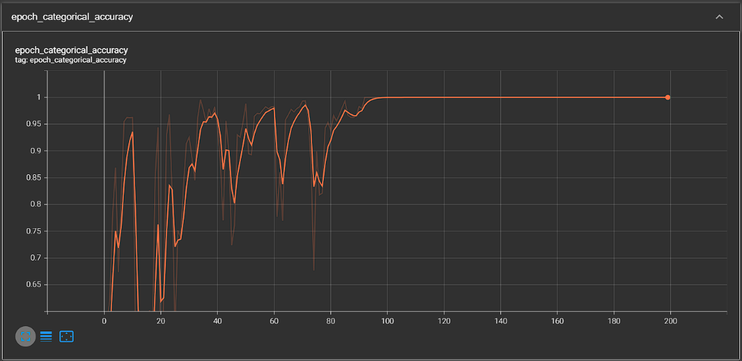
Collecting dataset required for the experimental study of the proposed algorithm is created using MediaPipe which is an open-source library developed by Google.
This graph illustrates the accuracy analysis during the training phase.
Extraction of landmarks using Mediapipe.
Training Accuracy Analysis.

Slide 15
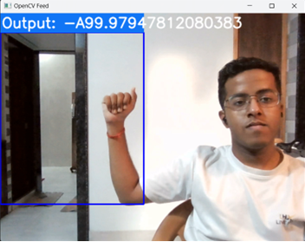
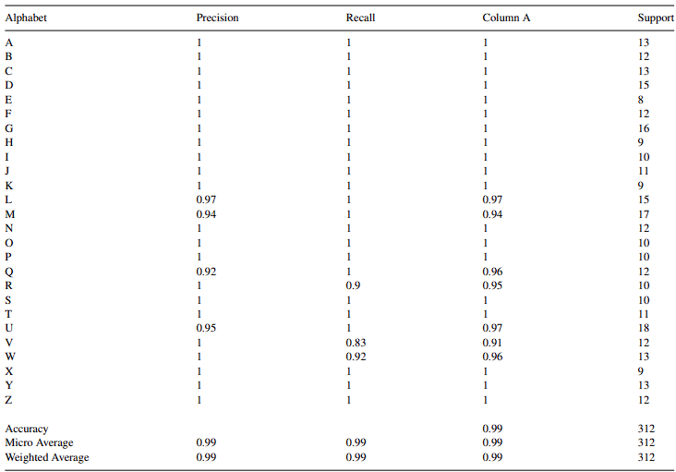
Live Detection using Webcam and image processing algorithms with webcam technology.
The subsequent data illustrates the precision, recall, and support metrics for each alphabet.
Live Detection using Webcam.
Precision and Recall Table

Slide 16
12. Conclusion :
Thus, the project undertook the development and evaluation of an LSTM model specific for the recognition of dynamic ASL gestures. It displayed peak performance after 250 iterations, each consisting of 78 steps. Further research might look into different architectures/settings to enhance accuracy, improve the model's applicability to additional sign languages by utilizing larger datasets, incorporate immediate context via recurrent networks or attention mechanisms, and evaluate real-world applicability and efficiency through user-focused studies for practical implementation.

Slide 17
13. Future Scope:
In future, the dataset can be enlarged so that the system can recognize more gestures. The TensorFlow model that has been used can be interchanged with another model as well. The system can be implemented for different sign languages by changing the dataset.

Slide 18
14. References
[1] “A Real-time Hand Gesture Recognition and Human- Computer Interaction System” , Pei Xu, Department of Electrical and Computer Engineering, University of Minnesota, Twin Cities.
[2] “LSTM based paraphrase identification using combined word embedding features.” In Soft computing and signal processing, pp. 385-394 , Aravinda Reddy, D., M. Anand Kumar, and K. P. Soman. Springer, Singapore, 2019
[3] “Draft manuscript accepted for publication in Sign Language Studies, Volume 6, Number 3”, Ross E. Mitchell, Gallaudet Research Institute,2006.
[4] “Hand Gesture Recognition of English Alphabets using Artificial Neural Network” Sourav Bhowmick, Sushant Kumar and Anurag Kumar, published on 2015.
[5] “Linguistics Of American Sign Language, American National Standard for Information Sciences”, Clayton Valli, Ceil Lucas

Slide 19
Thank You...!!

