Slide 1
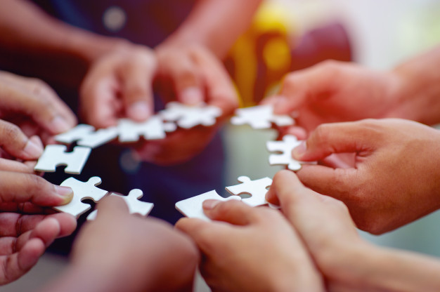

MechaCoders
Our goals
About our code
Technologies used
In the feature
Team slide

Slide 2
Team slide
BackEnd developer
BackEnd developer
Scrum trainer
QA Engineer
FrontEnd developer

Slide 3

Our goals:
For the organization of the school
To be
faster
It is very
easily accessible

Slide 4






Technologies used:

Slide 5




What are we planning in the feature?

Slide 6


