Slide 1
Global Video Game Sales Analysis (1980 - 2016)
An in-depth look at market trends

Slide 2

Table of Contents
Overview
Platform Life Cycles
Current Period
Sales per platform
Sony’s Dominance in the Market
Sales per Genre
Regional Analysis
Hypothesis Testing
“Average user ratings of the Xbox One and PC platforms are the same.”
“Average user ratings for the action games are higher than sports games”
Conclusions
Recommendations

Slide 3
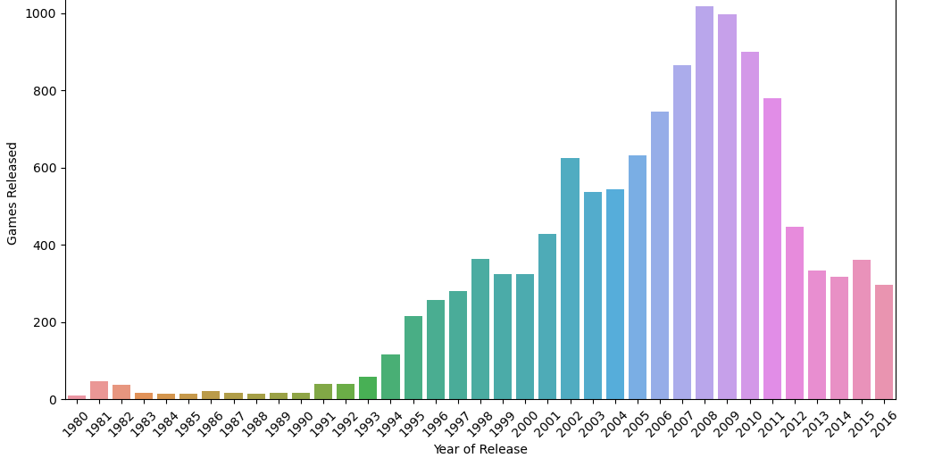
Overview
Games released per year: charting the rise in popularity of the industry.
Here we can see the significant growth of the of the video games market.
The number of new releases has increased steadily year over year until 2008.
Over the last 8 years there has been less over saturation of new releases, leaving room for new titles to enter the marketplace.

Slide 4
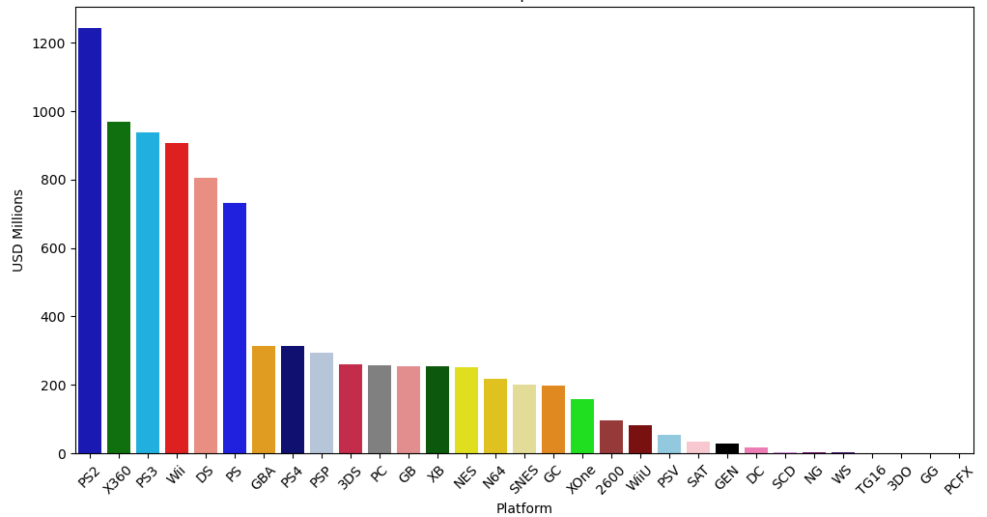
Overview
Total Sales per Platform
A distinct top tier is defined by six platforms:
PlayStation 2 - Sony
Xbox 360 - Microsoft
PlayStation 3 - Sony
Wii - Nintendo
Nintendo DS - Nintendo
PlayStation (1) - Sony

Slide 5
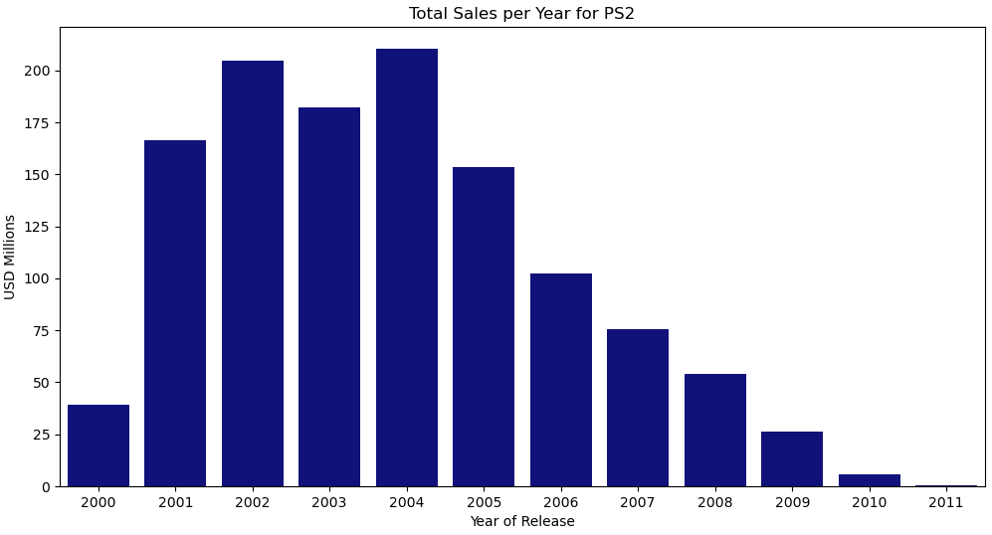
Platform Life Cycles
Five years growth

Slide 6
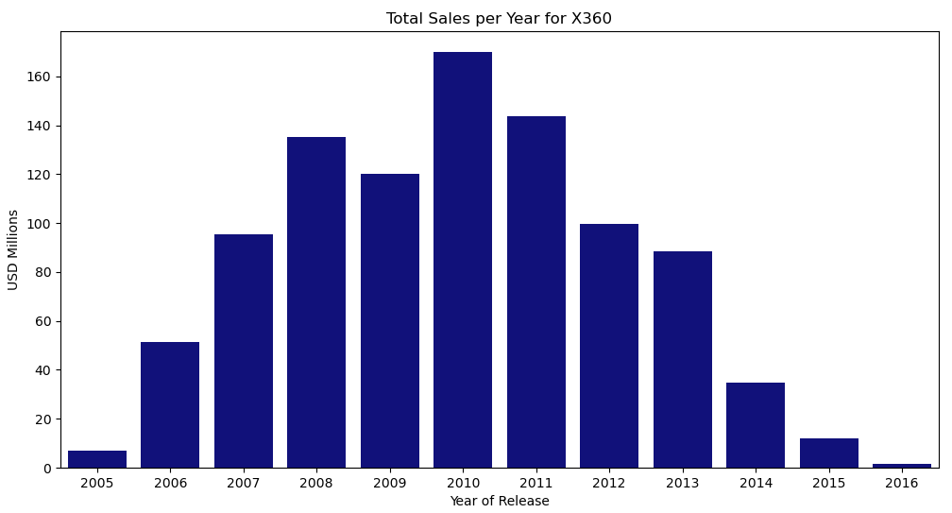
Platform Life Cycles
Six years growth

Slide 7
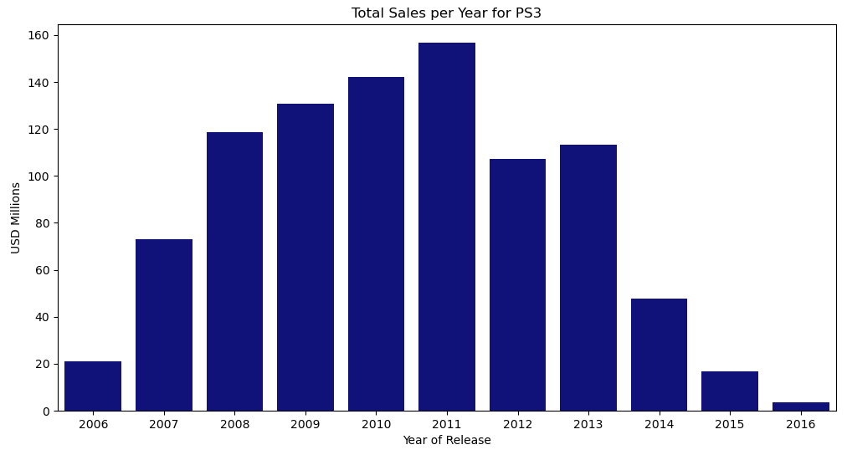
Platform Life Cycles
Six years growth

Slide 8
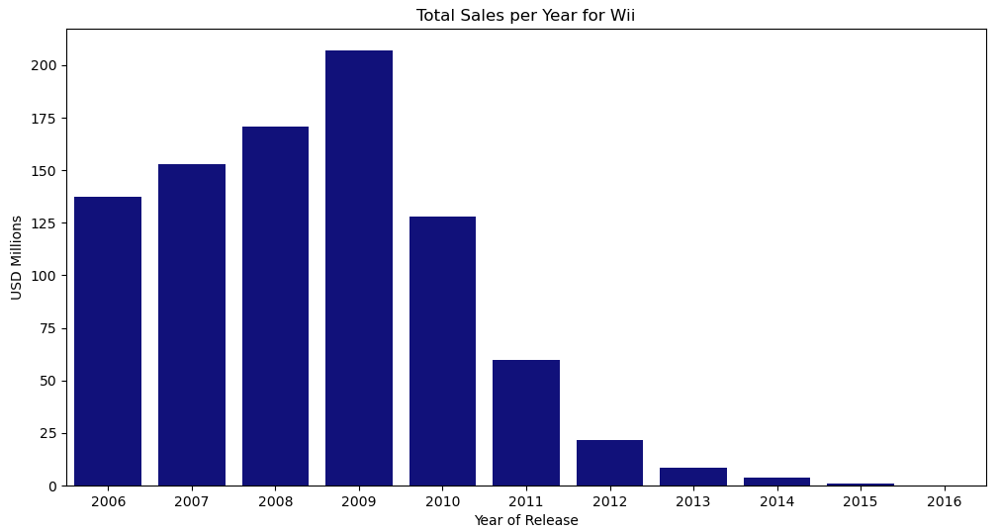
Platform Life Cycles
Four years growth

Slide 9
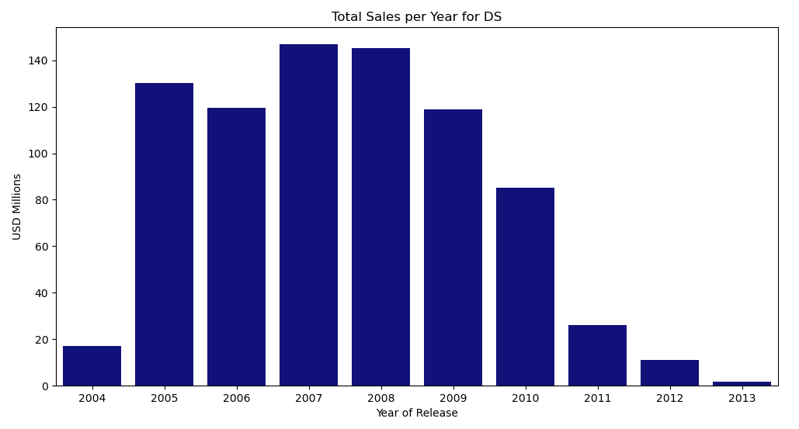
Platform Life Cycles
Four years growth

Slide 10
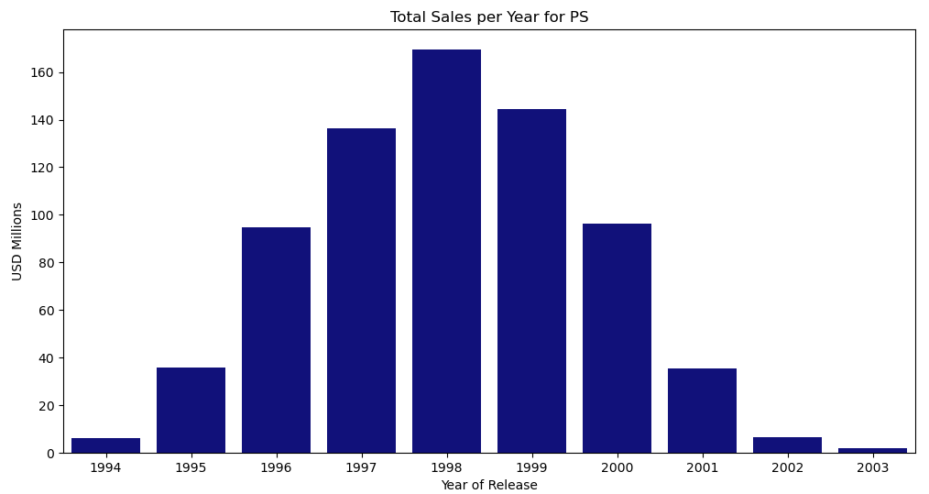
Platform Life Cycles
Five years growth

Slide 11
Platform Life Cycles
For the six top tier platforms we see a sales growth period spanning 4 - 6 years.
We can conclude an average life cycle of approximately 5 years.
Therefore we will consider the current period to be 2012 - 2016.

Slide 12
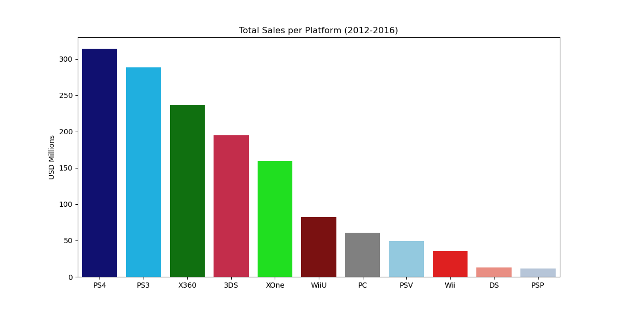
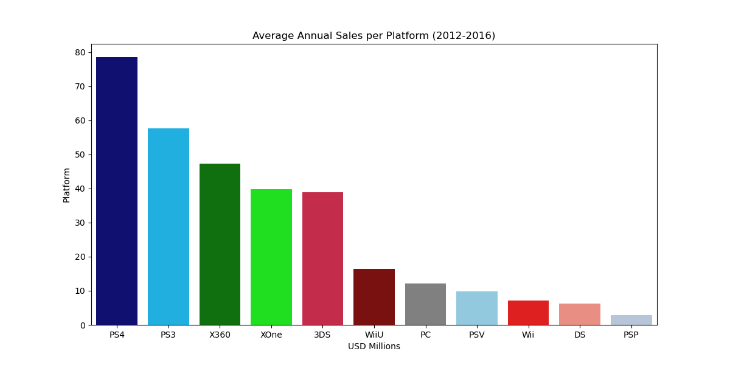
Current Period
Sales Per Platform
The PlayStation 4 (latest PS platform) leads in sales, followed by the PlayStation 3.
Microsoft’s latest platform sales have not caught up to their previous platform’s in total or average annual sales.
Nintendo is winning the mobile gaming market share while Sony and Microsoft compete for the console market share.

Slide 13
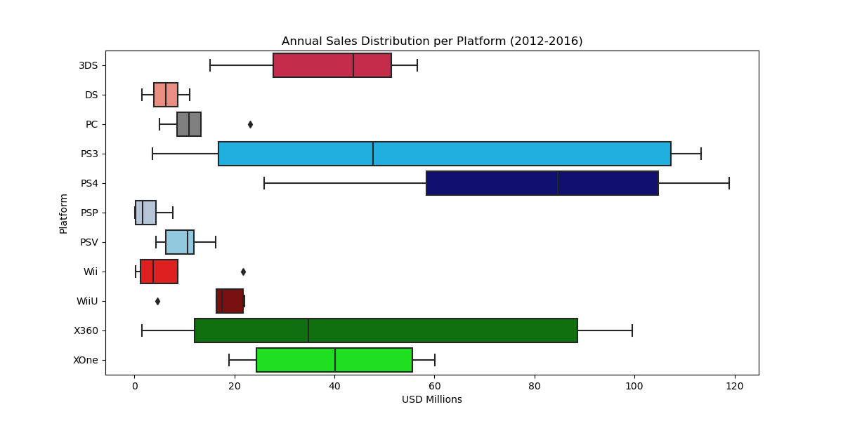
Current Period
Sales Per Platform
Console platforms generally drive more sales than do their portable counterparts - the Nintendo 3DS being the only portable platform represented among the top five selling platforms
The 3DS’s median and average sales within the current period are competitive with the median and average sales for both Xbox 360 and Xbox one, as well as the PlayStation 3.
PlayStation, owned by Sony, is the dominant manufacturer of the current period with 4 products in the market place and the PlayStation 4 and PlayStation 3 leading in total sales, and average annual sales for the current time period (respectively). Microsoft’s Xbox 360 and Xbox One struggle to compete with the PlayStation consoles, and face strong competition from the Nintendo 3DS.

Slide 14
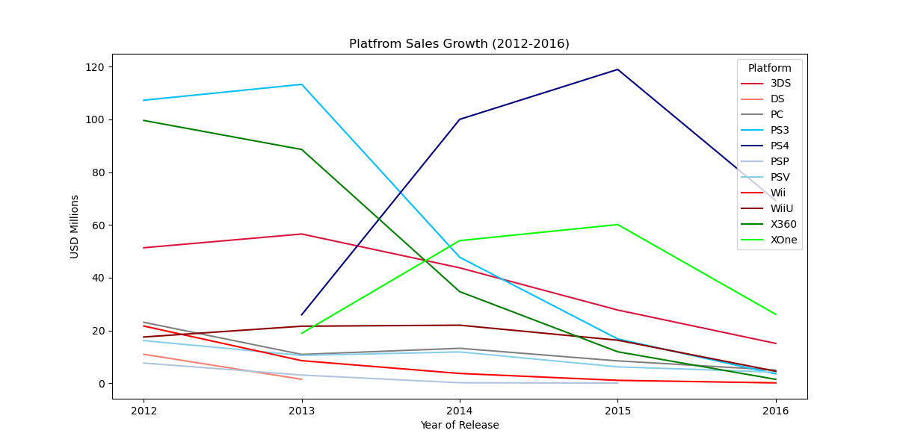
Current Period
Potential for Profitability
The platforms with the most potential for profitability are the PlayStation 4 and Xbox One, both just seemingly past their peak by only 1 year, and still within the 5 year life cycle. It is also important to note that sales data for 2016 may be incomplete, so sales for the PlayStation 4 and Xbox One may not have actually peaked yet. All other platforms in the current period, however, are well into their declining sales period.
More potential profitability would be in a new platform release. (Hindsight: the Nintendo Switch went on to be released in 2017).

Slide 15
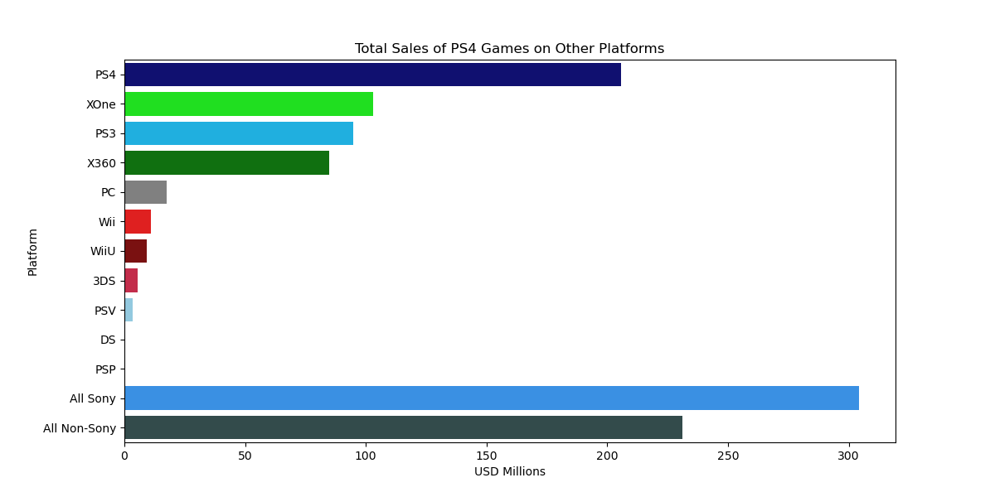
Sony’s Dominance in the Market
This chart depicts the PlayStation 4’s (and Sony’s, in general) dominance within the marketplace. For video games available on multiple platforms (from competing manufacturers), the PlayStation 4 holds a commanding lead in total sales over the Xbox one, followed closely by the PlayStation 3. Like wise, we can see Sony as a whole is leading far ahead of the cumulative efforts of all the other manufacturers in the modern era.
Note: For the sake of fair comparison, Sony exclusives (tittles only available on the PlayStation platforms) have been excluded from the total sales numbers.

Slide 16
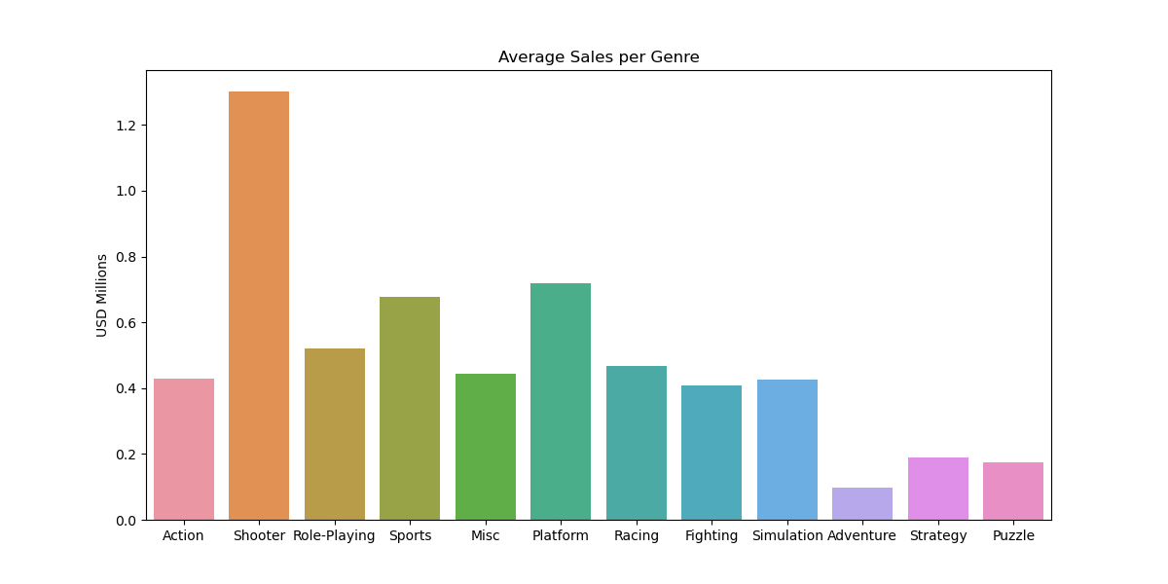
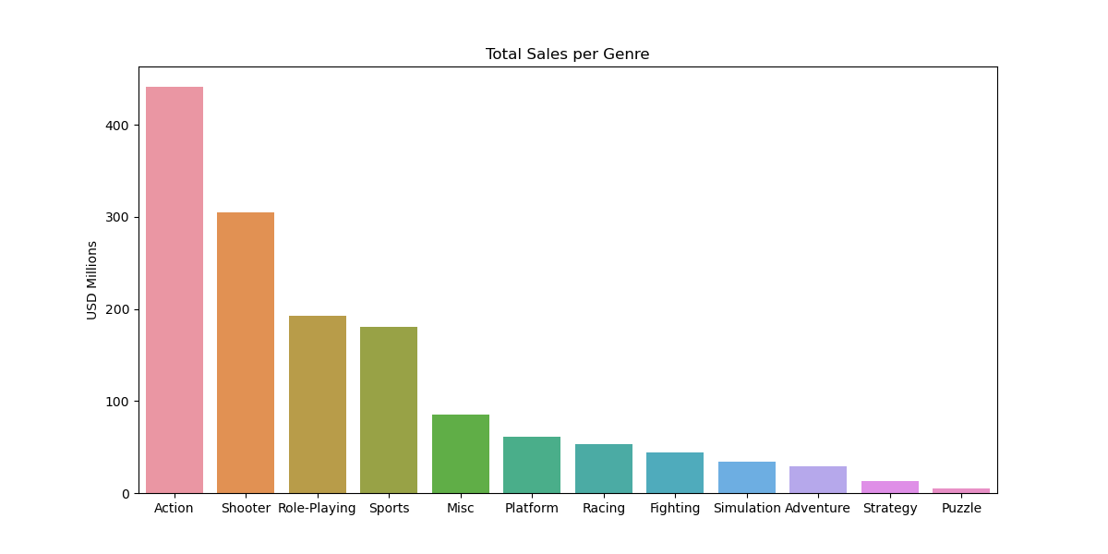
Sales Per Genre
"Action" and "Shooter" are the most profitable genres when considering total and annual average sales.
Action games boast the highest total sales due to a large volume of titles, shooter games have the highest average sales, suggesting higher profitability per title.
Genres like "Puzzle" and "Strategy" have both lower total and average sales, pointing to a smaller market presence and niche appeal.
This distribution suggests that high-sales genres benefit from blockbuster titles and mass appeal, while low-sales genres cater to more specialized audiences and may not see the same level of blockbuster success.

Slide 17
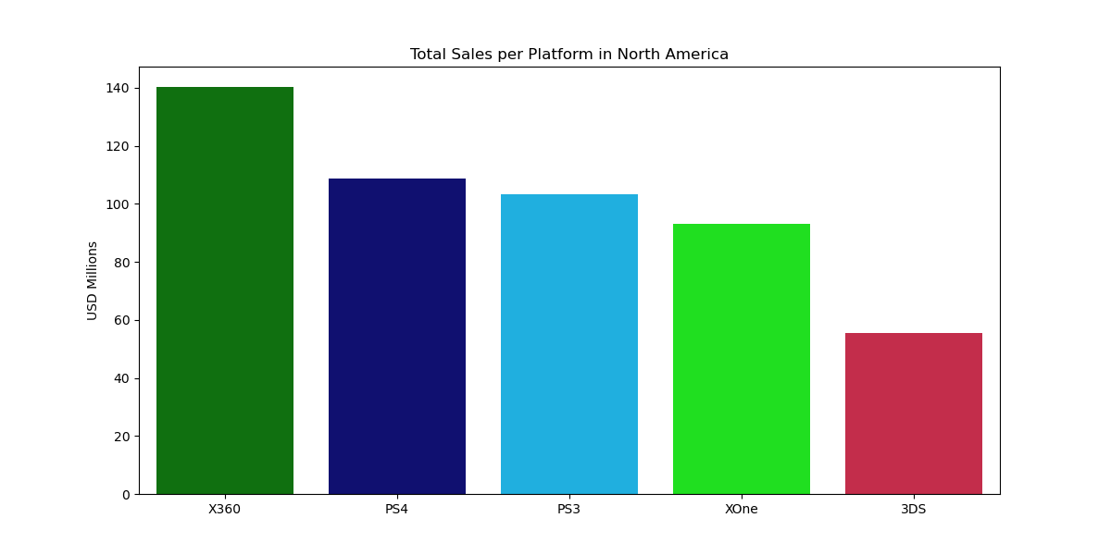
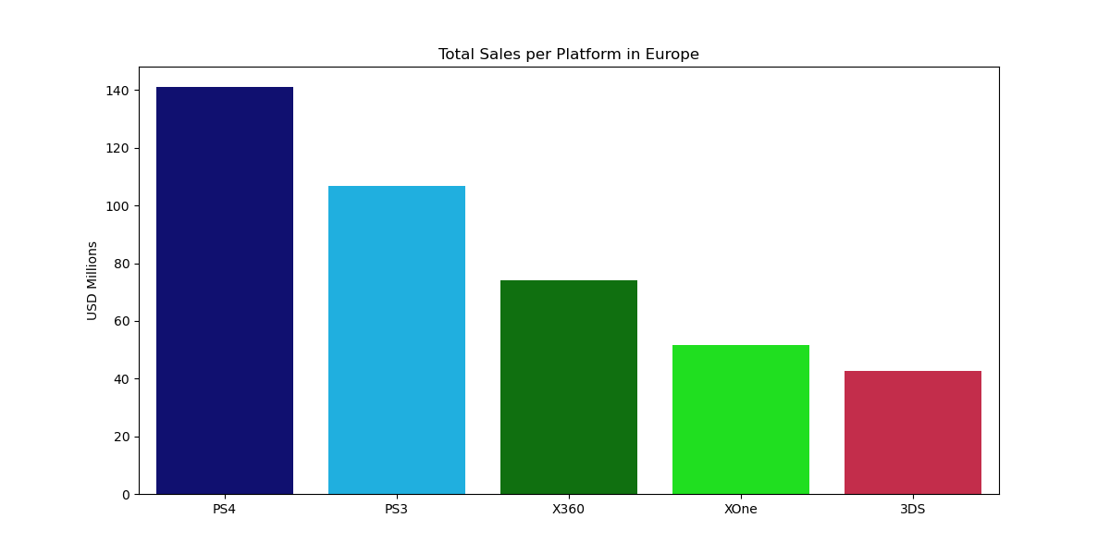
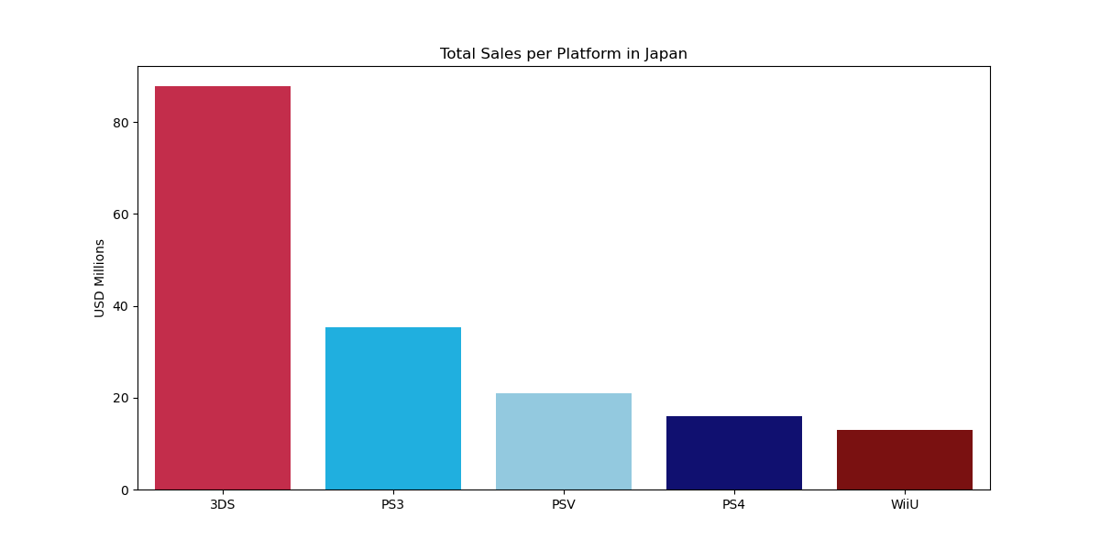
Regional Analysis
Top Platforms by Region
Each Region has a different leading platform:
North America - Xbox 360
Europe - PlayStation 4
Japan - 3DS
The Japanese market shows significantly lower sales compared to Western Markets.
The leading platforms in the Japanese market are very different from that of the Western markets. Their leading platforms are exclusively Japanese manufacturers (Sony and Nintendo), with the 3DS (a mobile platform) being the top seller in their market, and 5th best seller in the Western Markets.
Japan’s market is the only of the three with two portable platforms represented in its top sellers. This speaks to a greater appreciation for portable systems in the Japanese market.

Slide 18
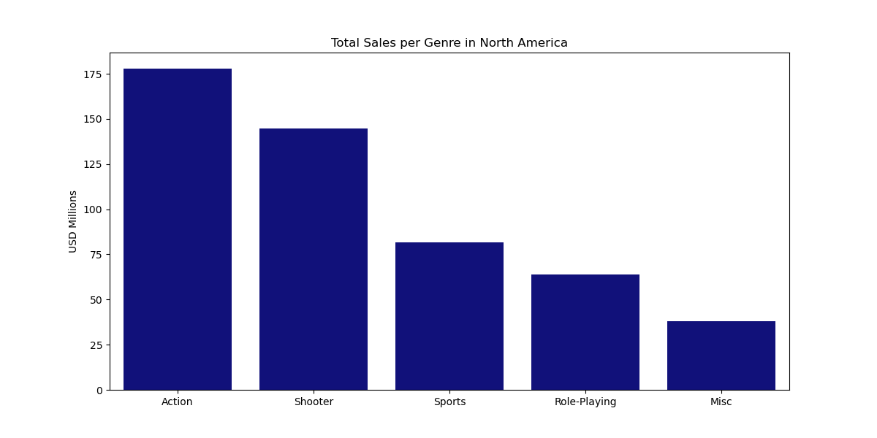
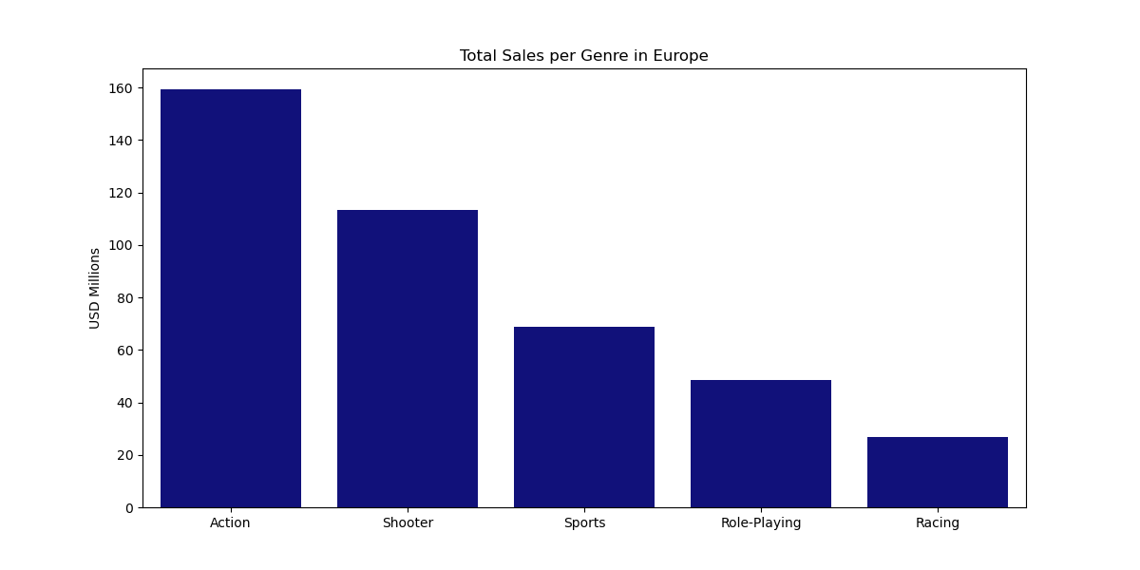
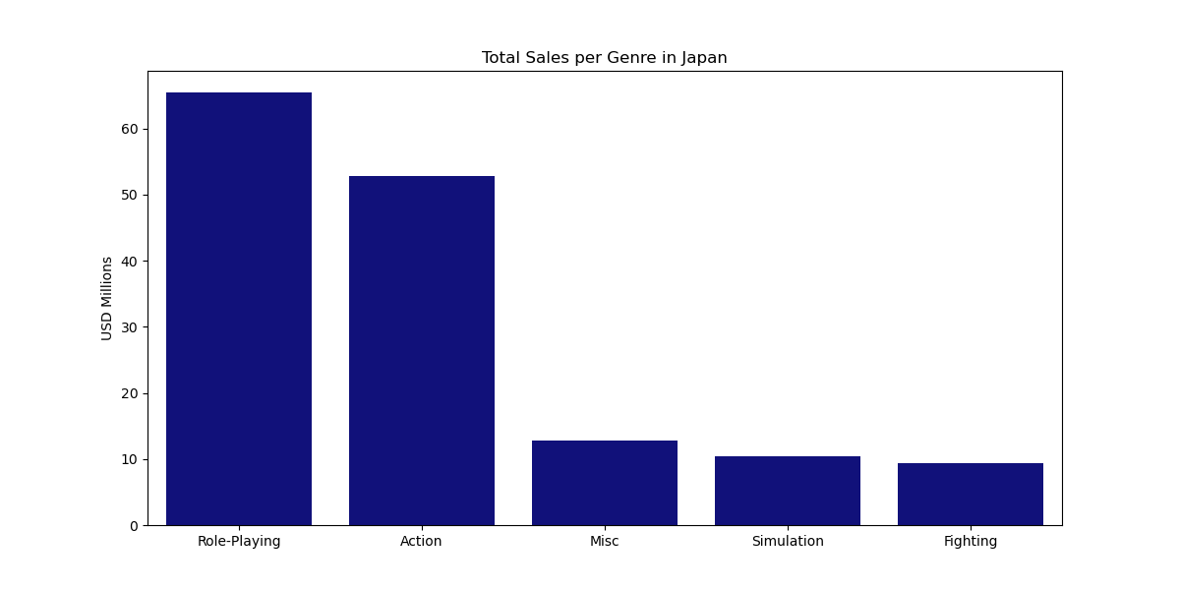
Regional Analysis
Top Genres by Region
Continued alignment between North America and Europe verses Japan - the top four selling genres in North America are the same as in Europe.
Japan’s top selling genre is Role-Playing, in a markedly different position than in the Western markets.
“Action” has a broad global appeal.
The fourth and fifth best selling genres in Japan, Simulation and Fighting, are not represented at all in the top genres for Western markets.
The notable differences between Western markets and Japan speak to significant disparities in video game genre preferences. Notably, the Action genre stands out as having the best chance for success across all three regional markets.

Slide 19
Hypothesis Testing
H1: “Average user ratings of the Xbox One and PC platforms are the same.”
With an Alpha value of 5% (chosen according to standard business practices), there is not enough evidence to say that there is a significant difference in user scores between the Xbox One and PC platforms. The scores could be similar enough that any observed difference could reasonably occur by chance.
However, with just 1% more leeway, the null hypothesis would have been rejected.

Slide 20
Hypothesis Testing
H2: “Average user ratings for the action games are higher than sports games”
With an alpha value of 5% and a P-value of ~5.98e-20 (practically zero), the probability of observing the difference in user scores between the Action and Sports genres due to random chance is nearly zero. In other words, there is very strong evidence that there is a significant difference in user scores between these two genres.
With action games having an average user rating of 6.83 and sports games having an average user rating of 5.46 we can conclude with relative certainty that, on average, action games receive higher user ratings

Slide 21
Conclusions
The average life cycle for a platform is approximately 5 years.
Sony Dominates the global market with their line of PlayStation platforms.
Action and shooter games yield the highest sales.
The action genre has strong global appeal.
There are significant differences in consumer preference between Western Markets and the Japanese market.

Slide 22
Recommendations
Invest in PlayStation 4 games: Given its market dominance and strong sales performance, investing in PlayStation 4 games is likely to yield high returns.
Invest in Console and PC Games: Focusing on games for consoles and PCs is recommended, as these platform sales outperform handheld and mobile platforms.
Prepare for a New Platform Release: With the most recent platforms being released in 2012, a new platform is likely to be released soon. Preparing for this release can help the company stay ahead of the competition.
Focus on Action and Shooter Genres: These genres have consistently performed well and are likely to continue to do so. Action, in particular, has a broad appeal across global markets.
Consider Regional Preferences: The significant differences between Western and Japanese markets should be considered carefully when developing and marketing games.

Slide 23
If you found this presentation to be insightful and believe my data analysis skills could bring value to your organization, I’d love to connect! I am actively seeking opportunities where I can contribute my expertise in analyzing data, drawing actionable insights, and presenting clear recommendations. Feel free to reach out to me here on LinkedIn or via email for potential job opportunities or collaborations.
END

